Slide 1




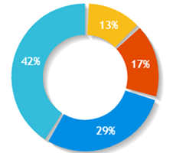


C.V. Raman College of Engineering
Principal Name
Dashboard
Grievances
Select Committee
Select
18
4
Search Application
Total Grievances
Escalated Grievances
FAQs
1
8
Satisfied Grievances
Pending Grievances
Top 5 Committee Wise Grievance registered
Type of Grievances
Total
Solved
Examination Cell
Admission Cell
Training & Placement
Others
35
30
25
20
15
10
Academics Transport Canteen Hostel Others
Voice
Terms of Use | Privacy Policy | Right to Information | Reports | Directory
Copyright © 2019. AICTE, Nelson Mandela Marg, Vasant Kunj, New Delhi -110070

Slide 2
C.V. Raman College of Engineering
Principal Name
Dashboard
Select Committee
Select
Examination Cell
Admission Cell
Training & Placement Cell
Accounts Department
Security
Ragging
Transport
Canteen
Hostel
Grievances
Select
18
4
Search Application
Total Grievances
Escalated Grievances
FAQs
1
8
Satisfied Grievances
Pending Grievances
Top 5 Committee Wise Grievance registered
Type of Grievances
Total
Solved
Examination Cell
Admission Cell
Training & Placement
Others
35
30
25
20
15
10
Academics Transport Canteen Hostel Others
Voice
Terms of Use | Privacy Policy | Right to Information | Reports | Directory
Copyright © 2019. AICTE, Nelson Mandela Marg, Vasant Kunj, New Delhi -110070

Slide 3


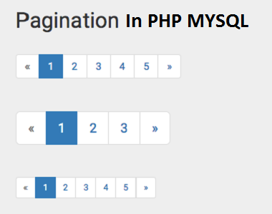
C.V. Raman College of Engineering
Principal Name
s
Dashboard
Seeking Approvals
Grievances
Grievance ID
Student Details
Grievance Type
Description
Attachment
ETA
Connect
Action
Search Application
IND038
View
Examination Cell
Text
20-02-2019
Comment
View History
IND043
View
Admission Cell
Text
23-02-2019
Comment
View History
FAQs
IND045
View
Training & Placement Cell
Text
21-02-2019
Comment
View History
IND089
View
Accounts Department
Text
17-02-2019
Comment
View History
Escalated Grievances
Grievance ID
Student Details
Grievance Type
Description
Attachment
ETA
Connect
Status
IND038
View
Examination Cell
Text
20-02-2019
Comment
View History
Re-open
IND043
View
Admission Cell
Text
23-02-2019
Comment
View History
Delayed
Resolved Grievances
Grievance ID
Student Details
Grievance Type
Description
Attachment
ETA
Closing Date
Closure Status
IND038
View
Examination Cell
Text
20-02-2019
20-02-2019
Normal
IND043
View
Admission Cell
Text
23-02-2019
23-02-2019
Delayed
IND043
View
Admission Cell
Text
23-02-2019
23-02-2019
Re-open
Voice
Terms of Use | Privacy Policy | Right to Information | Reports | Directory
Copyright © 2019. AICTE, Nelson Mandela Marg, Vasant Kunj, New Delhi -110070

Slide 4
C.V. Raman College of Engineering
Principal Name
Dashboard
Search Grievance
Grievances
Enter Grievance Id
IND038
Search
Search Application
Grievance ID
Student Details
Grievance Type
Description
Committee
Date of Issue
ETA
Attachment
Status
FAQs
IND038
View
Examination Cell
Text
Examination Cell
15-02-2019
20-02-2019
Resolved
Voice
Terms of Use | Privacy Policy | Right to Information | Reports | Directory
Copyright © 2019. AICTE, Nelson Mandela Marg, Vasant Kunj, New Delhi -110070

Slide 5
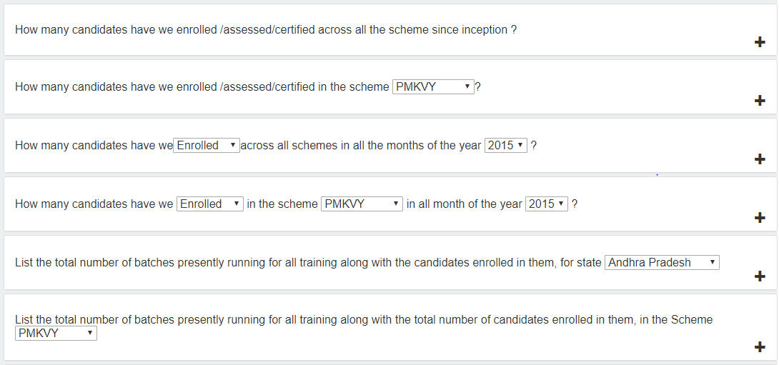
C.V. Raman College of Engineering
Principal Name
Dashboard
Frequently Asked Questions (FAQs)
Grievances
Search Application
FAQs
Voice
Terms of Use | Privacy Policy | Right to Information | Reports | Directory
Copyright © 2019. AICTE, Nelson Mandela Marg, Vasant Kunj, New Delhi -110070

