Slide 1







C.V. Raman College of Engineering
Student Name
Dashboard
18
1
8
9
My Grievances
Total Grievances
Escalated Grievances
Satisfied Grievances
Pending Grievances
Search
Is something bothering you? Let us know
FAQs
Grievance Type *
Select
Grievance Description *
Please give all the details of your Problem
Image
Attachment
Upload file pdf, jpeg, jpg, png
Browse
Submit
Voice
Terms of Use | Privacy Policy | Right to Information | Reports | Directory
Copyright © 2019. AICTE, Nelson Mandela Marg, Vasant Kunj, New Delhi -110070

Slide 2
C.V. Raman College of Engineering
Student Name
Dashboard
18
1
8
9
My Grievances
Total Grievances
Escalated Grievances
Satisfied Grievances
Pending Grievances
Search
Is something bothering you? Let us know
FAQs
IMage
Select
Examination Cell
Admission Cell
Training & Placement Cell
Accounts Department
Security
Ragging
Transport
Canteen
Hostel
Miscellaneous
Grievance Type *
Select
Details *
Please give all the details of your Problem
Image
Attachment
Upload file pdf, jpeg, jpg, png
Browse
Submit
Voice
Terms of Use | Privacy Policy | Right to Information | Reports | Directory
Copyright © 2019. AICTE, Nelson Mandela Marg, Vasant Kunj, New Delhi -110070

Slide 3

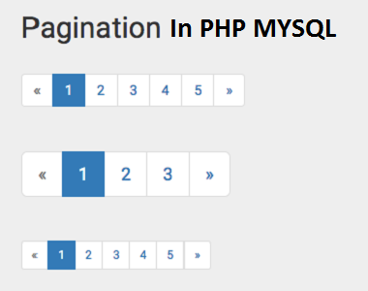
C.V. Raman College of Engineering
Student Name
Dashboard
Raised/ Re-open Grievances
My Grievances
Grievance ID
Lodged on
Grievance Type
Description
ETA
Attachment
IND038
15-02-2019
Examination Cell
Text
20-02-2019
Search
IND043
16-02-2019
Admission Cell
Text
23-02-2019
FAQs
IND045
11-02-2019
Training & Placement Cell
Text
21-02-2019
In Action Grievances
Grievance ID
Grievance Type
Description
Attachment
ETA
Connect
Status
IND038
Examination Cell
Text
20-02-2019
Comment
View History
In Progress
IND043
Admission Cell
Text
23-02-2019
Comment
View History
In Progress
IND045
Training & Placement Cell
Text
21-02-2019
Comment
View History
In Progress
IND089
Accounts Department
Text
17-02-2019
Comment
View History
In Progress
Addressed Grievances
Grievance ID
Grievance Type
Description
Attachment
Date of Completion
Action
Status
IND038
Examination Cell
Text
20-02-2019
Comment
View History
Re-open
Addressed
IND043
Admission Cell
Text
23-02-2019
Comment
View History
Re-open
Addressed
Voice
Terms of Use | Privacy Policy | Right to Information | Reports | Directory
Copyright © 2019. AICTE, Nelson Mandela Marg, Vasant Kunj, New Delhi -110070

Slide 4
C.V. Raman College of Engineering
Student Name
Dashboard
Raised/ Re-open Grievances
My Grievances
Grievance ID
Lodged on
Grievance Type
Description
ETA
Attachment
IND038
15-02-2019
Examination Cell
Text
20-02-2019
Search
IND043
16-02-2019
Admission Cell
Text
23-02-2019
History
FAQs
IND045
11-02-2019
Training & Placement Cell
Text
21-02-2019
Grievance ID
Date
Comment
Commented by
In Action Grievances
IND038
15-02-2019
Fill your university roll number correctly
Pranjal
Grievance ID
Grievance Type
Description
Attachment
ETA
Connect
Status
IND038
Examination Cell
Text
20-02-2019
Comment
View History
In Progress
IND043
Admission Cell
Text
23-02-2019
Comment
View History
In Progress
IND045
Training & Placement Cell
Text
21-02-2019
Comment
View History
In Progress
IND089
Accounts Department
Text
17-02-2019
Comment
View History
In Progress
Addressed Grievances
Grievance ID
Grievance Type
Description
Attachment
Date of Completion
Action
Status
IND038
Examination Cell
Text
20-02-2019
Comment
View History
Re-open
Addressed
IND043
Admission Cell
Text
23-02-2019
Comment
View History
Re-open
Addressed
Voice
Terms of Use | Privacy Policy | Right to Information | Reports | Directory
Copyright © 2019. AICTE, Nelson Mandela Marg, Vasant Kunj, New Delhi -110070

Slide 5
C.V. Raman College of Engineering
Student Name
Dashboard
Search Grievance
My Grievances
Enter Grievance Id
IND038
Search
Search
FAQs
Grievance ID
Grievance Type
Description
Assigned Committee
Date of Issue
ETA
Status
Comments
Attachment
IND038
Examination Cell
Text
Exam Control
15-02-2019
20-02-2019
Resolved
View
Voice
Terms of Use | Privacy Policy | Right to Information | Reports | Directory
Copyright © 2019. AICTE, Nelson Mandela Marg, Vasant Kunj, New Delhi -110070

Slide 6
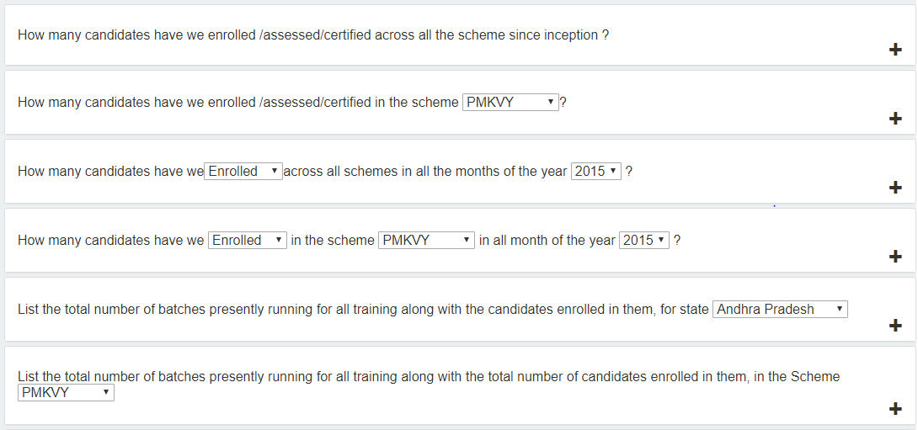
C.V. Raman College of Engineering
Student Name
Dashboard
Frequently Asked Questions (FAQs)
My Grievances
Search
FAQs
Voice
Terms of Use | Privacy Policy | Right to Information | Reports | Directory
Copyright © 2019. AICTE, Nelson Mandela Marg, Vasant Kunj, New Delhi -110070

