Slide 1
Project Title
CSE7101- Capstone Project
Review-3
Automated Attendance System for Rural Schools
Using Biometrics, IoT and Edge Computing
Department of Computer Science and Engineering
Presidency University, Bangalore
Under the Supervision of,
Ms. Saiqa Khan - Assistant Professor
Mr. Thatimakula Saikumar – Assistant Professor
School of Computer Science and Engineering
Presidency University
Roll Number | Student Name
20221CSE0307 20221CSE0306 20221CSE0673 | PRIYANKA G PRIYADARSHINI HANSRAJ
Name of the Program: Computer Science and Engineering
Name of the HoD: Dr.Asif Mohammed , Dr.Blessed Prince
Name of the Program Project Coordinator: Dr.Jayavadivel Ravi , Mr.Muthuraju V
Name of the School Project Coordinators: Dr. Sampath A K , Dr. Geetha A

Slide 2
Abstract
Automated attendance system designed for rural schools.
Uses biometric fingerprint authentication to prevent proxy attendance.
Edge computing enables offline-first operation.
Solar-powered IoT hardware ensures reliability in low power areas.
SMS alerts notify parents about student attendance.

Slide 3
Literature Survey
IoT RFID attendance system – Kumar et al. (2021)
Biometric attendance system – Sharma & Patel (2020)
Edge computing for rural systems – Rahman et al. (2022)
Solar powered IoT monitoring – Das & Singh (2021)
Cloud vs Edge attendance systems – Ahmed & Khan (2022)

Slide 4
Objectives
Prevent proxy attendance using biometric authentication.
Ensure offline-first operation using edge computing.
Reduce infrastructure dependency using solar power.
Increase parent engagement through SMS notifications.
Provide low bandwidth synchronization for rural networks.

Slide 5
Existing Methods & Drawbacks
Manual attendance is time-consuming and error-prone.
RFID systems allow proxy attendance.
Cloud-based biometrics require stable internet.
Mobile apps require smartphones and connectivity.
Rural infrastructure limitations reduce system reliability.
To develop an accessible PWA that provides curated job information tailored for PwDs, featuring simplified language, text-to-speech, and a screen-reader friendly interface.
To enhance the employability of users by integrating coaching modules, mock tests, and guidance on application processes within the platform.
To increase awareness and utilization of the 4% job reservation policy for PwDs by implementing specific filters and dedicated information sections.
To bridge the communication gap by providing a platform for parents/guardians to track opportunities and their ward's progress, addressing literacy barriers.
To ensure wide accessibility by deploying a low-data usage PWA compatible with various devices (desktops, smartphones, tablets), especially in semi-urban and rural areas.

Slide 6
Proposed Method
Offline-first attendance architecture.
Biometric fingerprint authentication.
Edge computing for local processing.
Solar powered IoT device support.
SMS notifications for parents.

Slide 7
System Architecture
Presentation Layer: React.js Progressive Web App.
Application Layer: Node.js and Express backend.
Data Layer: MongoDB database.
Cloud hosting using AWS or GCP.
Secure authentication using JWT.

Slide 8
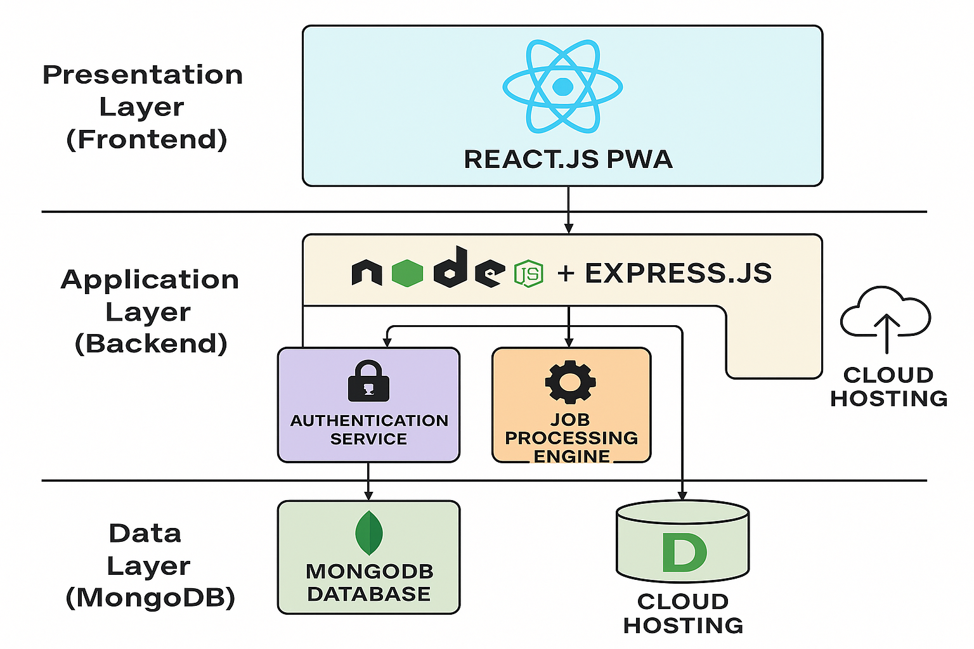
Modules
User Authentication Module
Student & Staff Management Module
Attendance Management Module
Analytics and Reporting Module
Notification and Alert Module
Admin Control Module

Slide 9
Timeline
Requirement Analysis
System Design
Frontend Development
Backend Development
Testing and Integration
Final Deployment

Slide 10
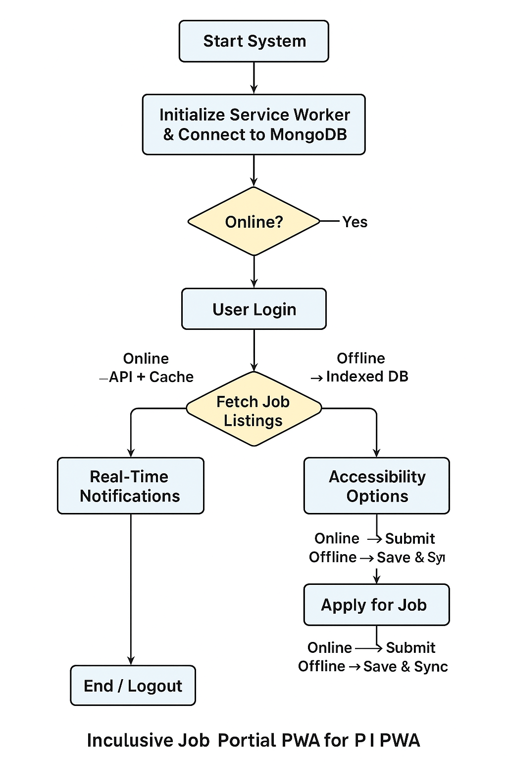
Hardware & Software
Frontend: React.js, Tailwind CSS, Shadcn UI
Backend: Node.js, Express.js
Database: PostgreSQL / MongoDB
Authentication: JWT
Tools: VS Code, Postman, GitHub

Slide 11
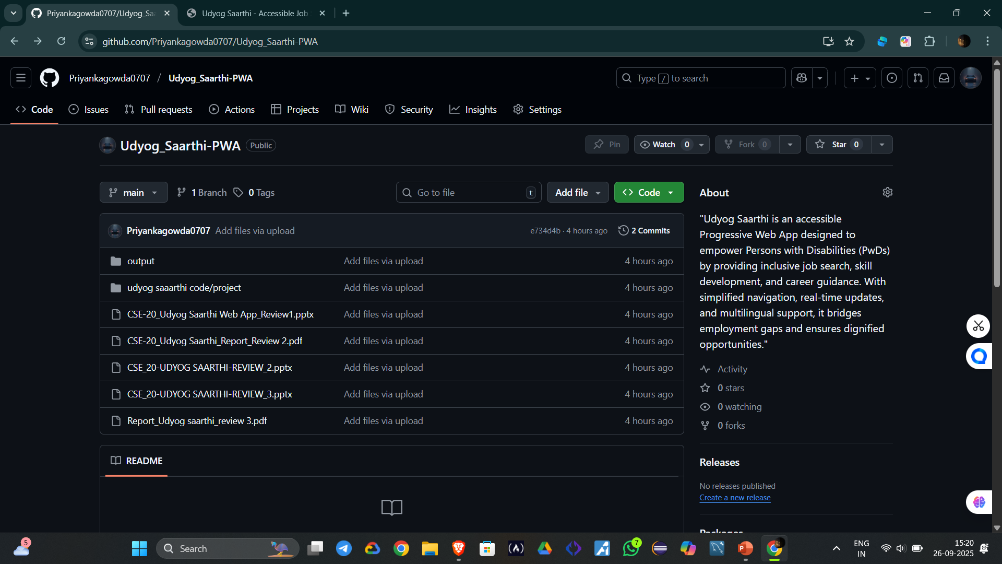
Conclusion
Biometric and IoT based attendance improves accuracy.
Edge computing enables offline operation.
Solar power supports rural deployment.
SMS notifications increase parental involvement.
System improves transparency and education monitoring.

Slide 12
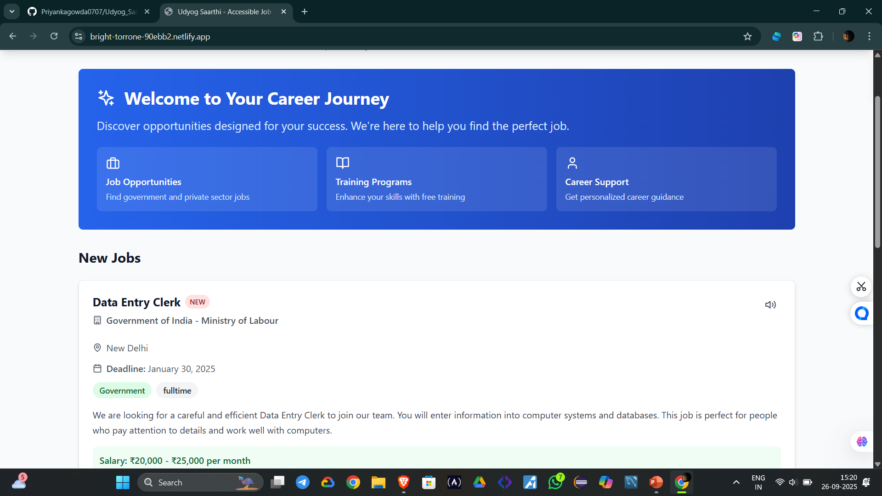
Ui/ux

Slide 13
Modules
User Authentication Module: Handles secure registration and login for PwDs and Guardians using JWT.
Profile Management Module: Allows users to create and manage their profiles, specifying disability type, skills, and job preferences.
Job Search & Listing Module: The core module to browse, search, and filter job opportunities specifically based on reservation categories and disability type.
Training & Coaching Module: Provides access to skill development videos, mock tests, and application guidance resources.
Accessibility Module: Integrates TTS functionality, language selection, and ensures UI compliance with accessibility standards.
Notification Module: Alerts users and guardians about new job postings, application deadlines, and new training content.
Admin Portal Module: Allows the admin to post new jobs, manage training content, and oversee user accounts.

Slide 14
Background and Related work for title Selection
Background
In India, 64% of Persons with Disabilities (PwDs) are unemployed.
The government has a 4% job reservation for PwDs, but many still miss out.
Main reasons: lack of awareness, hard-to-read job information, low digital skills, and late updates.
Current job platforms are not fully accessible for PwDs, especially in D & E categories.
Related Work
Employment News Online – Shares jobs but no audio or simple language support.
National Career Service (NCS) Portal – Has job listings but not PwD-friendly.
NGO Training Apps – Teach skills but do not connect directly to government job updates.
Key Need
A single, easy-to-use platform with job info, training details, real-time alerts, and offline access for PwDs.

Slide 15
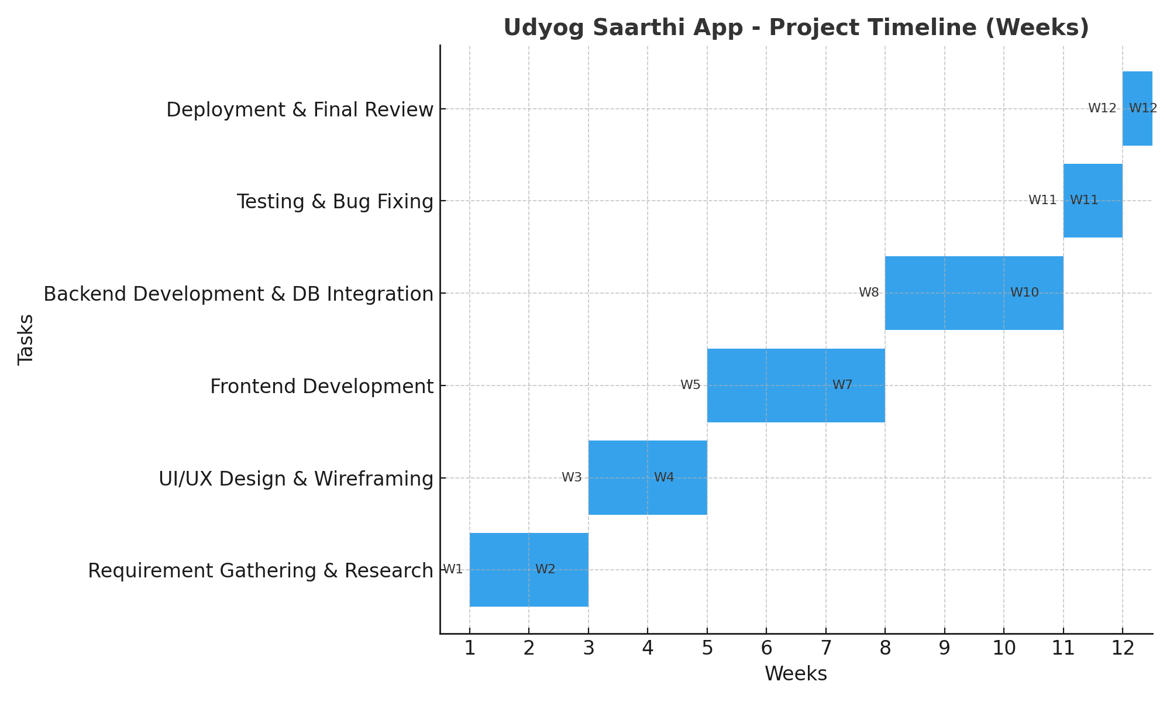
Timeline

Slide 16
Hardware & Software
Category | Details
Frontend | React.js (PWA), HTML5, CSS3, JavaScript (ES6+)
Backend | Node.js, Express.js
Database | MongoDB
Authentication | JWT (JSON Web Tokens)
Version Control | Git, GitHub
Development Tools | VS Code, Postman
Hosting Platform | AWS EC2 / S3 or Google Cloud Platform (GCP)
End-User Hardware | Smartphones, Tablets, Desktops/Laptops with a modern browser (Chrome, Edge, Firefox) and internet connection.

Slide 17
References
Ministry of Statistics and Programme Implementation. (2021). Report on Persons with Disabilities in India.
Government of India. (2016). The Rights of Persons with Disabilities Act.
World Health Organization. (2019). Global Report on Disability.
Dr. D. P. Sharma, "Digital Inclusion of PwDs in India," in IEEE Access, vol. 10, 2022.
S. Gupta, "Inclusive Employment Platforms for Persons with Disabilities," Springer,021.
Darcy, S., & Taylor, T. (2009). Disability citizenship and digital capital: The case of web accessibility.
Lazar, J., et al. (2015). What Frustrates Screen Reader Users on the Web: A Study of 100 Blind Users.
Bühler, C., & Heck, H. (2001). Empowerment by Digital Media of People with Disabilities.
Kumar, A., & Singh, P. (2020). A Study on Challenges Faced by Persons with Disabilities in India in Accessing Employment.
W3C Web Accessibility Initiative (WAI). Web Content Accessibility Guidelines (WCAG) 2.1.

Slide 18
Future Work
Add smart job suggestions using AI, so users see jobs that fit their skills.
Improve accessibility features like sign-language support, voice commands, and simple navigation.
Allow offline job applications, which will automatically submit when the internet is back.
Work with government portals and NGOs to bring in more job opportunities.
Create a dashboard with insights to help policymakers and NGOs understand user needs better.
Build mobile apps for Android and iOS for easier access

Slide 19
Conclusion
This project introduces an inclusive job portal PWA for Persons with Disabilities (PwDs) that solves problems of inaccessible job information, lack of awareness, and low digital literacy. Using the MERN stack, it provides offline access, real-time notifications, multilingual support, and text-to-speech to make job opportunities more accessible. The system ensures usability even without internet and delivers timely updates from government job sources. In the future, features like AI-based job suggestions, better accessibility tools, offline job applications, and mobile apps can make the platform even stronger. Overall, it is a practical and impactful solution to bridge the employment gap for PwDs.

Slide 20


