Slide 1
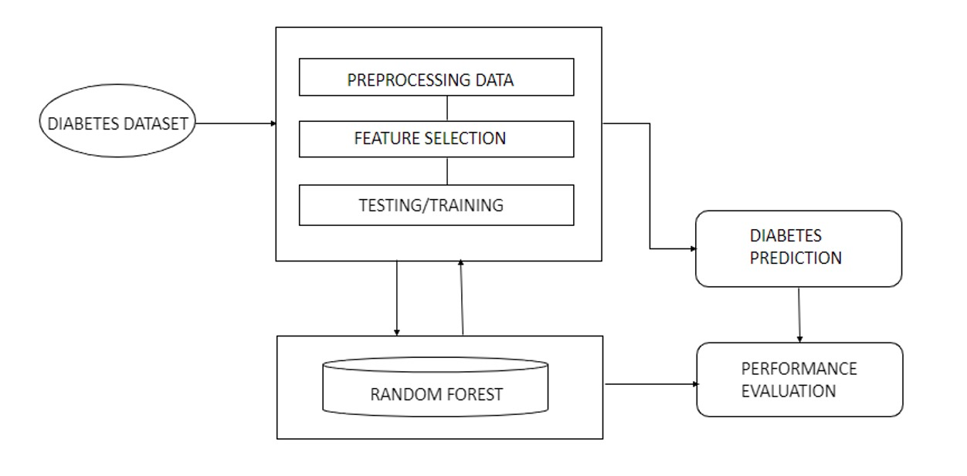
Architecture

Slide 2
Methodology
COLLECTION
CLEANING
EXPLORATORY DATA ANAYSIS
MODEL BUILDING
MODEL BUILDING MODEL DEPLOYMENT

