Slide 1
Executive Dashboard: Sales, Profit & Growth Analysis
Prepared by: Priyanka Rai
Date: 26-04-2025
Internship: Data Analyst Internship (Elevate Labs)

Slide 2
Objective
Create an executive-level dashboard summarizing Sales, Profit, and Growth.
Make the dashboard interactive and easy to understand for business stakeholders.

Slide 3
Dataset Information
Dataset: Global Superstore Sales Data (Kaggle).
Records: 5,000+ rows.
Fields: Row ID, Order ID, Order Date, Ship Date, Ship Mode, Customer ID, Customer Name, Segment, City, State, Country, Postal Code, Market, Region, Product ID, Category, Sub-Category, Product Name, Sales, Quantity, Discount, Profit, Shipping Cost, Order Priority.

Slide 4
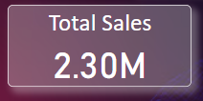
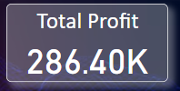
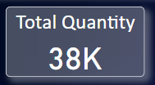
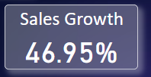
Key KPIs Monitored
Total Sales
Total Profit
Total Quantity
Sales Growth (%)

Slide 5
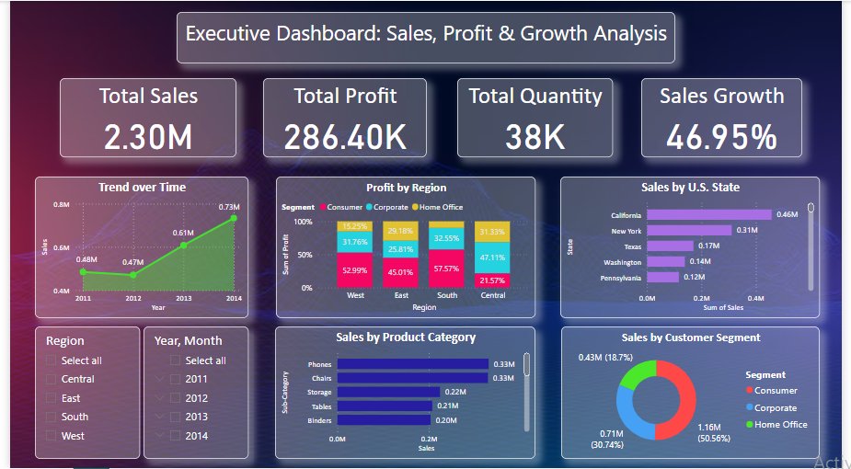
Dashboard Features
KPI Cards at top: Sales, Profit, Growth, Quantity.
Interactive Filters: Region, Year.
Trend analysis over time.
Sales by Product Category, State, Segment.
Dark theme and clean layout.

Slide 6
Learnings from the Task
How to create executive dashboards.
Choosing and visualizing KPIs.
Using DAX to calculate Growth (%).
Importance of interactivity and design.

