Slide 1
Prebooking Parking Area System
Submitted By,
Priyanka N
MCA B
29

Slide 2
Agenda
Objective
Existing System vs Proposed System
Modules
Tables
Tools and Technologies
Conclusion

Slide 3
Objective
To design and develop a Smart Parking System allowing users to pre-book parking spots for specific shops or malls.
To reduce the time spent searching for parking spaces in crowded areas.
Increase customer satisfaction by ensuring parking availability for users.
Provide real-time parking information to users.
Minimize traffic congestion.
Offer safe and easy payment options for a smooth checkout experience.

Slide 4
Existing System vs Proposed System
Existing System
Proposed System
Manual parking methods.
Lack of assurance that a parking spot will be available when needed.
Delays in identifying and parking vehicles.
Current system do not provide real-time information about availability.
No pre-booking option
Replaces manual parking bookings with an online system where users can easily search, book, and pay for parking spots.
Provides a simple interface for users to view parking availability and make reservations.
Displays up-to-date information on parking spots, ensuring users can only book available spaces..
Save time and reduce complexity.
Pre-booking and Payments.

Slide 5
Modules
1. ADMIN MANAGEMENT MODULE
Admin:
View user details.
Add cost details.
View slot details.
Daily wise slot updation.
Update the slot’s availability when the booked time and date have passed.

Slide 6
2. USER MANAGEMENT MODULE:
User register to create a profile.
User can login and become member of the system.
View the availability of slots
View status of the booking.
3. SLOT SELECTION MODULE
User can select the slot using date, time, hours and vehicle details.
User can view the details and cost to confirm bookings.
Finally confirm their slot and make payments.
4. WAITLIST MANAGEMENT
Places a user in queue and notifies when a slot becomes available.
Allow users to cancel their waitlist request easily if they no longer need a spot.

Slide 7
5. REFUND SYSTEM AND PENALTY
Charge a penalty for late cancellation made within a hour of the booking start time.
Provide a refund for cancellation made before the penalty
6. FEEDBACK MODULE
Adding a google form for user feedback.
Use feedback to improve future maintenance schedules.
7. REPORT
Generate reports of slot booking

Slide 8
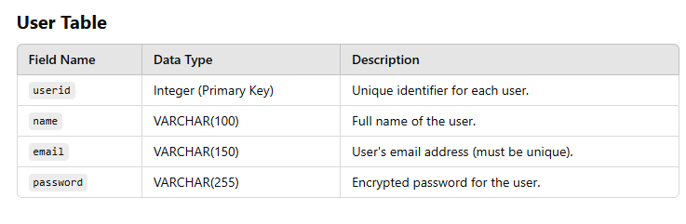
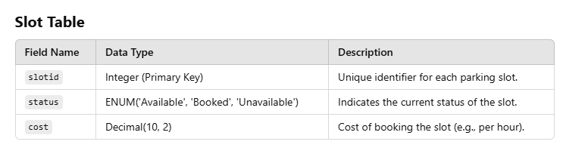
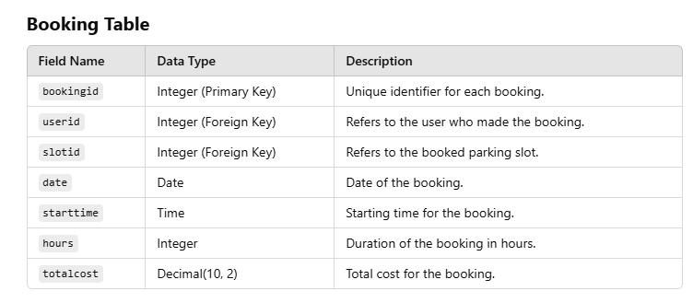
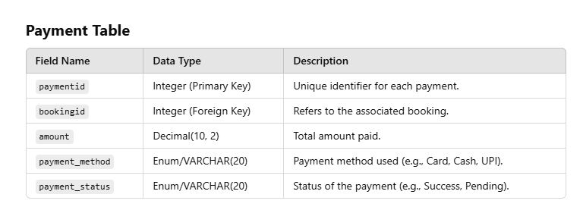
Tables

Slide 9
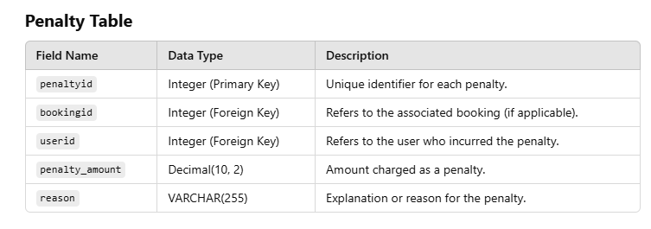
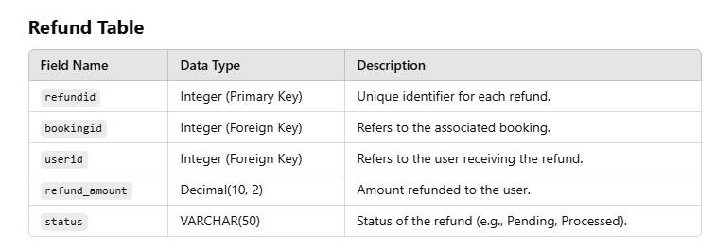
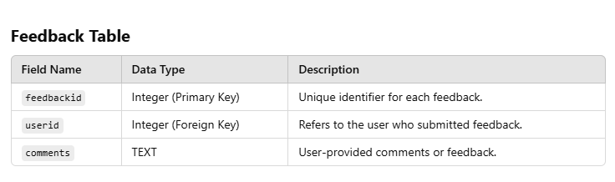
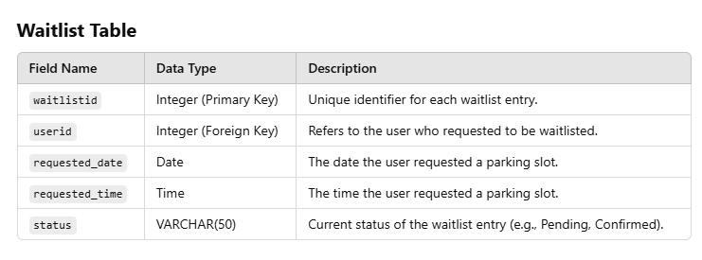

Slide 10
Tools and Technologies
Frontend: Html ,Css, js, Bootstrap.
Backend: Python- Django
Database: Sqlite3
Development Tools: VS Code

Slide 11
Conclusion
This project makes parking management simple and efficient
Users can easily prebook slots and pay in advance.
Reduces waiting times and avoids confusion.
Uses parking spaces more effectively.
Helps admins track availability and manage bookings.
Supports the idea of smarter and modern parking solutions.

Slide 12
THANK YOU….!

