Slide 1
Name: Priyanka Salvi Batch code: 7670

Slide 2
What is JavaScript?
JavaScript is a cross-platform, object-oriented scripting language used to make webpages interactive

Slide 3
JavaScript History
JavaScript was developed in 1995.
A Netscape programmer named Brandan Eich Developed it in just 10 days.
JavaScript was initially named as Mocha but quickly become known as live Script and later JavaScript.
JavaScript was earlier developed to run on Browsers. .

Slide 4
Introduction
JavaScript (Live Script) is cross-platform , object oriented scripting language used to make webpages interactive ( e.g., having complex animation, clickable buttons, popup menus etc.)
JavaScript is not java . They are similar in some ways but fundamentally different in others.

Slide 5
Free JavaScript Editors
Sublime Text.
Visual Studio Code.
Brackets.
Notepad, Notepad++.

Slide 6
Key features
Open source.
Just-in- time compiled language.
Embedded along with HTML and makes web pages alive.
Originally named as Live Script.
Executable in both browser and server which has JavaScript engines like V8(Chrome),SipderMonkey(Firefox)etc.

Slide 7
3 ways to add javascript to a web pages
Embedding / internal code.
Inline code.
External file.

Slide 8
JavaScript comments
JavaScript support single-line as well as multi-line comments.
Single-line comments: single-line comments begin with a double forward slash(//).
Ex.// This is my first JavaScript program
Multi-line comment: multi-line comments begins with a slash and an asterisk(/*) and ends with an asterisk and slash(*/).
Ex. /* This is my first program in JavaScript*/

Slide 9
Applications
Web applications
Presentations
Server applications
Web servers
Games
Arts
Smartwatch Apps

Slide 10
How to Run JavaScript?
Being a scripting language, JavaScript cannot run on its own. In fact, the browser is responsible for running JavaScript code. When a user requests an HTML page with JavaScript in it, the script is sent to the browser and it is up to the browser to execute it.

Slide 11
JavaScript syntax
JavaScript can be implemented using JavaScript statements that are placed within the <script>…</script> HTML tags in a web page.
A simple syntax of your JavaScript will appear as follows.
<script……>
JavaScript code
</script>

Slide 12
Simple Code for example
<html>
<head>
<title>My First JavaScript code</title>
<script type="text/java script">
alert("Hello World!");
</script>
</head>
<body>
</body>
</html>

Slide 13
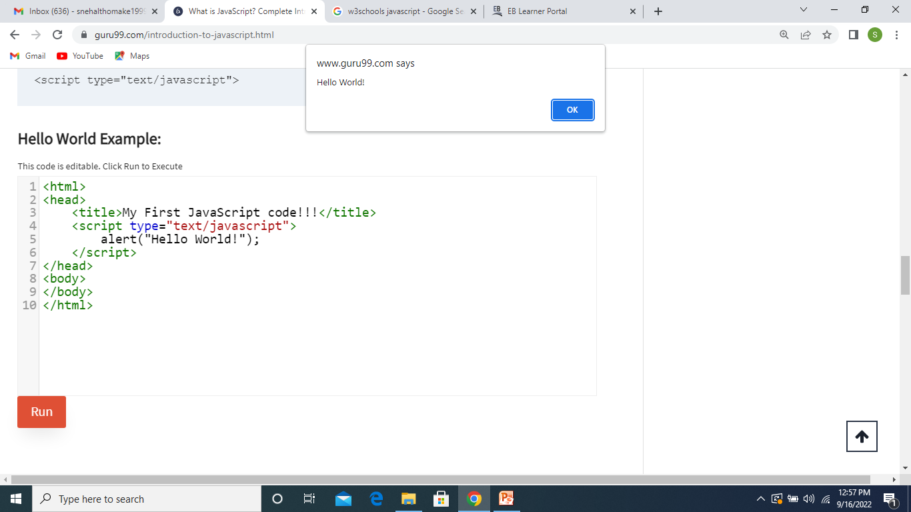
After Run the code

