Slide 1


DETERMINATION OF RECIPE BY ANALYSIS OF VARIOUS INGREDIENTS
VISVESVARAYA TECHNOLOGICAL UNIVERSITY
BELAGAVI – 590 014
DAYANANDA SAGAR ACADEMY OF TECHNOLOGY AND MANAGEMENT
DEPARTMENT OF COMPUTER SCIENCE ENGINEERING
BY
PRIYANKA S (1DT16CS071)
SHIVANI P R (1DT16CS094)
TUSHAR M (1DT16CS110)
YASHASWINI V (1DT16CS117)
UNDER THE GUIDANCE OF
DR C NANDINI
HOD, DEPT OF CSE

Slide 2
AGENDA
Abstract
Introduction
Literature Survey
Existing System
Proposed System
Modules
Results
Conclusion
References

Slide 3
INTRODUCTION
According to the recent statistical studies, on an average about 1 in 4 people consume fast food per day.
As regular consumption of fast food is unhealthy, our model is defined to benefit the youngsters to cook for themselves, in their busy-scheduled daily life.
Machine Learning provides systems the ability to automatically learn and improve from experience without being explicitly programmed.
In Image Processing, an image is digitized, by performing operations on it, which results in an improved image to retrieve meaningful data.
Our task is to list recipes that can be prepared using the given ingredients.
A recommendation technique is utilized in which the ingredients taken as input, is analyzed with the help of dataset and the appropriate dishes is recommended to the user.

Slide 4
LITERATURE SURVEY
Title | Algorithms Used | Advantages | Disadvantages
A Deep Convolutional Neural Network for Food Detection and Recognition, 2018 | Convolutional Neural Networks | 24 weighted layers due to which accuracy is very high. CNN achieved higher accuracy with manually extracted features | Multifood classes within a single plate or the variance of the food texture for the same type.
Classification of Food Images through Interactive Image Segmentation, 2018 | Image Segmentation: Random Forest Image Classification: SVM | Random Forest classifies each pixel in either foreground or background. Image segmentation effectively differentiates foreground and background. | Irrelevant objects and background have to be removed else accuracy is compromised. It is observed that some of the segmented food parts may have some holes.

Slide 5
Title | Algorithms Used | Advantages | Disadvantages
A Framework to Estimate the Nutritional Value of Food in Real Time Using Deep Learning Techniques, 2018 | Convolutional Neural Networks | Aims to minimize the user input and automate the task as much as possible. 85% accuracy is achieved on our dataset. | The challenge is in the accurate computation of ingredients and nutritional value of the food. Fails to segment the food proportions properly.
Food recognition on smartphone using transfer learning of convolution neural network, 2017 | Convolutional Neural Networks, Transfer Learning | Smart phone’s camera is used to extend the database. CNN and transfer learning are used to improve speed and accuracy | There is no standard base line for which we can quantitatively evaluate our outputs to the actual results.

Slide 6
Title | Algorithms Used | Advantages | Disadvantages
Recipe Retrieval using Ingredient Recognition, 2017 | Data Classification: KNN Image Classification: SVM | Real time usage can be used in grocery stores with real time ingredients. Classification based on ingredients and time required for cooking. | The application is only for Android smart phones. Nutrition obtained and the budget required to prepare the food item is unknown.
Food image description based on deep-based joint food category, ingredient and cooking method recognition, 2017 | Joint Recognition: Convolutional Neural Networks | One major advantage is the usage of the joint recognition for food image description | The UPMC Food- l01 dataset is quite challenging because images were collected from uncontrolled sources.

Slide 7
EXISTING SYSTEM
  Prediction of food recipes by providing ingredients as textual input.
  The data scrapped from the website is prone to noise where there are lots of typos, stop word and unwanted line spacing.
  In order to clean the noise, preprocessing is done and obtained data is stored in the database.
  With the help of KNN classification algorithm, the input ingredients are processed and the suggested class is recommended as a recipe which visualized in the website.

Slide 8
DISADVANTAGES
Input can only be given as a text and no other format.
A maximum of only three ingredients can be given at a time for prediction.
No nutritional description is given, only link to the website is mentioned.
User cannot give feedback about the recipe.

Slide 9
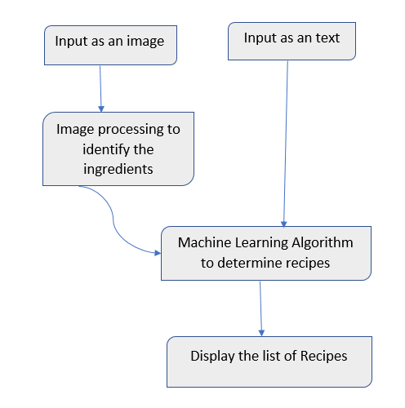
PROPOSED SYSTEM
Two datasets are used.
Ingredients are given in the form of text or an image.
Uses Image Processing technique to identify the
ingredients given as an image input.
A Machine Learning Algorithm is used to
analyse through the dataset.
Displays the list of recipes.

Slide 10
MODULES
Dataset creation.
Image Processing algorithm to identify the input ingredient.
Machine Learning Algorithm to list the recipes.
User Interface

Slide 11
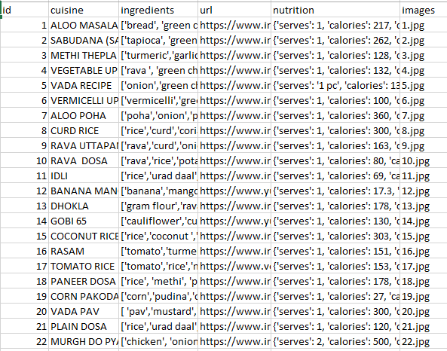
DATASET CREATION
Recipe Dataset
We will create our own dataset.
The dataset will consist of the dish name
along with a list of its ingredients, food
image and website link.
Caloric and other basic nutrition content
is also added into the dataset.
Websites considered:
https://www.indianhealthyrecipes.com
https://www.indianfoodforever.com
https://www.archanaskitchen.com

Slide 12
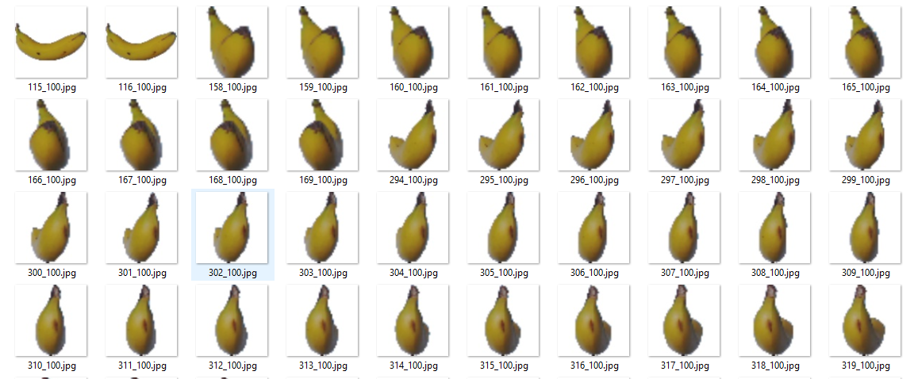
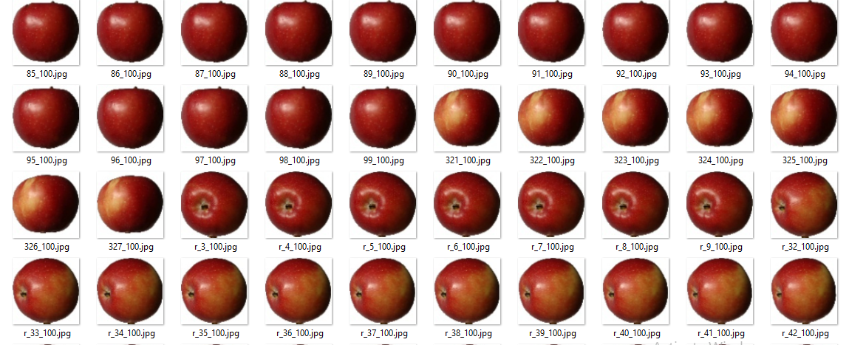
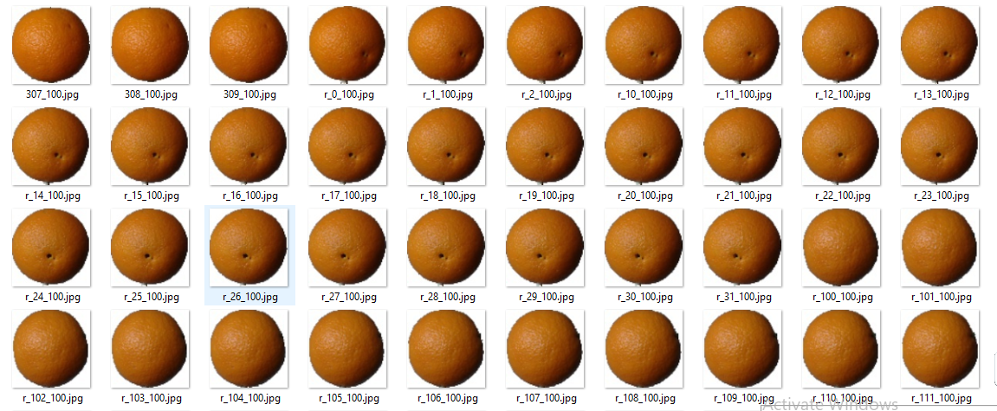
Image Processing Dataset
Dataset used- Fruits 360, taken from kaggle.
It consider various fruits and a few vegetables.
Dataset consist of images captured in 360 degrees.

Slide 13
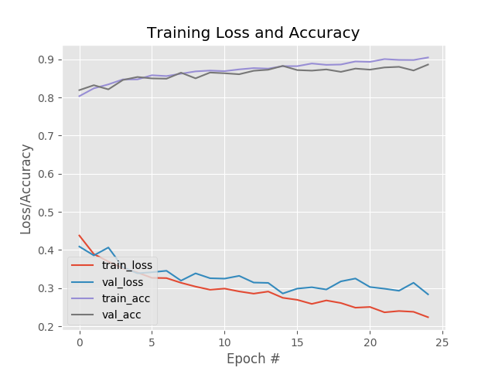
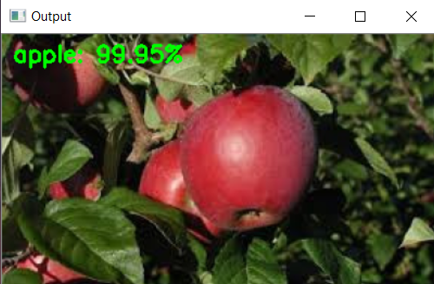
ALGORITHMS USED
Image Processing Algorithm:
The model have been trained using Keras Library.
The architecture of the neural network used here is commonly known as LeNet architecture.
The average training accuracy of the model is 94.57% .

Slide 14
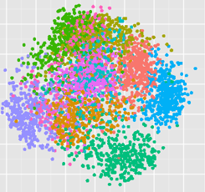
ALGORITHMS USED
Machine Learning Algorithm used :
  K-Nearest Neighbors algorithm is used.
  The ingredients of each recipe is converted into a single dimensional vector form and then plotted.
  Then the distance between the input ingredient and each row of the training data is calculated using the Manhattan formula.
  Based on the distance values, sort them in ascending order. It will then choose the top K rows from the sorted array.
  It will assign a class to the test point based on most
  frequent class of these rows.

Slide 15
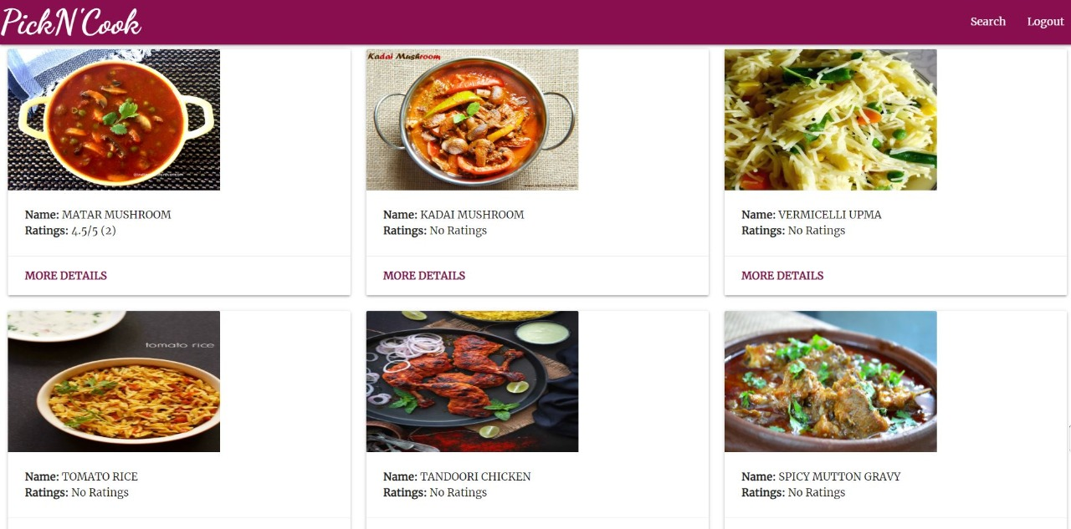
RESULT
RESULT
A Django webapp is developed.

Slide 16
CONCLUSION
The LeNet architecture successfully recognises the various image input with a very high accuracy.
Our KNN classifier efficiently classifiers the recipes based on the ingredients matched.
As future enhancements we would like to expand our image dataset so as to recognize more ingredients.
We would also like to determine recipes based on diverse cuisines.

Slide 17
REFERENCES
J. Chen, L. Pang, and C.-W. Ngo, “Cross-modal recipe retrieval: How to cook this dish?” in International Conference on Multimedia Modeling. Springer, 2017.
Jingjing Chen and Chong-Wah Ngo. Deep-based ingredient recognition for cooking recipe retrieval. In Proceedings of the 2016 ACM on Multimedia Conference,2016.
Kaiming He, Xiangyu Zhang, Shaoqing Ren, and Jian Sun. Deep residual learning for image recognition. In Proceedings of the IEEE Conference on Computer Vision and Pattern Recognition, 2016.
M. H. He, F. Kong, and J. Tan, "Dietcam: Multiview food recognition using a multikernel svm, " IEEE Journal of Biomedical and Health Informatics, 2016.
Xin Wang, Devinder Kumar, Nicolas Thome, Matthieu Cord, and Frederic Precioso. Recipe recognition with large multimodal food dataset. In Multimedia & Expo Workshops (ICMEW), 2015 IEEE International Conference on, IEEE, 2015.

Slide 18
THANK YOU

