Slide 1
iGiveBlood (Blood Donation App)
Priyanka Suryawanshi
A20512344

Slide 2
Project Idea
Blood donation is a continuing and critical necessity. It is critical for medical emergencies, operations, and the treatment of chronic diseases such as cancer.
Demand rises in tandem with population growth, and global health emergencies can interrupt supply. Blood, unlike many other medicinal resources, cannot be synthesized; it must be obtained from willing donors. Blood donation on a regular basis saves lives.
“Every year, around 4.5 million blood transfusions are required worldwide, which equates to approximately 12,328 blood transfusions required every minute.”

Slide 3
Project Implementation
iGiveBlood is an blood donation app. iGiveBlood donation app ensures easy blood donation and donor’s privacy. Connecting blood donors and the needy saves time, increases the likelihood of saving lives, and removes the blood shortage.
Splash screen
Launching two screens
Home Page
Blood Donation Form
Donor’s List View
Hospital Near Me

Slide 4
API Used
SQLite
Stored Donor’s data in database from the registration form.
Extra Credit
Google Maps API
Find hospitals near me to donate or get blood in any situations.

Slide 5
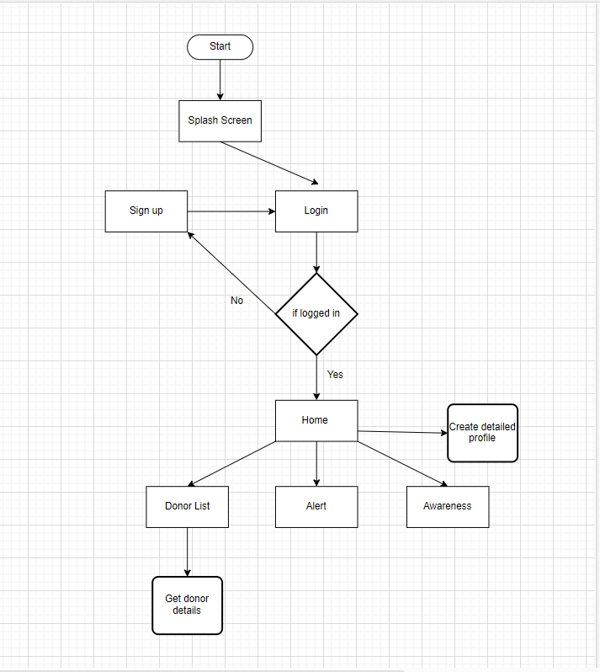
Project Flow

Slide 6
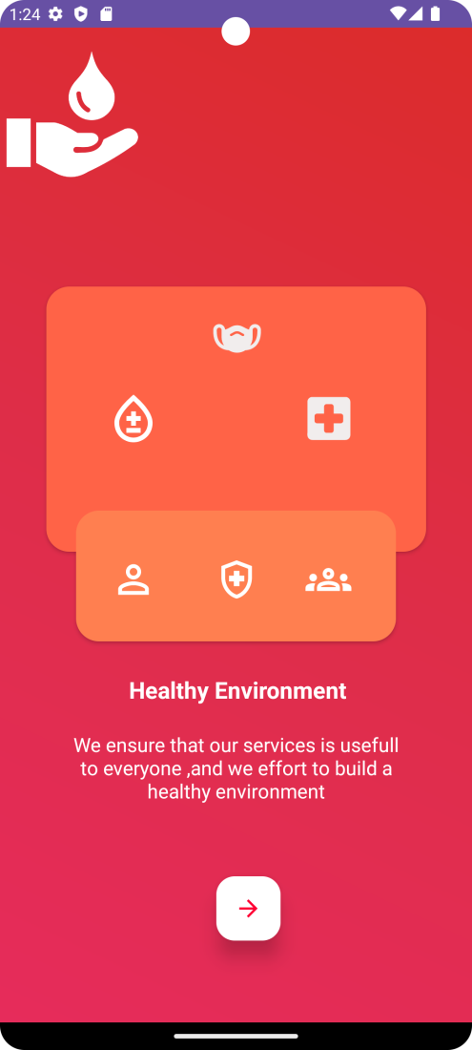
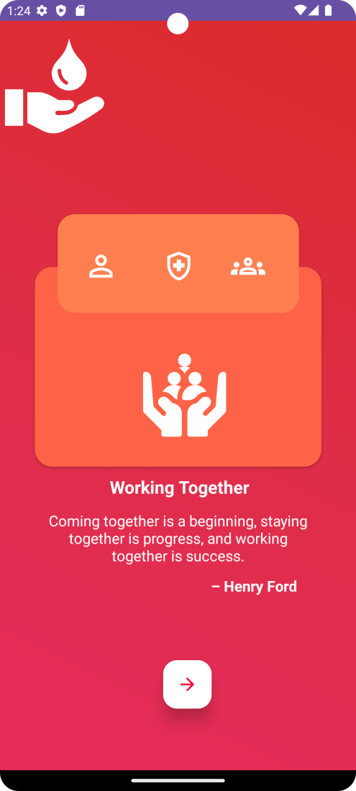
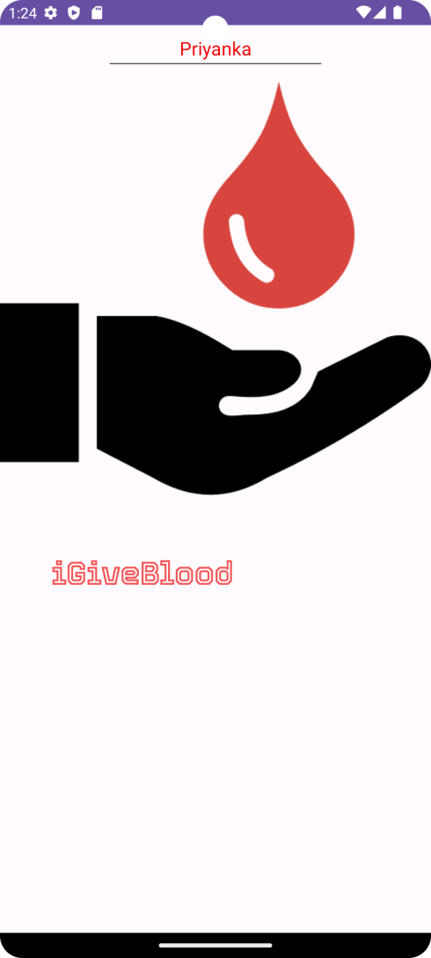
Screenshots

Slide 7
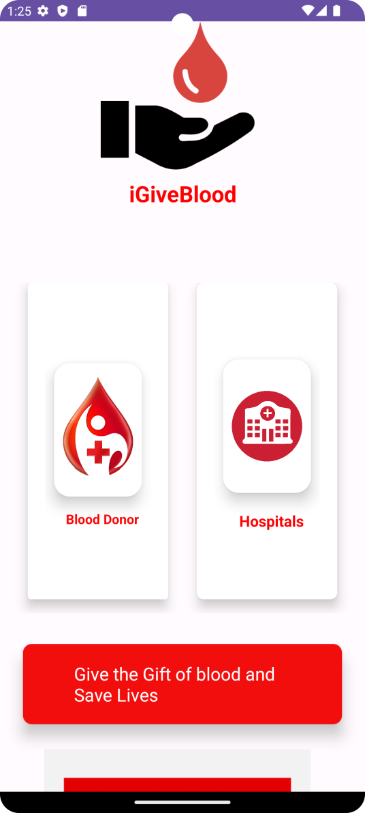
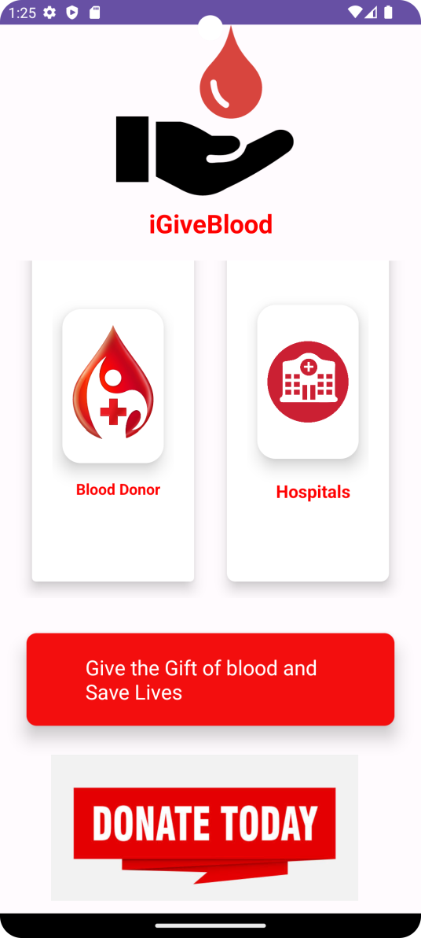
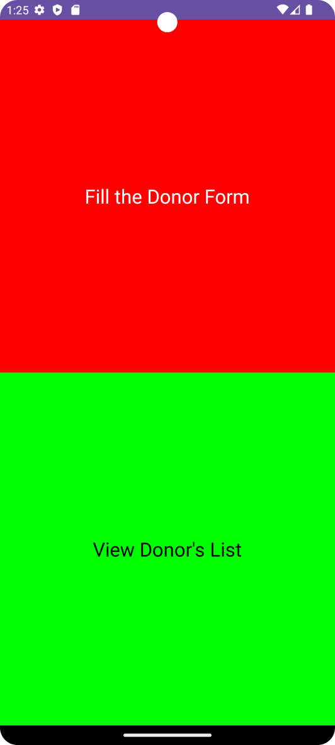

Slide 8
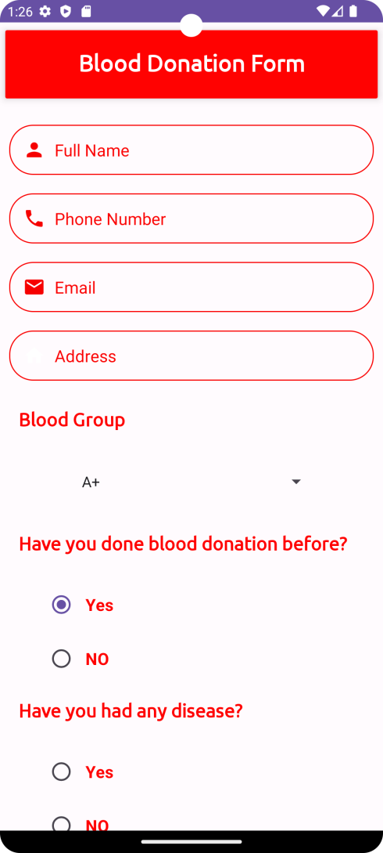
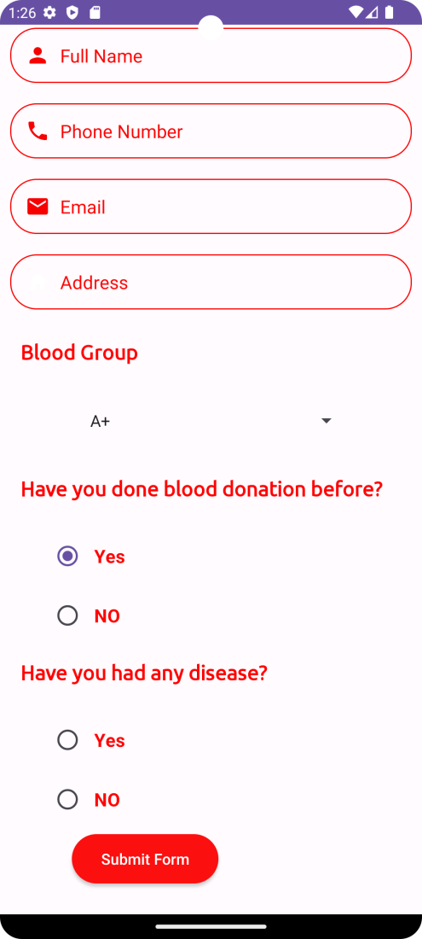
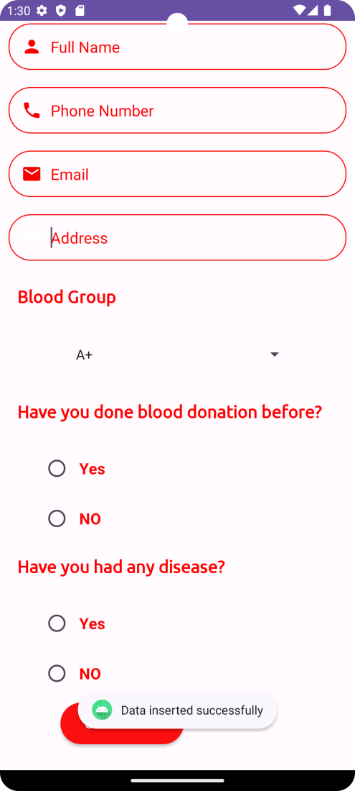

Slide 9
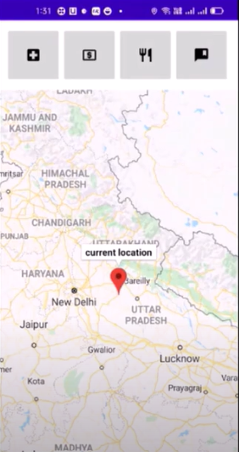
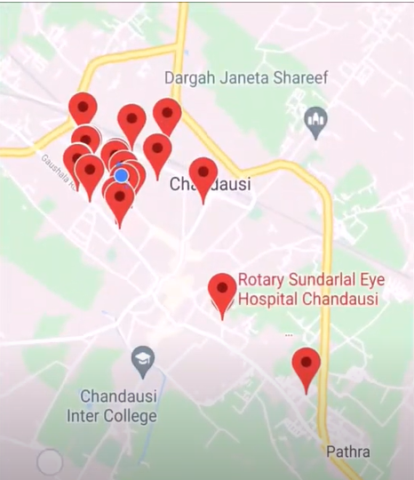

Slide 10
Video Presentation

Slide 11
Problems Faced
Google Map API:
Map used to get crashed automatically I had to rebuild and run again.
Feature crashing:
API crashing caused hospital near by me to crash.

Slide 12
Future Scope
Google API can be implemented for more features like blood tracking.
Can make a hospital chain app for blood donation.
Integrating direct chat with the Blood donor.

Slide 13

Ask Questions

Slide 14
Thank You !!

