Slide 1

Sentiment Analysis on Consumer Reviews
Priyanka Verma, Aspiring Data Analyst

Slide 2

Project Overview
1
Objective
2
Techniques
Predict sentiment from consumer reviews.
ML and deep learning techniques.
3
Patterns
Explore hidden patterns using topic modeling.

Slide 3
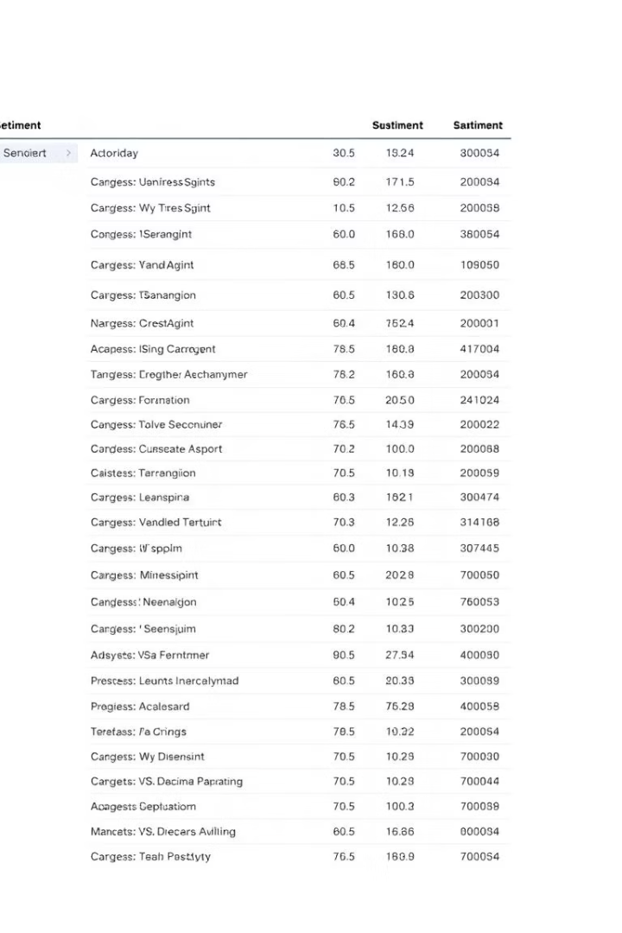
Dataset Description
Files
Features
train_data.csv, test_data.csv, test_data_hidden.csv
Review Text, Review Attributes
Target
Sentiment (Positive, Negative, Neutral)

Slide 4
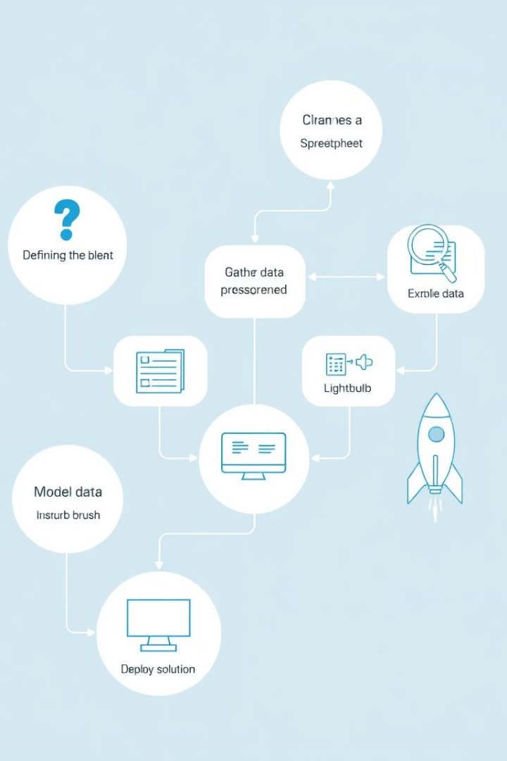




Project Workflow
Data Preprocessing & EDA
Feature Engineering (TF-IDF)
Class Imbalance Handling (SMOTE)
Model Training (ML & LSTM)

Slide 5
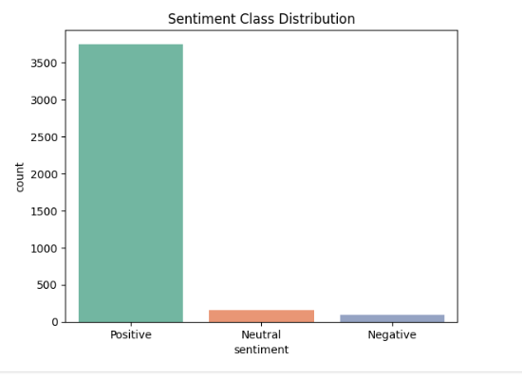
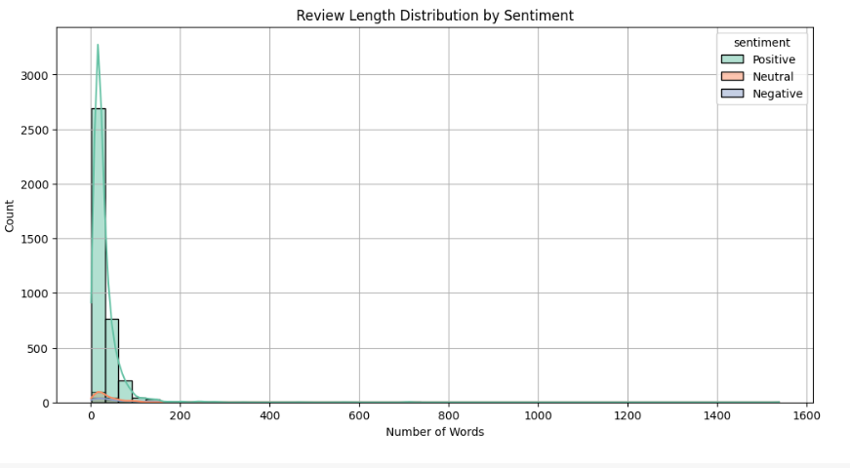



Exploratory Data Analysis
Sentiment Distribution
Frequent Words
Review Length

Slide 6
Class Imbalance Treatment
Applied SMOTE
Verified Ratios
Balanced distribution achieved.
New class ratios confirmed.

Slide 7



Feature Engineering
Max Features
2
5000
Text Vectorization
1
TF-IDF
3
Applied
Preprocessed review text

Slide 8
Modeling Techniques
1
Traditional ML
2
Deep Learning
3
Model Optimization

Slide 9
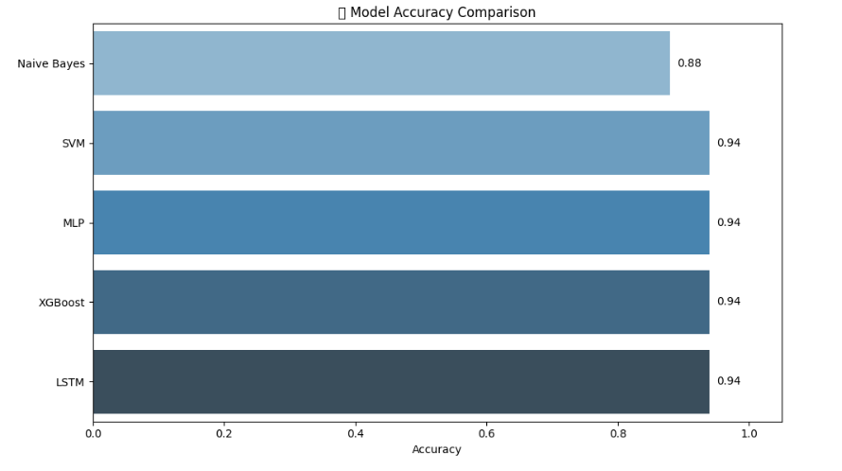
Model Evaluation (Accuracy)
0.95
SVM
Best Model
0.95
MLP
Best Model
0.94
XGBoost
0.94
LSTM

Slide 10
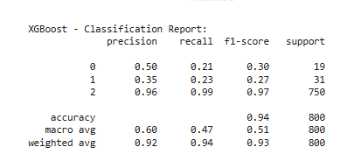
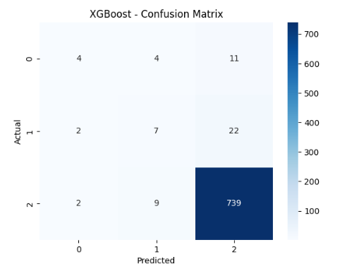
Confusion Matrix Comparison
Side-by-side plots
Analysis
Confusion matrices for all models.
False Positives / Negatives.

Slide 11


