Slide 1
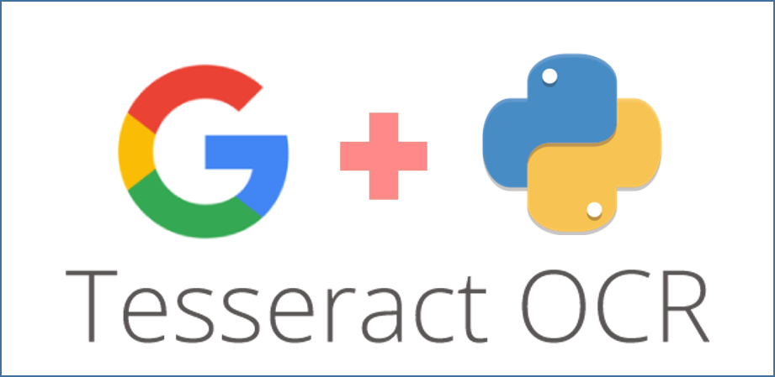

OCR System with YOLOv3 for Text Detection
Presented by Priyanka Verma, this project focuses on designing a deep learning pipeline that leverages YOLOv3 for efficient object detection applied to text images. The system aims to localize and identify text regions accurately across varying image conditions.
By Priyanka Verma

Slide 2
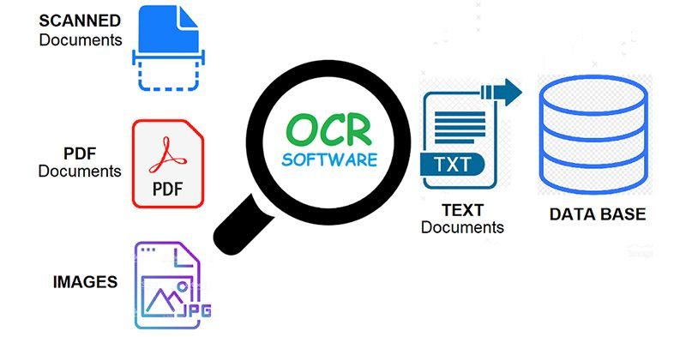
Problem Statement
Goal
Develop an automated method to precisely detect and localize text areas in images utilizing YOLOv3-based object detection.
Challenges
Diverse text fonts, sizes, and complex backgrounds complicate detection.
Generating accurate bounding boxes requires precise localization.
Maintaining real-time inference speeds for OCR applications.

Slide 3
Project Objectives
1
Dataset Creation
Build a custom OCR object detection dataset with carefully annotated images in YOLO format.
2
Model Training
Train the YOLOv3 model on the labeled dataset to detect text regions robustly.
3
Performance Evaluation
Assess the model using mean Average Precision (mAP), precision, and recall metrics.
4
Deployment Preparation
Optimize and ready the trained model for real-world OCR deployment scenarios.

Slide 4
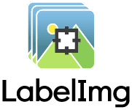
Dataset Overview
Total Images
Image Dimensions
The dataset contains a significant 100 scanned images of thyrocare lab report covering a wide variety of text appearances.
All images are resized to a uniform 416×416-pixel resolution to maintain consistency during training.
Annotation Format
Labeling Tool
Annotations adhere strictly to the YOLO format with normalized bounding boxes for each text region.
Utilized LabelImg, a user-friendly annotation tool allowing precise bounding box placement and export in YOLO format.

Slide 5
Data Preparation Steps
Mount Google Drive
Access and manage datasets on the cloud to facilitate collaboration and processing.
Image Resizing
Standardize images to 416×416 pixels, essential for compatibility with YOLOv3 input requirements.
Annotation File Creation
Create corresponding empty text files for annotation entry structured in YOLO format.
Manual Annotation with LabelImg
Draw bounding boxes around text areas to generate precise labels, ensuring quality data for training.
Normalization
Convert bounding box coordinates to normalized values as per YOLO’s format specification.

Slide 6
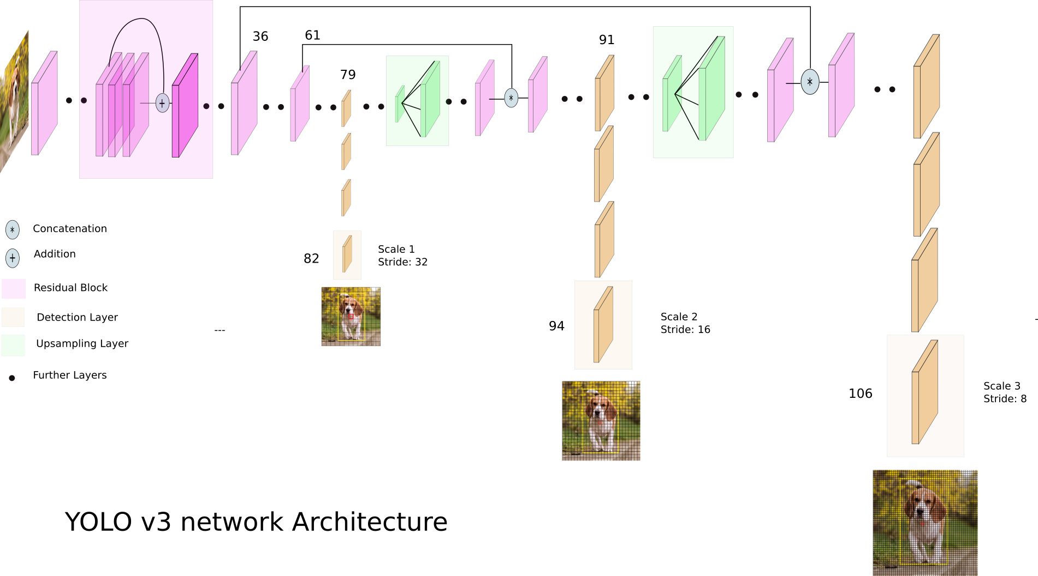
Model Architecture: YOLOv3
Multi-scale Detection
Backbone Network
Employs detection at three scales (13×13, 26×26, 52×52) to capture objects of varying sizes effectively.
Darknet-53 backbone extracts rich features through deep residual blocks enhancing accuracy.
Anchor Boxes & Feature Pyramid
Utilizes predefined anchor boxes with feature pyramid architectures to precisely localize bounding boxes.

Slide 7
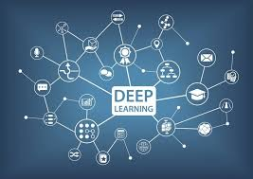
Training Details
Framework
Darknet / PyTorch
Epochs
To be specified (e.g., 30-50 epochs for convergence)
Loss Functions
Combination of objectness, classification, and localization losses
Evaluation Metrics
Mean Average Precision (mAP) and Intersection over Union (IOU)
The training pipeline ensures balanced optimization across detection accuracy and bounding box fidelity.

Slide 8
Results
Performance Metrics
Sample Detection
mAP: To be reported (expected high accuracy)
Visual demonstration of YOLOv3’s capacity to correctly localize text, even in challenging backgrounds.
Precision and Recall: Balanced for robust detection

Slide 9
Learnings and Challenges
Key Learnings
Effective image preprocessing enhances model input consistency.
Accurate bounding box annotation is critical for training quality.
Understanding YOLO’s training dynamics improves convergence and accuracy.
Major Challenges
Handling annotation misalignment impacting model learning.
Ensuring label consistency across diverse annotation batches.
Managing class imbalance between text and background regions.

Slide 10
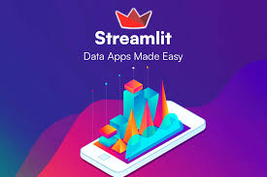
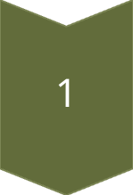
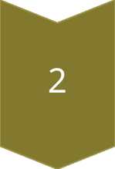
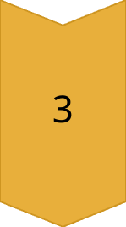
Future Work
Text Recognition Addition
Integrate Tesseract or CRNN models for full OCR pipeline completion including character recognition.
Upgrade to YOLOv5
Employ YOLOv5 for improved detection speed and accuracy with more advanced architecture.
Deployment
Deploy the model using lightweight frameworks like Streamlit or Flask for accessible real-time OCR applications.

Slide 11


