Slide 1
Purely: Blockchain-based decentralized platform for patient centric healthcare data access.
Under the guidance: Ashutosh Bhatia Sir
Poojan Vimabhai Sheth (2024H1030081P) Priyank Shah (2024H1030092P)

Slide 2
Discussion
Purely: A blockchain-based decentralized platform for a patient centric healthcare data access.
Focused on empowering patients with verifiable digital identities (DIDs) for secure, selective data control.
DIDs are World Wide Web Consortium (W3C) specification that allows for a decentralized identity.
The system uses Ethereum smart contracts, IPFS for data storage, and React-based UI integrated with MetaMask.
A comprehensive solution designed to address current EHR system and interoperability issues.

Slide 3
INTRODUCTION
EMR systems in the US are digitized but remain institution-owned, limiting data portability and access.
Departments such as radiology, labs, and billing have there own different systems, leading to data silos.
Patients often have no visibility or control over how or where their data is used.
Purely applies decentralized identifiers (DIDs) to put patients in charge.
Blockchain provides a infrastructure enabling seamless, cross-institutional record access.

Slide 4
PROBLEM STATEMENT
The healthcare ecosystem suffers from data silos and patient don’t have control of their own data.
Patients aren't active participants; they cannot revoke access or track how their data is used.
Insurance processing is inefficient due to the lack of verified, tamper-proof claim sources.

Slide 5
LITERATURE REVIEW
MediLinker (Bautista et al., 2023): Introduced a blockchain-based health identity platform emphasizing self-sovereign identity (SSI) using Hyperledger Indy and Aries. Patients receive digital wallets, store credentials off-chain, and use them across multiple healthcare institutions. MediLinker proves the technical feasibility of using blockchain and DIDs to achieve patient-centric healthcare and FHIR-based interoperability.
Technical Design and Development of a Self-Sovereign Identity Management Platform for Patient-Centric Health Care using Blockchain Technology(2023): Emphasizes interoperability, privacy, and real-time consent control.
Designing and testing a blockchain application for patient identity management in healthcare (2021): Explores the importance of verifiable credentials in identity verification and how DIDs simplify access while preserving privacy. It confirms the practical relevance of W3C’s DID specifications and verifiable credential standards in healthcare and beyond.

Slide 6
PROJECT OBJECTIVE
Develop a decentralized identity framework using blockchain for health identities.
Empower patients with the ability to grant and revoke to their own health data.
It also patient’s to track their current medication and dose.
Facilitate interactions between hospitals and insurers using signed digital credentials.
Ensure that patient diagnosis and treatment are encrypted across systems.
Minimize dependency on physical documentation by digitizing credentials in patient wallets.

Slide 7
WHY BLOCKCHAIN?
Shared Ledger: All participants operate from a common, tamper-proof data source.
Auditability: Every access, claim, and credential issue is traceable, enabling full transparency.
Confidentiality: Smart contracts manage access control using permissioned data models.
Scalability: The system is designed to grow with the number of users, hospitals, and insurers.
Privacy: Patient’s information and diagnosis are not shared on the blockchain but just there DIDs and encrypted payload.

Slide 8
STAKEHOLDERS OVERVIEW
Patients: Register using MetaMask; get DID issued and share health data securely.
Hospitals: Does the treatment and diagnosis and provides encrypted data.
Insurance Providers: Verifiers who process claims based on trusted DIDs without accessing private info.
All parties trust credentials because they originate from a cryptographically signed source

Slide 9
DATA MODEL
On-Chain: Stores public DIDs of patients and organizations, claim metadata, and insurance records.
Off-Chain: Encrypted diagnosis, treatment, stored in IPFS and and personal details are stored in user wallets.
Access Control: Only patients can decrypt data using their private keys.
Even hospitals can’t access records unless granted permission through DID linking.
Revocation says that patient has denied future usage and that is recorded on blockchain and that data is no longer verifiable.

Slide 10
USE CASE - I & II
Amy receives a DID after verifying her identity at the clinic A.
She visits a new clinic, shares her verified DID and medical history without re-entering data.
Temporarily delegates insulin pickup to her friend, then revokes access post-use.
Tracks medication records, buys insurance policies, and maintains health consistency across providers.
Jose registers at a community clinic using a gym ID and receives a DID—no national ID required.
He controls access to his sensitive diagnosis and shares records only with trusted clinics.
When treated, data is encrypted by the hospital and only decryptable by Jose.
Insurance claims are processed using DID—hospital credential is trusted, no personal details shared.
Enables healthcare access for undocumented or underprivileged communities with privacy protection

Slide 11
SYSTEM ARCHITECTURE
Frontend (React) allows users to register, login, and manage credentials with MetaMask.
Data is encrypted before uploading to IPFS and then hash linked through smart contracts in the blockchain.
Hospitals issue signed treatment credentials; encryption patient’s public key.
Smart contracts track policies, assign claims, and log revocation/approval actions.
System integrates DID resolvers to verify identity and provenance in real-time.

Slide 12
CREDENTIAL LIFECYCLE
Credential issuance starts at registration—patients present proof of identity; hospital generates a DID.
Patients use this DID to share data with other hospitals, insurers, or research institutions.
Revocation lists are checked via smart contracts to validate access permissions.
Users can view all access logs and modify permissions through their Purely portal.

Slide 13
STATE DIAGRAM
Registration Flow: User connects MetaMask → submits Gov ID→ DID generated → smart contract updated.
Credential Flow: Hospital signs treatment data → encrypts → stores hash on-chain → sends to IPFS→creates a smart contract.
Claim Flow: Doctor initiates claim → smart contract routes to insurer → insurer validates and settles → if rejected then patient is liable to pay for the charges.
Access Flow: Patient grants or revokes access → verified using DID registry and access lists.

Slide 14
IMPLEMENTATION DETAILS
Solidity smart contracts deployed on Ethereum Sepolia Testnet.
Frontend built in React.js; wallet connectivity via MetaMask for signing and sending transactions.
DID operations handled using libraries like ethr-did(secp256k1).
Off-chain storage handled through IPFS; content hashes stored in the blockchain for traceability.
IPFS currently uses SHA-256 by default, which produces a 256 bit (32 byte) output, and that output is encoded with Base58.

Slide 15
Encrypted Data Transfer
Doctor enters full diagnosis (symptoms, prescription, date) in structured JSON format.
Full message is stringified and signed using the doctor’s private key.
The { message, signature } is encrypted usingg the patient’s public key.
Encrypted package is uploaded to IPFS (e.g., Web3.Storage) returns a content hash (CID) to uniquely identify the file. Smart contract stores only the IPFS hash + patient/doctor address.
Patient decrypts the with their private key, then the message. Signature is verified using the doctor’s public key to confirm authenticity.

Slide 16
SECURITY POLICY AND PRIVACY
End-to-end encryption ensures data is never readable by unauthorized entities.
DID-based cryptographic signing verifies identity and prevents impersonation.
Patients maintain complete control over what gets shared, with whom, and for how long.
Claims and data access are auditable without revealing personal identifiers.
Zero-trust architecture—privacy by design, verifiability by default.

Slide 17
RESULTS
Simulated patients successfully generated and used DIDs to interact with multiple hospitals.
Treatment records encrypted and retrieved only through verified keys.
Insurers processed claims based on signed credentials without needing patient details.
Full cycle of access, claim, and revocation tested across dummy wallets and contract calls.
System maintained confidentiality, access control, and traceability throughout.

Slide 18
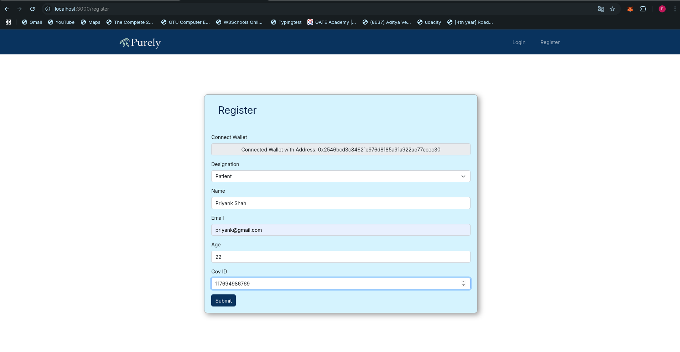
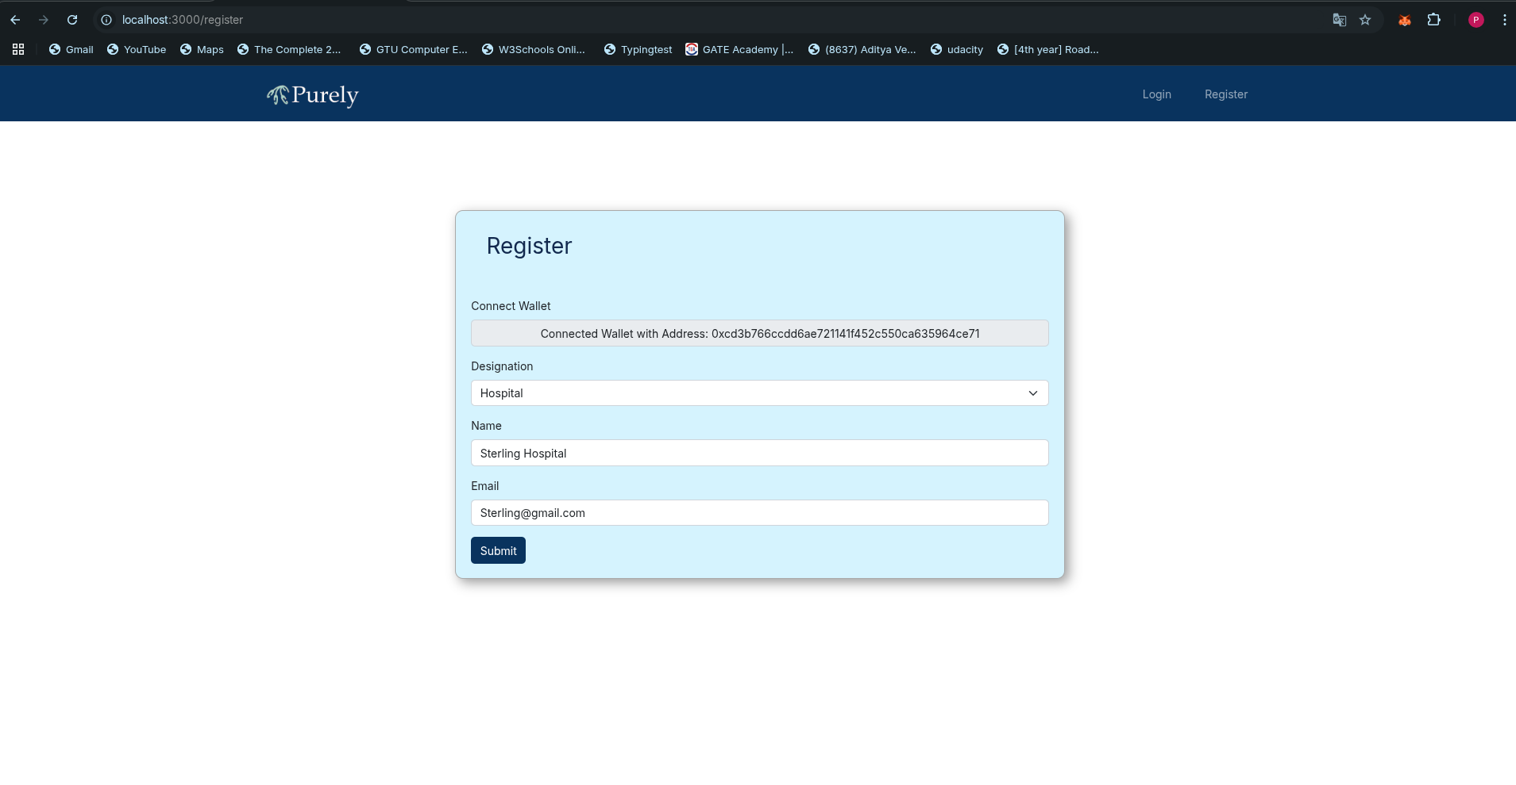
Registration

Slide 19
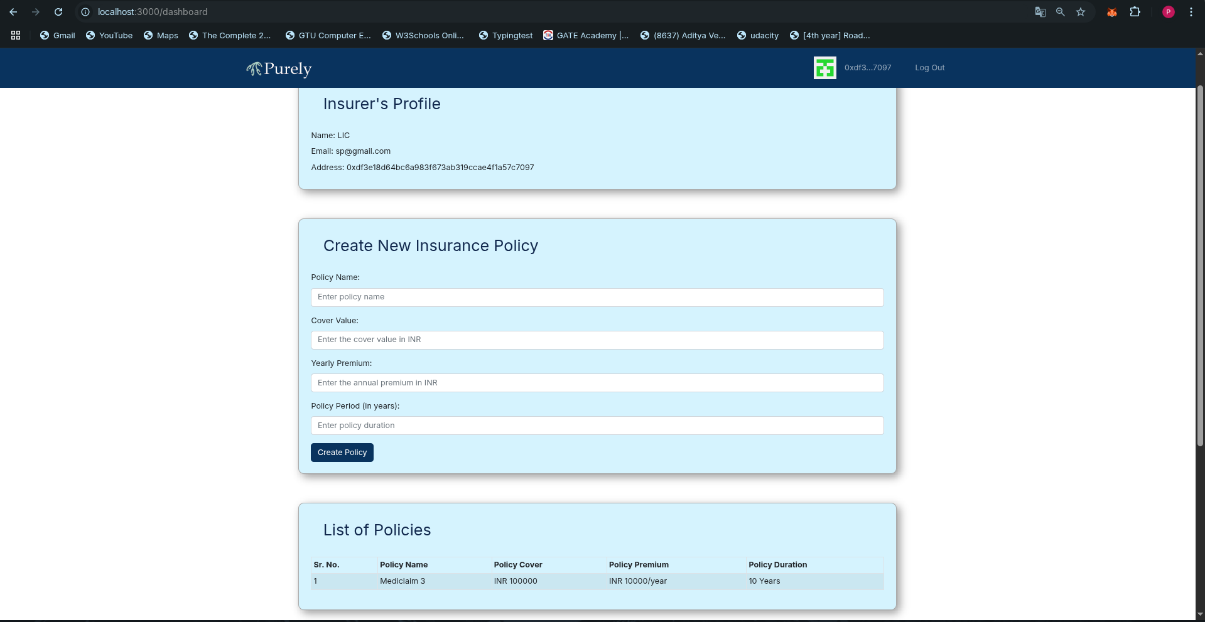
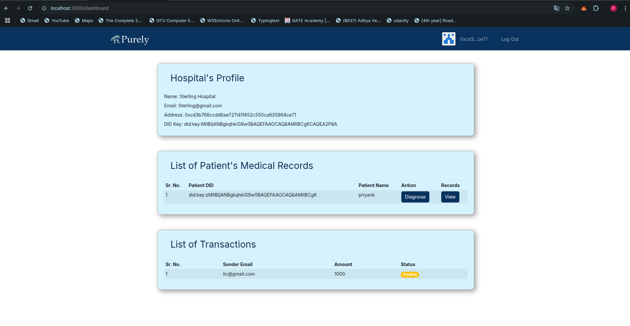
Insurance & Doctor Page

Slide 20
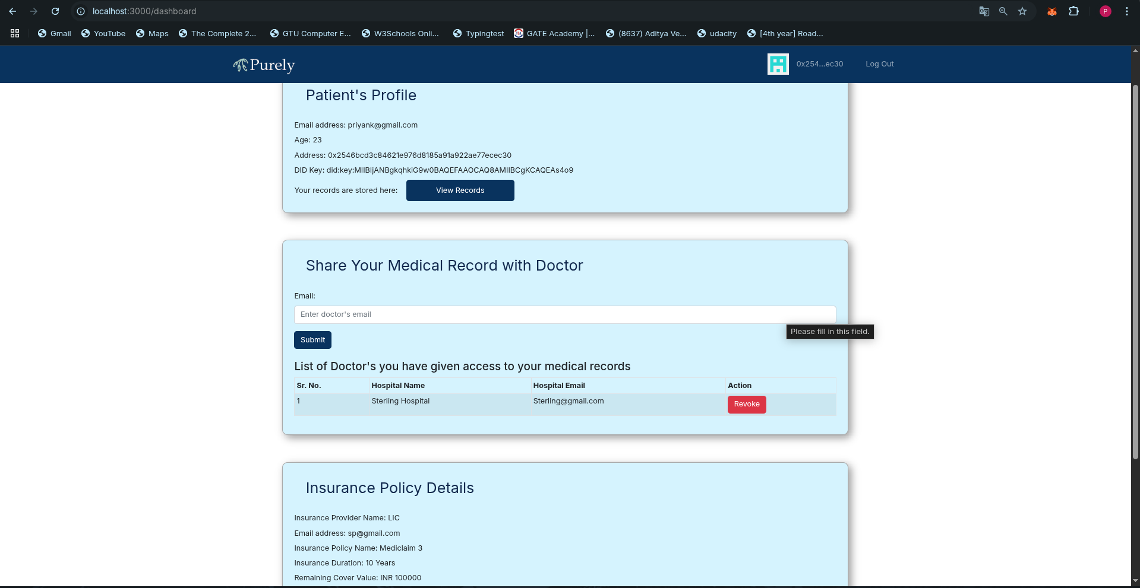
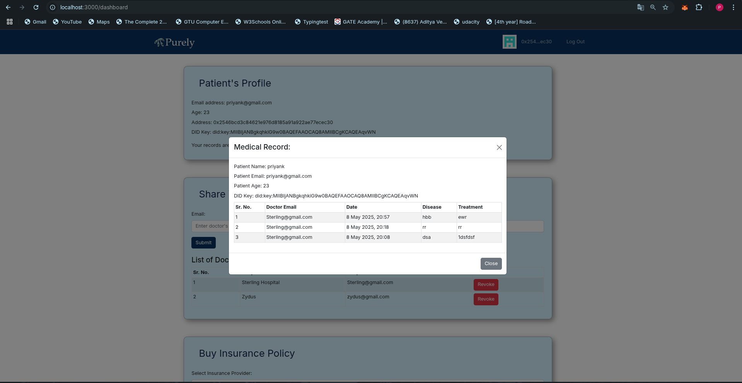
Patient Page

Slide 21
COMPARISON WITH TRADITIONAL HIES
HIEs: Centralized, provider-controlled, limited portability and privacy.
Purely: Decentralized, patient-controlled, fully portable and encrypted identity.
Verifiable credentials replace the need for centralized data brokers.
Audit logs ensure transparency, and DID-based architecture fosters interoperability.
Real-time access and data-sharing possible without backend system integrations.

Slide 22
FUTURE WORK
Develop cross-platform mobile wallet apps with biometric authentication.
Add support for parental or guardian DIDs to manage children or elderly records.
Integrate more stakeholders into the system and manage them accordingly like Labs, Pharmacy, Researchers etc.

Slide 23
CONCLUSION
Purely demonstrates how decentralized identity can transform healthcare access.
It offers patient-centric control, privacy-preserving claims, and secure health data exchange.
Reduces operational friction and builds trust across hospital and insurer networks.
Validated through realistic simulations and real-world use case mapping.
A step toward a more ethical, privacy-respecting, and efficient digital health future.

Slide 24
THANK YOU !

