Slide 1
Professional Ethics
Social Implications of Computers

Slide 2

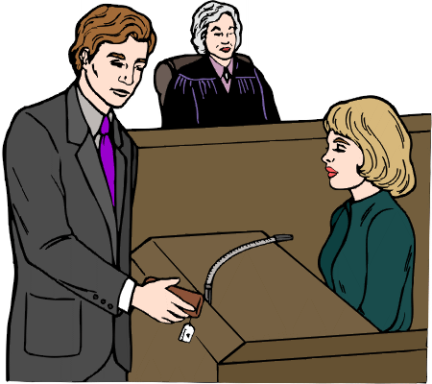
Pop Quiz
What’s a professional?
Notes:
See next slide.

Slide 3
A professional is...
... someone whose boss can legally make him/her work overtime without paying time and a half.
So why would anyone want to be one?
Notes:
(In US labor law.)
The point of this is to deconstruct the idea of professionalism as an obvious good. Like anything else, it requires critical analysis.

Slide 4
My son, the doctor
Make mom happy.
Generally (bot not necessarily) higher pay.
In theory, a professional decides him/herself how to do the job, rather than doing it the boss’s way.
Snob appeal. When Reagan broke the air traffic controllers’ union, one reason he succeeded was that they had a history of no solidarity with other unions. They didn’t even think it was a union: the Professional Air Traffic Controllers Organization (PATCO). So the pilots’ union, etc., didn’t honor their strike.
Notes:
Time was when doctors and lawyers were independent self-employed entrepreneurs with clients, lay people with no say over the conditions of work. But these days, with HMOs and big law firms, that distinction no longer holds.
It’s worth noting that doctors and lawyers don’t spend any time agonizing over whether they’re professionals or not.

Slide 5
Why codes of ethics?
One reason is that people don’t take you seriously as professionals unless you have one.
But the main reason is...
Notes:
... on the next slide!

Slide 6
Why codes of ethics?
One reason is that people don’t take you seriously as professionals unless you have one.
But the main reason is ass covering.
You build a bridge. It falls down. You get sued. Your lawyer says: “My client was following the professional standards of civil engineers. It’s not his fault those standards didn’t anticipate (insert cause of collapse).”
Notes:
And this is a legitimate defense to a tort claim, although of course not guaranteed to convince the jury.

Slide 7
The Association for Computing Machinery
The main (largest, oldest) professional association of computer programmers, more recently branched out to include other computer-related professional categories.
(The competition is the IEEE Computer Society, which appeals to people with one foot in Electrical Engineering.)
Members must agree to the ACM Code of Ethics.
The Code includes “general moral imperatives” and then “more specific professional responsibilities.”
Notes:
This is where we get specific about computer professionals.

Slide 8
ACM’s General Moral Imperatives
Contribute to society and human well-being.
Avoid harm to others.
Be honest and trustworthy.
Be fair and take action not to discriminate.
Honor property rights including copyrights and patents.
Give proper credit for intellectual property.
Respect the privacy of others.
Honor confidentiality.
Notes:
Three out of eight (I’m including the last one) about ownership of ideas! Who wrote this code anyway? And no mention of the virtues of sharing and cooperation.

Slide 9
ACM’s Specific Professional Responsibilities
Strive to achieve the highest quality, effectiveness and dignity in both the process and products of professional work.
Acquire and maintain professional competence.
Know and respect existing laws pertaining to professional work.
Accept and provide appropriate professional review.
Give comprehensive and thorough evaluations of computer systems and their impacts, including analysis of possible risks.
Honor contracts, agreements, and assigned responsibilities.
Improve public understanding of computing and its consequences.
Access computing and communication resources only when authorized to do so.
Notes:
Not so bad. Four out of eight about software engineering issues, typical of such codes. More about duty to employers than about duty to the general public, but risks in #5 and consequences in #7 are steps in that direction.
I’m omitting section 3, about the specific duties of managers. It’s pretty similar.

