Slide 1
Privacy
Social Implications of Computers

Slide 2
Privacy as Instrumental Good
Avoid discrimination based on, e.g., HIV status.
Allow anonymous political speech.
Protect personal security, e.g., against stalkers.
Restrain exercise of state power, e.g., require warrants.
Prevent spread of incorrect information.
Notes:
“Instrumantal” = for the sake of some other more fundamental goal, e.g., free speech.

Slide 3
Privacy as Intrinsic Good
Different public selves in different contexts.
“Right to be left alone.”
Part of human dignity.
Avoid “creepy” repurposing of information.
Notes:
“I’m not doing anything wrong, so I have nothing to hide.” But you don’t talk to your teacher the way you talk to your friends, and you talk still differently to your parents. Emphasize that there’s nothing dishonest about this. Maybe explore the connection with the history of gay sex, formerly illegal in the US and now viewed as constitutionally protected, because the government has no business looking over your shoulder in your bedroom.

Slide 4
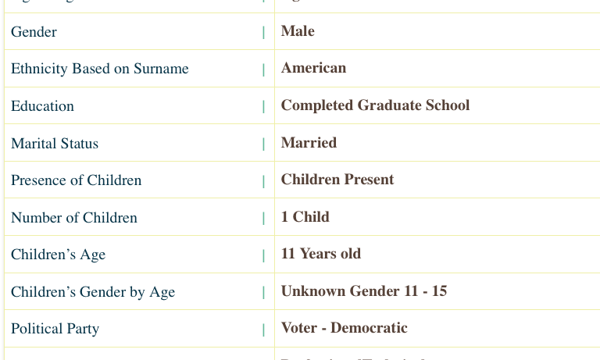
Brian according to Acxiom
Notes:
You can get your own info from acxiom.com if you want to share it. I left out the parts I consider sensitive but your standards might be different.
The circled items are wrong. I’m single, and my son was 26 when I got this report.

Slide 5
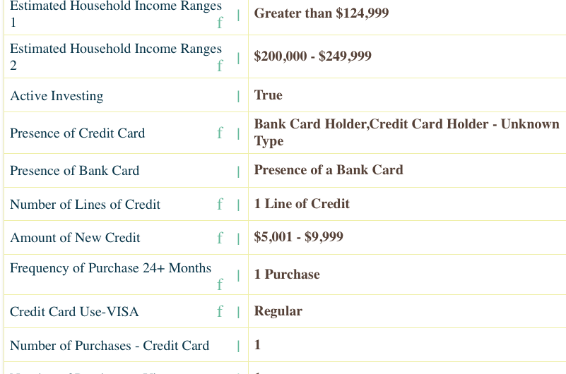
Brian according to Acxiom
Notes:
I wish I made that much! Off by a factor of two. You’d think they’d get /that/ right!
And, I only made one purchase in two years?? It’s more like 50 a month – most of my bills are paid by credit card.

Slide 6
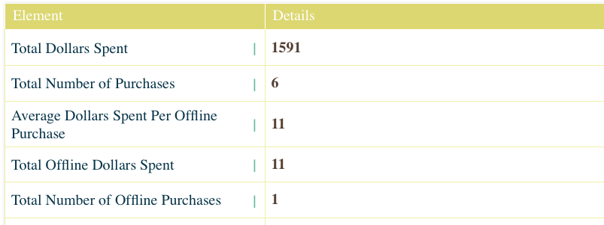
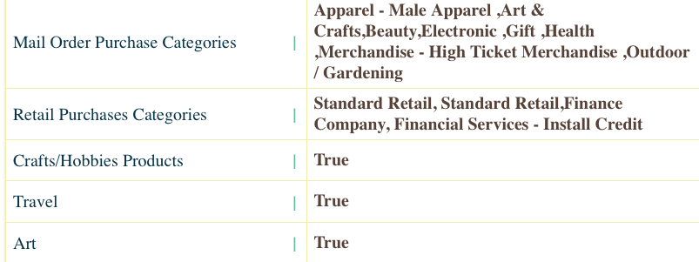
Brian according to Acxiom
Notes:
Basically all of this is wrong, except that I do buy art and electronics.

Slide 7
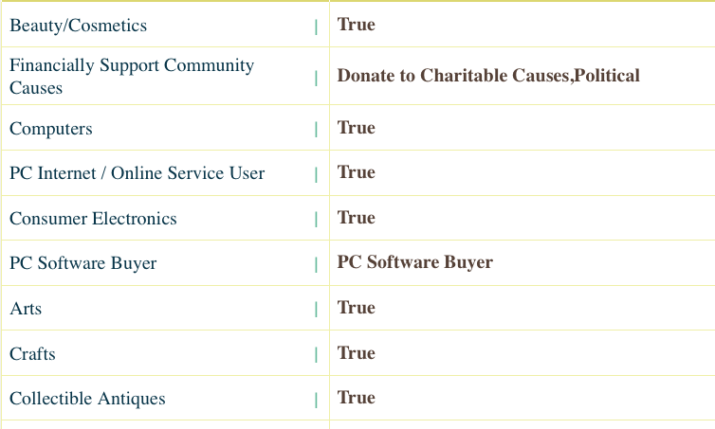
Brian according to Acxiom
Notes:
This is true, but what are the free speech implications of telling everyone who does business with me about it?
There’s /lots/ more in the report; you may not want to go through all four slides in detail but students should understand that it’s way more than just whether I pay my bills on time.

Slide 8
The threats to privacy
Governments
Corporations
People with cellphone cameras
Notes:
It’s important that students understand that these three are very different, and all are important. The third is recent.

Slide 9
The Case Against Privacy
You gain convenience from tailored ads, location services.
People today care more about online friendship.
Governments need to protect us against bad guys.
Businesses must verify eligibility for, e.g., credit.
If I’m doing nothing wrong, I have nothing to hide.
Notes:
It is said that young people don’t care about privacy the way the older generation does. That’s changing somewhat, as kids discover that potential employers read their Facebook page, but it’s definitely true that young people have lower /expectation/ of privacy, especially those born after 9/11.

