Slide 1
Owning Ideas
Social Implications of Computers

Slide 2
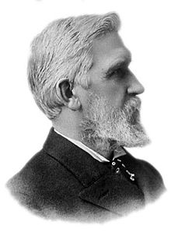
Who is Elisha Gray?
Notes:
He invented the telephone, but got to the patent office a few *hours* after Bell. (His phone was better, and Bell ended up building Gray’s version.)

Slide 3
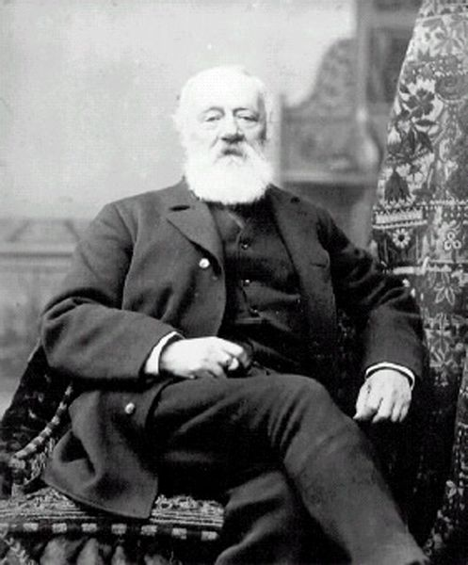
Who is Antonio Meucci?
Notes:
He invented the telephone, five years earlier, but he’s Italian, so it doesn’t count. ( ← sarcasm )

Slide 4
Inventions Aren’t Strokes of Genius
The telephone, the electric light, the steam engine, all were researched in several labs at once, because the enabling technologies came into place and all working engineers knew it.
So why do we issue patents? They’re a way to encourage engineers to work hard at perfecting new technology.
Exceptions: Xerox, Velcro—nobody else was working on these.
Notes:
Another reason everyone invents the same thing at the same time is government funding setting the agenda.

Slide 5
US Constitution
Article 1, Section 8:
The Congress shall have Power [...]
To promote the Progress of Science and useful Arts, by securing for limited Times to Authors and Inventors the exclusive Right to their respective Writings and Discoveries;
[...]

Slide 6
Copyright History
The earliest copyrights were granted to printers, not authors, and were part of licensing schemes meant to prevent the printing of seditious or irreligious material.
In Europe, but not in the United States, the law distinguishes between
Economic rights to profit from the publication of a work, which can be assigned, e.g., to a publisher, and
Moral rights to protect the integrity and attribution of the work, which belong only to the author.
Notes:
Even people who think “information wants to be free” on the Internet might have reason to respect authors’ moral rights.
European laws often don’t have fair use exceptions like US law.

Slide 7
Copyright and Patent as Social Bargain
“To promote the Progress of Science and useful Arts, by securing for limited Times to Authors and Inventors the exclusive Right to their respective Writings and Discoveries” (This is US, but other countries have similar history.)
In other words, the purpose of copyright and patent is
to get ideas into the public domain eventually
to prevent the loss of technology through secrecy
Compare with “real property” (land), which you own by right and can pass down to your descendants forever.
Notes:
Lost technology: artists’ pigments, Stradivarius violins...
(Morally, real property is problematic, too – it was usually stolen from someone by force long ago. But the /law/ sees it very differently.)

Slide 8
Copyright and Computers
In an ideal “free” market, prices tend to fall to the marginal cost of making one more item.
Digital storage enables unlimited, lossless copying at zero marginal cost.
Copyright has always been a way to prevent the operation of market forces, in order to support artists. But now everyone is a potential publisher, not just companies with expensive duplication equipment.
Notes:
According to the RIAA, you may not buy a CD and copy the songs onto your computer even if you never actually listen directly to the CD. You’re supposed to buy the songs again from an online store.
With older technologies, material cost and quality degradation limited amateur copying to a quantity not worth the publishers’ effort to enforce.

Slide 9
Changing the Bargain?
Some argue that the ease of digital copying and distribution make copyright obsolete, but in another sense the technology makes copyright more important than ever.
Can we find other ways to support the creation of art without limiting copying? One such attempt was a fee added to the price of blank CDs.
DMCA changes the bargain in the other direction, into an effective permanent “intellectual property” right.
Notes:
RMS: Put a “$” button on the music player that sends $1 directly to the artist of the song currently playing. Entirely optional.
RMS: Hardly any musicians actually make money from music sales because the record labels require contracts that pay artists based on *net* income, and there never is any net income because of creative accounting practices.
(... but this isn’t true about movies!)

Slide 10
Do Software Patents Hinder Progress?
No: The patent system supports the enormous efforts required to build modern, internationalized, easy-to-use, extensively tested software systems.
Yes: Patents last too long because the software development cycle is so much shorter than traditional manufacturing cycles; many patents have been granted for obvious ideas; the accumulation of thousands of obscure patents let big companies exclude competitors.
Maybe the basic idea is okay but the details need work.
Notes:
Things have gotten somewhat better since the patent office started hiring computer programmers as patent examiners.
Big companies file trivial patents as a defensive strategy against other big companies’ patents. Then they cross-license each other, so effectively the big companies can ignore patents, but nobody else can develop software without tripping over some.

