Slide 1
Computers and Work
Social Implications of Computers
Notes:
Two topics combined, really: what it’s like to work in the software industry, and how computers affect working people in general.

Slide 2
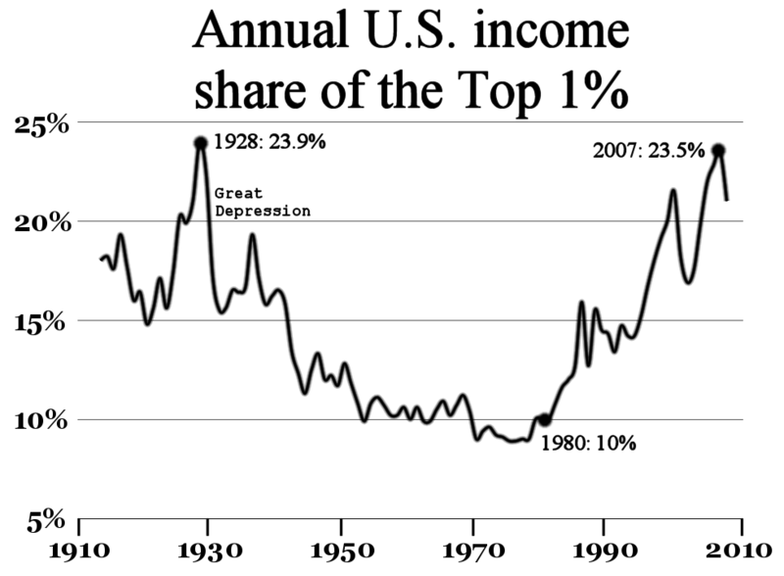
The Vanishing Middle Class
Notes:
Despite the stereotype of bankers jumping out of windows, the Depression didn’t hurt the top 1% much. Between then and now, the FDR safety nets allowed the growth of a broad middle class, which has since 1980 been gradually destroyed, mostly by the Reagan Revolution but partly by computers too – see next slide.

Slide 3
Why?
Tax policy (the “Reagan revolution”)
Globalization (which lowers wages)
Automation eliminates blue-collar jobs
... so unions are weakened
Bimodal distribution of jobs:
low-paying service jobs (maid, janitor, burger flipper)
high(er)-paying jobs requiring computing skills
Also financial deregulation and several more reasons.
Notes:
The dot-com vaporware bubble created a lot of paper wealth with no real social wealth behind it, devaluing middle class savings.

Slide 4
Automation: Not Just Factories
ATMs replace bank tellers
Self-checkout at the grocery store
Online ticket sales replace travel agents
Amazon replaces local store clerks
Online courses replace teachers!
New jobs are created, but
not as many
lower pay
requiring computer skills
Notes:
The net loss of jobs was once controversial but by now the statistics are unmistakable.

Slide 5
On the Job
High tech speedup:
computer monitoring of each worker’s throughput
(e.g. calls per minute in a call center)
locked restrooms log individually coded card keys
Thwarting flexibility:
“Sorry, the computer won’t let me do that.”
Loss of privacy
the company reads your email
Notes:
Of course this is just the gloomy side of the picture. Automation has made some jobs easier and safer, too. It’s important that much of this applies even to workers who don’t mainly work directly with computers.

Slide 6
Computer Science grads do fine
Starting salary for BS/BA in CS/EE around $60K
Starting salary for MS in CS/EE around $70K
Berkeley alumni starting salary:
L&S CS BA $95K
EECS BS $83K
CS MS $100K
CS PhD > $120K
(All numbers based on survey responses. YMMV.)
Notes:
These numbers are as of 2013.
The Berkeley numbers are an unabashed ad for Berkeley computer science! ☺

Slide 7
Not enough programmers?
Big movement, NSF-funded, to get computer science into high schools
(Full disclosure: BJC gets some of the funds)
Statistics show that CS degrees in the US are insufficient to meet the demand for “computing jobs”
But the statistics are controversial because those jobs include lots that don’t require computer science.
One reason for the movement is a self-serving effort by tech companies to get more work visas for Indian programmers (who are cheaper than domestic ones).
But a lot of activists are honestly motivated, too.
P.S. If everyone learned to program, would they all get jobs?
Notes:
This is meant as a mild corrective to the code.org sort of idea of a utopian future in which everyone is a programmer.

Slide 8
The zero-sum economy
First law of economics: You can’t eat information.
For people working in the non-information economy that feeds, houses, and clothes us, the entire information economy is essentially parasitic.
No real workers can afford Bay Area housing, for example.
As everyone now understands, the money industry (hedge funds, arbitrage, etc.) is especially parasitic.
So take responsibility for people whose skills are less well rewarded than yours! They don’t deserve to be poor.
P.S. Yeah, not quite zero-sum, because information makes agriculture more efficient. But not enough to pay for the startup gazillionaires.
Notes:
This is all controversial. Most economists will tell you that “intellectual property” /is/ real wealth, not parasitic. Most will even argue that the money industry is socially useful.
The third bullet point is the kind of “thou shalt” that I generally try to avoid. Maybe it’s less relevant to high school students, not all of whom will be highly paid computer professionals. But it might start a discussion about the nature of desert. Do smart people *deserve* to be rich?

