Slide 1

Implementation of FCFS Algorithm for Subject Allocation
A High-Concurrency Concurrency-Safe Registration System using Pessimistic Locking
PRESENTED BY
Priyansee Mukeshkumar Soni
ID: 202511011
SUPERVISED BY
Prof. P M Jat
M.Tech ICT, DAU

Slide 2
Presentation Outline
• Problem Statement: The Race Condition
• Barging & Fairness Violation
• Motivation: Why this Matters
• Design Objectives
• Technology Stack
• System Architecture Overview
• Architecture Explanation
• Database Design & Schema • The Three-Phase FCFS Algorithm • Phase 0: The Wait-Free Doorway • Phase 1 & 2: Locking & Commit • Concurrency Handling Visualization • Deadlock Prevention Strategy • Case Study: Hibernate Cache Bug • Results & Key Decisions

Slide 3
The Problem: Transactional Race Conditions
Concurrent read-modify-write operations on un-synchronized resources lead to "Lost Updates".
• Lost Update Phenomenon: Occurs when concurrent transactions read identical state, leading to overwriting of allocation counts.
• Integrity Breach: Without synchronization, the database fails to enforce the physical limit of available resources.

Slide 4
Barging & Fairness Violation
Optimistic locking with retries destroys the "First-Come-First-Serve" requirement.
• The Barging Problem: Later requests can acquire locks while earlier requests are in a "back-off" or retry state.
• Fairness Guarantee: Strict FCFS ensures that temporal priority is the only factor in resource acquisition.

Slide 5
Design Objectives
• FCFS Fairness: Requests that arrive earlier must be served before later ones.
• Deadlock Freedom: Concurrent transactions must never stall each other in circular lock waits.
• Atomicity: A student is enrolled in all courses within a slot, or none.

Slide 6
Technology Stack
• Java 21 (LTS) & Spring Boot 3.x
• PostgreSQL 16 & Hibernate 6
• HikariCP Connection Pooling
• Thymeleaf / HTML5
• Maven Build System
• Embedded Tomcat

Slide 7
System Architecture – Overview
1. Browser (Thymeleaf / CSS)
2. Web Layer: RegistrationController
3. Service Layer: AllocationService (@Transactional)
4. Data Layer: Spring Data JPA (Hibernate)
5. Database: PostgreSQL

Slide 8
Full Stack – Layered Interaction
1. Client Layer: Captures intent via POST form.
2. Web Layer: Maps request to system logic.
3. Service Layer: Enforces 3-phase FCFS algorithm.
4. Persistence Layer: Translates Java to SQL with Locks.
5. Database Layer: Physically serializes threads via Row Locks.

Slide 9
Database Design – Full Schema
• ec2.courses: Base subject definitions
• ec2.termcourses: Slot definitions
• ec2.termcourseavailablefor: LOCKING TARGET (Seats/Booked)
• ec2.studentregistration: Student term records
• ec2.studentregistrationcourses: Allocation mapping

Slide 10
FCFS Algorithm – High-Level Flow
Phase 0: VALIDATE (Wait-Free Discovery)
Phase 1: LOCK (Acquiring Row Locks in Sorted Order)
Phase 2: COMMIT (Atomic Capacity Check & Update)

Slide 11
Formal Algorithm: FCFS Allocation
Step 1: Start Transaction, Fetch IDs, Validate Eligibility.
Step 2: Sort IDs, Acquire SELECT FOR NO KEY UPDATE locks.
Step 3: Verify Capacity, Update Booked Count, Insert Enrollment, Commit.

Slide 12
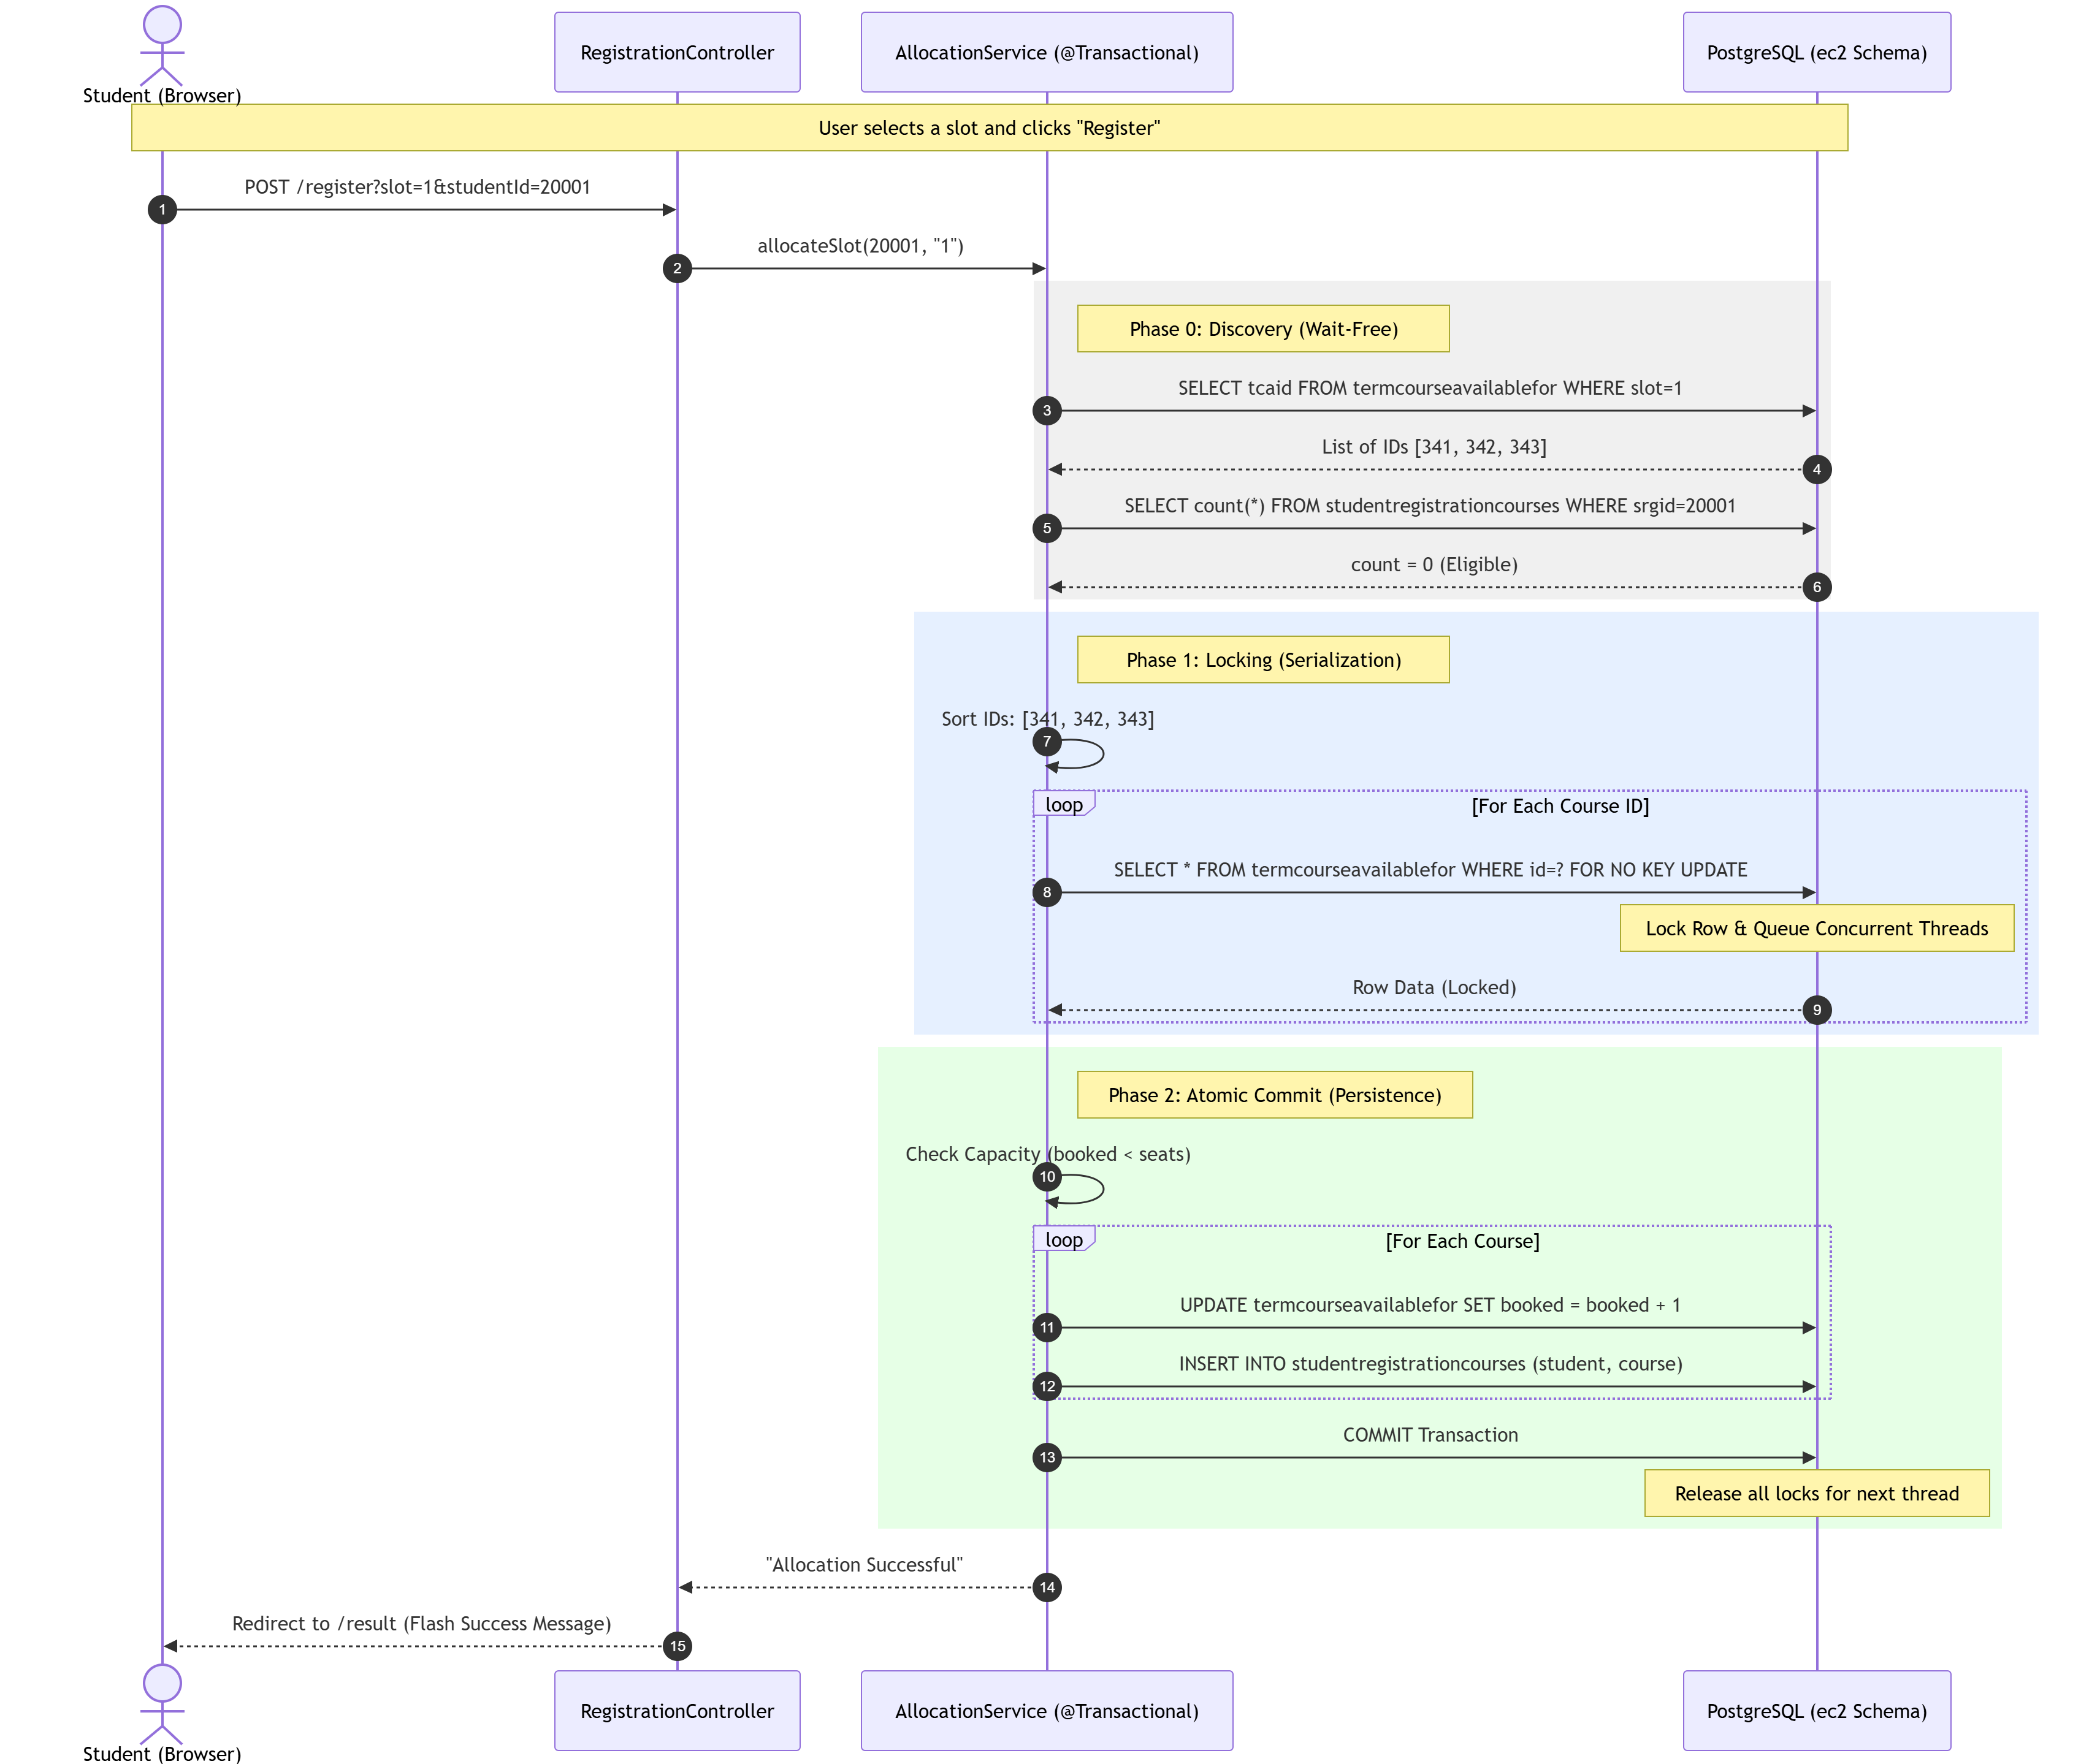
System Sequence Diagram

Slide 13
Phase 0: Discovery (Wait-Free)
List<Long> tcaIds = repo.findTcaIdsBySlot(slotId);
if (alreadyEnrolled(studentId)) throw AlreadyEnrolledException();

Slide 14
Phase 1: Growing (Acquiring Locks)
Collections.sort(tcaIds);
for (Long id : tcaIds) {
repo.findTcafByIdWithLock(id);
}

Slide 15
Phase 2: Atomic Commitment
if (booked >= seats) throw SlotFullException();
updateBookedCount();
saveEnrollment();

Slide 16
Concurrency: Holder vs. Waiters
• Transaction A: LOCK HOLDER (Executing logic)
• Transaction B & C: WAITING (Blocked at SELECT FOR UPDATE)
• FIFO Queueing: PostgreSQL manages wait-order.
• Lock Persistence: Released only on COMMIT.

Slide 17
Deadlock Prevention: Global Ordering
• Sorting TCA_IDs eliminates Circular Wait.
• Deterministic acquisition order makes deadlock structurally impossible.
• Removes need for expensive deadlock detection at runtime.

Slide 18
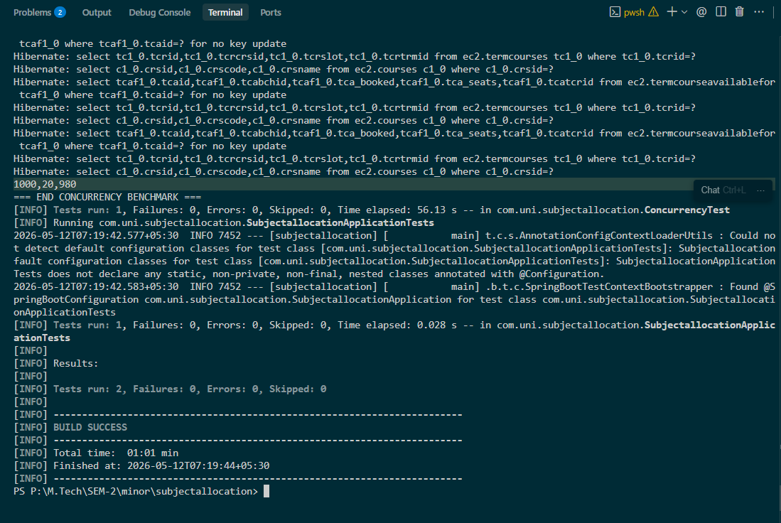
Technical Validation: Terminal Logs

Slide 19
Empirical Results & Testing
• 1,000 Concurrent Threads Tested
• 20 Successful Allocations (Total Seats)
• 980 Rejections (Correctly Handled)
• 0 Overbooked | 0 Duplicates

Slide 20
Other Key Engineering Decisions
• ddl-auto=validate: Prevents schema corruption.
• HikariCP Caps: Managed connection pressure.
• UUID/Long PKs: Scalable indexing for locks.

Slide 21
Conclusion
"Elective registration is a test of database integrity, not just application logic. Through pessimistic locking and sorted acquisition, we achieved 100% safety with zero overbookings."

Slide 22
Thank You
Questions? Discussions? Feedback?

