Slide 1

Implementation of FCFS Algorithm for Subject Allocation
A High-Concurrency Concurrency-Safe Registration System using Pessimistic Locking
PRESENTED BY Priyansee Mukeshkumar Soni ID: 202511011
SUPERVISED BY Prof. P M Jat M.Tech ICT, DAU

Slide 2
M.TECH MINOR PROJECT PRESENTATION
Presentation Outline
• Problem Statement: The Race Condition
• Barging & Fairness Violation
• Motivation: Why this Matters
• Design Objectives
• Technology Stack
• System Architecture Overview
• Layered Architecture Interaction
• Database Design & Schema
• FCFS High-Level Flow
• Formal Algorithm
• Sequence Diagram
• Phase 0, 1, 2 Implementation
• Concurrency: Holder vs Waiters
• Deadlock Prevention
• Results & Conclusion
2 / 22

Slide 3
M.TECH MINOR PROJECT PRESENTATION
The Problem: Transactional Race Conditions
Concurrent read-modify-write operations on un-synchronized resources lead to "Lost Updates".
Lost Update Phenomenon
Occurs when concurrent transactions read identical state, leading to overwriting of allocation counts.
3 / 22

Slide 4
M.TECH MINOR PROJECT PRESENTATION
Barging & Fairness Violation
The Barging Problem
Later requests can acquire locks while earlier requests are in a "back-off" or retry state.
4 / 22

Slide 5
M.TECH MINOR PROJECT PRESENTATION
Design Objectives
FCFS Fairness
Requests that arrive earlier must be served before later ones — no thread barging allowed.
Deadlock Freedom
Concurrent transactions must never stall each other in circular lock waits.
Atomicity
A student is enrolled in all courses within a slot, or none — no partial allocations possible.
5 / 22

Slide 6
M.TECH MINOR PROJECT PRESENTATION
Technology Stack
Java 21 (LTS)
Spring Boot 3.x
PostgreSQL 16
Hibernate 6 / JPA
HikariCP
Thymeleaf / HTML5
Maven
Embedded Tomcat
6 / 22

Slide 7
M.TECH MINOR PROJECT PRESENTATION
System Architecture – Overview
Browser
↓
RegistrationController
↓
AllocationService
↓
Spring Data JPA
↓
PostgreSQL
7 / 22

Slide 8
M.TECH MINOR PROJECT PRESENTATION
Full Stack – Layered Interaction
1. Client Layer
POST form submission | Code: form action='/register'
2. Web Layer
Request Mapping | Code: RegistrationController
3. Service Layer
Business Logic & Tx | Code: AllocationService
4. Persistence Layer
SQL Translation & Locks | Code: @Lock(PESSIMISTIC_WRITE)
5. Database Layer
Row-Level Serialization | Code: FOR NO KEY UPDATE
8 / 22

Slide 9
M.TECH MINOR PROJECT PRESENTATION
Database Design – Full Schema
courses
termcourses
termcourseavailablefor
crsid (PK) crsname
tcrid (PK) crsid (FK)
tcaid (PK) tca_seats tca_booked
9 / 22

Slide 10
M.TECH MINOR PROJECT PRESENTATION
FCFS Algorithm – High-Level Flow
1. VALIDATE (Phase 0) ➔ 2. LOCK (Phase 1) ➔ 3. COMMIT (Phase 2)
10 / 22

Slide 11
M.TECH MINOR PROJECT PRESENTATION
Formal Algorithm
Step 1: Start Transaction, Fetch IDs, Validate Eligibility Step 2: Sort IDs, Acquire Pessimistic Locks (FOR NO KEY UPDATE) Step 3: Verify Capacity, Atomic Update, Commit
11 / 22

Slide 12
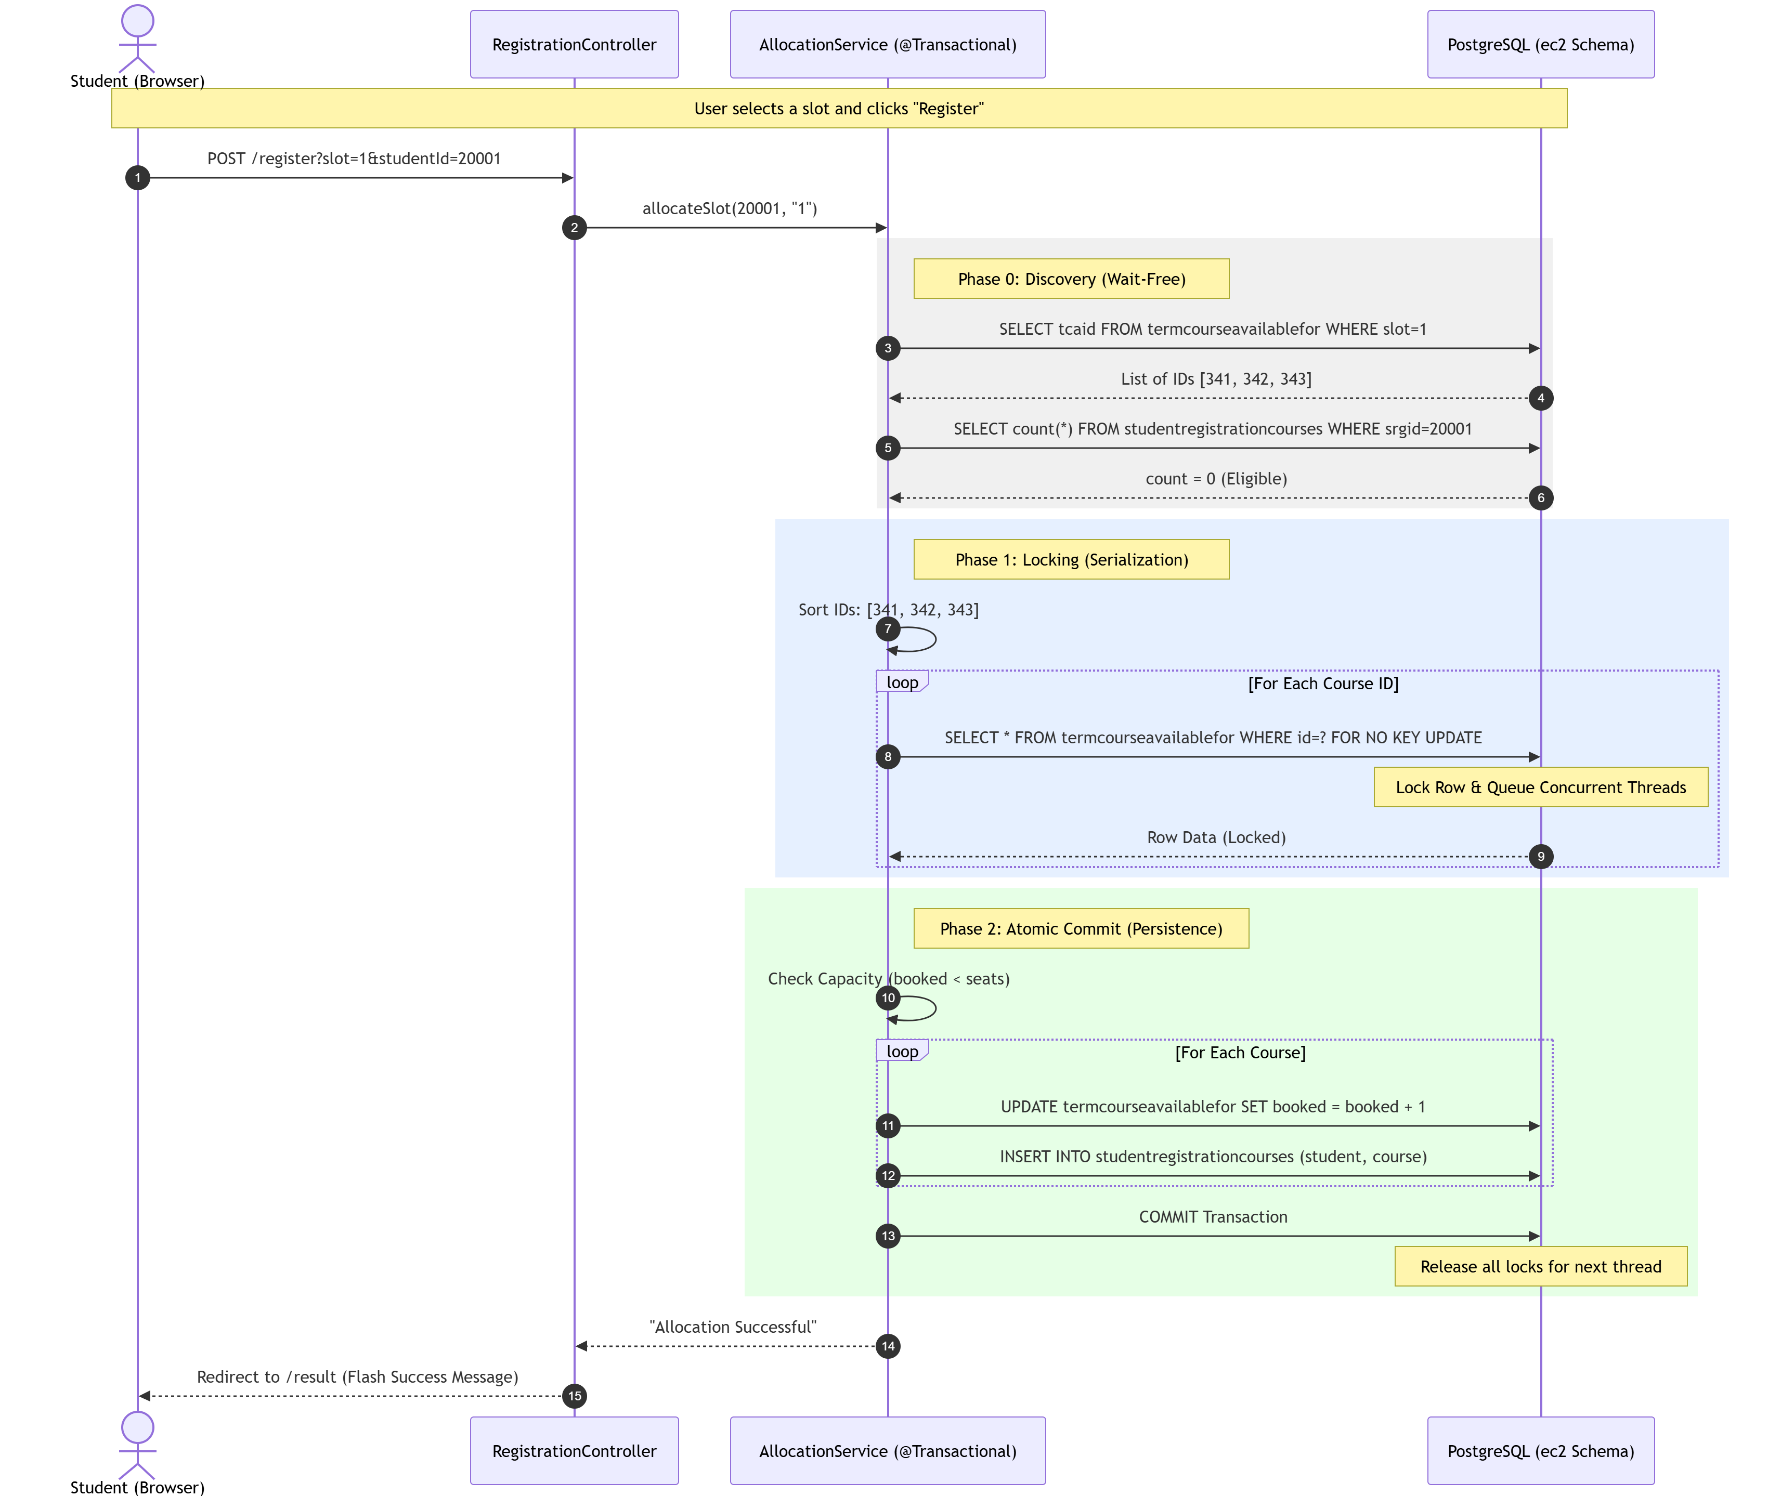
M.TECH MINOR PROJECT PRESENTATION
System Sequence Diagram
12 / 22

Slide 13
M.TECH MINOR PROJECT PRESENTATION
Phase 0: Discovery
List<Long> tcaIds = repo.findTcaIdsBySlot(slot); countBySrcsrgid(registration.getSrgid()) > 0;
13 / 22

Slide 14
M.TECH MINOR PROJECT PRESENTATION
Phase 1: Locking
Collections.sort(tcaIds); repo.findTcafByIdWithLock(id);
14 / 22

Slide 15
M.TECH MINOR PROJECT PRESENTATION
Phase 2: Commitment
if (booked >= seats) throw RuntimeException(); repo.save(lockedTca);
15 / 22

Slide 16
M.TECH MINOR PROJECT PRESENTATION
Concurrency: Holder vs Waiters
Transaction A
LOCK HOLDER - Executing logic
Transaction B
WAITING - Blocked at SELECT FOR UPDATE
Transaction C
WAITING - Blocked at SELECT FOR UPDATE
16 / 22

Slide 17
M.TECH MINOR PROJECT PRESENTATION
Deadlock Prevention
Global Ordering
Sorting resource IDs eliminates Circular Wait. Ensures deterministic acquisition order.
17 / 22

Slide 18
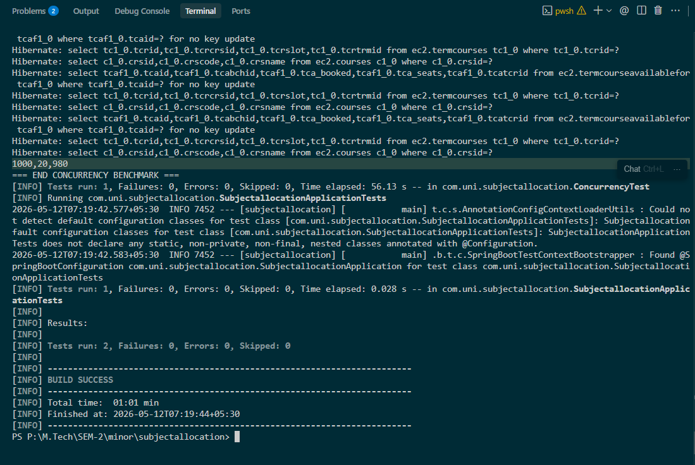
M.TECH MINOR PROJECT PRESENTATION
Technical Validation: Terminal Logs
18 / 22

Slide 19
M.TECH MINOR PROJECT PRESENTATION
Empirical Results
20
980
0
0
ALLOCATED
REJECTED
OVERBOOKED
DUPLICATES
19 / 22

Slide 20
M.TECH MINOR PROJECT PRESENTATION
Other Key Decisions
ddl-auto=validate
Prevents schema corruption.
HikariCP max 20
Managed connection pressure.
20 / 22

Slide 21
M.TECH MINOR PROJECT PRESENTATION
Conclusion
"Elective registration is a test of database integrity, not just application logic. Achieved 100% safety with zero overbookings."
21 / 22

Slide 22
M.TECH MINOR PROJECT PRESENTATION
Thank You Questions?
22 / 22

