Slide 1


Clothes Website
- Prepared By:
Name : Chhapiya Priyansh
Roll No : 194
Enrollment No : 23002170110024
Branch : CE

Slide 2
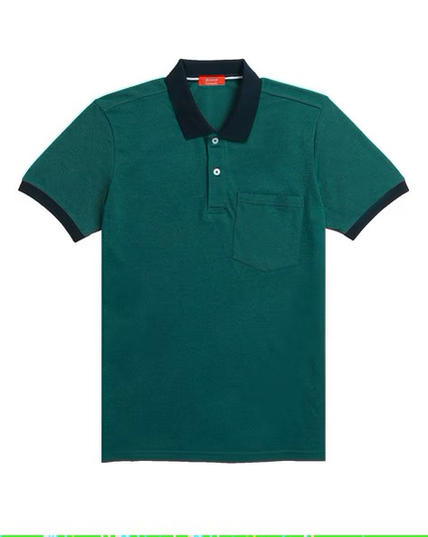
Introduction
This is a Clothe website that is made by using HTML , CSS and JAVASCRIPT.
This website is designed to provide some information of cloths to Users. and buy it online.
The website's user-friendly interface makes it easy for users to navigate and find the information they need.

Slide 3
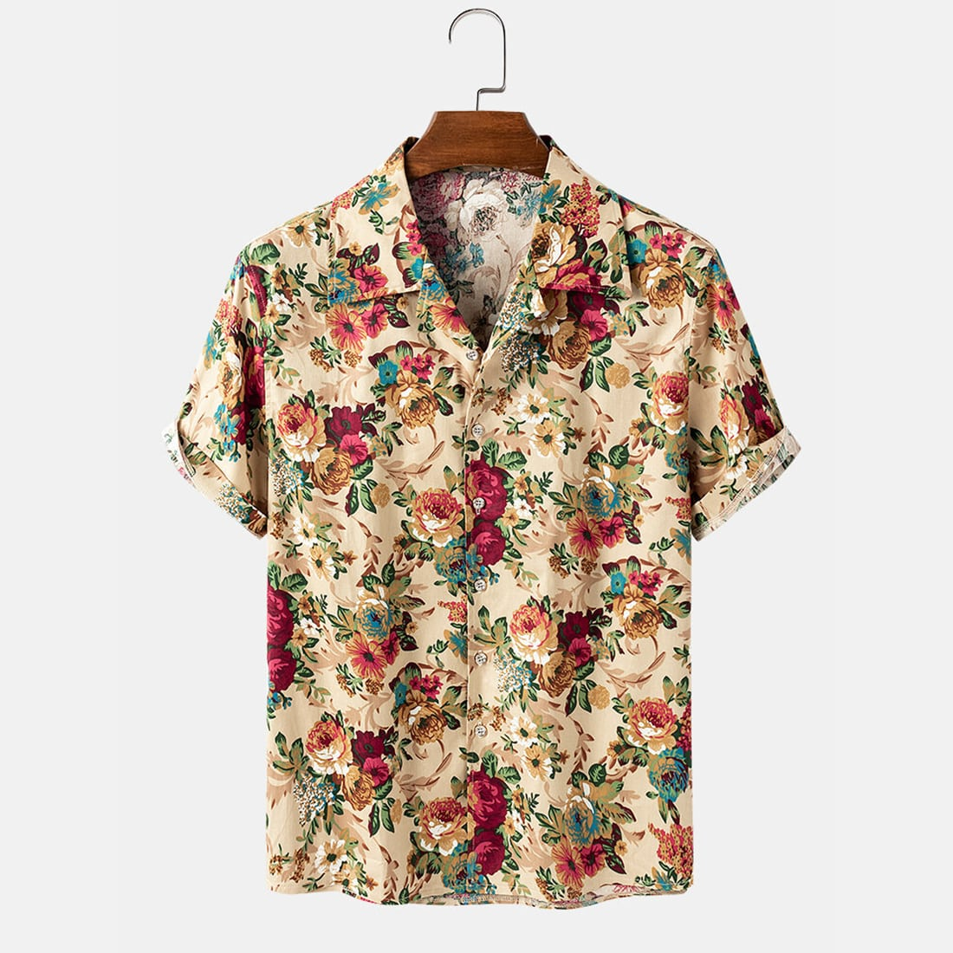
Functionality :-
Displays various clothing items in a grid format.
High-quality images of products should be displayed prominently to give users a clear view of what they are purchasing.
Smooth scrolling and hover effects enhance user interaction.

Slide 4

Merits :-
Easy to Develop & Deploy – Simple structure using HTML, CSS, and JavaScript.
Low Maintenance – No server-side database management is required.
24/7 Availability for shopping.
Fast Loading Speed.

Slide 5
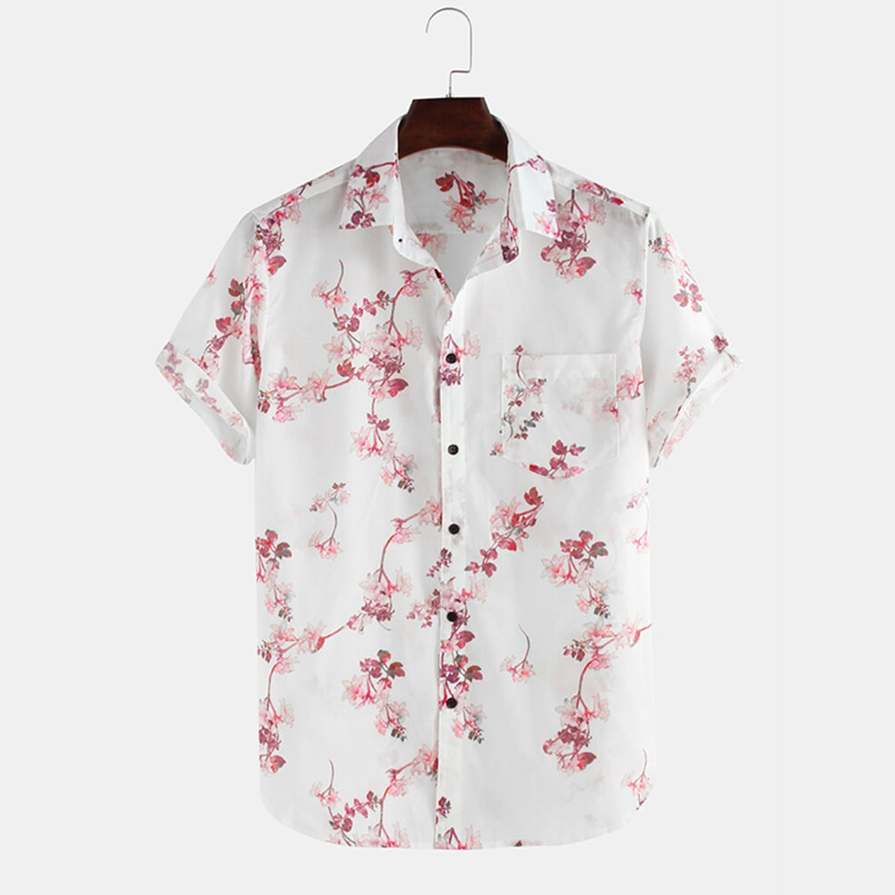
Demerits :-
Limited Functionality – Cannot handle user authentication, payments, or data storage.
Security Risks – Lacks protection features like HTTPS encryption or user authentication.
Shipping Costs
Shipping Delays problems

Slide 6

Future Scope :-
Allow users to track orders, save favorites, and manage their profile.
Artificial Intelligence (AI) In Customer Service
Allow users to track orders, save favorites, and manage their profile.

Slide 7

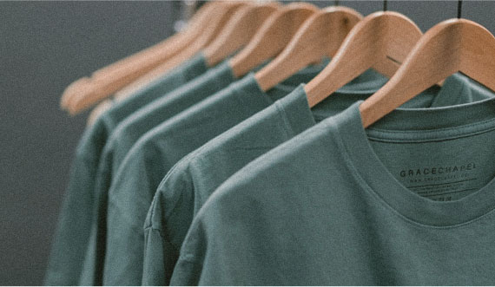
Thank you

