Slide 1
Presentation cover slide example: Vertical white logo on blue background
Learning technical aspects of Docebo from bits of the course
Docebo Learn Crash Course
Priyansh Rajiv Dhotar
Education Domain | SSIT
27-01-2026

Slide 2
Docebo Learn – Model
Organizational Structure is managed by branches. Users sit inside branches.
Groups layer on top of branches for functional training
Courses contain training materials.
Enrollments + Visibility Rules decide who sees what
Reports read data from all the above

Slide 3
Creating Users in Docebo Learn – Overview
Technical view
There are 3 users enter Docebo:
Individual User Creation - Used for: new hires, role changes, corrections
Bulk Import (CSV Upload) - onboarding waves, mergers, migrations
Self-Registration - Users create their own accounts. Three modes:
Free (no approval)
Moderated (admin approval required)
Admin-Only (no self-signup)

Slide 4
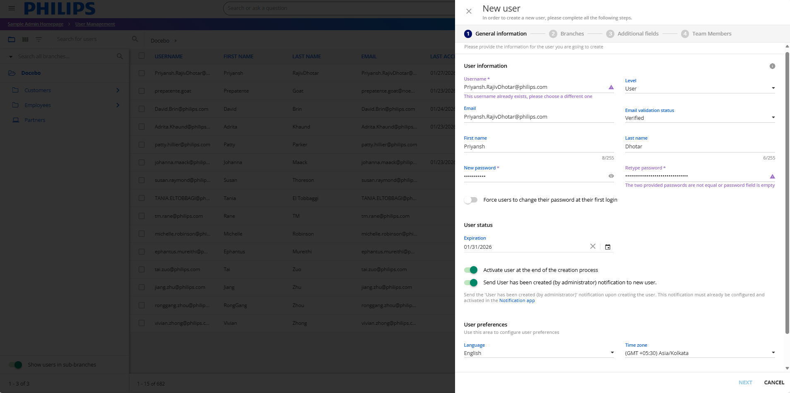
Admin Menu > Admin Menu: E-learning: Users > New Users/branch > New User

Slide 5
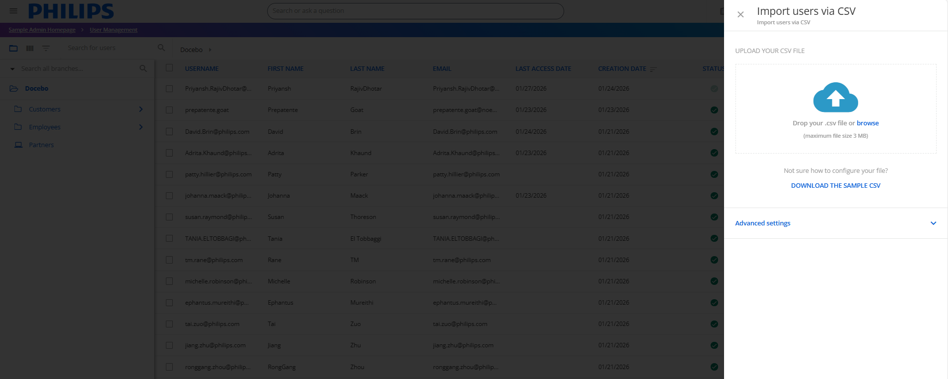
Admin Menu > Admin Menu: E-learning: Users > Import and manage > Manage users via CSV

Slide 6
User Levels and Permissions
Level | Purpose
user | Learns only
poweruser | Manages specific users, content, groups
superadmin | Full, unlimited control
Power Users are configurable
Permission sets can be reused via profiles
Avoid giving superadmin unless absolutely required

Slide 7
User Profile
Default fields + Additional fields = A complete user profile
Job title
Location
Language
Manager
Branch-linked custom fields
Controls visibility
Enables automation
Improves reporting accuracy

Slide 8
Branches vs Groups
Aspect | Branches | Groups
Primary Purpose | Represent the organizational structure | Represent learning needs and segmentation
Typical Use Case | Company hierarchy (Dept → Team → Sub-team) | Cross-functional, role-based, or temporary learning cohorts
Structure Type | Hierarchical (parent–child) | Flat (no hierarchy)
Segmentation Logic | Single factor (org position) | Multiple factors (role, location, tenure, skills, etc.)
Flexibility Over Time | Low – changes reflect org changes | High – adapts easily to change
How Users Are Added | Manual or CSV import | Manual or automatic (rules-based)
Automatic Membership | Not supported | Supported (conditions-based)
Best For | Stable, long-term structure | Dynamic, evolving training needs
Impact on Visibility | Strong control over content visibility | Used mainly for targeting and reporting
Extended Enterprise / Domains | Required | Not supported
Manager Perspective | Mirrors reporting lines | Mirrors training requirements
Risk if Misused | Over-complex org trees | Overlapping or confusing segmentation

Slide 9
Managers and Teams
Users can have:
Direct Manager
Functional Manager (up to 10 types)
“User manages a team” enables:
My Team view
Progress tracking
Observations & evaluations
Relationships are bidirectional

Slide 10
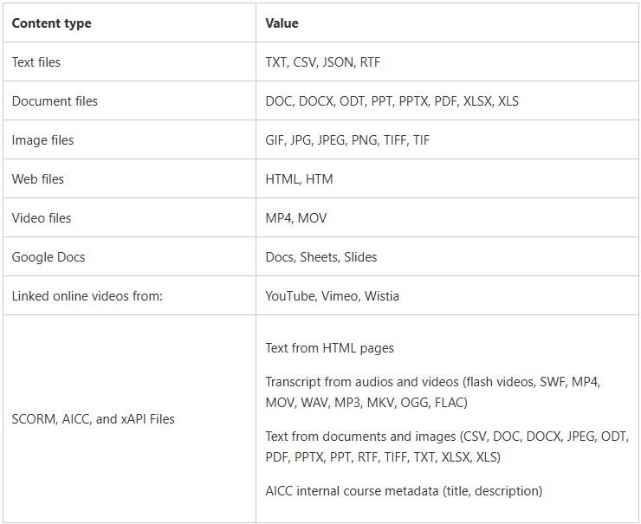
Types of Courses
E-learning
ILT (Live Training)
Reporting happens at training material level, not just course level.

