Slide 1

















MADHOGS
PRESENTS
11:11PM

Slide 2
Meet the Team
Priyansh Pachauri
Tanay Sharma
Vaibhav Raj
Pranav Pande
11:11PM

Slide 3
INTRODUCTION:
Have you ever searched for a YouTube video seeking for a review or a full explanation of a topic, only to find after watching the entire video that it was not what you were looking for in the first place?
Previously, YouTube had a dislike button that helped you assess whether the video was useful or not, but the feature has been removed. However, there is a hack that can still help us determine whether the video is useful or not, and that is the COMMENTS.

Slide 4
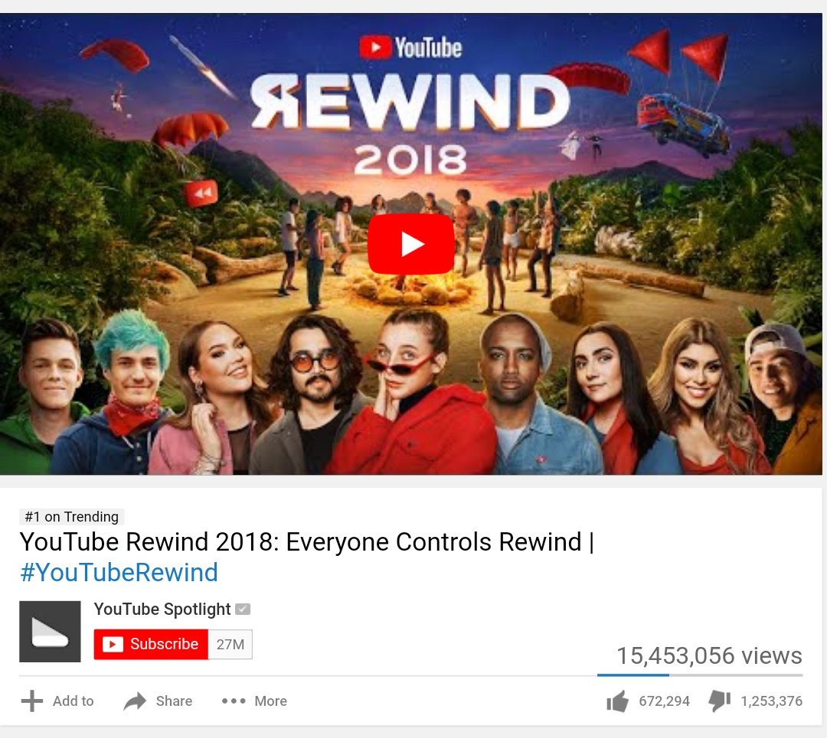
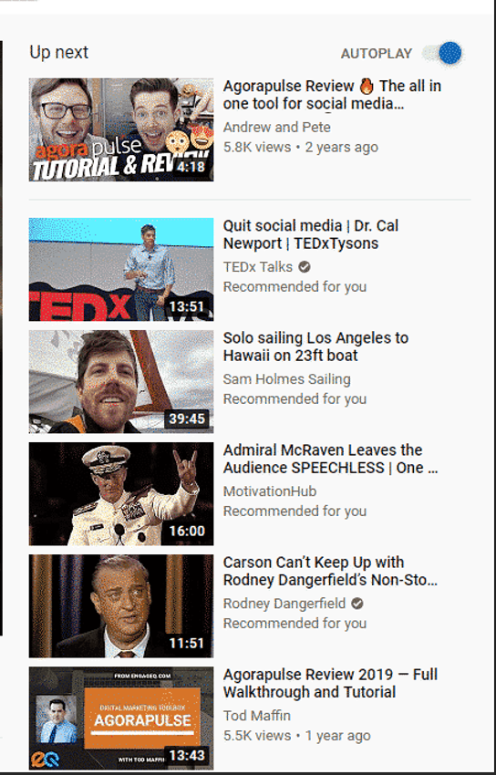


Slide 5


Slide 6
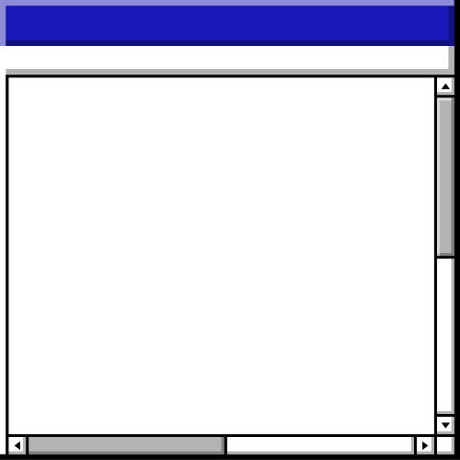
Problem Statement :
To develop a Chrome extension that provides users with insights into YouTube videos by analyzing comments. The extension will classify comments into positive, negative, and neutral sentiments, generate summarized remarks, and display essential keywords to help users decide whether a video is worth watching.
Back to Agenda Page

Slide 7


PROPOSED
SOLUTION

Slide 8
KTV: Know The Video
This chrome extension allows the user to receive data about the desired video as to how helpful it is and whether it is worth devoting the time

Slide 9

The KTV uses the Comments as a mean to get the average review of how the viewers felt after watching it and what all aspect it covers.

Slide 10
we will be creating a Chatbot that will be answering the queries about the video and thus provides insights about the video without watching it

Slide 11
Firstly, the data fetched from the comments is classified into Positive, Negative and Neutral and a proportional data is displayed.

Slide 12
Also, a summarized remark based on all the comments is generated that gives a Highlight of what the viewers had to say
And finally, the important and essential keywords used by the viewers are displayed

Slide 13





Section Header • Section Header • Section Header • Section Header • Section Header • Section Header • Section Header • Section Header
Technical Approach:
Data Collection: Fetching comments using the YouTube API.
Sentiment Analysis: Classifying comments using ML models (e.g., twitter-roberta-base-sentiment from Hugging Face).
chatbot: we will provide a chatbot which will curate to the users personal questions. this chatbot will be trained to answer questions that will be based on the summary and the comments of the video
Keyword Extraction: Displaying important keywords from the comments. this can be done by Rake-NLTK
Front-End Development: Building a user-friendly Chrome extension interface.
Back to Agenda Page
Section Header • Section Header • Section Header • Section Header • Section Header • Section Header • Section Header • Section Header

Slide 14
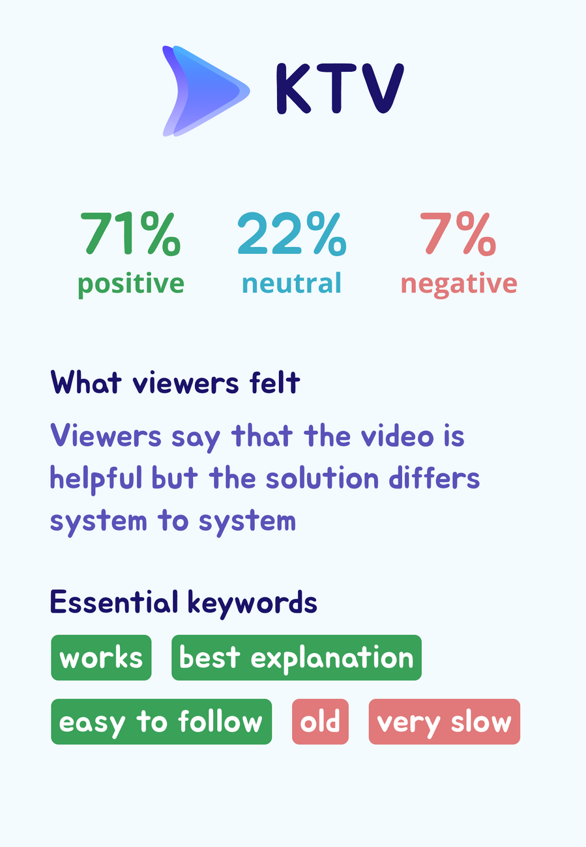


Slide 15
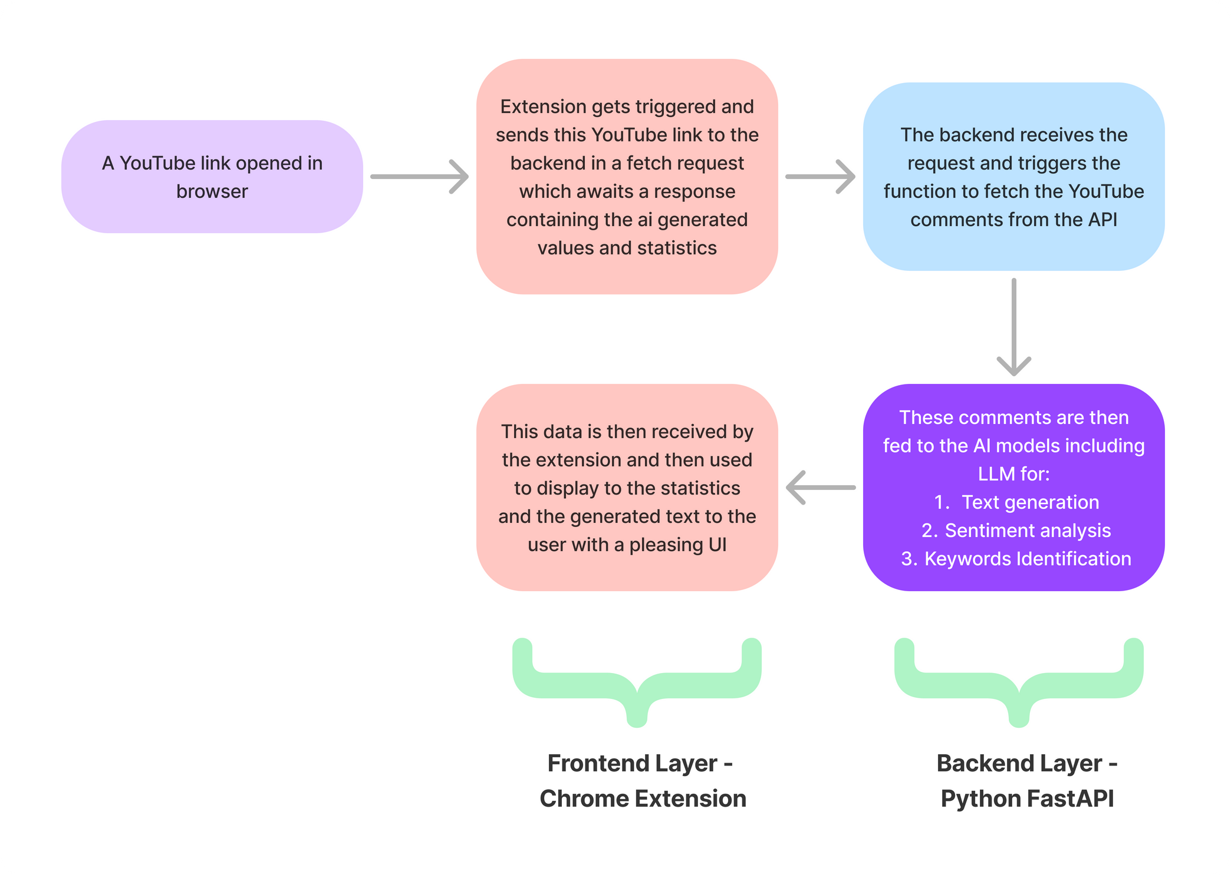
The
Architecture

Slide 16
FEASIBILITY
Technical Feasibility:
Uses Chrome's extension platform; supported and well-documented.
Backend with FastAPI for efficient API handling.
Initial setup on localhost for development; feasible to move to cloud.
Resource Feasibility:
Low development cost using common web technologies (JavaScript, Python).
Small development team required; manageable timeline.
Legal and Ethical Feasibility:
Ensure compliance with data privacy laws (e.g., GDPR).
Adhere to YouTube's API and data usage policies.

Slide 17
SCALIBILITY
Sentiment Analysis Scalability:
Enhance sentiment model accuracy by training on larger datasets.
Integrate scalable AI services (e.g., Google Cloud NLP, IBM Watson).
Feature and UX Scalability:
Room for adding new features (e.g., video recommendations, social sharing).
Optimize UI/UX for handling more complex data presentation.
Implement user analytics for feedback and optimization.

Slide 18
Impact
Enhanced User Experience:
Provides real-time sentiment analysis of YouTube videos, helping users quickly gauge the content's tone.
Empowers users to make informed decisions about content consumption.
Educational and Informational Value:
Helps educators and learners understand video sentiment for research or study.
Assists content creators in analyzing viewer feedback and improving content quality.
Market Differentiation:
Potential to attract a wide user base, from casual viewers to professionals and educators.
Commercial Potential:
Monetization through premium features, API access for third-party integration, or ad placements.
Social Impact:
Promotes mindful content consumption by highlighting video timestamps.

Slide 19










Section Header • Section Header • Section Header • Section Header • Section Header • Section Header • Section Header • Section Header
Target Audience
The target audience for the "KTV - Know The Video" Chrome extension includes a wide range of YouTube users. General viewers can quickly gauge the sentiment of videos to decide if they're worth watching. Content creators can analyze viewer feedback to improve their content strategies.
Educators and students can use the extension to assess the credibility of educational videos.
Marketers can target their ads more effectively based on video sentiment.
Back to Agenda Page
Section Header • Section Header • Section Header • Section Header • Section Header • Section Header • Section Header • Section Header

Slide 20







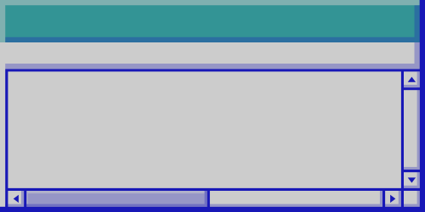










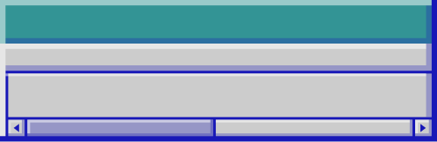

Thank you!

