Slide 1
PM Case Study Design careers page form for applicant

Slide 2
AGENDA
Problem Statement
Sign Up Flow
Sign Up Layout
Success Layout
Verification Process
Assumption, Edge Cases & Call outs
Questionnaire

Slide 3
Problem Statement
WTR is a product-based company building HR management systems for Media & Telecommunications industries. The Product team at WTR corporation is planning to revamp the careers page on the WTR website.
The plan is to allow applicants to sign up on the WTR's website with their details and then allow them to apply for the jobs they are interested in.
Task:
Assuming user has hit the ‘Signup’ button, design the following -
1. Signup form with required inputs for registering
2. Success message on submitting the signup form ( redirecting to email for verification)
3. Verification email for activating the profile
You will be evaluated on following –
1. Wireframes, messaging & product specifications for:
a. The 'signup form'
b. The post submission 'success message' for the form
2. 'Email format and content' used for verifying email address
3. Input fields covered, checks and validations for the input fields defined
4. Structure and format of the document submitted
Important Notes:
1. Explain the wireframes showing the user journey
2. Describe the functionality and provide details for the Engineering team
3. Cover the assumptions, callouts and edge cases in the case study

Slide 4



Sign up flow -
< WTR Website Layout
User click on career icon it will redirect to sign up page

Slide 5
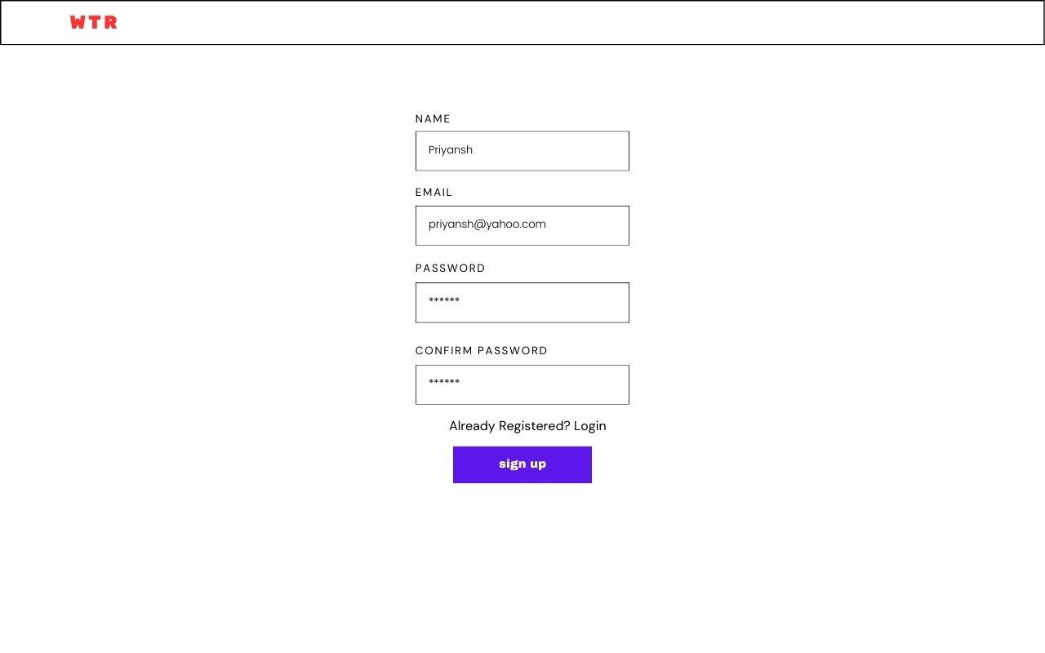
WTR Sign Up Layout –
< Wireframe
Functionality
Email : Required field, should be a valid email format (example@example.com), unique check with backend.(Only Email ID based Login, not phone number based or social ID based Login applicable)
Full name : Required field, should accept alphabets only.
Password : Required field, minimum length of 8 characters, should include at least one uppercase letter, one lowercase letter, one number, and one special character.
Confirm Password : Required field, should match the password field.
Sign Up Button : Clicking on Sign up button submits the form for validation.

Slide 6
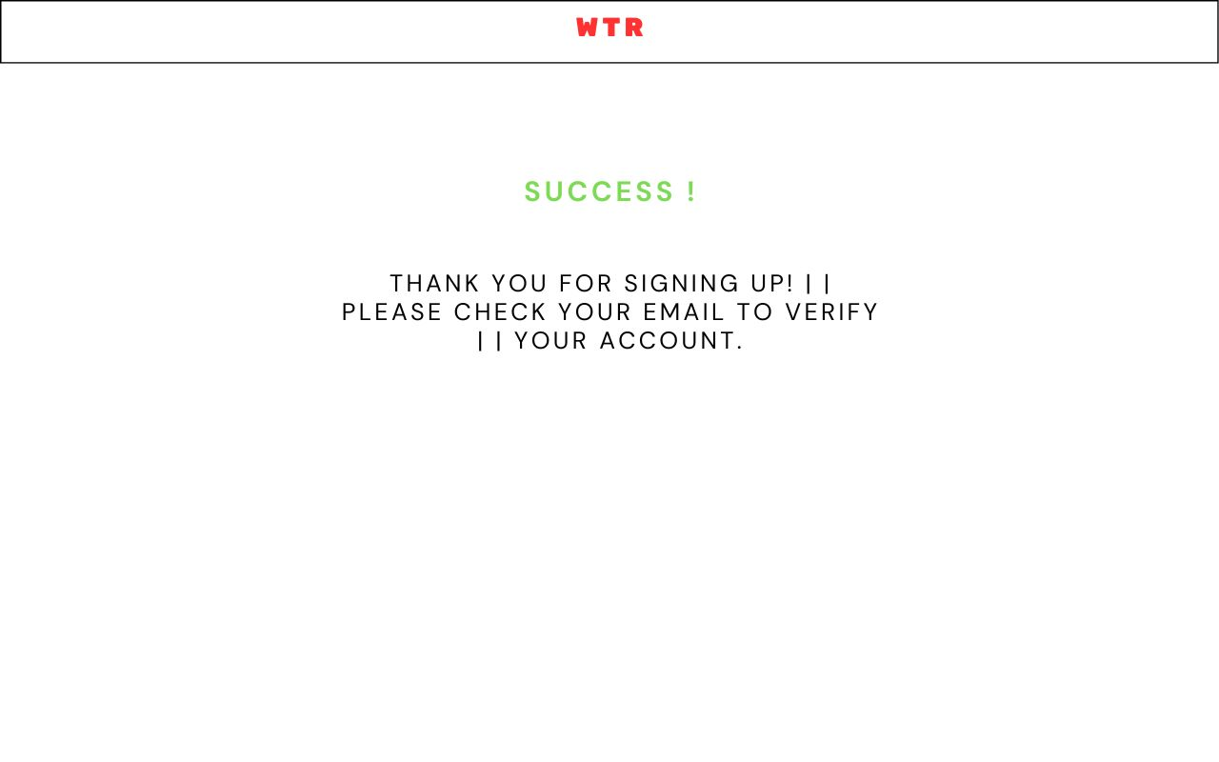
Success Message
< Wireframe
Functionality
Upon successful submission of the signup form, the user sees a success message.
Notifies the user about the next step in the signup process.

Slide 7
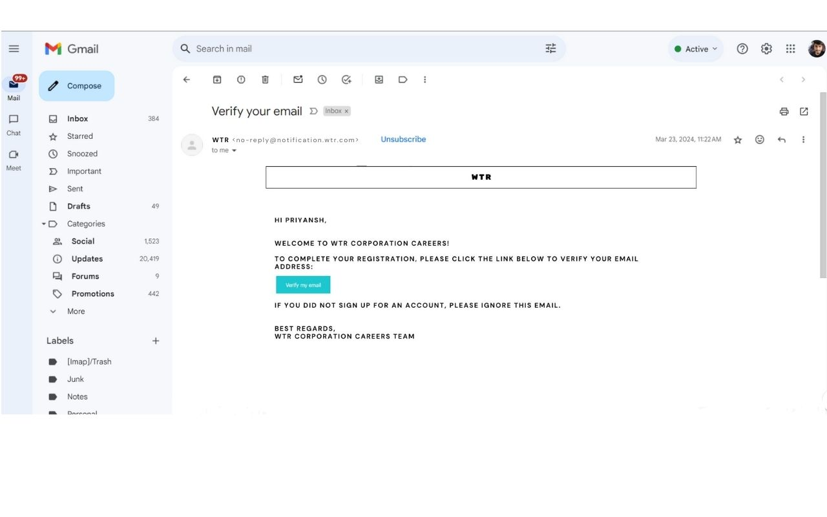
Verification Process
< Wireframe
Functionality
Contains a unique verification link for each user.
Upon clicking the Verify my Email button, the user's email address is verified, and their account is activated.

Slide 8
Assumptions, Edge Cases & Call Outs :
Assumption: The user provides valid inputs in the signup form.
Edge Case:
User attempts to signup with an already registered email address, display an error message prompting the user to login or use a different email.
User enters mismatching passwords in the password and confirm password fields, display an error message.
Callout:
The success message emphasizes checking the email for verification to guide the user on the next steps.
The verification email should be sent instantly upon successful signup to ensure a seamless user experience.

Slide 9
Thank You
Priyansh Bairagi
priyanshbairagi14@gmail.com
+91 -9907755803

