Slide 1
Neural Architectures for Text-Based Question Answering
Shang Gao

Slide 2
Overview
What is question answering?
What is question answering and why is it important?
Deep learning fundamentals
Fundamental concepts required to understand more complex neural QA architectures
Question answering framework
High level modular framework for understanding how neural QA architectures work
Current state-of-the-art
What is the current best in neural architectures for text-based question answering?
Looking Ahead
What are the current research trends and challenges in question answering?

Slide 3
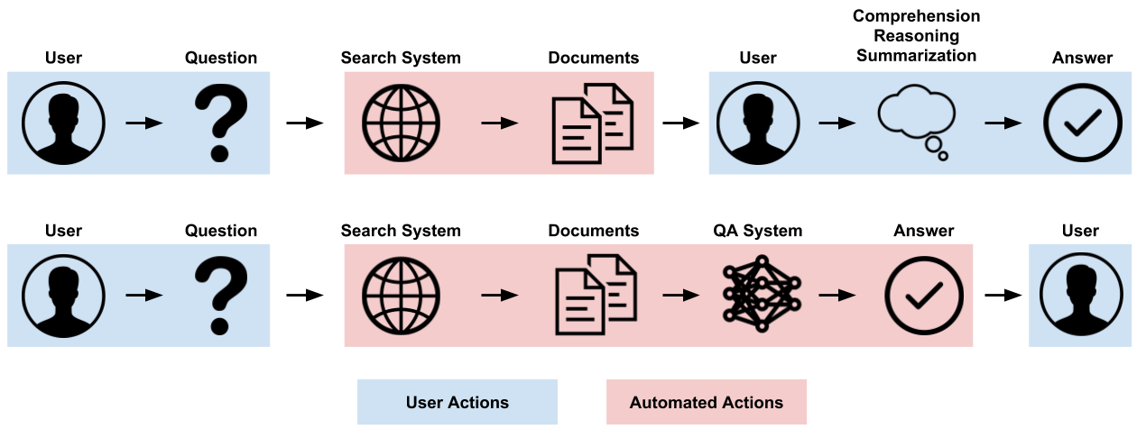
What is Question Answering?
In traditional information retrieval, a human asks a question, the IR system retrieves a set of relevant documents (millions?), and the human has to read those documents to find the answer
In question answering, an automated QA system searches the documents returned by the IR system and directly returns the answer

Slide 4
What is Question Answering?
QA systems can save a lot of time and money, especially in tasks requiring costly expert knowledge (e.g., law and medicine)
Note that a QA system works in conjunction with an IR system, it does not replace the IR system

Slide 5
Types of Question Answering
Knowledge Source
Images
Knowledge base or knowledge graph
Corpus of text documents
Question/Answer Type
Fill in the blank
Yes/no or multiple choice
Find the relevant text segment in the document (or fact from knowledge base)
Generate your own answer
This talk will focus on Extractive Text Based Question Answering

Slide 6
Applications of Question Answering
Law
Assist in research for legal cases
Help lawyers keep up with changing laws and regulations
Medicine
Assist in biomedical research
Assist doctors in disease diagnosis
General Public Use (e.g. personal assistants)
Check hours for a business
Answer questions that utilize well established facts (e.g. when was Abraham Lincoln born?)

Slide 7
Deep Learning Fundamentals

Slide 8
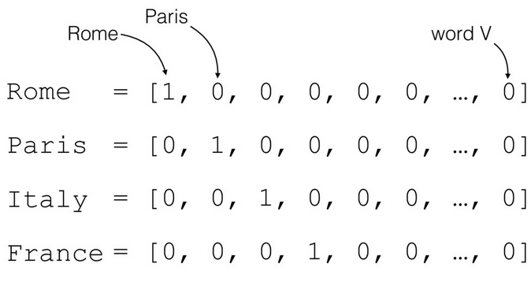
Word Embeddings
Machine learning classifiers take in numerical inputs
Text does not translate directly into numbers
One-hot encodings
Does not capture the semantic meaning of words
Two words that are similar in meaning (‘dog’ and ‘dogs’) are treated as totally independent

Slide 9
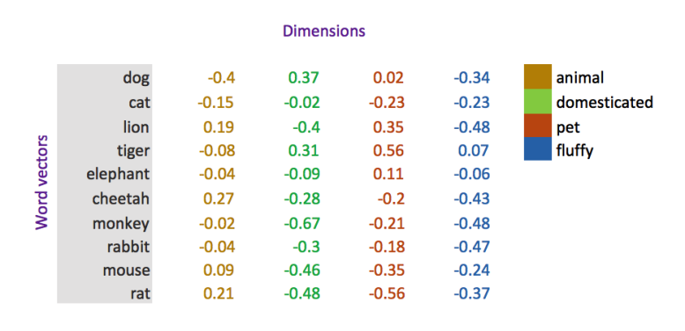
Word Embeddings
Word embeddings are vector representations of words
Words similar in meaning will have vectors that are close in distance, and vice versa
When ML model learns about a word, it also learn how to deal with words similar to that word

Slide 10
Word Embeddings
There are many ways to generate word embeddings
One popular algorithm is Word2Vec
Predict the neighbor words using each center word – words that appear in similar contexts will have similar word embedding vectors

Slide 11
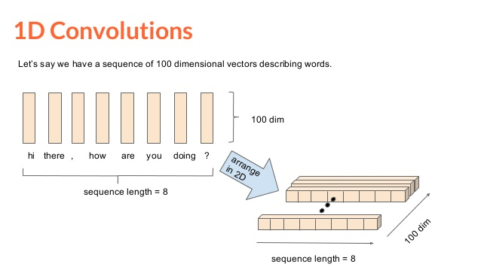
Convolutional Neural Networks
In image-based CNNs, convolutions slide horizontally and vertically across an image
In text-based CNNs, convolutions slide only horizontally across a window of X words
Pros: super fast (relatively) and easy to parallelize
Cons: cannot find meaningful relationships beyond small window (stacked layers may mitigate this)

Slide 12
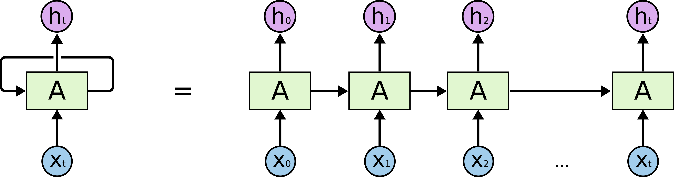
Recurrent Neural Networks
RNNs are designed to handle sequential data, like text
An RNN processes a text sequence one word at a time
For each word, it also takes into account information from all previous words before that word
Unlike CNNs, RNNs can capture patterns over long sequences of text
RNNs are extremely slow to train because the operations for each word in a sequence depend on all previous words in the sequence (quadratic computational complexity)

Slide 13
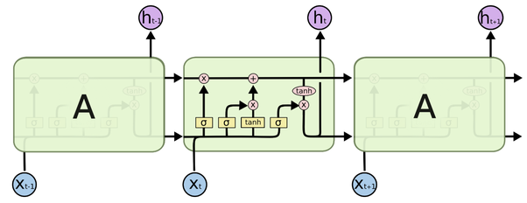
Recurrent Neural Networks
Many advanced RNN architectures have been developed that help find complex patterns over long sequences of data
Long-short term memory units (LSTMs) and gated recurrent units (GRUs) are popular for text
These use gating functions and internal memory to filter and remember important information across many timesteps
For detailed information, see paper

Slide 14
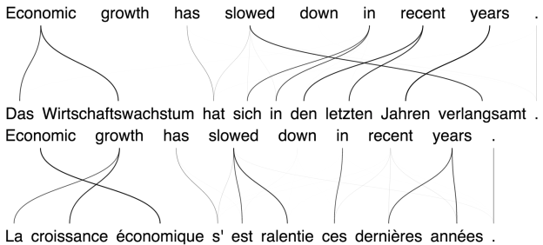
Neural Attention
First used in machine translation, neural attention finds relationships between the words in two different sequences
In question answering, neural attention allows the QA system to find the segments in the passage that are most relevant to a given question
For implementation details, see paper

Slide 15
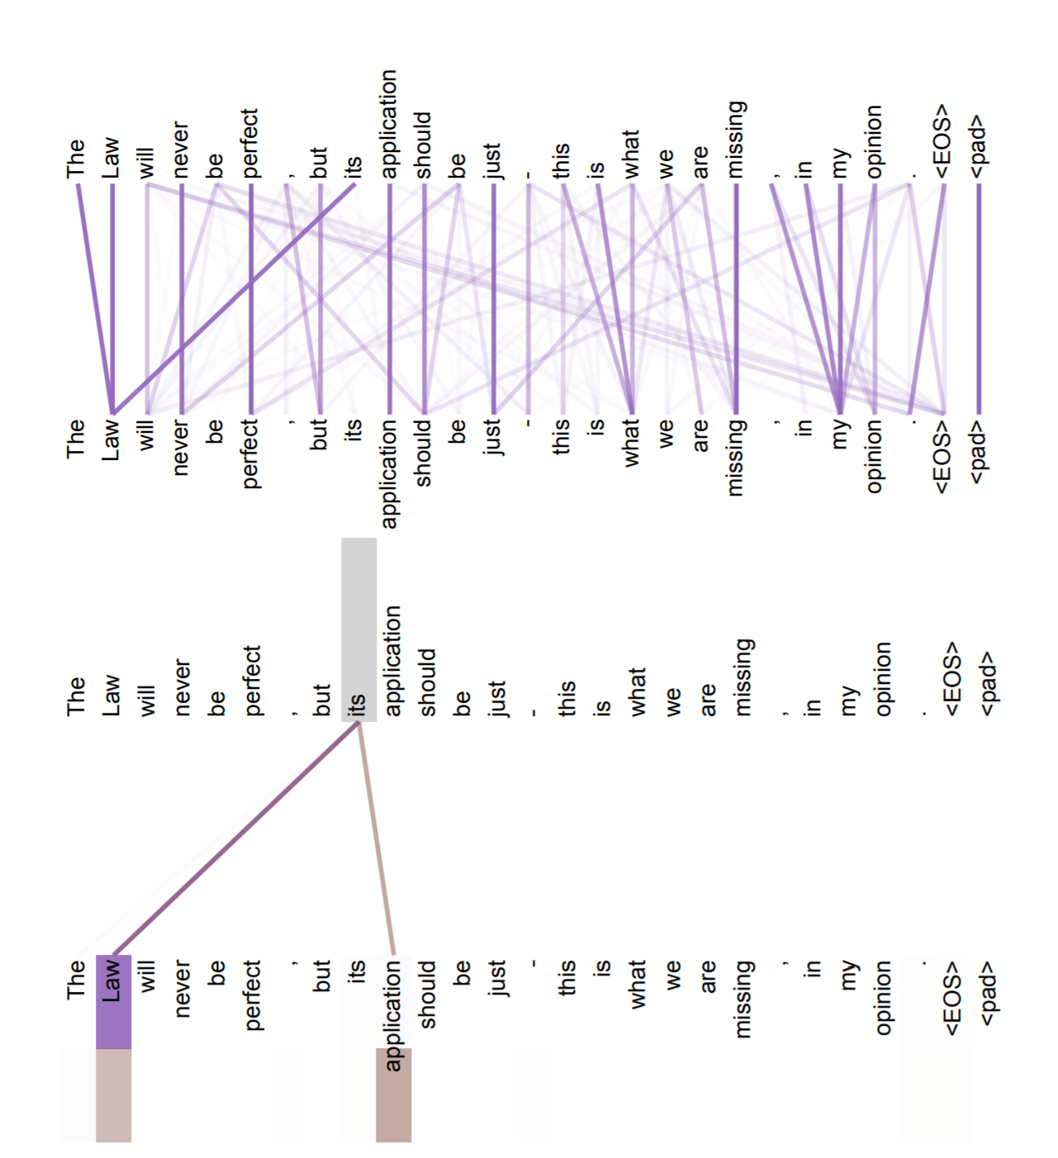
Self Attention
Self attention is a form of neural attention in which a sequence of words is compared against itself
This allows the network to learn important relationships between words in the same sequence, especially across long distances

Slide 16
Neural QA Framework

Slide 17
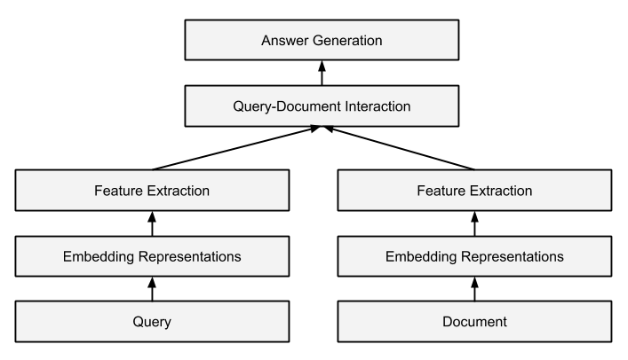
Neural QA Framework
Most architectures for extractive text-based QA are composed of the same set of modules
While the implementation details within each module differ between QA systems, the general function of each module remains the same

Slide 18
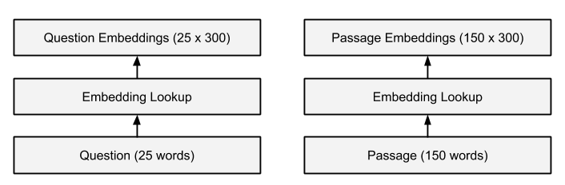
Embedding Representations
The embedding representations module converts the words in the question and passage into embedding representations
Most state-of-the-art QA systems utilize several different types of word embeddings in conjunction:
Word embeddings generate by a state-of-the-art algorithm (ELMo, FastText, GLoVe)
Character-level embeddings generated by a character-level CNN
Part-of-speech embeddings
Named-entity-recognition embeddings

Slide 19
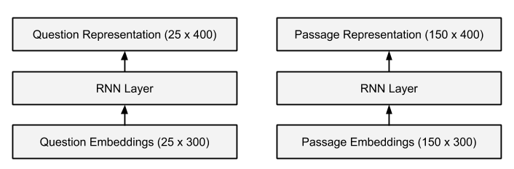
Query and Document Feature Extraction
The feature extraction module extracts useful features from the words in the question and passage
Words like “who” and “what” may indicate the thrust of a question
Named entities or dates may be good answer candidates in the passage
The feature extraction module is often composed of one or more layers of bidirectional RNNs, CNNs, and/or self-attention

Slide 20
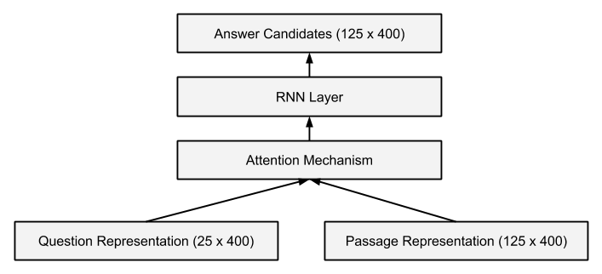
Query-Document Interaction
The query-document interaction module compares the features from the question with the features from the passage to find answer candidates in the passage
Almost always utilizes some form of neural attention
Most state-of-the-art systems use several layers of highly complex neural attention mechanisms
This is usually followed by additional layers of RNNs, CNNs, and/or self-attention for additional feature extraction

Slide 21
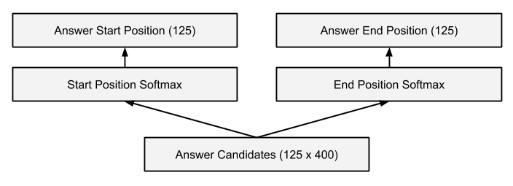
Answer Generation
The answer generation module generates the start and end positions of the answer span in the passage.
We use two parallel softmaxes across all the possible word positions in the passage
This gives us the probability of each word in the passage of being the start or end of the answer span
We now have two softmax classification problems, so we can train the network using cross entropy loss

Slide 22
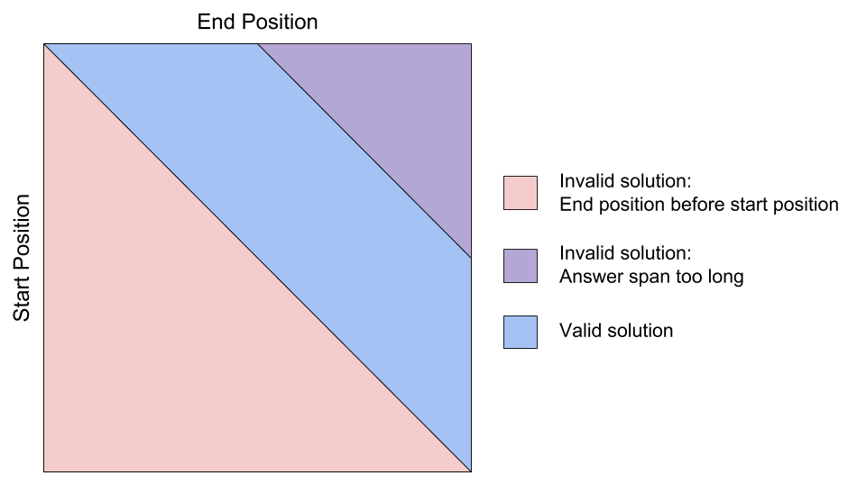
Answer Generation
Many QA systems add additional sophistication to answer generation modules
End position should depend on the start position
Penalize the model more if predicted answer span is farther away from true answer span
Additional constraints must be applied to ensure a valid answer span
The start position must come before the end position
The answer span shouldn’t exceed a maximum length

Slide 23
Current State-of-the-Art

Slide 24
Stanford Question Answering Dataset
Probably the most popular dataset for QA benchmarking
First, 536 popular English Wikipedia articles were randomly selected
23,215 paragraphs extracted from these articles
Each paragraph has up to 5 crowd-sourced questions
Total of 107785 question-answer pairs
Each question has at least 3 answers – one from the original question writer and two from other humans who were only shown the question
Crowdworkers were asked to pose a wide variety of questions
Understanding synonyms between the question and paragraph
Relying on world knowledge not directly stated in the question or paragraph
Understanding variations in sentence structure between the question and paragraph
Reasoning across multiple sentences in a paragraph

Slide 25
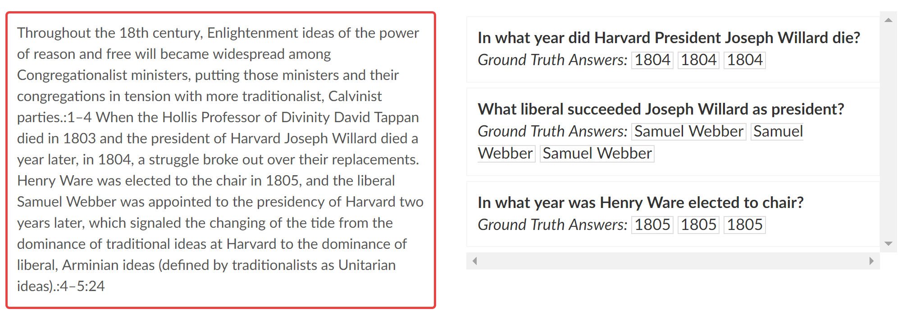
Stanford Question Answering Dataset

Slide 26
Evaluation Metrics
80/10/10 Train/Validation/Test Split
Exact Match (EM) Score
1 if predicted answer span exactly matches any one of the true answers, 0 otherwise
F1 score
Measures overlap between predicted answer span and true answer span
Highest F1 score from the available true answers is used
Will always be higher than EM score
Human performance
Use one of the human-generated answers (not the original question writer) to evaluate against the other human-generated answers

Slide 27
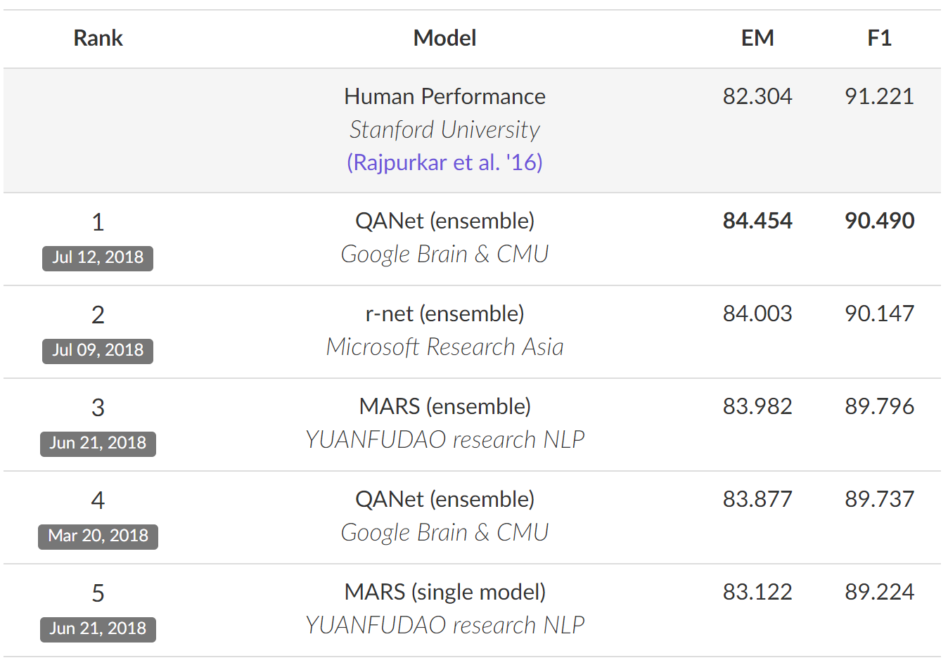
SQuAD Leaderboard
Current best performer on SQuAD beats human EM score, very close to human F1 score
For implementation details of top three models, see paper

Slide 28
Research Trends and Challenges

Slide 29
Self-Attention
One big problem with many neural QA systems is that they are very slow to train
Most QA systems take many days or weeks to train.
This is usually caused by the heavy reliance on RNNs.
QA-Net, the current top performer on SQuAD, utilizes self-attention layers instead of RNN layers.
Like RNNs, self-attention can find long-distance relationships across a long sequence of words.
Like CNNs, self-attention is relatively fast and easy to parallelize.
QA-Net trains around 10x faster than other state-of-the-art RNN-based QA systems.
Many applications in NLP are moving toward self-attention-based approaches.

Slide 30
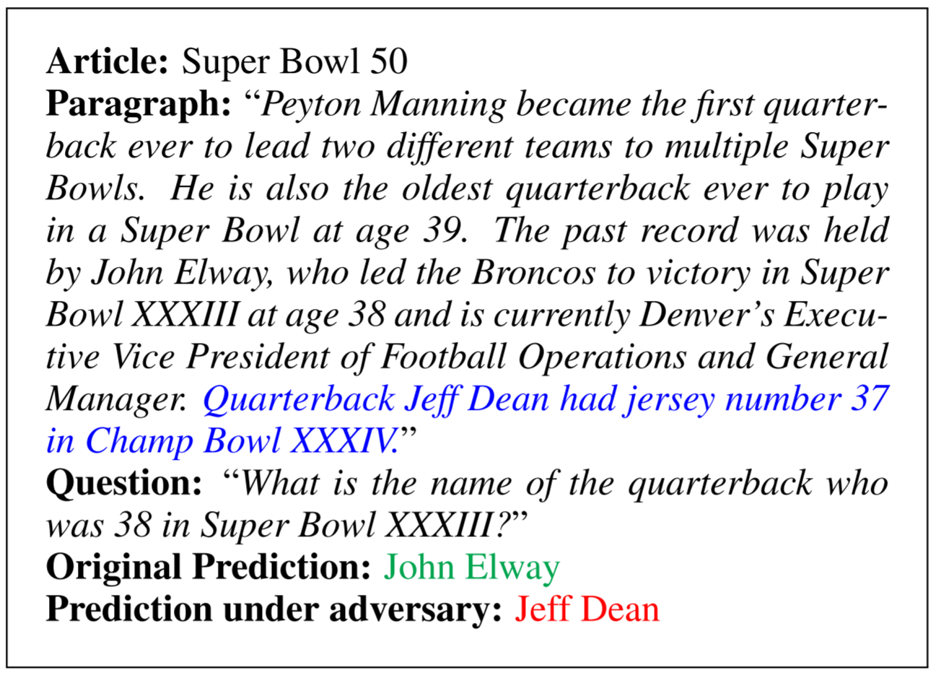
Adversarial Datasets
New research has shown that most QA systems can be easily fooled.
The Adversarial SQuAD dataset adds an additional sentence to the passage that mirrors the true answer, but with verbs, nouns, and sentence structure changed.
Across 16 state-of-the-art QA systems, average F1 score dropped from 0.75 to 0.36.
Adversarial SQuAD shows that QA systems are still matching words, not truly understanding the passage.

Slide 31
More Realistic Datasets
MS MARCO – based off real world search engine queries and answers
misspellings in the question
noisy data with conflicting information
questions that can’t be answered by extracting a text segment (e.g. summarization, entailment)
Best performing system get F1 score of 0.70
BioASQ Biomedical QA Challenge
Questions require highly technical domain-specific background knowledge
Best performing system gets 70% accuracy for yes/no, 40% for factoid-type questions
COLIEE Legal QA Challenge
Questions require advanced logical reasoning
Best performing system gets 65% accuracy for yes/no, 70% for entailment-type questions

Slide 32
Additional Challenges
Using combinations of information sources
QA systems that can utilize both a corpus of text documents and a knowledge base/graph
Generating custom answers
It’s hard to develop QA systems that can synthesize an answer in natural language, rather than simply find the correct text segment
Reproducibility
Reproducibility remains a challenge across all of deep learning

Slide 33
Questions?

