Slide 1
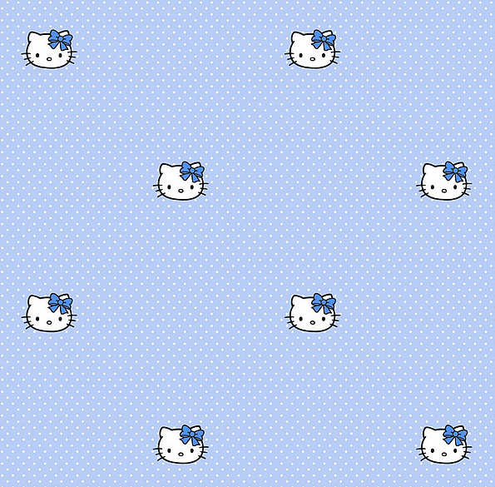
Graph databases: a brief introduction
Francisco Moreno
Excerts from
“Learning Neo4j”
Rik Van Bruggen

Slide 2
The property graph model
A graph structure means that we will be using vertices and edges (or nodes and relationships, as we prefer to call these elements) to store data in a persistent manner.
As a consequence, the graph structure enables us to:
represent data (for some domains) in a much more natural way, without some of the distortions of the relational data model
Apply various types of graph algorithms on these structures

Slide 3
One of the key capabilities is to traverse the graph—to walk on its nodes and relationships and hop from one node to the next by following the explicit pointers that connect the nodes.
This capability—sometimes also referred to as index free adjacency, which essentially means that you can find adjacent/neighboring nodes without having to do an index lookup

Slide 4
The property graph model is suited for:
Directed graphs: The links between nodes (also known as the relationships) have a direction.
• Multirelational graphs: There can be multiple relationships between two nodes that are the same.
• Properties: Storing key-value pairs as the properties of the nodes and relationships.

Slide 5
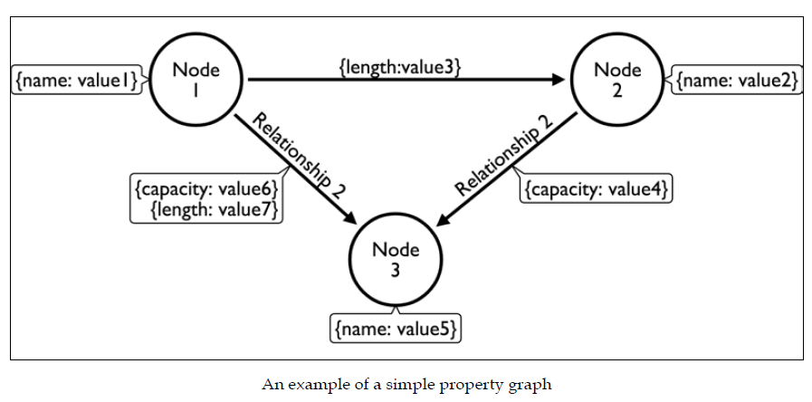

Slide 6
Some aspects of this model:
There is no fixed schema (schema-less): If one node or relationship has more or fewer properties, we do not have to alter the design for this…Although having some kind of schema as you move closer to production is probably not a bad idea
Nodes and node properties seem to be quite easy to understand: nodes will have properties just like records/rows in a table will have fields/columns.

Slide 7
Relationships are a bit different. They always have a start and an end point; therefore, they have a direction. Their power lies in:
Relationships are explicit: They are not established at query time through a join operation.
Relationships can have properties too: They can have values associated with them that can specify the length, capacity, or any other characteristic of that relationship.

Slide 8
In Neo4j, this data model has been enriched with a couple of key concepts that extend the core property graph model:
Node labels are a way of semantically categorizing the nodes in your graph. A node can have zero, one, or more labels assigned to it
Relationship types achieve something similar to what you do with node labels, but to relationships. Relationship types are mandatory properties for relationships (every relationship must have one and only one type)

Slide 9
Why (or why not) graph databases
There are a number of typical data problems (and database system queries) that are an excellent match for a graph database, and there are a number of other types of data questions that are not specifically designed to be answered by such systems.

Slide 10
Why use a graph database?
Complex queries are the types of questions that you want to ask of your data that are inherently composed of a number of complex join operations.
An example of such a complex query would be:
“Find all the restaurants in a certain London neighborhood that serve Indian food, are open on Sundays, and cater for kids.”

Slide 11
In relational terms, this would mean joining up data from the restaurant table, the food type table, the Opening hours table, the Caters for table, and the zip-code table holding the London neighborhoods and then providing an answer.

Slide 12
In a graph database, a join operation will never need to be performed: all we need to do is to find a starting node in the database (for example, London), usually with an index lookup, and then just use the index free adjacency characteristic and hop from one node (London) to the next (Restaurant) over its connecting relationships (Restaurant-[LOCATED_IN]->London). Every hop along this path is, in effect, the equivalent of a join operation.
Pattern

Slide 13
We often refer to these types of queries as pattern matching queries. We specify a pattern, we anchor that pattern to one or more starting points, and start looking for matching occurrences of that pattern.
As you can see, the graph database will be an excellent tool to spin around the anchor node and figure out whether there are matching patterns connected to it.
Non-matching patterns will be ignored, and matching patterns that are not connected to the starting node will not even be considered.

Slide 14
This, actually, is one of the key performance characteristics of a graph database: as soon as you "grab" a starting node, the database will only explore the vicinity of that starting node and will be completely oblivious to anything that is not connected to the starting node.
Local search!

Slide 15
Another type of query that is extremely well suited for graph databases are queries where you would be looking to find out how different data elements are related to each other. In other words, finding the paths between different nodes on your graph.
Consider the following example:

Slide 16
How far (in the network) are Jennifer and Angelina from each other?
Keira
Brad
Jennifer
Ange-lina
N’Dea
To solve this query in a graph database is “easy”, in a relational database may be more difficult (considering conventional relational operations)

Slide 17
Why not use a graph database
The whole concept of the category of Not Only SQL databases is all about task-orientation. Use the right tool for the job. So that also must mean that there are certain use cases that graph databases are not as perfectly suited for.
So, let us briefly touch on a couple of categories of operations that you would probably want to separate from the graph database category that Neo4j belongs to.

Slide 18
Large, set-oriented queries
If you are trying to put together large sets of things (nodes), that do not require a lot of joining or require a lot of aggregation (summing, counting, averaging, and so on) on these sets then the performance of the graph database compared to other database management systems will be not as favorable.
The problem is that the nodes are scattered, they are like
single-table rows!

Slide 19
Graph global operations
While graph databases are powerful at answering "graph local" questions, they are not suited for answering graph global operations, i.e., operations that apply over the whole graph (e.g., centrality, in-betweeness measures).

Slide 20
An example*
Designing a Social Network Graph Database
Imagine you are starting a new social networking site designed for NoSQL database developers.
Let us assume this site will allow for developers to
• Join and leave the site
• Follow the postings of other developers
• Post questions for others with expertise in a particular area
• Suggest new connections with other developers based on shared interests
• Rank members according to their number of connections, posts, and answers
* From “NoSQL for Mere Mortals”, Dan Sullivan.

Slide 21
The model will start simple with just two entities: developers and posts.
Properties of developers include
• Name
• Location
• NoSQL databases used
• Years of experience with NoSQL databases

Slide 22
Posts have several properties as well, such as
• Date created
• Topic keywords
• Post type (for example, question, tip, news)
• Title
• Body of post

Slide 23
Next, we consider relations between entities.
The “follows” relation is a relation between developers in our simple model.
For example, if Robert follows Andrea, then Robert will see all of Andrea’s posts when he logs on to the NoSQL social network.

Slide 24
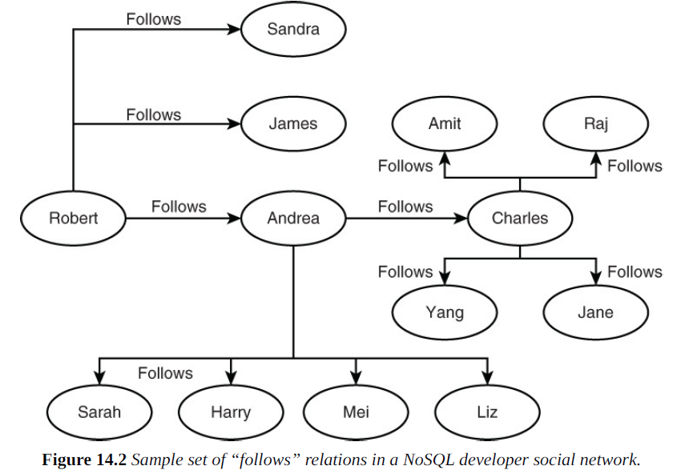

Slide 25
The relation between developers and posts is “created”; that is, developers create posts.
On the other hand, at first glance, the post-relation-post may not appear useful. After all, posts do not create other posts. However, a post may be created in response to another post. This is particularly useful for some queries.

Slide 26
Imagine that Robert posted a question.
Andrea and Charles might each reply with their own answers.
Robert then posts another question to clarify his understanding of Andrea’s response.
Andrea responds with additional details.
Meanwhile, Edith adds additional details to Charles’s post.
The resulting graph of posts is a tree with Robert’s initial post as the root and branches that follow the two parts of the conversation thread.

Slide 27
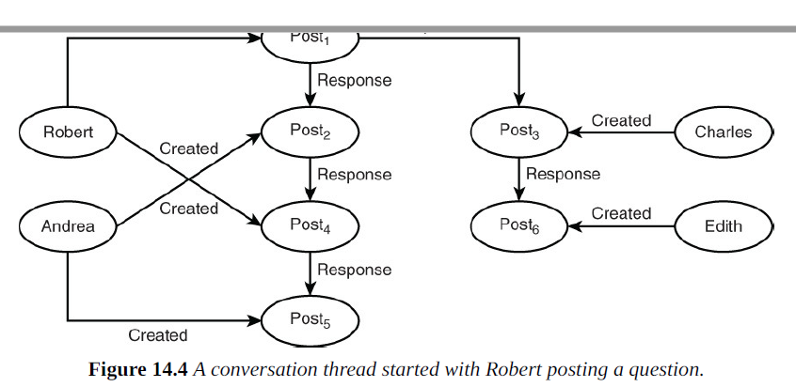
Root post
Created
Response

Slide 28
Querying a Graph
Next, we show some queries that reference vertices and edges and rewrite them in terms of the NoSQL social network example.
As next table shows, abstract queries map to useful queries about graph databases. Some queries are based on paths, such as the distance between two nodes; for example, “How many follows relations are between Developer A and Developer B?” Other queries consider the global structure of the graph, such as “If a developer left the social network, would there be disconnected groups of developers?”

Slide 29
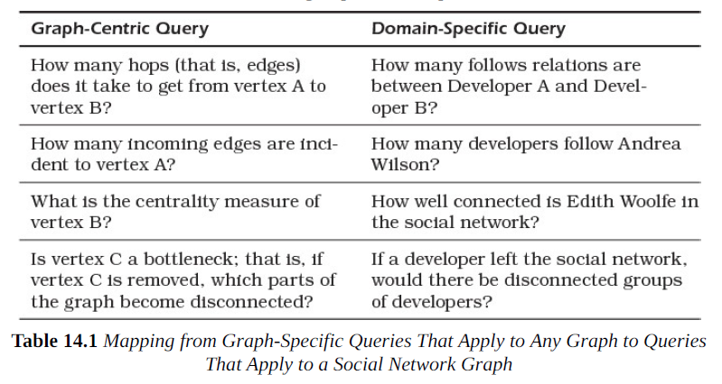

Slide 30
The Cypher query language provides a declarative, SQL-like language for building queries.
Cypher is used with the Neo4j graph database (https://neo4j.com/product).
Alternatively, developers can use Gremlin, a graph traversal language that works with a number of different graph databases.

