Slide 1


Graphs for Data Science and Machine Learning
Dr. Jim Webber
Chief Scientist, Neo4j
#neo4j
@jimwebber
1

Slide 2

It’s Not What You Know

Slide 3
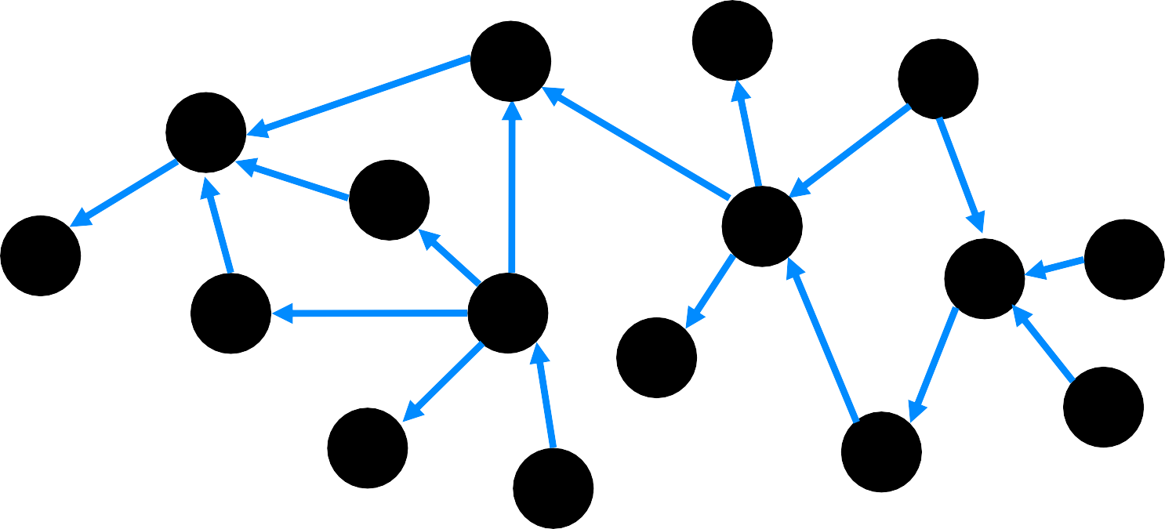
It’s Who You Know

Slide 4
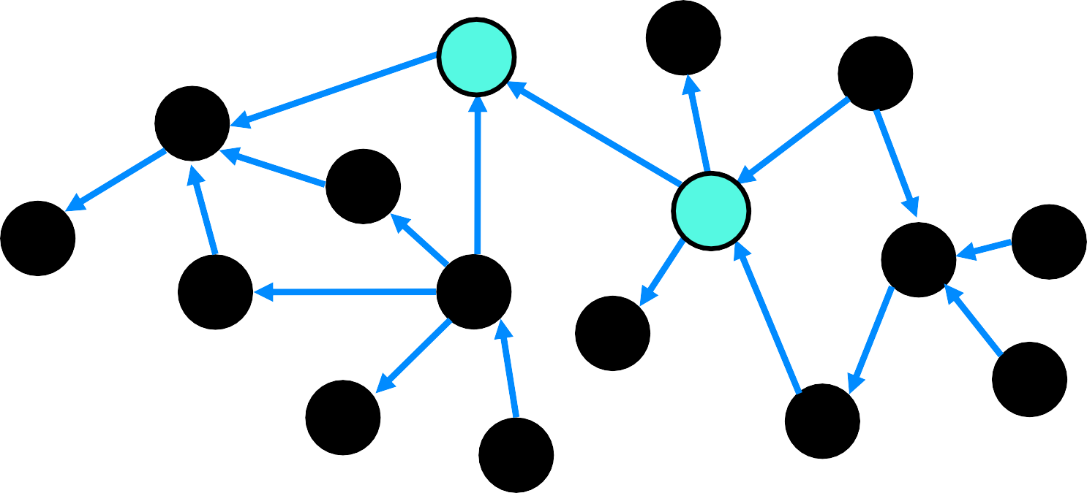
It’s Who You Know And Where They Are

Slide 5


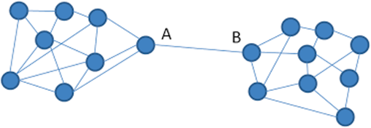
Network Structure is Highly Predictive
5
Higher Pay and More Promotions
People Near Structural Holes
Organizational Misfits
“Organizational Misfits and the Origins of Brokerage in Intrafirm Networks” A. Kleinbaum “Structural Holes and Good Ideas” R. Burt
Neo4j, Inc. All rights reserved 2021
Photo by Helena Lopes on Unsplash

Slide 6
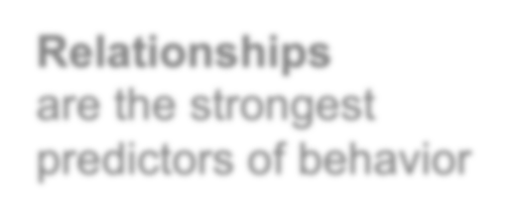

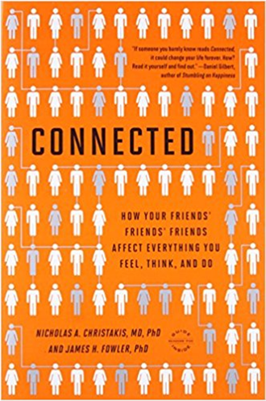
Relationships
are the strongest predictors of behavior
But You Can’t Analyse What You Can’t See
Most data science techniques ignore relationships
It’s painful to manually engineer connected features from tabular data
Graphs are built on relationships, so…
You don’t have to guess at the correlations: with graphs, relationships are built in
James Fowler
Neo4j, Inc. All rights reserved 2021
6
Neo4j, Inc. All rights reserved 2021

Slide 7
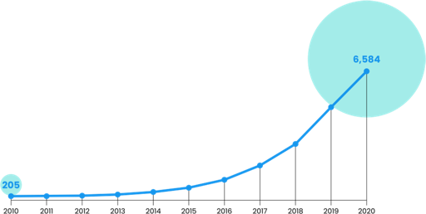
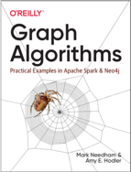

According to Garner, “Graphs form the foundation of modern D&A, with capabilities to enhance and
improve user collaboration, ML models and explainable AI.
AI Research Papers Featuring Graph
The recent Gartner AI in Organizations Survey demonstrates that graph techniques are increasingly prevalent as AI maturity grows, going from 13% adoption when AI maturity is lowest to 48% when
maturity is highest.”
Source: Dimensions Knowledge System
Analytics & Data Science Interest Exploding in Neo4j Community
4x
Increase in traffic to Neo4j GDS page in 2H- 2020
+4.8m
Views on the graph algorithms short video
+193k
downloads
⁷ Neo4j, Inc. All rights reserved 2021
Top 10 Tech Trends in Data and Analytics, 16 Feb 2021

Slide 8



Wait, what’s a graph?
Name: “Andre” Born: May 29, 1970 Twitter: “@dan”
Name: “Mica”
Born: Dec 5, 1975
Node
Represents an entity in the graph
Relationship
Connect nodes to each other
Property
Describes a node or relationship:
e.g. name, age, weight etc
S_{L}I_{O}ST_{V}ER_{S}
ANDRE
BROTHER
MICA
DRIVES
OWNS
Since:
Jan 10, 2011
CAR
Brand “Volvo”
Model: “V70”

Slide 9







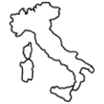


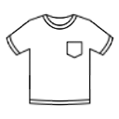



Everything is Naturally Connected
Knows
Bought
Plays_for
Knows
Knows
Viewed
Plays
Bought
In_sport
Fan_of
Returned
Lives_in
Knows
Bought
Likes
Networks of People
Employees, Customers, Suppliers, Partners, Influencers, etc.
Transaction Networks
Risk management, Supply chain, Orders, Payments, etc.
Knowledge Networks
Enterprise content, Domain specific content, eCommerce content, etc

Slide 10
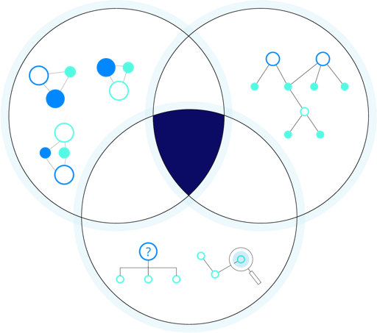
Graphs & Data Science
Machine Learning Visualization
Queries
Find the patterns you know exist.
Machine Learning
Uncover trends and make predictions
Visualization
Explore, collaborate, and explain
Analytics
Graph Data Science
Feature Engineering
Data Exploration
Queries

Slide 11
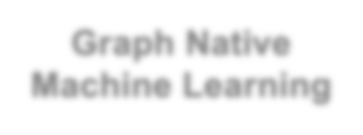
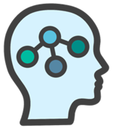

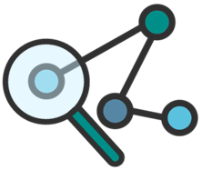


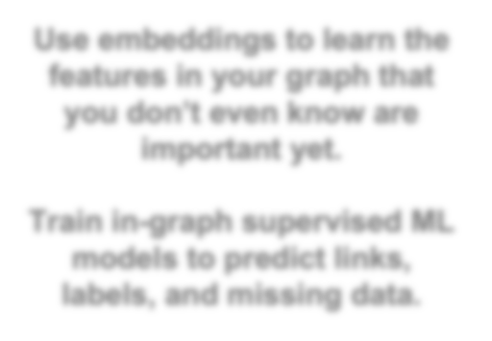








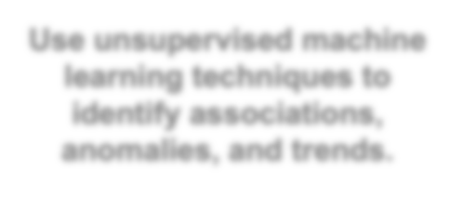




Graph Native Machine Learning
Graphs & Data Science
Graph Algorithms
Knowledge Graphs
Use embeddings to learn the features in your graph that you don’t even know are important yet.
Use unsupervised machine learning techniques to identify associations, anomalies, and trends.
Train in-graph supervised ML models to predict links, labels, and missing data.
Find the patterns you’re looking for in connected data

Slide 12

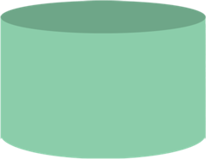

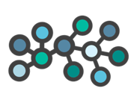
Neo4j’s Graph Data Science Framework
Neo4j Graph Data Science Library
Neo4j Database
Neo4j Bloom
Scalable Graph Algorithms & Analytics Workspace
Native Graph Creation & Persistence
Visual Graph Exploration & Prototyping

Slide 13
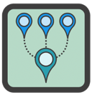
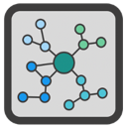


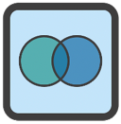
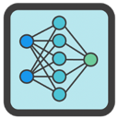
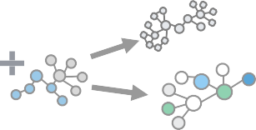
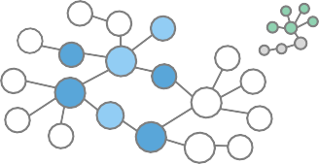



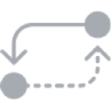
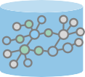
The Neo4j GDS Library
~70 Robust Graph Algorithms & ML methods
Compute metrics about the topology and connectivity
Build predictive models to enhance your graph
Highly parallelized and scale to 10’s of billions of nodes
Efficient & Flexible Analytics Workspace
Computational Graph
Automatically reshapes transactional graphs into an in-memory analytics graph
Optimized for global traversals and aggregation
Create workflows and layer algorithms
Store and manage predictive models in the
model catalog
Mutable In-Memory Workspace
Native Graph Store
13

Slide 14

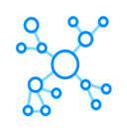

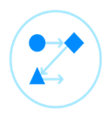
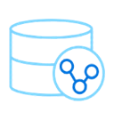


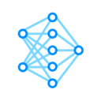
~70 Graph Data Science Techniques in Neo4j
14
Pathfinding & Search Shortest Path Single-Source Shortest Path All Pairs Shortest Path A* Shortest Path Yen’s K Shortest Path Minimum Weight Spanning Tree K-Spanning Tree (MST) Random Walk Breadth & Depth First Search | Centrality & Importance Degree Centrality Closeness Centrality Harmonic Centrality Betweenness Centrality & Approx. PageRank Personalized PageRank ArticleRank Eigenvector Centrality Hyperlink Induced Topic Search (HITS) Influence Maximization (Greedy, CELF) | Community Detection Triangle Count Local Clustering Coefficient Connected Components (Union Find) Strongly Connected Components Label Propagation Louvain Modularity K-1 Coloring Modularity Optimization Speaker Listener Label Propagation | Supervised Machine Learning Node Classification Link Prediction … and more!
Heuristic Link Prediction Adamic Adar Common Neighbors Preferential Attachment Resource Allocations Same Community Total Neighbors Neo4j, Inc. All rights reserved 2021 | Similarity Node Similarity K-Nearest Neighbors (KNN) Jaccard Similarity Cosine Similarity Pearson Similarity Euclidean Distance Approximate Nearest Neighbors (ANN) | Graph Embeddings Node2Vec FastRP FastRPExtended GraphSAGE | Synthetic Graph Generation Scale Properties Collapse Paths One Hot Encoding Split Relationships Graph Export Pregel API (write your own algos)

Slide 15
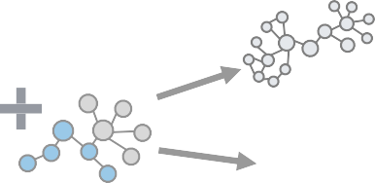
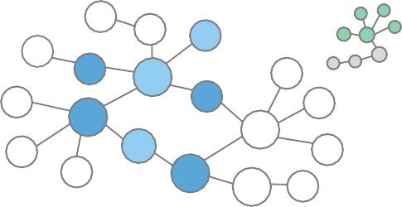


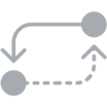

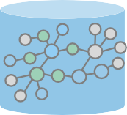
Our Special Sauce: The Graph Catalogue
A graph-specific analytics workspace that’s mutable – integrated with a native- graph database
Computational Graph
Neo4j automates data transformations
Experiment with different data sets, data models
Fast iterations & layering
Production ready features, parallelization & enterprise support
Ability to persist and version data
Mutable In-Memory Workspace
Native Graph Store

Slide 16
Right, so how will this improve
my machine learning project?

Slide 17


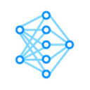
Neo4j’s Graph Data Science Library
ONLY in neo4j
More Algos than
any other vendor
Unsupervised Graph Algorithms
Supervised Machine Learning
Clustering
Which parts of my graph are connected to each other?
Community
Association
Which nodes are most similar?
Similarity
Link Prediction
Where will connections form next?
Node Classification
What’s the label for this node?
Detection Pathfinding
Dimension Reduction
(generalization)
How important is each node?
Centrality Embeddings

Slide 18

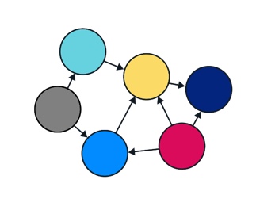
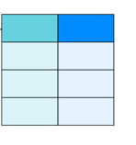

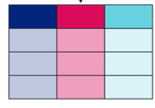
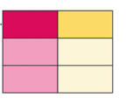
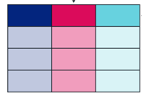





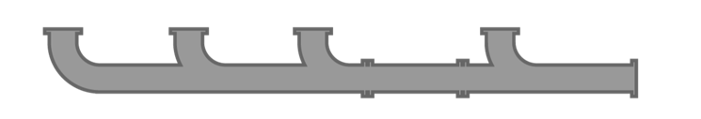
Better Predictions with Data You Already Have
Traditional ML ignores network structure because it’s difficult to extract
Add graph data to existing ML pipelines to increase accuracy, or
Graphs use relationships to unlock otherwise unattainable predictions
Machine Learning Pipeline

Slide 19
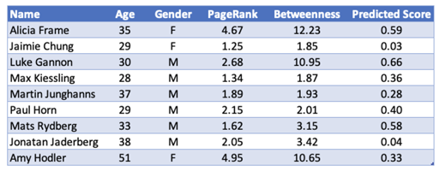
Graphs & Supervised Machine Learning
Predictions influenced by
graph structure
Traditional ML problems where relationships between your data points are important predictive features
Predictions about
graph structure
Enhance your graph by predicting missing data or changes to your graph that will occur in the future

Slide 20
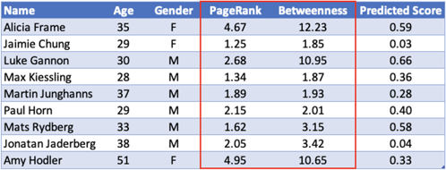
Graphs & Supervised Machine Learning
Predictions influenced by
graph structure
Traditional ML problems where relationships between your data points are important predictive features
Predictions about
graph structure
Enhance your graph by predicting missing data or changes to your graph that will occur in the future

Slide 21
Graphs & Supervised Machine Learning
Predictions influenced by
graph structure
Traditional ML problems where relationships between your data points are important predictive features
Predictions about
graph structure
Enhance your graph by predicting missing data or changes to your graph that will occur in the future

Slide 22
Graphs & Supervised Machine Learning
Predictions influenced by
graph structure
Traditional ML problems where relationships between your data points are important predictive features
Predictions about
graph structure
Enhance your graph by predicting missing data or changes to your graph that will occur in the future

Slide 23
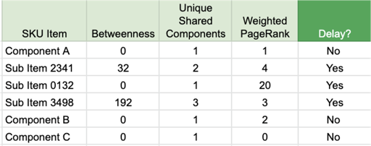
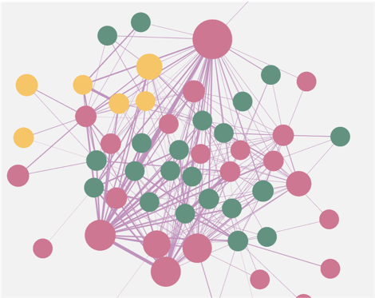
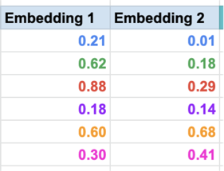
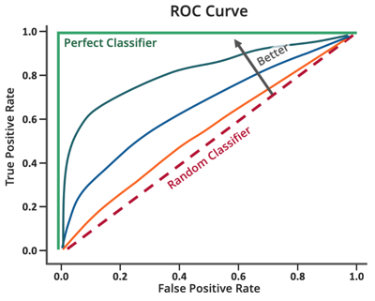
Graph Feature Engineering
Feature Engineering is how we combine and process data to create new, more meaningful features. Graph algorithms and embeddings translate the connections within your data into the rows and columns you need for ML.
Neo4j, Inc. All rights reserved 2021

Slide 24



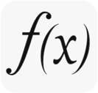













In-Graph Machine Learning
Node classification: “What kind of node is this?”
Link prediction: “Should there be a relationship between these nodes?”
Labeled data: Pairs of nodes that are either linked or not Features: Pre-existing attributes, algorithms (pageRank), embedding

Slide 25








Node Classification - in Neo4j
Node classification:
Predicting a node label or (categorical) property
Load your in- memory graph with labels & features
Specify the property you want to predict and the features for making that prediction
Use
nodeClassification.train
Neo4j Automates the Tricky Parts:
The predictive model appears in the model catalog, ready
to apply to new data
Splits data for train & test
Builds logistic regression models using the training data & specified parameters to predict the correct label
Evaluates the accuracy of the models using the test data
Returns the best performing model

Slide 26



Link Prediction - in Neo4j
Link Prediction:
Predicting unobserved edges or relationships that will form in the future
Load your in- memory graph with labels & features
Split your graph into train & test
Use
splitRelationships.mutate
linkPrediction.train
Neo4j Automates the Tricky Parts:
The predictive model appears in the model catalog, ready
to apply to new data
Builds logistic regression models using the training data & specified parameters to predict the correct label
Evaluates the accuracy of the models using the test data
Returns the best performing model

Slide 27
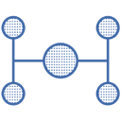
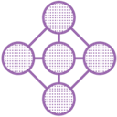
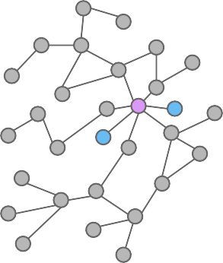







Machine Learning Models in Neo4j
Train a model using your graph and apply it to new or unseen data
Not a data model — a predictive model
Models live in the Neo4j in the
model catalog
Contains versioning information
Input data
Time stamps
Model names
ML Models in the Analytics Workspace
Trained models can be persisted to disk and shared with colleagues

Slide 28























Neo4j: The Only Completely In-Graph, ML Workflow
Use Predictions for Decisions
Graph-Native Feature Engineering
Train Predictive Model
Apply Model to Existing / New Data
Use Predictions to Enhance the Graph
Queries Algorithms Embeddings
Model Type
Property
Selection
Train & Test
Model Selection
Store Model in Database
Publish & Share

Slide 29































































Neo4j is part of your data ecosystem
29
DATA SOURCES
Structured
Ontologies
Unstructured
INGEST
Apache Hop
APOC
PRODUCT COMPONENTS
USE CASES
VISUALIZE
Journey Analytics
Risk Analytics
DATA ANALYTICS
Churn Analysis
What-if Analysis
Next Best Case
Neo4j GDS Library
Neo4j
Bloom
Feature Engineering & ML
Fraud
DRIVERS & APIs
Recommendations
DATA MANAGEMENT
Data Fabric
Data Compliance
Data Governance
AUTO ML
Data Provenance
Data Lineage
Neo4j, Inc. All rights re
se
rved 2021

Slide 30
Real World Use Cases

Slide 31








Graph Data Science Spans Industries and Uses
Fraud Detection
Market Segmentation
Personalized Recommendations
Life Sciences
Churn Prediction
Master Data Management
Predictive Maintenance
Cybersecurity

Slide 32


Accelerate Innovation using Neo4j Graph Data Science
From Simple to Highly Sophisticated Data Science
High
Data Science Analytics
Analysis Complexity
Simple, Ad Hoc
Full Production
Analysis Repeatability

Slide 33










Accelerate Innovation using Neo4j Graph Data Science
From Simple to Highly Sophisticated Data Science
High
R&D: Better health outcomes through machine learning on patient journeys
Analysis Complexity
Data Science
Analytics
FinServ Customers
Fraud Detection with graph feature engineering + AutoML
Analytics to improve reliability by predicting problems in a supply-chain knowledge graph
Simple, Ad Hoc
Full Production
Analysis Repeatability

Slide 34


Boston Scientific
Finding At-Fault Components
34
Challenge: Difficulty finding faulty components via ad hoc analytics on a vertically integrated supply chain
Solution: Uses a knowledge graph to model and analyze their complex products
Results:
Quickly pinpoint root causes of problems
Reduced query times from two minutes to seconds
Anti-recommendation using graph algorithms to identify and eliminate bad combinations of components
Neo4j, Inc. All rights reserved 2021

Slide 35


Top 10 Bank Fighting Fraud
Challenge: Graphs are an important predictive signal, but can be challenging to incorporate into production ML
Solution: Use Neo4j for repeatable feature engineering and incorporate results into autoML pipelines.
Results:
Identified millions of dollars in previously undetectable fraud
Enriched graph with the results of investigations to improve future predictions
35
Neo4j, Inc. All rights reserved 2021

Slide 36




AstraZeneca
Patient Journey
Challenge: How to best intervene sooner for complex diseases that develop over years
Solution: Neo4j knowledge graph of 3 yrs of visits, tests, & diagnosis with 10’s billions of records. Using graph algorithms and machine learning together.
“We used graph algorithms to find patients that had specific journey types and patterns and then find others that are close and similar.”
Joseph Roemer
Global Commercial IT Insight & Analytics Sr. Director AstraZeneca
Results:
Identified journey archetypes and patterns using graph feature engineering as input to ML
Revealed journey similarities over time with community detection
Found influential touch-points in the journey using graph algorithms
36
Neo4j, Inc. All rights reserved 2021

Slide 37



Graph Data Science Answers the BIG Questions
Connected Data is
Powerful
Graph Data Science uses Connections to Answer Critical Questions
What’s most important and influential in my business?
But traditional approaches to data make it impossible to reveal and effectively use those connections as data sizes become large
Predictive signals get lost in big data noise
What’s occurring that’s unusual?
What’s going to happen next?

Slide 38






Neo4j Graph Data Science
70 Graph Algorithms More supported algorithms than any other vendor
Graph-Native ML
Only commercial offering with full graph ML workflows
Humane Experience Automatic transformation from storage to analytics and visualization
Scalable Data Science Algorithms running over 10’s billions of nodes in production
Extensible
Integrate with other data sources and ML platforms
Strongest Community 220K+ practioners 72K+ meetups

Slide 39




Resources
Graph Resources
Video: Advantages of Graph Technology
Whitepaper: AI & Graph Technology: Enhancing AI with Context & Connections
Whitepaper: Financial Fraud Detection with Graph Data Science
Case Study: Meredith Corporation
Neo4j Bookshelf
Graph Databases For Dummies
Graph Data Science For Dummies
O’Reilly Graph Algorithms
O’Reilly Knowledge Graphs

Slide 40
Thank you!
Come see us at Stand B400
Dr. Jim Webber
Chief Scientist, Neo4j jim.webber@neo4j.com

