Slide 1

Penetration Testing on Web Server
Target: certifiedhacker.com
By:- Priyansh Sharma (2023A1R119) &
Sahil Latotra (2023A1R089)

Slide 2
Project Objectives:
To check how secure the web server is.
To find weak points using scanning and information gathering.
To try safe exploitation for learning.
To give suggestions for fixing the problems.

Slide 3
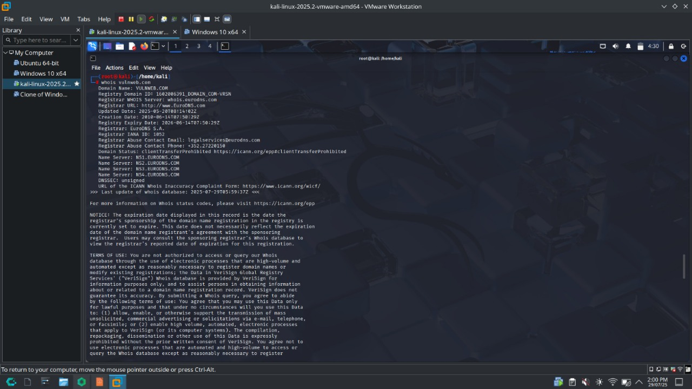
Tools and Websites Used
whois – Find domain owner details.
nslookup- Check DNS Records.
whatweb- Know web server details.
dirb- Find hidden folders.
Burp Suite- Scan for web bugs.
sqlmap- Test for SQL Injection.
theHarvester- Find emails.
wafw00f- Detect firewalls.

Slide 4
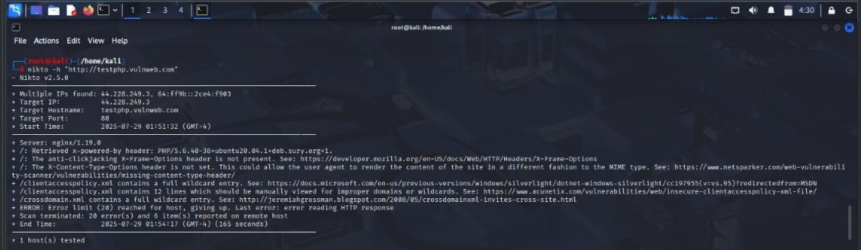
Footprinting & Reconnaissance
Domain- testphp.vulnweb.com
IP address, Location, Server OS, Web Tech
Open ports and directory listing.
Firewall presence.
Social Media and employee info.
Nikto scan showing server info and missing security headers

Slide 5
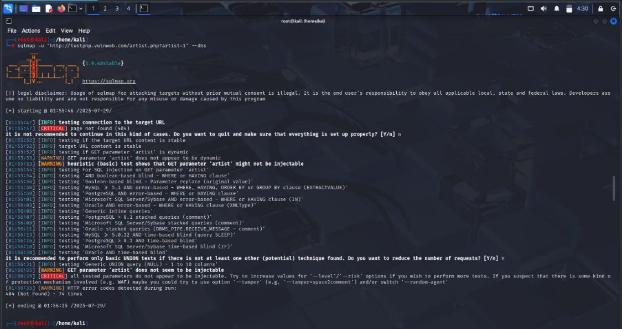
Vulnerability Scanning
Used sqlmap to test for SQL Injection.
Target URL: testphp.vulweb.com/artist.php?artist=1
Page gave 404 error, so scan din’t work.
Shows how SQL injection is attempted.
Detected open ports using tools like Nikto.
Found headers and missing security configs.
Checked for firewall using wafw00f.
Tried SQL injection with sqlmap- but page not found(404)

Slide 6
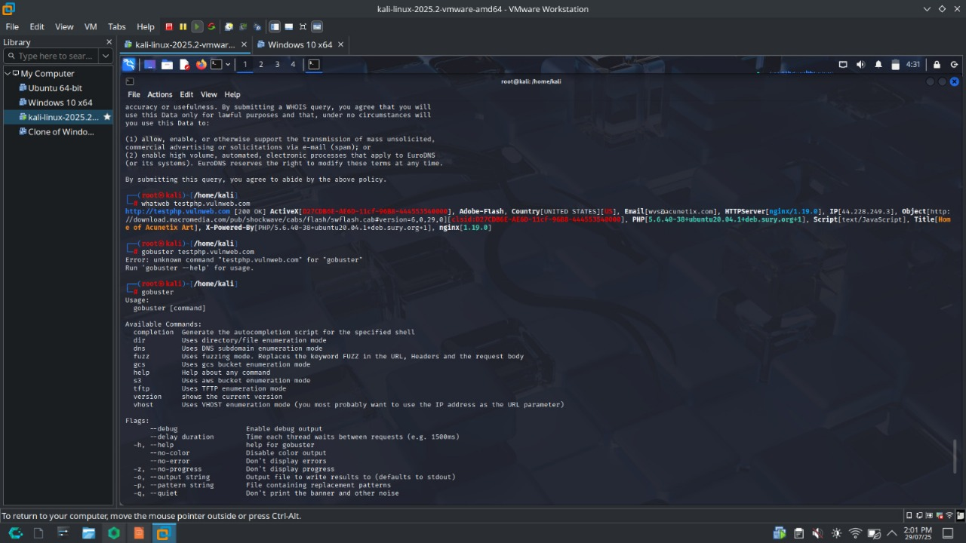
Exploitation Attempt
Tried extracting data using sqlmap.
Wanted to get admin usernames and passwords.
Could not retrieve data due to page issue.
Tested XSS on contact form using script injection.

Slide 7
Recommendations
Use a Web Application Firewall (WAF).
Clean user inputs to prevent SQLi and XSS.
Hide sensitive files like robots.txt .
Keep server and software updated.
Restrict admin access and monitor logs.
Do regular security testing.

Slide 8
Conclusion
Found security issues like SQL injection risk and exposed files.
Some pages were missing, but scanning helped learn the process.
XSS vulnerability was found.
Following good security practices is important.
Regular testing helps protect websites.

Slide 9
Thank you

