Slide 1
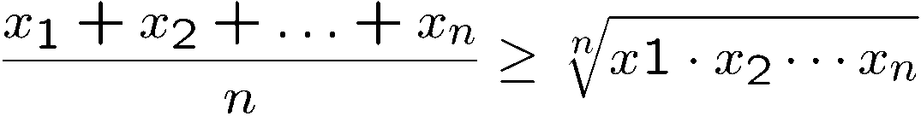

Introduction to Discrete Mathematics
A
B
C
a = qb+r gcd(a,b) = gcd(b,r)

Slide 2
Basic Information
Instructor: Amit Kumar
Course Homepage: follow link from
www.cse.iitd.ac.in/~amitk/
Teaching Assistants: Jatin Batra, Chirag Agrawal, Ritesh Baldwa, Mohammad Rahman
Tutorials: M,Tu,Th (1300-1400)
Slides:
Will be posted on the course page
adapted (with permission from Lac chi Lau) from course on Discrete Mathematics at CUHK.

Slide 3
Course Material
Textbook: Discrete Mathematics and its Applications, 7th ed
Author: Kenneth H. Rosen
Publisher: McGraw Hill

Slide 4
Course Requirements
Minors: 20% each
Lecture Quizzes: 20%
Major: 40%

Slide 5
Checker
x=0
Start with any configuration with all men on or below the x-axis.

Slide 6
Checker
x=0
Move: jump through your adjacent neighbour,
but then your neighbour will disappear.

Slide 7
Checker
x=0
Move: jump through your adjacent neighbour,
but then your neighbour will disappear.

Slide 8
Checker
x=0
Goal: Find an initial configuration with least number of men to jump up to level k.

Slide 9
K=1
x=0
2 men.

Slide 10
K=2
x=0

Slide 11
K=2
x=0
Now we have reduced to the k=1 configuration, but one level higher.
4 men.

Slide 12
K=3
x=0
This is the configuration for k=2, so jump two level higher.

Slide 13
K=3
x=0
8 men.

Slide 14
K=4
x=0

Slide 15
K=4
x=0

Slide 16
K=4
x=0

Slide 17
K=4
x=0

Slide 18
K=4
x=0
Now we have reduced to the k=3 configuration, but one level higher
20 men!

Slide 19
K=5
39 or below
40-50 men
51-70 men
71- 100 men
101 – 1000 men
1001 or above

Slide 20
Why Mathematics?
Design efficient computer systems.
How did Google manage to build a fast search engine?
What is the foundation of internet security?
algorithms, data structures, database,
parallel computing, distributed systems,
cryptography, computer networks…
Logic, number theory, counting, graph theory…

Slide 21
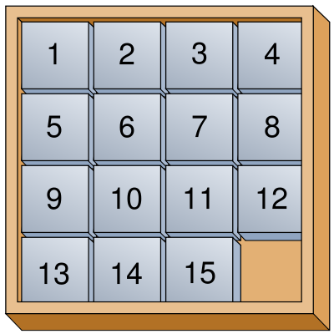

Topic 1: Logic and Proofs
How do computers think?
Logic: propositional logic, first order logic
Proof: induction, contradiction
Artificial intelligence, database, circuit, algorithms

Slide 22
Topic 2: Number Theory
Number sequence
(Extended) Euclidean algorithm
Prime number, modular arithmetic, Chinese remainder theorem
Cryptography, RSA protocol
Cryptography, coding theory, data structures

Slide 23
Topic 3: Counting
Sets and Functions
Combinations, Permutations, Binomial theorem
Counting by mapping, pigeonhole principle
Recursions
A
B
C
Probability, algorithms, data structures

Slide 24
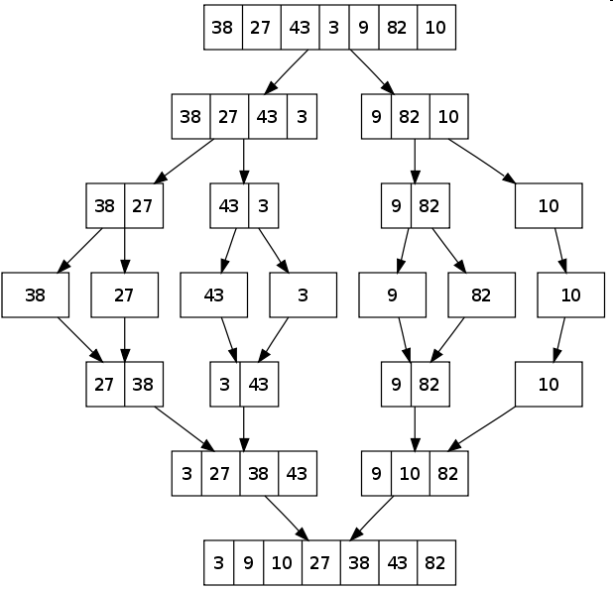
Topic 3: Counting
How many steps are needed to sort n numbers?
Algorithm 1 (Bubble Sort):
Every iteration moves the i-th smallest number to the i-th position
Algorithm 2 (Merge Sort):
Which algorithm runs faster?

Slide 25
Topic 4: Graph Theory
Graphs, Relations
Degree sequence, Eulerian graphs, isomorphism
Trees
Matching
Coloring
Computer networks, circuit design, data structures

Slide 26
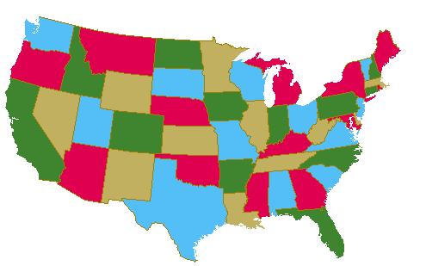
Topic 4: Graph Theory
How to color a map?
How to send data efficiently?

Slide 27
Objectives of This Course
To learn basic mathematical concepts, e.g. sets, functions, graphs
To be familiar with formal mathematical reasoning, e.g. logic, proofs
To improve problem solving skills
To see the connections between discrete mathematics and computer science

Slide 28
Pythagorean theorem
c
b
a
Familiar?
Obvious?

Slide 29

Good Proof
b
c
b-a
a
b-a
We will show that these five pieces can be rearranged into:
(i) a c×c square, and then
(ii) an a×a & a b×b square
And then we can conclude that

Slide 30
Good Proof
The five pieces can be rearranged into:
(i) a c×c square
c
b-a
c
c
a
b
c

Slide 31
Good Proof
How to rearrange them into an axa square and a bxb square?
b
c
b-a
a
b-a

Slide 32
Good Proof
a
b
a
b-a
a
b
74 proofs in http://www.cut-the-knot.org/pythagoras/index.shtml

Slide 33
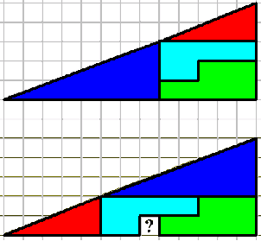
Bad Proof
A similar rearrangement technique shows that 65=64…
What’s wrong with the proof?

Slide 34
Mathematical Proof
To prove mathematical theorems, we need a more rigorous system.
The standard procedure for proving mathematical theorems is invented by
Euclid in 300BC. First he started with five axioms (the truth of these
statements are taken for granted). Then he uses logic to deduce the truth
of other statements.
It is possible to draw a straight line from any point to any other point.
It is possible to produce a finite straight line continuously in a straight line.
It is possible to describe a circle with any center and any radius.
It is true that all right angles are equal to one another.
("Parallel postulate") It is true that, if a straight line falling on two straight lines make the interior angles on the same side less than two right angles,
the two straight lines, if produced indefinitely, intersect on that side on which are the angles less than the two right angles.
Euclid’s proof of Pythagorean’s theorem
http://en.wikipedia.org/wiki/Pythagorean_theorem

