Slide 1
Pigeonhole Principle
If more pigeons
than pigeonholes,

Slide 2
Pigeonhole Principle
then some hole must have at least two pigeons!
Pigeonhole principle
A function from a larger set to a smaller set cannot be injective.
(There must be at least two elements in the domain that have
the same image in the codomain.)

Slide 3
Generalized Pigeonhole Principle
Generalized Pigeonhole Principle
If n pigeons and h holes,
then some hole has at least
pigeons.
♠ ♥ ♣ ♦
Cannot have < 3 cards in every hole.

Slide 4
Club vs Strangers
Let’s agree that given any two people, either they have met or not.
If every people in a group has met, then we’ll call the group a club.
If every people in a group has not met, then we’ll call a group of strangers.
Theorem: Every collection of 6 people includes a club of 3 people,
or a group of 3 strangers.
Let x be one of the six people.
By the (generalized) pigeonhole principle, we have the following claim.
Claim: Among the remaining 5 people, either 3 of them have met x,
or 3 of them have not met x.

Slide 5
Club vs Strangers
Theorem: Every collection of 6 people includes a club of 3 people,
or a group of 3 strangers.
Claim: Among the remaining 5 people, either 3 of them have met x,
or 3 of them have not met x.
Case 1: “3 people have met x”
Case 1.1: No pair among those people met each other.
Then there is a group of 3 strangers.
OK!
Case 1.2: Some pair among those people have met each other.
Then that pair, together with x, form a club of 3 people.
OK!

Slide 6
Club vs Strangers
Theorem: Every collection of 6 people includes a club of 3 people,
or a group of 3 strangers.
Claim: Among the remaining 5 people, either 3 of them have met x,
or 3 of them have not met x.
Case 2: “3 people have not met x”
Case 2.1: Every pair among those people met each other.
Then there is a club of 3 people.
OK!
OK!
Case 2.2: Some pair among those people have not met each other.
Then that pair, together with x, form a group of 3 strangers.

Slide 7
Club vs Strangers
Theorem: Every collection of 6 people includes a club of 3 people,
or a group of 3 strangers.
Theorem: For every k, if there are enough people,
then either there exists a club of k people,
or a group of k strangers.
A large enough structure cannot be totally disorder.

Slide 8
More applications 3
Among n+1 positive integers not exceeding 2n there must be an integer that divides one of the other integers.
Let $1≤a_{1}<a_{2}<…<a_{n+1}≤2n$ be the $n+1$ integers. No loss of generality to assume they are distinct as else the stmt is trivially true.
Let $b_{i}=a_{i}/2^{k_{i}}$ be odd. Then $1≤b_{1},b_{2},…, b_{n+1}≤2n−1$ are $n+1$ odd integers.
Since there are only $n$ odd integers between 1 and $2n−1$, by PHP for some $i,j, b_{i}=b_{j}$.
Let $a_{i}<a_{j}$. Then $k_{i}<k_{j}$ and so $a_{i}=b_{i}2^{k_{i}}$ divides $a_{j}=b_{j}2^{k_{j}}$

Slide 9
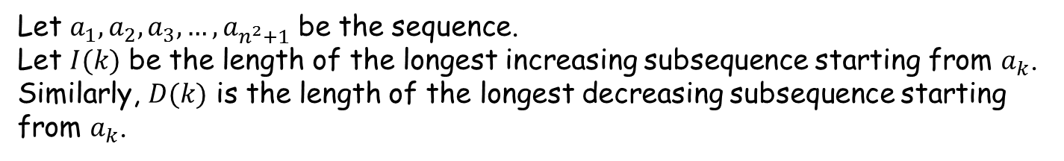
More applications 4
Every sequence of $n^{2}+1$ distinct numbers contains a subsequence of length n+1 that is strictly increasing or strictly decreasing
e.g. 8, 11, 9, 1, 4, 6, 12, 10, 5, 7 contains the increasing subsequence 1,4,6,10 of length 4.
Let $a_{1},a_{2},a_{3}, …{,a}_{n^{2}+1}$ be the sequence.
Let $I(k)$ be the length of the longest increasing subsequence starting from $a_{k}$. Similarly, $D(k)$ is the length of the longest decreasing subsequence starting from $a_{k}$.
In the above example: $I(3)=2, D(3)=3, I(5)=3, D(5)=1$

Slide 10
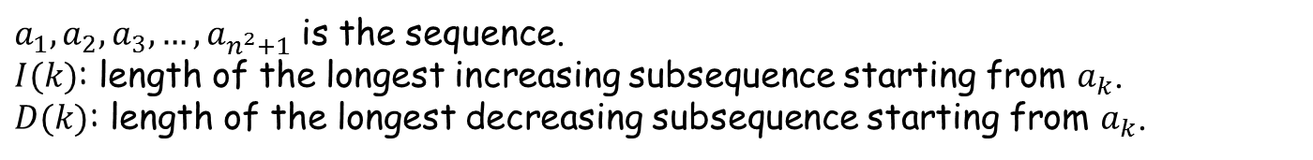
More applications 4 (contd.)
$a_{1},a_{2},a_{3}, …{,a}_{n^{2}+1}$ is the sequence.
$I(k)$: length of the longest increasing subsequence starting from $a_{k}$.
$D(k)$: length of the longest decreasing subsequence starting from $a_{k}$.
If for some $k$, $I(k)$ or $D(k)$ exceeds $n$ then we are done (there is an inc./dec. subsequence of length $n+1$).
For contradiction, assume $∀k, 1≤I\left(k\right),D\left(k\right)≤n$.
Consider the $n^{2}+1$ tuples $\left(I\left(1\right),D\left(1\right)\right), \left(I\left(2\right), D\left(2\right)\right),…,\left(I\left(n^{2}+1\right),D\left(n^{2}+1\right)\right).$ Since these takes $n^{2}$ different values, by PHP $∃r,s:\left(I\left(r\right),D\left(r\right)\right)=\left(I\left(s\right),D\left(s\right)\right)$.
No loss of generality to assume that $r<s$.

Slide 11
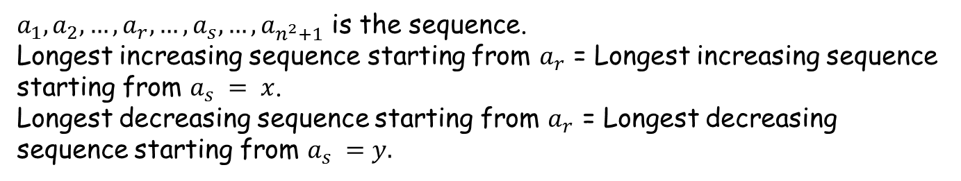
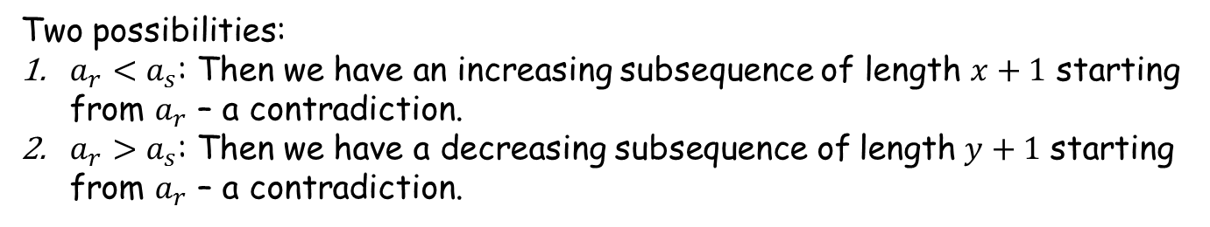
More applications 4 (contd.)
$a_{1},a_{2},…, a_{r},…,a_{s},…, a_{n^{2}+1}$ is the sequence.
Longest increasing sequence starting from $a_{r}$ = Longest increasing sequence starting from $a_{s} = x$.
Longest decreasing sequence starting from $a_{r}$ = Longest decreasing sequence starting from $a_{s} =y.$
Two possibilities:
$a_{r}<a_{s}$: Then we have an increasing subsequence of length $x+1$ starting from $a_{r}$ – a contradiction.
$a_{r}>a_{s}$: Then we have a decreasing subsequence of length $y+1$ starting from $a_{r}$ – a contradiction.
This implies tat our assumption that “there is no increasing or decreasing subsequence of length more than $n$” is incorrect.

Slide 12
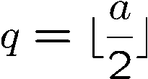
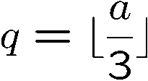
The Quotient-Remainder Theorem
For b > 0 and any a, there are unique numbers
q ::= quotient(a,b), r ::= remainder(a,b), such that
a = qb + r and 0  r < b.
We also say q = a div b and r = a mod b.
When b=2, this says that for any a,
there is a unique q such that a=2q or a=2q+1.
When b=3, this says that for any a,
there is a unique q such that a=3q or a=3q+1 or a=3q+2.

Slide 13
The Quotient-Remainder Theorem
For b > 0 and any a, there are unique numbers
q ::= quotient(a,b), r ::= remainder(a,b), such that
a = qb + r and 0  r < b.
Given any b, we can divide the integers into many blocks of b numbers.
For any a, there is a unique “position” for a in this line.
q = the block where a is in
r = the offset in this block
a
-b
0
b
2b
kb
(k+1)b
Clearly, given a and b, q and r are uniquely defined.

Slide 14
This Lecture
Quotient remainder theorem
Greatest common divisor & Euclidean algorithm
Linear combination and GCD, extended Euclidean algorithm
Prime factorization and other applications

Slide 15
Common Divisors
c is a common divisor of a and b means c|a and c|b.
gcd(a,b) ::= the greatest common divisor of a and b.
Say a=8, b=10, then 1,2 are common divisors, and gcd(8,10)=2.
Say a=10, b=30, then 1,2,5,10 are common divisors, and gcd(10,30)=10.
Say a=3, b=11, then the only common divisor is 1, and gcd(3,11)=1.
Claim. If p is prime, and p does not divide a, then gcd(p,a) = 1.

Slide 16
Greatest Common Divisors
Given a and b, how to compute gcd(a,b)?
Can try every number,
but can we do it more efficiently?
Let’s say a>b.
If a=kb, then gcd(a,b)=b, and we are done.
Otherwise, by the Division Theorem, a = qb + r for r>0.

Slide 17
Greatest Common Divisors
Let’s say a>b.
If a=kb, then gcd(a,b)=b, and we are done.
Otherwise, by the Division Theorem, a = qb + r for r>0.
a=12, b=8 => 12 = 8 + 4
gcd(12,8) = 4
gcd(8,4) = 4
a=21, b=9 => 21 = 2x9 + 3
gcd(21,9) = 3
gcd(9,3) = 3
a=99, b=27 => 99 = 3x27 + 18
gcd(99,27) = 9
gcd(27,18) = 9
Euclid: gcd(a,b) = gcd(b,r)!

Slide 18
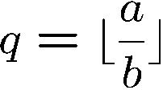

Euclid’s GCD Algorithm
a = qb + r
Euclid: gcd(a,b) = gcd(b,r)
gcd(a,b)
if b = 0, then answer = a.
else
write a = qb + r
answer = gcd(b,r)

Slide 19
Example 1
gcd(a,b)
if b = 0, then answer = a.
else
write a = qb + r
answer = gcd(b,r)
GCD(102, 70) 102 = 70 + 32
= GCD(70, 32) 70 = 2x32 + 6
= GCD(32, 6) 32 = 5x6 + 2
= GCD(6, 2) 6 = 3x2 + 0
= GCD(2, 0)
Return value: 2.

Slide 20
Example 2
gcd(a,b)
if b = 0, then answer = a.
else
write a = qb + r
answer = gcd(b,r)
GCD(252, 189) 252 = 1x189 + 63
= GCD(189, 63) 189 = 3x63 + 0
= GCD(63, 0)
Return value: 63.

Slide 21
Example 3
gcd(a,b)
if b = 0, then answer = a.
else
write a = qb + r
answer = gcd(b,r)
GCD(662, 414) 662 = 1x414 + 248
= GCD(414, 248) 414 = 1x248 + 166
= GCD(248, 166) 248 = 1x166 + 82
= GCD(166, 82) 166 = 2x82 + 2
= GCD(82, 2) 82 = 41x2 + 0
= GCD(2, 0)
Return value: 2.

Slide 22
Correctness of Euclid’s GCD Algorithm
a = qb + r
Euclid: gcd(a,b) = gcd(b,r)
When r = 0:
Then gcd(b, r) = gcd(b, 0) = b since every number divides 0.
But a = qb so gcd(a, b) = b = gcd(b, r), and we are done.

Slide 23
Correctness of Euclid’s GCD Algorithm
a = qb + r
Euclid: gcd(a,b) = gcd(b,r)
When r > 0:
Let d be a common divisor of b, r
b = k₁d and r = k₂d for some k₁, k₂.
a = qb + r = qk₁d + k₂d = (qk₁ + k₂)d => d is a divisor of a
Let d be a common divisor of a, b
a = k₃d and b = k₁d for some k₁, k₃.
r = a – qb = k₃d – qk₁d = (k₃ – qk₁)d => d is a divisor of r
So d is a common factor of a, b iff d is a common factor of b, r
d = gcd(a, b) iff d = gcd(b, r)

Slide 24
How fast is Euclid’s GCD Algorithm?
Naive algorithm: try every number,
Then the running time is about 2b iterations.
Euclid’s algorithm:
In two iterations, the b is decreased by half. (why?)
Then the running time is about 2log(b) iterations.
Exponentially faster!!

Slide 25
This Lecture
Quotient remainder theorem
Greatest common divisor & Euclidean algorithm
Linear combination and GCD, extended Euclidean algorithm
Prime factorization and other applications

Slide 26
Linear Combination vs Common Divisor
Greatest common divisor
d is a common divisor of a and b if d|a and d|b
gcd(a,b) = greatest common divisor of a and b
Smallest positive integer linear combination
d is an integer linear combination of a and b if d=sa+tb for integers s,t.
spc(a,b) = smallest positive integer linear combination of a and b
Theorem: gcd(a,b) = spc(a,b)

Slide 27
Linear Combination vs Common Divisor
Theorem: gcd(a,b) = spc(a,b)
For example, the greatest common divisor of 52 and 44 is 4.
And 4 is a linear combination of 52 and 44:
6 · 52 + (−7) · 44 = 4
Furthermore, no linear combination of 52 and 44 is equal to a smaller positive integer.
To prove the theorem, we will prove:
gcd(a,b) <= spc(a,b)
gcd(a,b) | spc(a,b)
spc(a,b) <= gcd(a,b)
spc(a,b) is a common divisor of a and b

Slide 28
GCD <= SPC
3. If d | a and d | b, then d | sa + tb for all s and t.
Proof of (3)
d | a => a = dk₁
d | b => b = dk₂
sa + tb = sdk₁ + tdk₂ = d(sk₁ + tk₂)
=> d|(sa+tb)
Let d = gcd(a,b). By definition, d | a and d | b.
GCD | SPC
Let f = spc(a,b) = sa+tb
By (3), d | f. This implies d <= f. That is gcd(a,b) <= spc(a,b).

Slide 29
SPC <= GCD
We will prove that spc(a,b) is actually a common divisor of a and b.
First, show that spc(a,b) | a.
Suppose, by way of contradiction, that spc(a,b) does not divide a.
Then, by the Division Theorem,
a = q x spc(a,b) + r and spc(a,b) > r > 0
Let spc(a,b) = sa + tb.
So r = a – q x spc(a,b) = a – q x (sa + tb) = (1-qs)a + qtb.
Thus r is an integer linear combination of a and b, and spc(a,b) > r.
This contradicts the definition of spc(a,b), and so r must be zero.
Similarly, spa(a,b) | b.
So, spc(a,b) is a common divisor of a and b, thus by definition spc(a,b) <= gcd(a,b).

Slide 30
Extended GCD Algorithm
How can we write gcd(a,b) as an integer linear combination?
This can be done by extending the Euclidean’s algorithm.
Example: a = 259, b=70
259 = 3·70 + 49
70 = 1·49 + 21
49 = 2·21 + 7
21 = 7·3 + 0 done, gcd = 7
49 = a – 3b
21 = 70 - 49
21 = b – (a-3b) = -a+4b
7 = 49 - 2·21
7 = (a-3b) – 2(-a+4b) = 3a – 11b

Slide 31
Extended GCD Algorithm
Example: a = 899, b=493
899 = 1·493 + 406 so 406 = a - b
493 = 1·406 + 87 so 87 = 493 – 406
= b – (a-b) = -a + 2b
406 = 4·87 + 58 so 58 = 406 - 4·87
= (a-b) – 4(-a+2b) = 5a - 9b
87 = 1·58 + 29 so 29 = 87 – 1·58
= (-a+2b) - (5a-9b) = -6a + 11b
58 = 2·29 + 0 done, gcd = 29

Slide 32
This Lecture
Quotient remainder theorem
Greatest common divisor & Euclidean algorithm
Linear combination and GCD, extended Euclidean algorithm
Prime factorization and other applications

Slide 33
Application of the Theorem
Theorem: gcd(a,b) = spc(a,b)
Why is this theorem useful?
we can now “write down” gcd(a,b) as some concrete equation,
(i.e. gcd(a,b) = sa+tb for some integers s and t),
and this allows us to reason about gcd(a,b) much easier.
(2) If we can find integers s and t so that sa+tb=c,
then we can conclude that gcd(a,b) <= c.
In particular, if c=1, then we can conclude that gcd(a,b)=1.

Slide 34
Prime Divisibility
Theorem: gcd(a,b) = spc(a,b)
Lemma: p prime and p|a·b implies p|a or p|b.
pf: say p does not divide a. so gcd(p,a)=1.
So by the Theorem, there exist s and t such that
sa + tp = 1
(sa)b + (tp)b = b
Hence p|b
p|ab
p|p
Cor : If p is prime, and p| a₁·a₂···a_{m} then p|a_{i} for some i.

Slide 35
Fundamental Theorem of Arithmetic
Every integer, n>1, has a unique factorization into primes:
p₀ ≤ p₁ ≤ ··· ≤ p_{k}
p₀ p₁ ··· p_{k} = n
Example:
61394323221 = 3·3·3·7·11·11·37·37·37·53

Slide 36
Unique Factorization
Theorem: There is a unique factorization.
proof: suppose, by contradiction,
that there are numbers with two different factorization.
By the well-ordering principle, we choose the smallest such n >1:
n = p₁·p₂···p_{k} = q₁·q₂···q_{m}
Since n is smallest, we must have that p_{i}  q_{j} all i,j
(Otherwise, we can obtain a smaller counterexample.)
Since p₁|n = q₁·q₂···q_{m}, so by Cor., p₁|q_{i} for some i.
Since both p₁ = q_{i} are prime numbers, we must have p₁ = q_{i}.
contradiction!

Slide 37
Application of the Theorem
Theorem: gcd(a,b) = spc(a,b)
Lemma. If gcd(a,b)=1 and gcd(a,c)=1, then gcd(a,bc)=1.
By the Theorem, there exist s,t,u,v such that
sa + tb = 1
ua + vc = 1
Multiplying, we have (sa + tb)(ua + vc) = 1
saua + savc + tbua + tbvc = 1
(sau + svc + tbu)a + (tv)bc = 1
By the Theorem, since spc(a,bc)=1, we have gcd(a,bc)=1

Slide 38
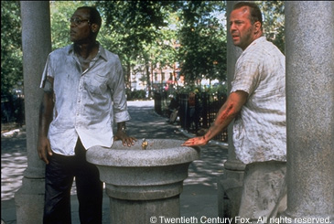
Die Hard
Simon says: On the fountain, there should be 2 jugs, do you see them? A 5-gallon and a 3-gallon. Fill one of the jugs with exactly 4 gallons of water and place it on the scale and the timer will stop. You must be precise; one ounce more or less will result in detonation. If you're still alive in 5 minutes, we'll speak.

Slide 39
Die Hard
Start with empty jugs: (0,0)
Fill the big jug: (0,5)
3 Gallon Jug
5 Gallon Jug

Slide 40
Die Hard
Pour from big to little:
(3,2)
3 Gallon Jug
5 Gallon Jug

Slide 41
Die Hard
Empty the little: (0,2)
3 Gallon Jug
5 Gallon Jug

Slide 42
Die Hard
Pour from big to little: (2,0)
3 Gallon Jug
5 Gallon Jug

Slide 43
Die Hard
Fill the big jug: (2,5)
3 Gallon Jug
5 Gallon Jug

Slide 44
Die Hard
Pour from big to little:
(3,4)
3 Gallon Jug
5 Gallon Jug
Done!!

Slide 45
Die Hard
What if you have a 9 gallon jug instead?
3 Gallon Jug
5 Gallon Jug
9 Gallon Jug
Can you do it? Can you prove it?

Slide 46
Die Hard
Supplies:
3 Gallon Jug
9 Gallon Jug
Water

Slide 47
Invariant Method
Invariant: the number of gallons in each jug is a multiple of 3.
i.e., 3|b and 3|l (3 divides b and 3 divides l)
Corollary: it is impossible to have exactly 4 gallons in one jug.
Bruce Dies!

Slide 48
Generalized Die Hard
Can Bruce form 3 gallons using 21 and 26-gallon jugs?
This question is not so easy to answer without number theory.

Slide 49
General Solution for Die Hard
Invariant in Die Hard Transition:
Suppose that we have water jugs with capacities B and L. Then the amount of water in each jug is always an integer linear combination of B and L.
Theorem: gcd(a,b) = spc(a,b)
Corollary: Every linear combination of a and b is a multiple of gcd(a, b).
Corollary: The amount of water in each jug is a multiple of gcd(a,b).

Slide 50
General Solution for Die Hard
Corollary: The amount of water in each jug is a multiple of gcd(a,b).
Given jug of 3 and jug of 9, is it possible to have exactly 4 gallons in one jug?
NO, because gcd(3,9)=3, and 4 is not a multiple of 3.
Given jug of 21 and jug of 26, is it possible to have exactly 3 gallons in one jug?
gcd(21,26)=1, and 3 is a multiple of 1,
so this possibility has not been ruled out yet.
Theorem. Given water jugs of capacity a and b,
it is possible to have exactly k gallons in one jug
if and only if k is a multiple of gcd(a,b).

Slide 51
General Solution for Die Hard
Theorem. Given water jugs of capacity a and b,
it is possible to have exactly k gallons in one jug
if and only if k is a multiple of gcd(a,b).
Given jug of 21 and jug of 26, is it possible to have exactly 3 gallons in one jug?
gcd(21,26) = 1
5x21 – 4x26 = 1
15x21 – 12x26 = 3
Repeat 15 times:
1. Fill the 21-gallon jug.
2. Pour all the water in the 21-gallon jug into the 26-gallon jug.
Whenever the 26-gallon jug becomes full, empty it out.

Slide 52
General Solution for Die Hard
15x21 – 12x26 = 3
Repeat 15 times:
1. Fill the 21-gallon jug.
2. Pour all the water in the 21-gallon jug into the 26-gallon jug.
Whenever the 26-gallon jug becomes full, empty it out.
There must be exactly 3 gallons left after this process.
Totally we have filled 15x21 gallons.
We pour out some multiple t of 26 gallons.
The 26 gallon jug can only hold somewhere between 0 and 26.
So t must be equal to 12.
And there are exactly 3 gallons left.

Slide 53
General Solution for Die Hard
Given two jugs with capacity A and B with A < B, the target is C.
If gcd(A,B) does not divide C, then it is impossible.
Otherwise, compute C = sA + tB.
Repeat s times:
1. Fill the A-gallon jug.
2. Pour all the water in the A-gallon jug into the B-gallon jug.
Whenever the B-gallon jug becomes full, empty it out.
The B-gallon jug will be emptied exactly t times.
After that, there will be exactly C gallons in the B-gallon jug.

