Slide 1
Multiplication Inverse
The multiplicative inverse of a number a is another number a’ such that:
a · a’  1 (mod n)
For real numbers, every nonzero number has a multiplicative inverse.
For integers, only 1 has a multiplicative inverse.
An interesting property of modular arithmetic is that
there are multiplicative inverse for integers.
For example, 2 * 5 = 1 mod 3, so 5 is a multiplicative inverse
for 2 under modulo 3 (and vice versa).
Does every number has a multiplicative inverse in modular arithmetic?

Slide 2
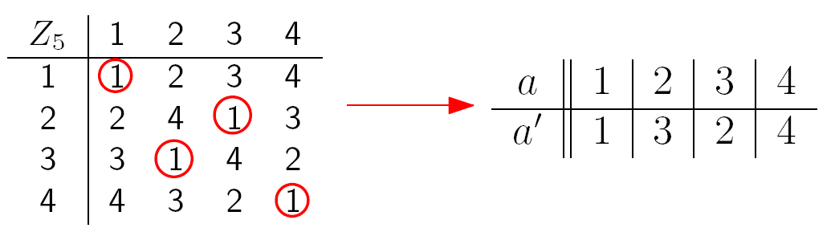
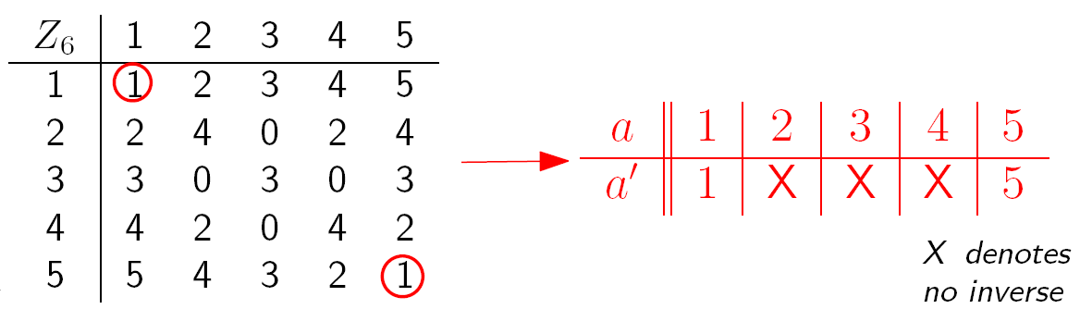
Multiplication Inverse
Does every number has a multiplicative inverse in modular arithmetic?

Slide 3
Multiplication Inverse
What is the pattern?

Slide 4
Case Study
Why 2 does not have a multiplicative inverse under modulo 6?
Suppose it has a multiplicative inverse y.
2y  1 (mod 6)
=> 2y = 1 + 6x for some integer x
=> y = ½ + 3x
This is a contradiction since both x and y are integers.

Slide 5
Necessary Condition
Claim. An integer k does not have an multiplicative inverse under modulo n,
if k and n have a common factor >= 2 (gcd(k,n) >= 2).
Proof.
Suppose, by contradiction, that there is an inverse k’ for k such that
k’k = 1 (mod n)
Then k’k = 1 + xn for some integer x.
Since both k and n have a common factor, say c>=2,
then k=ck₁ and n=cn₁ for some integers k₁ and n₁.
So k’ck₁ = 1 + xcn₁.
Then k’k₁ = 1/c + xn₁
This is a contradiction since the LHS is an integer but the RHS is not.
This claim says that for k to have a multiplicative inverse modulo n,
then a necessary condition is that k and n do not have a common factor >= 2.

Slide 6
Sufficient Condition
What about if gcd(k,n)=1?
Would k always have an multiplicative inverse under modulo n?
For example,
gcd(3,7) = 1
3·5  1 (mod 7)
gcd(4,11) = 1
4·3  1 (mod 11)
gcd(8,9) = 1
8·8  1 (mod 9)
It seems that there is always an inverse in such a case, but why?
gcd(8,9) = 1
8s + 9t = 1 for some integers s and t
8s = 1 – 9t
gcd(8,9) = spc(8,9)
8s  1 (mod 9)

Slide 7
Sufficient Condition
Theorem. If gcd(k,n)=1, then have k’ such that
k·k’  1 (mod n).
gcd(k,n)=spc(k,n)
Proof: Since gcd(k,n)=1, there exist s and t so that sk + tn = 1.
So tn = 1 - sk
This means n | 1 – sk.
This means that 1 – sk  0 (mod n).
This means that 1  sk (mod n).
So k’ = s is an multiplicative inverse for k.
The multiplicative inverse can be computed by the extended Euclidean algorithm.
Corollary: k has a multiplicative inverse mod n if and only if gcd(k,n)=1

Slide 8
This Lecture
Multiplicative inverse
Cancellation in modular arithmetic
Application: check digit scheme
Fermat’s little theorem

Slide 9
Cancellation
Note that  (mod n) is very similar to =.
If a  b (mod n), then a+c  b+c (mod n).
If a  b (mod n), then ac  bc (mod n)
However, if ac  bc (mod n),
it is not necessarily true that a  b (mod n).
For example, 4·2  1·2 (mod 6), but 4  1 (mod 6)
3·4  1·4 (mod 8), but 3  1 (mod 8)
4·3  1·3 (mod 9), but 4  1 (mod 9)
There is no general cancellation in modular arithmetic.
Observation: In all the above examples c and n have a common factor.

Slide 10
Cancellation
Why a·k  b·k (mod n) when a ≠ b?
Without loss of generality, assume 0 < a < n and 0 < b < n.
Because if a·k  b·k (mod n), then also (a mod n)·k  (b mod n)·k (mod n).
smaller than n.
This means that ak = bk + nx.
This means that (a-b)k = nx, which means a-b=(nx)/k.
Since 0 < a < n and 0 < b < n, it implies that –n < a-b < n.
Therefore, nx/k must be < n.
For this to happen, n and k must have a common divisor >= 2!
Okay, so, can we say something when gcd(n,k)=1?

Slide 11
Cancellation
Claim: Assume gcd(k,n) = 1. If i·k  j·k (mod n), then i  j (mod n).
For example, multiplicative inverse always exists if n is a prime!
Proof.
Since gcd(k,n) = 1, there exists k’ such that kk’  1 (mod n).
i·k  j·k (mod n).
=> i·k·k’  j·k·k’ (mod n).
=> i  j (mod n)
Remarks (Optional): This makes arithmetic modulo prime a field,
a structure that “behaves like” real numbers.
Arithmetic modulo prime is very useful in coding theory.

Slide 12
This Lecture
Multiplicative inverse
Cancellation in modular arithmetic
Application: check digit scheme
US Postal Money Order
Airline Ticket
ISBN
Fermat’s little theorem

Slide 13
Check Digit Scheme
In many identification numbers, there is a check digit appended at the end.
The purpose of this check digit is to detect errors (e.g. transmission error).
For example, consider your HKID card number M123456(X).
You want to have the check digit X to detect typos. Typical typos are:
single digit 123456 123356
transposition 123456 124356
We want to design check digit scheme (a formula to compute X)
so that these two types of errors can always be detected.
It turns out that some simple modular arithmetic can do the trick.

Slide 14

US Postal Money Order
The last digit is the check digit, and it is computed by the following formula:
a₁₁ = (a₁ + a₂ + a₃ + … + a₈ + a₉ + a₁₀) mod 9
In the above example,
1 = (1 + 6 + 4 + 2 + 0 + 6 + 9 + 0 + 3 + 6) mod 9
You can use this formula to generate the check digit.

Slide 15
US Postal Money Order
a₁₁ = a₁ + a₂ + a₃ + … + a₈ + a₉ + a₁₀ (mod 9)
Can it be used to detect single digit error?
Correct number 27914009534 27914009534
Incorrect number 27914009834 27014009534
In the first case, (2 + 7 + 9 + 1 + 4 + 0 + 0 + 9 + 8 + 3) mod 9 = 43 mod 9 = 7
and the error is detected.
But in the second case, (2+7+0+1+4+0+0+9+8+3) mod 9 = 31 mod 9 = 4
and the error is not detected.

Slide 16
US Postal Money Order
a₁₁ = a₁ + a₂ + a₃ + … + a₈ + a₉ + a₁₀ (mod 9)
Can it be used to detect single digit error?
Correct number a₁a₂a₃…a₁₀a₁₁
Incorrect number b₁a₂a₃…a₁₀a₁₁
To be able to detect the error, we want
a₁ + a₂ + a₃ + … + a₈ + a₉ + a₁₀ (mod 9) ≠ b₁ + a₂ + a₃ + … + a₈ + a₉ + a₁₀ (mod 9)
This happens if and only if a₁ (mod 9) ≠ b₁ (mod 9)
So it cannot detect the error exactly when a₁ (mod 9) = b₁ (mod 9)

Slide 17
US Postal Money Order
a₁₁ = a₁ + a₂ + a₃ + … + a₈ + a₉ + a₁₀ (mod 9)
Can it be used to detect transposition error?
Correct number a₁a₂a₃…a₁₀a₁₁
Incorrect number a₂a₁a₃…a₁₀a₁₁
To be able to detect the error, we want
a₁ + a₂ + a₃ + … + a₈ + a₉ + a₁₀ (mod 9) ≠ a₂ + a₁ + a₃ + … + a₈ + a₉ + a₁₀ (mod 9)
This will never happen because the two sums are always the same.

Slide 18
US Postal Money Order
The last digit is the check digit, and it is computed by the following formula:
a₁₁ = a₁ + a₂ + a₃ + … + a₈ + a₉ + a₁₀ (mod 9)
Can it be used to detect single digit error?
Except when a_{i} (mod 9) = b_{i} (mod 9)
Can it be used to detect transposition error?
Never, except possibly the error is not the check digit

Slide 19
This Lecture
Multiplicative inverse
Cancellation in modular arithmetic
Application: check digit scheme
US Postal Money Order
Airline Ticket
ISBN
Fermat’s little theorem

Slide 20
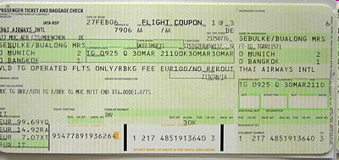
Airline Ticket Identification Number
The last digit is the check digit, and it is computed by the following formula:
a₁₅ = a₁a₂a₃…a₁₃a₁₄ (mod 7)
For example, consider the ticket number 0-001-1300696719-4
The check digit is 4, since
00011300696719 = 11300696719 = 1614385245 · 7 + 4

Slide 21
Airline Ticket Identification Number
a₁₅ = a₁a₂a₃…a₁₃a₁₄ (mod 7)
Can it be used to detect single digit error?
Correct number a₁a₂…a_{i}…a₁₃a₁₄
Incorrect number a₁a₂…b_{i}…a₁₃a₁₄
The error is not detected if and only if
a₁a₂…a_{i}…a₁₃a₁₄  a₁a₂…b_{i}…a₁₃a₁₄ (mod 7)
if and only if a₁a₂…a_{i}…a₁₃a₁₄ - a₁a₂…b_{i}…a₁₃a₁₄  0 (mod 7)
if and only if a_{i}10^{14-i} - b_{i}10^{14-i}  0 (mod 7)
if and only if a_{i} - b_{i}  0 (mod 7) since 7 does not divide 10
if and only if a_{i}  b_{i} (mod 7)

Slide 22
Airline Ticket Identification Number
a₁₅ = a₁a₂a₃…a₁₃a₁₄ (mod 7)
Can it be used to detect transposition error?
Correct number a₁a₂…cd…a₁₃a₁₄
Incorrect number a₁a₂…dc…a₁₃a₁₄
The error is not detected if and only if
a₁a₂…cd…a₁₃a₁₄  a₁a₂…dc…a₁₃a₁₄ (mod 7)
if and only if a₁a₂…cd…a₁₃a₁₄ - a₁a₂…dc…a₁₃a₁₄  0 (mod 7)
if and only if (c10^{j+1} + d10^{j}) – (d10^{j+1} + c10^{j})  0 (mod 7)
if and only if c10^{j}(10-1) - d10^{j}(10-1)  0 (mod 7)
if and only if 9·10^{j}(c-d)  0 (mod 7)
if and only if c  d (mod 7) since 7 does not divide 9 and 7 does not divide 10

Slide 23
Airline Ticket Identification Number
The last digit is the check digit, and it is computed by the following formula:
a₁₅ = a₁a₂a₃…a₁₃a₁₄ (mod 7)
Can it be used to detect single digit error?
Except when a_{i} (mod 7) = b_{i} (mod 7)
Can it be used to detect transposition error?
Except when c (mod 7) = d (mod 7)

Slide 24
This Lecture
Multiplicative inverse
Cancellation in modular arithmetic
Application: check digit scheme
US Postal Money Order
Airline Ticket
ISBN
Fermat’s little theorem

Slide 25
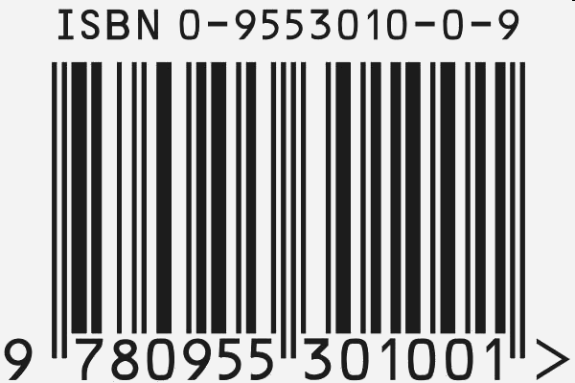
International Standard Book Number
The last digit is the check digit, and it satisfies the following equation:
10a₁ + 9a₂ + 8a₃ + 7a₄ + 6a₅ + 5a₆ + 4a₇ + 3a₈ + 2a₉ + a₁₀  0 (mod 11)
Note: When the check digit is 10, it assigns a₁₀ the special symbol X.

Slide 26
International Standard Book Number
10a₁ + 9a₂ + 8a₃ + 7a₄ + 6a₅ + 5a₆ + 4a₇ + 3a₈ + 2a₉ + a₁₀  0 (mod 11)
Can it be used to detect single digit error?
Correct number a₁a₂…a_{i}…a₉a₁₀
Incorrect number a₁a₂…b_{i}…a₉a₁₀
The error is not detected if and only if
10a₁ + 9·10₂…+(11-i)a_{i}…+2·a₉+a₁₀  10a₁ + 9·10₂…+(11-i)b_{i}…+a₁₀ (mod 11)
if and only if (11-i)a_{i}  (11-i)b_{i} (mod 11)
if and only if a_{i}  b_{i} (mod 11) since gcd(11-i,11)=1 and so we can cancel
(Another way to see it is to multiply the multiplicative inverse of (11-i) on both sides.)
This happens only when a_{i} = b_{i}, in which case there is no error!

Slide 27
International Standard Book Number
10a₁ + 9a₂ + 8a₃ + 7a₄ + 6a₅ + 5a₆ + 4a₇ + 3a₈ + 2a₉ + a₁₀  0 (mod 11)
Can it be used to detect transposition error?
Correct number a₁a₂…cd…a₉a₁₀
Incorrect number a₁a₂…dc…a₉a₁₀
The error is not detected if and only if
10a₁+…+ (11-i-1)c + (11-i)d +…+a₁₀  10a₁+…+ (11-i-1)d + (11-i)c +…+a₁₀ (mod 11)
if and only if (11-i-1)(c-d) + (11-i)(d-c)  0 (mod 11)
if and only if c-d  0 (mod 11)
This happens only when c = d, in which case there is no error!

Slide 28
International Standard Book Number
The last digit is the check digit, and it satisfies the following equation:
10a₁ + 9a₂ + 8a₃ + 7a₄ + 6a₅ + 5a₆ + 4a₇ + 3a₈ + 2a₉ + a₁₀  0 (mod 11)
Note: When the check digit is 10, it assigns a₁₀ the special symbol X.
Can it be used to detect single digit error?
Yes, always.
Can it be used to detect transposition error?
Yes, always.

