Slide 1
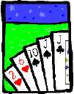
Basic Counting

Slide 2
This Lecture
We will study some basic rules for counting.
Sum rule, product rule, generalized product rule
Permutations, combinations
Binomial coefficients, combinatorial proof
Inclusion-exclusion principle

Slide 3
Sum Rule
|S|: the number of elements in a set S.
A
B
If sets A and B are disjoint, then
|A ∪ B| = |A| + |B|

Slide 4
Sum Rule
A
B
If sets A and B are disjoint, then
|A ∪ B| = |A| + |B|
Class has 43 women, 54 men, so total enrollment = 43 + 54 = 97
26 lower case letters, 26 upper case letters, and 10 digits,
so total characters = 26+26+10 = 62

Slide 5
Product Rule
Recall that, given two sets A and B, the Cartisean product
Fact: If |A| = n and |B| = m, then |AxB| = mn.
A = {a, b, c, d}, B = {1, 2, 3}
A × B = {(a,1),(a,2),(a,3),
(b,1),(b,2),(b,3),
(c,1),(c,2),(c,3),
(d,1),(d,2),(d,3) }
Example: If there are 4 men and 3 women, there are
possible married couples.

Slide 6
Product Rule
Fact: If |A| = n and |B| = m, then |AxB| = mn.
In general let A = {a₁, a₂, a₃, …, a_{m}} and B = {b₁, b₂, …, b_{n}}.
We can arrange the elements into a table as follows.
A × B = {(a₁,b₁), (a₁,b₂),…, (a₁,b_{n}),
(a₂,b₁), (a₂,b₂),…, (a₂,b_{n}),
(a₃,b₁), (a₃,b₂),…, (a₃,b_{n}),
…
(a_{m},b₁), (a_{m},b₂),…, (a_{m},b_{n}), }
There are m rows, and each row has n elements,
and so there are a total of mn elements.

Slide 7
Product Rule
Fact: |A₁xA₂x…xA_{k}| = |A₁|x|A₂|x…x|A_{k}|.
The formal proof uses mathematical induction.
But the proof idea is not difficult.
We think of A₁xA₂x…xA_{k} as (…((A₁xA₂)xA₃)…xA_{k}).
That is, we first construct A₁xA₂, and it is a set of size |A₁|x|A₂|.
Then, we construct (A₁xA₂)xA₃, the product of A₁xA₂ and A₃,
and it is a set of size (|A₁|x|A₂|)x|A₃| by the product rule on two sets.
Repeating the argument we can see that |A₁xA₂x…xA_{k}| = |A₁|x|A₂|x…x|A_{k}|.

Slide 8
Example: Counting Strings
Let B={0,1}.
The set of 2-bit strings is just BxB.
The set of 10-bit strings is just BxBxBxBxBxBxBxBxBxB, denoted by B¹⁰.
By the product rule, |BxB| = |B|x|B| = 2x2 = 4, and
|B¹⁰| = |B|x|B|x|B|x|B|x|B|x|B|x|B|x|B|x|B|x|B| = |B|¹⁰ = 2¹⁰ = 1024.
What is the number of 10-bit strings?

Slide 9
Example: IP Addresses
What is the number of IP addresses?
An IP address is of the form 192.168.0.123.
There are four numbers, each is between 0 and 255.
Let B={0,1,…,255}.
Then the set of IP addresses is just B⁴.
By the product rule, |B⁴| = |B|⁴ = 256⁴ = 4294967296.

Slide 10
Example: Product Rule
In general we have:
m^{n}.
The number of length-n strings from an alphabet of size m is
That is, |B^{n}| = |B|^{n}.
e.g. the number of length-n binary strings is 2^{n}
the number of length-n strings formed by capital letters is 26^{n}

Slide 11
Example: Counting Passwords
How many passwords satisfy the following requirements?
between 6 & 8 characters long
starts with a letter
case sensitive
other characters: digits or letters
First we define the set of letters and the set of digits.
L = {a,b,…,z,A,B,…,Z}
D = {0,1,…,9}

Slide 12
Example: Counting Passwords
L ::= {a,b,…,z,A,B,…,Z}
D ::= {0,1,…,9}
We first count the number of passwords with a specific length.
Let P_{n} be the set of passwords with length n.
P₆ =

Slide 13
Example: Counting Passwords
by product rule
by sum rule
The set of Passwords:
counting by partitioning
This is a common technique.
Divide the set into disjoint subsets.
Count each subset and add the answers.

Slide 14
At Least One Seven
How many # 4-digit numbers with at least one 7?
count by 1st occurrence of 7:
7xxx + o7xx + oo7x + ooo7
where x represents any digit from 1 to 10,
while o represent any digit from 1 to 10 except 7.
Clearly, each number containing at least one 7 is in
one of the above sets, and these sets are disjoint.
Therefore, the answer to the question is:
10³ + 9·10² + 9²·10 + 9³ = 3439
Method 1:
The set of 4-digit
numbers with 7 in
the first digit.
The set of 4-digit
numbers with 7 in
the second digit,
but the first digit
is not 7, and so on.
(counting by partitioning)

Slide 15
At Least One Seven
How many # 4-digit numbers with at least one 7?
Method 2:
|4-digit numbers with at least one 7|=
|4-digit numbers| − |those with no 7s|
= 10⁴ – 9⁴
= 3439
(counting the complement)
Counting the complement is a useful technique.

Slide 16
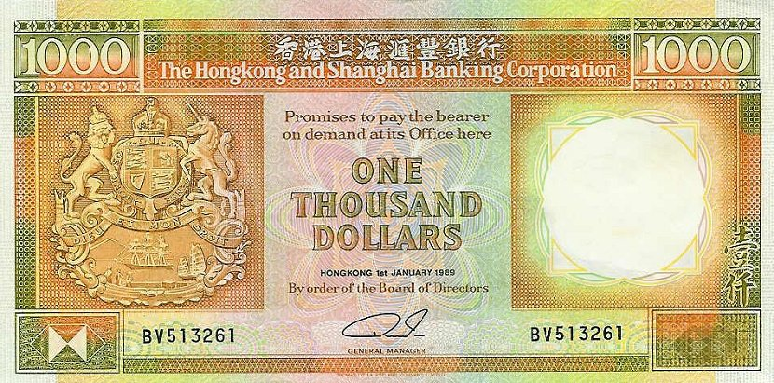
Defective Dollars
A dollar is defective if some digit appears
more than once in the 6-digit serial number.
How common are nondefective dollars?

Slide 17
Defective Dollars
How common are nondefective dollars?
10 possible choices for the first digit,
9 possible choices for the second digit, and so on…
So, there are 10x9x8x7x6x5
= 151200 serial number with all its digit different
There are totally 10⁶ = 1000000 serial numbers.
So, only about 15% of dollars are nondefective.

Slide 18
Generalized Product Rule
Q a set of length-k sequences. If there are:
n₁ possible 1st elements in sequences,
n₂ possible 2nd elements for each first entry,
n₃ possible 3rd elements for each 1st & 2nd,
…
then,
|Q| = n₁ · n₂ · n₃ · … · n_{k}

Slide 19
This Lecture
Sum rule, product rule, generalized product rule
Permutations, combinations
Binomial coefficients, combinatorial proof
Inclusion-exclusion principle

Slide 20
Permutations
Definition: A permutation of a set S is a sequence that
contains every element of S exactly once.
For example, here are all six permutations of the set {a, b, c}:
(a, b, c) (a, c, b) (b, a, c)
(b, c, a) (c, a, b) (c, b, a)
Ordering is important here.
How many permutations of an n-element set are there?
You can think of a permutation as a ranking of the elements.
So the above question is asking how many rankings of an n-element set.

Slide 21
Permutations
How many permutations of an n-element set are there?
There are n choices for the first element.
For each of these, there are n − 1 remaining choices for
the second element.
For every combination of the first two elements, there
are n − 2 ways to choose the third element, and so forth.
Thus, there are a total of
n · (n − 1) · (n − 2) · · · 3 · 2 · 1 = n!
permutations of an n-element set.
This is called n factorial.
Stirling’s formula (optional):

Slide 22
Example: Permutation
Suppose each digit is an element in {1,2,3,4,5,6,7,8,9}.
How many 9-digit numbers are there where each nonzero digit appears once?
Each such number corresponds to a permutation of 123456789,
and each permutation corresponds to such a number.
So the numbers of such numbers is equal to
the number of permutations of {1,2,3,4,5,6,7,8,9}.
Hence there are exactly 9! such numbers.
Alternatively, one can use the generalized product rule
directly to obtain the same result.

Slide 23
Combinations
How many subsets of size k of an n-element set?
Consider the set {1,2,3,4,5} where n=5.
If k=2, then there are 10 possible subsets of size 2,
i.e. {1,2}, {1,3}, {1,4}, {1,5}, {2,3}, {2,4}, {2,5}, {3,4}, {3,5}, {4,5}.
If k=3, then there are also 10 possible subsets of size 3,
i.e. {1,2,3}, {1,2,4}, {1,2,5}, {1,3,4}, {1,3,5}
{1,4,5}, {2,3,4}, {2,3,5}, {2,4,5}, {3,4,5}
Ordering is NOT important here.

Slide 24
Combinations
How many subsets of size k of an n-element set?
There are n choices for the first element.
For each of these, there are n − 1 remaining choices for
the second element.
There are n – k + 1 remaining choices for the last element.
Thus, there are a total of
n · (n − 1) · (n − 2) · · · (n – k + 1) to choose k elements.
So far we counted the number of ways to choose k elements,
when the ordering is important.
e.g. {1,2,3}, {1,3,2}, {2,1,3}, {2,3,1}, {3,1,2}, {3,2,1} will be counted as 6 different ways.

Slide 25
Combinations
How many subsets of size k of an n-element set?
We form the subsets by picking one element at a time.
There are n choices for the first element.
For each of these, there are n − 1 remaining choices for
the second element.
There are n – k + 1 remaining choices for the last element.
Thus, there are a total of
n · (n − 1) · (n − 2) · · · (n – k + 1) to choose k elements.
So far we counted the number of ways to choose k elements,
when the ordering is important.

Slide 26
Combinations
How many subsets of size k of an n-element set?
Thus, there are a total of
n · (n − 1) · (n − 2) · · · (n – k + 1) ways to choose k elements,
when the ordering is important.
How many different ordering of k elements are (over)-counted?
e.g. If we are forming subsets of size 3, then
(1,2,3), (1,3,2), (2,1,3), (2,3,1), (3,1,2), (3,2,1)
are counted as 6 different ways if the ordering is important.
In general, each subset of size k has k! different orderings,
and so each subset is counted k! times in the above way of choosing k elements.

Slide 27
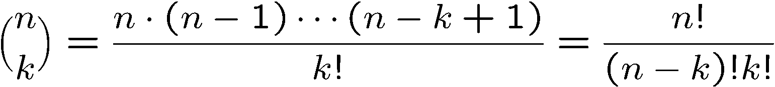
Combinations
How many subsets of size k of an n-element set?
Thus, there are a total of
n · (n − 1) · (n − 2) · · · (n – k + 1) ways to choose k elements,
when the ordering is important.
Each subset is counted, but is counted k! times, because
each subset contributes k! different orderings to the above.
So, when the ordering is not important, the answer is:
This is the
shorthand for
“n choose k”

Slide 28
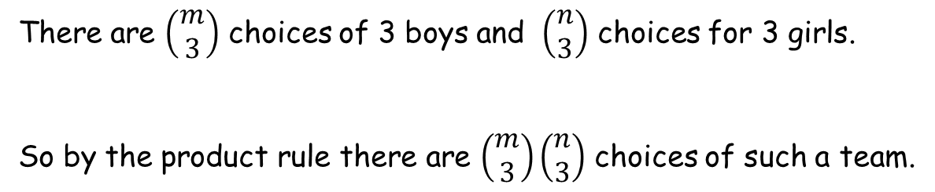
Example: Team Formation
There are m boys and n girls.
How many ways are there to form a team with 3 boys and 3 girls?
There are $\left(\begin{matrix}m \\ 3\end{matrix}\right)$ choices of 3 boys and $\left(\begin{matrix}n \\ 3\end{matrix}\right)$ choices for 3 girls.
So by the product rule there are $\left(\begin{matrix}m \\ 3\end{matrix}\right)\left(\begin{matrix}n \\ 3\end{matrix}\right)$ choices of such a team.
If m < 3 or n < 3, then the answer should be zero.
Don’t worry. We don’t like to trick you this way.

Slide 29
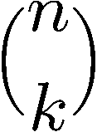
Example: Bit Strings with k Zeros
How many n-bit sequences contain k zeros and (n − k) ones?
We can think of this problem as choosing k positions
(out of the n possible positions) and set them to zeroes
and set the remaining positions to ones.
So the above question is asking the number of
possible positions of the k zeros, and the answer is:

Slide 30
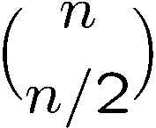
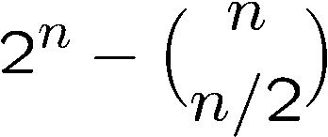
Example: Unbalanced Bit Strings
We say a bit string is unbalanced if there are
more ones than zeroes or more zeros than ones.
How many n-bit strings are unbalanced?
If n is odd, then every n-bit string is unbalanced, and the answer is 2^{n}.
If n is even, then the number of balanced strings is
by choosing n/2 positions to zeroes.
So the number of unbalanced n-bit strings is equal to
the number of all n-bit strings minus the number of balanced strings,
and so the answer is
(counting the complement)

Slide 31
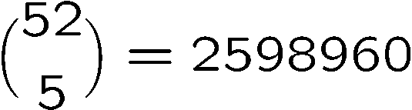
Poker Hands
There are 52 cards in a deck.
Each card has a suit and a value.
(♠ ♥ ♦ ♣)
4 suits
13 values
(2, 3, 4, 5, 6, 7, 8, 9, 10, J, Q, K, A)
Five-Card Draw is a card game in which each player
is initially dealt a hand, a subset of 5 cards.
How many different hands?

Slide 32
Example 1: Four of a Kind
A Four-of-a-Kind is a set of four cards with the same value.
How many different hands contain a Four-of-a-Kind?
One way to do this is to first map the problem into
a problem of counting sequences.

Slide 33

Example 1: Four of a Kind
A hand with a Four-of-a-Kind is completely described by a sequence specifying:
1. The value of the four cards.
2. The value of the extra card.
3. The suit of the extra card.
There are 13 choices for (1), 12 choices for (2), and 4 choices for (3).
By generalized product rule, there are 13x12x4 = 624 hands.
Only 1 hand in about 4165 has a Four-of-a-Kind!

Slide 34
Example 2: Full House
A Full House is a hand with three cards of one value and two cards of another value.
How many different hands contain a Full House?

Slide 35
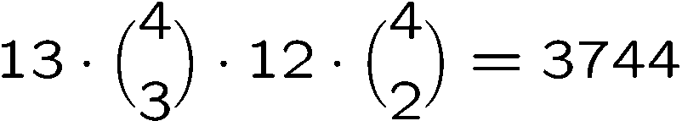
Example 2: Full House
There is a bijection between Full Houses and sequences specifying:
1. The value of the triple, which can be chosen in 13 ways.
2. The suits of the triple, which can be selected in (4 3) ways.
3. The value of the pair, which can be chosen in 12 ways.
4. The suits of the pair, which can be selected in (4 2) ways.
By generalized product rule, there are
Only 1 hand in about 634 has a Full House!

Slide 36

Example 3: Two Pairs
How many hands have Two Pairs; that is,
two cards of one value, two cards of another value, and one card of a third value?

Slide 37
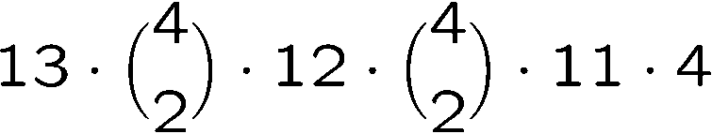
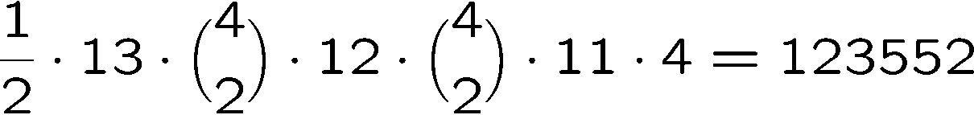
Example 3: Two Pairs
1. The value of the first pair, which can be chosen in 13 ways.
2. The suits of the first pair, which can be selected (4 2) ways.
3. The value of the second pair, which can be chosen in 12 ways.
4. The suits of the second pair, which can be selected in (4 2) ways
5. The value of the extra card, which can be chosen in 11 ways.
6. The suit of the extra card, which can be selected in 4 ways.
Number of Two pairs =
Double
Count!
So the answer is

Slide 38

Example 4: Every Suit
How many hands contain at least one card from every suit?
1. The value of each suit, which can be selected in 13x13x13x13 ways.
2. The suit of the extra card, which can be selected in 4 ways.
3. The value of the extra card, which can be selected in 12 ways.
Double count!
So the answer is 13⁴x4x12/2 = 685464

Slide 39
This Lecture
Sum rule, product rule, generalized product rule
Permutations, combinations
Binomial coefficients, combinatorial proof
Inclusion-exclusion principle

Slide 40
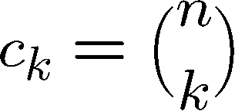
Binomial Theorem
We can compute the coefficients by simple counting arguments.
n times
Each term corresponds to selecting 1 or x from each of the n factors.
c_{k} is number of terms with exactly k x’s are selected from n factors.

Slide 41
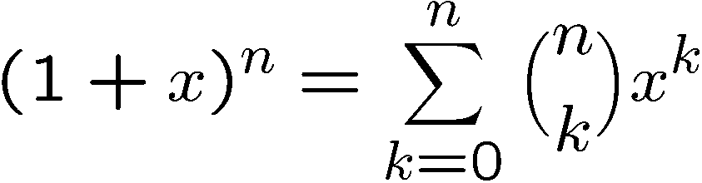
Binomial Theorem
(1+X)⁰ =
1
(1+X)¹ =
1 + 1X
(1+X)² =
1 + 2X + 1X²
(1+X)³ =
1 + 3X + 3X² + 1X³
(1+X)⁴ =
1 + 4X + 6X² + 4X³ + 1X⁴

Slide 42
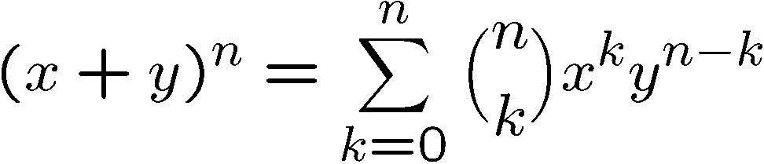
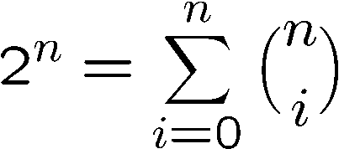
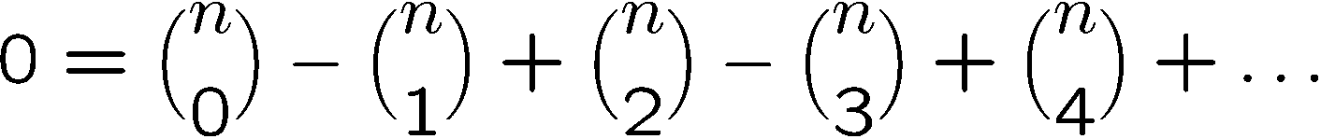
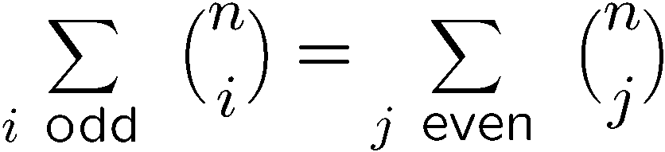
Binomial Coefficients
In general we have the following identity:
When x=1, y=1, it says that
When x=1, y=-1, it says that

Slide 43
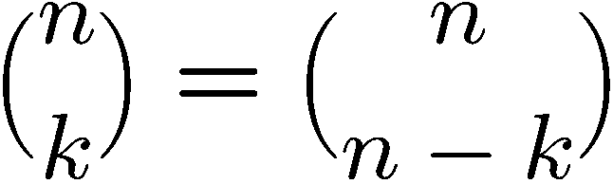
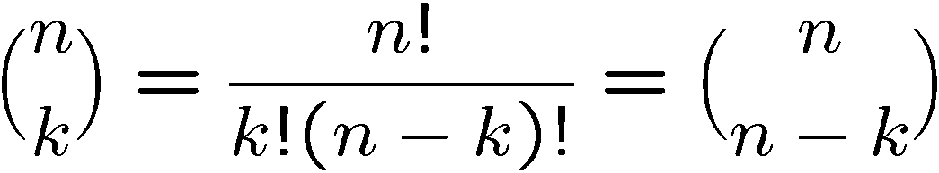
Proving Identities
Direct proof:
Combinatorial proof:
Number of ways to choose k items from n items
= number of ways to choose n-k items from n items

Slide 44
Finding a Combinatorial Proof
A combinatorial proof is an argument that establishes an algebraic fact by relying on counting principles.
Many such proofs follow the same basic outline:
1. Define a set S.
2. Show that |S| = n by counting one way.
3. Show that |S| = m by counting another way.
4. Conclude that n = m.
Double counting

Slide 45
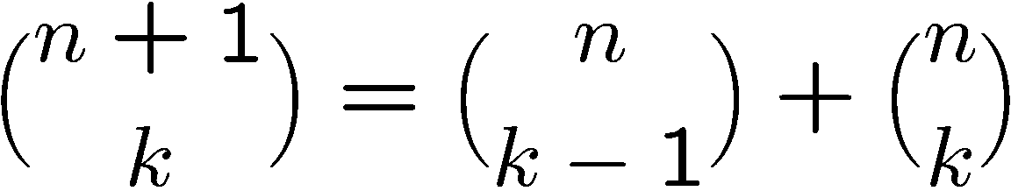
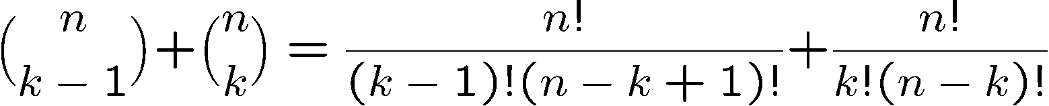
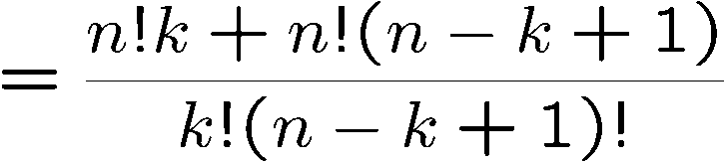
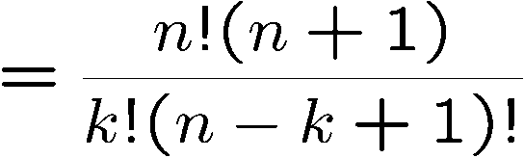
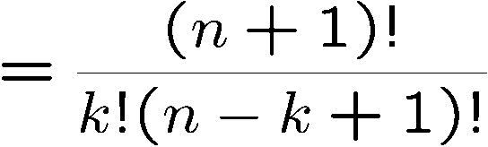
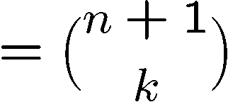
Proving Identities
Pascal’s Formula
Direct proof:
Direct proof:

Slide 46
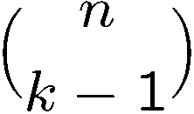

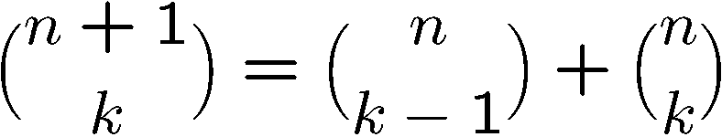
Proving Identities
Pascal’s Formula
Combinatorial proof:
The LHS is number of ways to choose k elements from n+1 elements.
Let the first element be x.
If we choose x, then we need to choose k-1 elements
from the remaining n elements, and number of ways to do so is
If we don’t choose x, then we need to choose k elements
from the remaining n elements, and number of ways to do so is
This partitions the ways to choose k elements from n+1 elements,
therefore

Slide 47
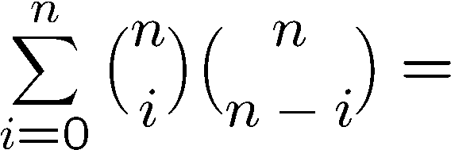
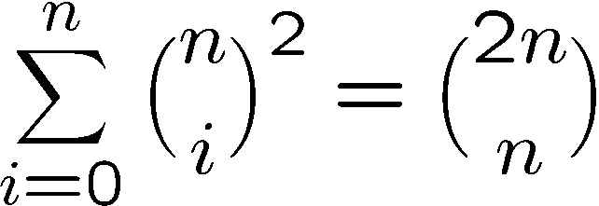
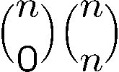
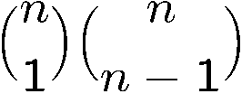
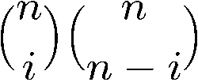
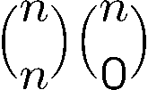
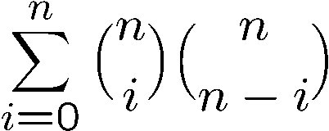
Combinatorial Proof
Consider we have 2n balls, n of them are red, and n of them are blue.
The RHS is number of ways to choose n balls from the 2n balls.
To choose n balls, we can
- choose 0 red ball and n blue balls, number of ways =
- choose 1 red ball and n-1 blue balls, number of ways =
…
choose i red balls and n-i blue balls, number of ways =
…
choose n red balls and 0 blue ball, number of ways =
Hence number of ways to choose n balls is also equal to

Slide 48
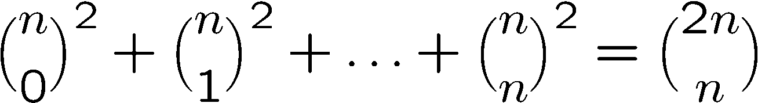
Another Way to Combinatorial Proof (Optional)
We can also prove the identity by comparing a coefficient of two polynomials.
Consider the identity
Consider the coefficient of x^{n} in these two polynomials.
Clearly the coefficient of x^{n} in (1+x)^{2n} is equal to the RHS.
So the coefficient of x^{n} in (1+x)^{n}(1+x)^{n} is equal to the LHS.

Slide 49
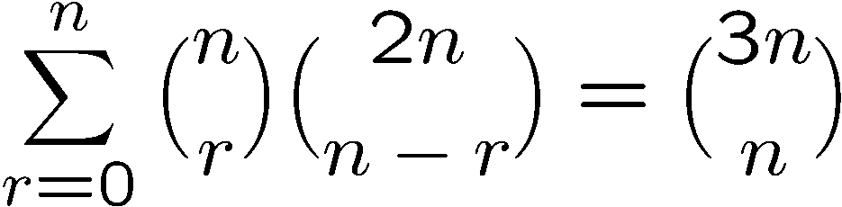
More Combinatorial Proof
Let S be all n-card hands that can be dealt from a deck containing
n red cards (numbered 1, . . . , n) and 2n black cards (numbered 1, . . . , 2n).
The right hand side = # of ways to choose n cards from these 3n cards.
The left hand side = # of ways to choose r cards from red cards x
# of ways to choose n-r cards from black cards
= # of ways to choose n cards from these 3n cards
= the right hand side.

Slide 50
Exercises
Prove that
Give a combinatorial proof of the following identify.
Can you give a direct proof of it?

Slide 51
Quick Summary
We have studied how to determine the size of a set directly.
The basic rules are the sum rule, product rule, and the generalized product rule.
We apply these rules in counting permutations and combinations,
which are then used to count other objects like poker hands.
Then we prove the binomial theorem and study combinatorial proofs of identities.
Finally we learn the inclusion-exclusion principle and see some applications.
Later we will learn how to count “indirectly” by “mapping”.

