Slide 1
More Counting
A
B
…
f
…
Lecture 16: Nov 9

Slide 2
This Lecture
We will study how to define mappings to count.
There will be many examples shown.
Bijection rule
Division rule
More mapping

Slide 3
Counting Rule: Bijection
If f is a bijection from A to B,
then |A| = |B|
A
B
…
f
…

Slide 4
Power Set
How many subsets of a set S?
P(S) = the power set of S
= the set of all subsets of S
for S = {a, b, c},
P(S) = {∅, {a}, {b}, {c}, {a,b}, {a,c}, {b,c}, {a,b,c} }
Suppose S has n elements.
How large is the power set of S?

Slide 5
Bijection: Power Set and Binary Strings
S : {s₁, s₂, s₃, s₄, s₅, … , s_{n}}
We define a bijection between subsets and binary strings
A: the set of all subsets of S
B: the set of all binary strings of length n
A
B
…
…
f
The mapping is defined in the following way:
subset: {s₁, s₃, s₄, … , s_{n}}
string: 1 0 1 1 0 … 1

Slide 6

Bijection: Power Set and Binary Strings
The mapping is defined in the following way:
subset: {s₁, s₃, s₄, … , s_{n}}
A
B
…
…
string: 1 0 1 1 0 … 1
f
This mapping is a bijection, because
each subset is mapped to a unique binary string, and
each binary string represents a unique subset.
Therefore, |A| = |B|, and |B| can be computed directly.
So, |n-bit binary strings| = |P(S)|

Slide 7
A Chess Problem
In how many different ways can we place a pawn (p),
a knight (k), and a bishop (b) on a chessboard so that
no two pieces share a row or a column?

Slide 8
A Chess Problem
We define a mapping between configurations to
sequences (r(p), c(p), r(k), c(k), r(b), c(b)),
where r(p), r(k), and r(b) are distinct rows,
and c(p), c(k), and c(b) are distinct columns.
A: the set of the configurations of the 3 pieces
B: the set of the such sequences of 6 numbers
A
B
…
…
f
If we can define a bijection between A and B,
and also calculate |B|, then we can determine |A|.

Slide 9
A Chess Problem
We define a mapping between configurations to
sequences (r(p), c(p), r(k), c(k), r(b), c(b)),
where r(p), r(k), and r(b) are distinct rows,
and c(p), c(k), and c(b) are distinct columns.
(7,6,2,5,5,2)
(2,5)
This is a bijection, because:
each configuration is mapped to a unique sequence
each sequence represents a unique configuration.
(5,2)
So, to count the number of chess configurations,
it is enough to count the number of such sequences.
(7,6)

Slide 10
A Chess Problem
We define a mapping between configurations to
sequences (r(p), c(p), r(k), c(k), r(b), c(b)),
where r(p), r(k), and r(b) are distinct rows,
and c(p), c(k), and c(b) are distinct columns.
Using the generalized product rule,
there are 8 choices of r(p) and c(p),
there are 7 choices of r(k) and c(k),
there are 6 choices of r(b) and c(b).
Thus, total number of configurations
= (8x7x6)² = 112896.
(7,6,2,5,5,2)

Slide 11

Counting Doughnut Selections
There are five kinds of doughnuts.
How many different ways to select a dozen doughnuts?
00 (none) 000000 00 00
Chocolate Lemon Sugar Glazed Plain
A ::= all selections of a dozen doughnuts
Hint: define a bijection!
A
B
…
…
f

Slide 12
Counting Doughnut Selections
A ::= all selections of a dozen doughnuts
B::= all 16-bit binary strings with exactly four 1’s.
Define a bijection between A and B.
0011000000100100
00 1 1 000000 1 00 1 00
00 (none) 000000 00 00
Chocolate Lemon Sugar Glazed Plain
Each doughnut is represented by a 0,
and four 1’s are used to separate five types of doughnuts.

Slide 13
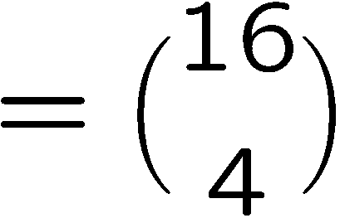
Counting Doughnut Selections
c chocolate, l lemon, s sugar, g glazed, p plain
maps to
a bijection
0^{c}10^{l}10^{s}10^{g}10^{p}
A ::= all selections of a dozen doughnuts
B::= all 16-bit binary strings with exactly four 1’s.

Slide 14
Choosing Non-Adjacent Books
There are 20 books arranged in a row on a shelf.
How many ways to choose 6 of these books so that
no two adjacent books are selected?
A ::= all selections of 6 non-adjacent books from 20 books
Hint: define a bijection!
A
B
…
…
f

Slide 15
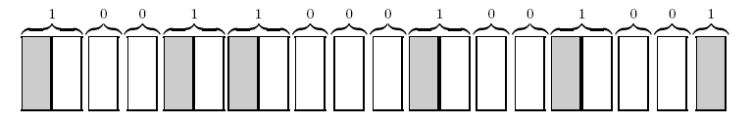
Choosing Non-Adjacent Books
A ::= all selections of 6 non-adjacent books from 20 books
B::= all 15-bit binary strings with exactly six 1’s.
Map each zero to a non-chosen book, each of the first five 1’s to a chosen
book followed by a non-chosen book, and the last 1 to a chosen book.
This is a bijection, because:
each selection maps to a unique binary string.
each binary string is mapped by a unique selection.

Slide 16
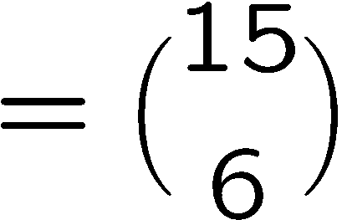
Choosing Non-Adjacent Books
A ::= all selections of 6 non-adjacent books from 20 books
B::= all 15-bit binary strings with exactly six 1’s.

Slide 17
In-Class Exercise
for i=1 to n do
for j=1 to i do
for k=1 to j do
printf(“hello world\n”);
How many “hello world” will this program print?

Slide 18
In-Class Exercise
for i=1 to n do
for j=1 to i do
for k=1 to j do
printf(“hello world\n”);
There are n possible positions for the i,j,k.
1 2 3 4 5 … n
…
Imagine there are n-1 separators for the n numbers.
If i=4, j=2, k=2, then there are two balls in 2 and one ball in 4.

Slide 19
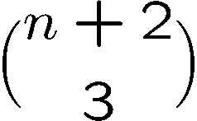
In-Class Exercise
for i=1 to n do
for j=1 to i do
for k=1 to j do
printf(“hello world\n”);
There are n possible positions for the i,j,k.
1 2 3 4 5 … n
…
There is a bijection between the positions for i,j,k
and the set of strings with n-1 ones and 3 zeros.
So, the program prints “hello world” exactly times.

Slide 20
In-Class Exercises
How many solutions are there to the equation x1+x2+x3+x4=10,
where x1,x2,x3,x4 are nonnegative integers?
Think of this as distributing 10 points amongst 4 variables.
x1 x2 x3 x4
0 0 0 0 0 0 0 0 0 0
Suppose x1=3, x2=5, x3=2, x4=0,
it corresponds to inserting 3 separations as above.

Slide 21
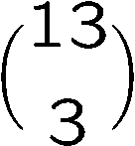
In-Class Exercises
How many solutions are there to the equation x1+x2+x3+x4=10,
where x1,x2,x3,x4 are nonnegative integers?
Think of this as distributing 10 points amongst 4 variables.
x1 x2 x3 x4
0 0 0 0 0 0 0 0 0 0
So there is a bijection between the integer solutions and
the set of binary strings with 10 zeros and 3 ones.
So, the are exactly integer solutions.

Slide 22

In-Class Exercises
How many integer solutions to x1+x2+x3+x4=10 if each xi>=1?
Method 1: Define a mapping directly,
using the idea of “non-adjacent” books.
Method 2: Set xi=yi+1.
So the equation becomes y1+y2+y3+y4=6,
where each yi is a non-negative integer.
Therefore we can apply the previous result,
and conclude that the answer is

Slide 23
This Lecture
Bijection rule
Division rule
More mapping

Slide 24
Division Rule
if function from A to B is k-to-1,
then
(generalizes the Bijection Rule)

Slide 25
Example 3: Two Pairs
This is something we have encountered before when we counted poker hands.
Double
Count!
A: the set of two pairs
B: the set of sequences which satisfy (1)-(6).
What we did was to show that the mapping from A to B is 1-to-2,
and thus conclude that 2|A| = |B|. Then we compute |B| and then |A|.

Slide 26
Another Chess Problem
In how many different ways can you place two identical rooks on a chessboard so that
they do not share a row or column?

Slide 27
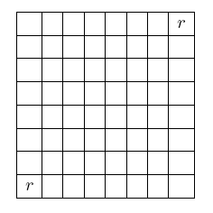
Another Chess Problem
We define a mapping between configurations
to sequences (r(1), c(1), r(2), c(2)),
where r(1) and r(2) are distinct rows,
and c(1) and c(2) are distinct columns.
A ::= all sequences (r(1),c(1),r(2),c(2)) with r(1) ≠ r(2) and c(1) ≠ c(2)
B::= all valid rook configurations
(1,1,8,8) and (8,8,1,1) maps
to the same configuration.
The mapping is a 2-to-1 mapping.

Slide 28

Another Chess Problem
A ::= all sequences (r(1),c(1),r(2),c(2)) with r(1) ≠ r(2) and c(1) ≠ c(2)
B::= all valid rook configurations
The mapping is a 2-to-1 mapping.
Using the generalized product rule to count |A|,
there are 8 choices of r(1) and c(1),
there are 7 choices of r(2) and c(2),
and so |A| = 8x8x7x7 = 3136.
Thus, total number of configurations
|B| = |A|/2 = 3136/2 = 1568.

Slide 29
Round Table
How many ways can we seat n different people at a round table?
Two seatings are considered equivalent if one can be obtained from the other by rotation.
equivalent

Slide 30
Round Table
A ::= all the permutations of the people
B::= all possible seating arrangements at the round table
Map each permutation in set A to a circular seating arrangement in set B by following the natural order in the permutation.

Slide 31
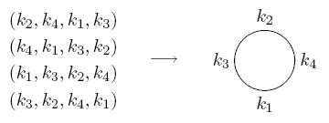

Round Table
A ::= all the permutations of the people
B::= all possible seating arrangements at the round table
This mapping is an n-to-1 mapping.
Thus, total number of seating arrangements
|B| = |A|/n = n!/n = (n-1)!

Slide 32

Counting Subsets
Now we can use the division rule to compute more formally.
How many size 4 subsets of {1,2,…,13}?
Let A::= permutations of {1,2,…,13}
B::= size 4 subsets
map a₁ a₂ a₃ a₄ a₅… a₁₂ a₁₃ to {a₁,a₂ ,a₃, a₄}
(that is, take the first k elements from the permutation)
How many permutations are mapped to the same subset??

Slide 33

Counting Subsets
map a₁ a₂ a₃ a₄ a₅… a₁₂ a₁₃ to {a₁,a₂ ,a₃ , a₄}
a₂ a₄ a₃ a₁ a₅ … a₁₂ a₁₃ also maps to {a₁,a₂ ,a₃, a₄}
as does a₂ a₄ a₃ a₁ a₁₃ a₁₂ … a₅
4!
9!
Any ordering of the first four elements (4! of them),
and also any ordering of the last nine elements (9! of them)
will give the same subset.
So this mapping is
4!9!-to-1

Slide 34

Counting Subsets
Let A::= permutations of {1,2,…,13}
B::= size 4 subsets
So number of 4 element subsets is
Number of m element subsets of an n element set is

Slide 35
MISSISSIPPI
How many ways to rearrange the letters in the word “MISSISSIPPI”?
Let A be the set of all permutations of n letters.
B be the set of all different words by rearranging “MISSISSIPPI”.
How many permutations are mapped to the same word?
4! possible ways to rearrange the S giving the same word
MISSISSIPPI
4! possible ways to rearrange the I giving the same word
2! possible ways to rearrange the P giving the same word
The mapping is 4!4!2!-to-1, and so there are 13!/4!4!2! different words.

Slide 36
Example: 20 Mile Walk
I’m planning a 20-mile walk, which should include 5 northward miles, 5 eastward miles, 5 southward miles, and 5 westward miles.
How many different walks are possible?
There is a bijection between such walks and sequences with 5 N’s, 5 E’s, 5 S’s, and 5 W’s.
The number of such sequences is equal to the number of rearrangements:
20!
5!5!5!5!

Slide 37
Exercises
What is the coefficient of x⁷y⁹z⁵ in (x+y+z)²¹?
There are 12 people. How many ways to divide them into 3 teams, each team with 4 people?

Slide 38
This Lecture
Bijection rule
Division rule
More mapping

Slide 39
Parenthesis
How many valid ways to add n pairs of parentheses?
E.g. There are 5 valid ways to add 3 pairs of parentheses.
((())) (()()) (())() ()(()) ()()()
Let r_{n} be the number of ways to add n pairs of parentheses.
A pairing is valid if and only if there are at least as many
open parentheses than close parentheses from the left.

Slide 40
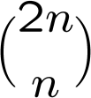
Monotone Path
A monotone path from (0,0) to (n,n) is a path consist of “right" moves (x-coordinate increase by 1) and “up" moves (y-coordinate increase by 1), starting at (0,0) and ending at (n,n).
How many possible monotone paths from (0,0) to (n,n)?
We can map a “right” move to an “x” and a “up” move to a “y”.
There is a bijection between monotone paths and words with n x’s and n y’s.
And so the answer is just

Slide 41
Monotone Path
We say such a path “lower-right" monotone path if all of the points (x_{i},y_{i}) on the path has x_{i} >= y_{i}.
lower-right monotone
NOT lower-right monotone
How many possible lower right monotone paths from (0,0) to (n,n)?

Slide 42
Monotone Path
How many possible lower right monotone paths from (0,0) to (n,n)?
We can still map a “right” move to an “x” and a “up” move to a “y”.
There is a bijection between (A) lower right monotone paths and
(B) words with n x’s and n y’s, with the additional constraint that
no initial segment of the string has more Y's than X's.
There is a bijection, but both sets look difficult to count.

Slide 43
Mountain Ranges
How many “mountain ranges” can you form with n upstrokes
and n downstrokes that all stay above the original line?
/\
/\ /\ /\/\ / \
/\/\/\, /\/ \, / \/\, / \, / \
We do not know how to solve these three problems yet, but
we can show that all these three problems have the same answer,
by showing that there are bijections between these sets.

Slide 44
Parenthesis and Monotone Paths
A pairing is valid if and only if there are at least as many
open parentheses than close parentheses from the left.
(()()()) ()()()()
xxyxyxyy
xyxyxyxy
We can map a “(” to an “x” and a “)” move to a “y”.
There is a bijection between (A) valid pairings and
(B) words with n x’s and n y’s, with the additional constraint that
no initial segment of the string has more Y's than X's.
In slide 19, we have seen that there is a bijection between (B)
and the set of lower right monotone paths, so there is a bijection
between (A) and the set of lower right monotone paths.

Slide 45
Parenthesis and Monotone Paths
A pairing is valid if and only if there are at least as many
open parentheses than close parentheses from the left.
A monotone path is “lower-right” if and only if there are at
least as many right moves than up moves from the starting point.
(()()()) ()()()()
So there is a bijection between these two sets by each open
parenthesis with a right move and a close parenthesis by an up move.

Slide 46
Monotone Paths and Mountain Ranges
By “rotating” the images, we see that a path not crossing the diagonal
is just the same as a mountain not crossing the horizontal line.
So there is a bijection between them by mapping “right” to “up” and “up” to “down”

Slide 47
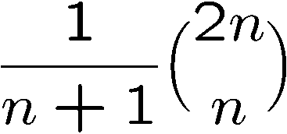
Parenthesis, Monotone Paths and Mountain Ranges
Now we know that these three sets are of equal size,
although we don’t know the size.
It turns out that the answer is exactly
This is called the nth Catalan number,
and has applications in many other places as well.
We will not compute it in the lecture,
but will do so in the advanced lecture about counting.

Slide 48
Mapping Between Infinite Sets (Optional)
How to compare the size of two infinite sets?
Cantor proposed an elegant defintion:
Two infinite sets are “equal” if there is a bijection between them.
Using this definition, it can be shown that:
The set of positive integers = the set of integers
The set of integers = the set of rational numbers
The set of integers ≠ the set of real numbers

Slide 49
Quick Summary
Counting by mapping is a very useful technique.
It is also a powerful technique to solve more complicated problems.
The basic examples usually map a set into a properly defined binary strings.
Then we see how to generalize this approach by considering k-to-1 functions.
Finally we see the mapping between more complicated sets.

