Slide 1

Argument
An argument is a sequence of statements.
All statements but the final one are called assumptions or hypothesis.
The final statement is called the conclusion.
An argument is valid if:
whenever all the assumptions are true, then the conclusion is true.
If today is Wednesday, then yesterday was Tuesday.
Today is Wednesday.
Yesterday was Tuesday.

Slide 2
Modus Ponens
If p then q.
p
q
If bandh, then class cancelled.
Bandh.
Class cancelled.
assumptions
conclusion
p | q | p→q | p | q
T | T | T | T | T
T | F | F | T | F
F | T | T | F | T
F | F | T | F | F
Modus ponens is Latin for “method of affirming”.

Slide 3
Modus Tollens
If p then q.
~q
~p
If Bandh, then class cancelled.
Class not cancelled.
No Bandh.
assumptions
conclusion
p | q | p→q | ~q | ~p
T | T | T | F | F
T | F | F | T | F
F | T | T | F | T
F | F | T | T | T
Modus tollens is Latin for “method of denying”.

Slide 4
Equivalence
A student is trying to prove that propositions P, Q, and R are all true.
She proceeds as follows.
First, she proves three facts:
P implies Q
Q implies R
R implies P.
Then she concludes,
``Thus P, Q, and R are all true.''
Proposed argument:
assumption
Is it valid?
conclusion

Slide 5




Valid Argument?
Is it valid?
assumptions
conclusion
P | Q | R
T | T | T
T | T | F
T | F | T
T | F | F
F | T | T
F | T | F
F | F | T
F | F | F
T | T | T
T | F | T
F | T | T
F | T | T
T | T | F
T | F | T
T | T | F
T | T | T
 | OK?
T | yes
F | yes
F | yes
F | yes
F | yes
F | yes
F | yes
F | no
To prove an argument is not valid, we just need to find a counterexample.

Slide 6
Valid Arguments?
assumptions
conclusion
p | q | p→q | q | p
T | T | T | T | T
T | F | F | F | T
F | T | T | T | F
F | F | T | F | F
If p then q.
q
p
Assumptions are true, but not the conclusion.
If you are a fish, then you drink water.
You drink water.
You are a fish.

Slide 7
Valid Arguments?
assumptions
conclusion
p | q | p→q | ~p | ~q
T | T | T | F | F
T | F | F | F | T
F | T | T | T | F
F | F | T | T | T
If p then q.
~p
~q
If you are a fish, then you drink water.
You are not a fish.
You do not drink water.

Slide 8


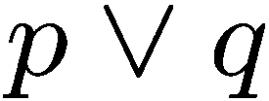
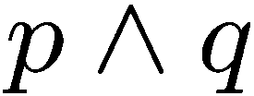




Exercises

Slide 9




More Exercises
Valid argument True conclusion
True conclusion Valid argument

Slide 10

Contradiction
If you can show that the assumption that the statement
p is false leads logically to a contradiction,
then you can conclude that p is true.
You are wearing a jacket.
If it was warm, then you would not have worn a jacket.
It is not warm.

Slide 11
Knights and Knaves
Knights always tell the truth.
Knaves always lie.
A says: B is a knight.
B says: A and I are of opposite type.
Suppose A is a knight.
Then B is a knight (because what A says is true).
Then A is a knave (because what B says is true)
A contradiction.
So A must be a knave.
So B must be a knave (because what A says is false).

Slide 12
Quick Summary
Conditional Statements
The meaning of IF and its logical forms
Contrapositive
If, only if, if and only if
Arguments
definition of a valid argument
method of affirming, denying, contradiction
Key points:
Make sure you understand conditional statements and contrapositive.
Make sure you can check whether an argument is valid.

Slide 13

Which is true?
Which is false?
“The sentence below is false.”
“The sentence above is true.”

Slide 14
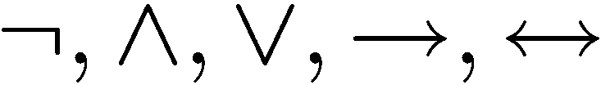
Limitation of Propositional Logic
Propositional logic – logic of simple statements
How to formulate Pythagoreans’ theorem using propositional logic?
b
c
a
How to formulate the statement that there are infinitely many primes?

Slide 15
Predicates
Predicates are propositions (i.e. statements) with variables
Example:
P (x,y) ::=
x + 2 = y
x = 1 and y = 3: P(1,3) is true
x = 1 and y = 4: P(1,4) is false
¬P(1,4) is true
When there is a variable, we need to specify what to put in the variables.
The domain of a variable is the set of all values
that may be substituted in place of the variable.

Slide 16


Set
To specify the domain, we often need the concept of a set.
Roughly speaking, a set is just a collection of objects.
R | Set of all real numbers
Z | Set of all integers
Q | Set of all rational numbers
Some examples
Given a set, the (only) important question is whether an element belongs to it.
means that x is an element of A (pronounce: x in A)
means that x is not an element of A (pronounce: x not in A)
Sets can be defined explicitly:
e.g. {1,2,4,8,16,32,…}, {CSC1130,CSC2110,…}

Slide 17

Truth Set
Sometimes it is inconvenient or impossible to define a set explicitly.
Sets can be defined by a predicate
Given a predicate P(x) where x has domain D, the truth set of P(x) is the set of all elements of D that make P(x) true.
e.g.
Let P(x) be “x is the square of a number”,
and the domain D of x is the set of positive integers.
Then the truth set is the set of all positive integers which are the square of a number.
e.g.
Let P(x) be “x is a prime number”,
and the domain D of x is the set of positive integers.
Then the truth set is the set of all positive integers which are prime numbers.

Slide 18



The Universal Quantifier
The universal quantifier
∀x
for ALL x
Example:
∀ x Z ∀ y Z, x + y = y + x.
c
Pythagorean’s theorem
b
a
Example:
This statement is true if the domain is Z, but not true if the domain is R.
The truth of a statement depends on the domain.

Slide 19
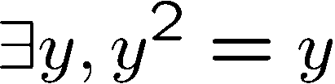
The Existential Quantifier
∃y
There EXISTS some y
e.g.
The truth of a statement depends on the domain.
Domain
Truth value
integers 
T
positive integers ⁺
T
negative integers ⁻
F
negative reals ⁻
T

Slide 20
Translating Mathematical Theorem
Fermat (1637): If an integer n is greater than 2,
then the equation a^{n} + b^{n} = c^{n} has no solutions in non-zero integers a, b, and c.
Andrew Wiles (1994)
http://en.wikipedia.org/wiki/Fermat's_last_theorem

Slide 21


Translating Mathematical Theorem
Goldbach’s conjecture: Every even number is the sum of two prime numbers.
Suppose we have a predicate prime(x) to determine if x is a prime number.
How to write prime(p)?

Slide 22
Quantifiers
Negation
Multiple quantifiers
Arguments of quantified statements
(Optional) Important theorems, applications

Slide 23
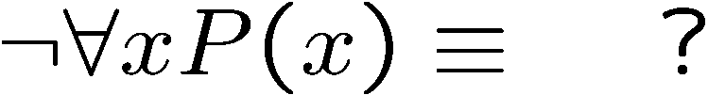
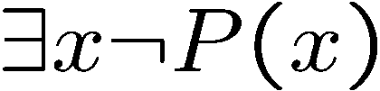


Negations of Quantified Statements
Everyone likes football.
What is the negation of this statement?
Not everyone likes football = There exists someone who doesn’t like football.
(generalized) DeMorgan’s Law
Say the domain has only three values.
The same idea can be used to prove it for any number of variables, by mathematical induction.

Slide 24
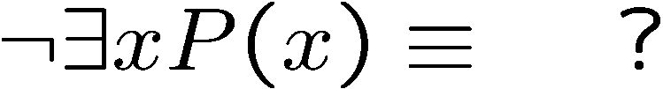
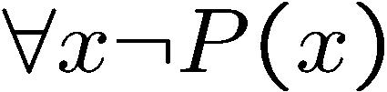

Negations of Quantified Statements
There is a plant that can fly.
What is the negation of this statement?
Not exists a plant that can fly = every plant cannot fly.
(generalized) DeMorgan’s Law
Say the domain has only three values.
The same idea can be used to prove it for any number of variables, by mathematical induction.

Slide 25
Quantifiers
Negation
Multiple quantifiers
Arguments of quantified statements
(Optional) Important theorems, applications

Slide 26
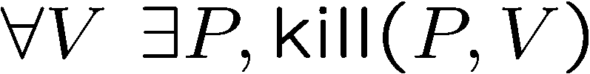
Order of Quantifiers
There is an anti-virus program killing every computer virus.
How to interpret this sentence?
For every computer virus, there is an anti-virus program that kills it.
For every attack, I have a defense:
against MYDOOM, use Defender
against ILOVEYOU, use Norton
against BABLAS, use Zonealarm …
 is expensive!

Slide 27
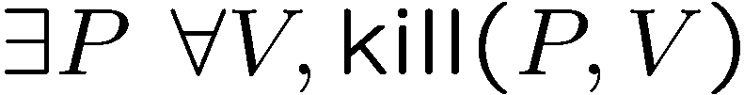
Order of Quantifiers
There is an anti-virus program killing every computer virus.
How to interpret this sentence?
There is one single anti-virus program that kills all computer viruses.
I have one defense good against every attack.
Example: P is CSE-antivirus,
protects against ALL viruses
That’s much better!
Order of quantifiers is very important!

Slide 28
Order of Quantifiers
Let’s say we have an array A of size 6x6.
1
 | 1 | 1 |  | 1
 |  | 1
 |  | 1 |  | 1
 |  |  | 1
 |  | 1
Then this table satisfies the statement.

Slide 29
Order of Quantifiers
Let’s say we have an array A of size 6x6.
1
 | 1 | 1 |  | 1
 |  | 1
 |  | 1 |  | 1
 |  |  | 1
 |  | 1
But if the order of the quantifiers are changes,
then this table no longer satisfies the new statement.

Slide 30
Order of Quantifiers
Let’s say we have an array A of size 6x6.
1 | 1 | 1 | 1 | 1 | 1
To satisfy the new statement, there must be a row with all ones.

Slide 31
Questions
Are these statements equivalent?
Are these statements equivalent?
Yes, in general, you can change the order of two “foralls”,
and you can change the order of two “exists”.

Slide 32
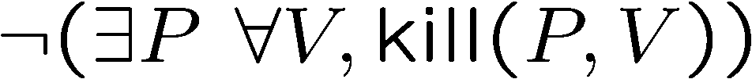
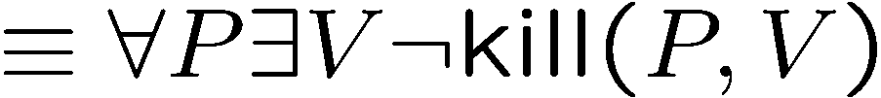
More Negations
There is an anti-virus program killing every computer virus.
What is the negation of this sentence?
For every program, there is some virus that it can not kill.

Slide 33
Exercises
There is a smallest positive integer.
There is no smallest positive real number.
There are infinitely many prime numbers.

Slide 34
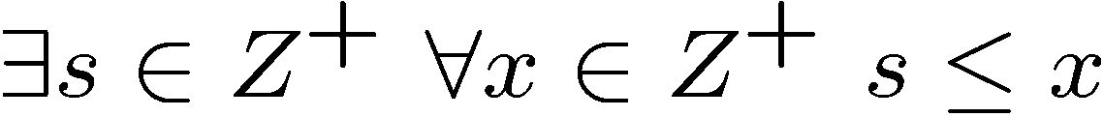

Exercises
There is a smallest positive integer.
There is no smallest positive real number.
There are infinitely many prime numbers.

