Slide 1
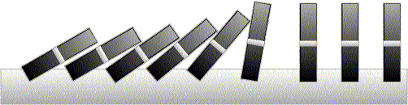
Induction
(chapter 4.2-4.4 of the book and chapter 3.3-3.6 of the notes)

Slide 2
This Lecture
Last time we have discussed different proof techniques.
This time we will focus on probably the most important one
– mathematical induction.
This lecture’s plan is to go through the following:
The idea of mathematical induction
Basic induction proofs (e.g. equality, inequality, property,etc)
An interesting example
A paradox

Slide 3


Odd Powers Are Odd
Fact: If m is odd and n is odd, then nm is odd.
Proposition: for an odd number m, m^{k} is odd for all non-negative integer k.
Let P(i) be the proposition that m^{i} is odd.
Idea of induction.
P(1) is true by definition.
P(2) is true by P(1) and the fact.
P(3) is true by P(2) and the fact.
P(i+1) is true by P(i) and the fact.
So P(i) is true for all i.

Slide 4
Divisibility by a Prime
Theorem. Any integer n > 1 is divisible by a prime number.
Let n be an integer.
If n is a prime number, then we are done.
Otherwise, n = ab, both are smaller than n.
If a or b is a prime number, then we are done.
Otherwise, a = cd, both are smaller than a.
If c or d is a prime number, then we are done.
Otherwise, repeat this argument, since the numbers are
getting smaller and smaller, this will eventually stop and
we have found a prime factor of n.
Idea of induction.

Slide 5
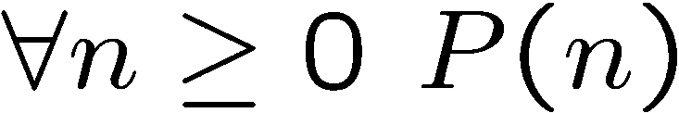
Idea of Induction
Objective: Prove
This is to prove
The idea of induction is to first prove P(0) unconditionally,
then use P(0) to prove P(1)
then use P(1) to prove P(2)
and repeat this to infinity…

Slide 6

The Induction Rule
0 and (from n to n +1),
proves 0, 1, 2, 3,….
P (0), P (n)P (n+1)
∀m∈N. P (m)
Much easier to prove with P(n) as an assumption.
Very easy to prove
For any n>=0
Like domino effect…

Slide 7
This Lecture
The idea of mathematical induction
Basic induction proofs (e.g. equality, inequality, property,etc)
An interesting example
A paradox

Slide 8
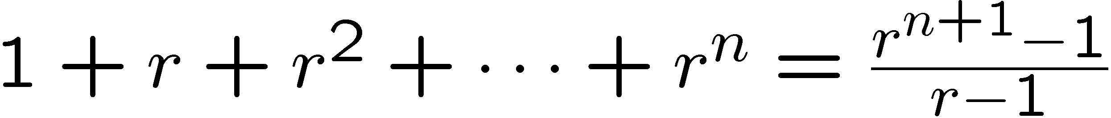
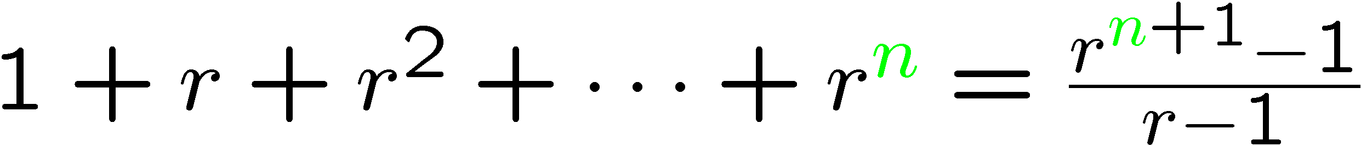
Proof by Induction
Let’s prove:
Statements in green form a template for inductive proofs.
Proof: (by induction on n)
The induction hypothesis, P(n), is:

Slide 9
Proof by Induction
Induction Step: Assume P(n) for some n ≥ 0 and prove P(n + 1):
Have P (n) by assumption:
So let r be any number  1, then from P (n) we have
How do we proceed?

Slide 10
Proof by Induction
adding r ^{n+1} to both sides,
But since r  1 was arbitrary, we conclude (by UG), that
which is P (n+1). This completes the induction proof.

Slide 11
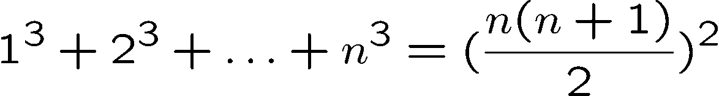

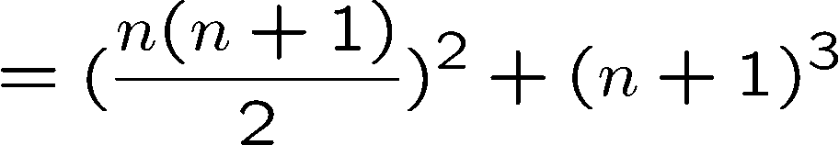

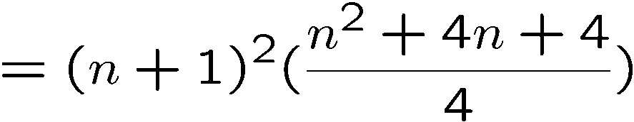
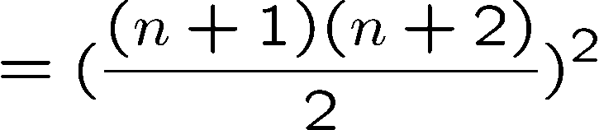
Proving an Equality
Let P(n) be the induction hypothesis that the statement is true for n.
Base case: P(1) is true
Induction step: assume P(n) is true, prove P(n+1) is true.
by induction

Slide 12






Proving a Property
Base Case (n = 1):
Induction Step: Assume P(i) for some i ≥ 1 and prove P(i + 1):
Assume
is divisible by 3, prove
Is divisible by 3.
Divisible by 3
Divisible by 3 by induction

Slide 13





Proving a Property
Base Case (n = 2):
Induction Step: Assume P(i) for some i ≥ 2 and prove P(i + 1):
Assume
is divisible by 6
Prove
is divisible by 6.
Divisible by 6
by induction
Divisible by 2
by case analysis

Slide 14









Proving an Inequality
Base Case (n = 3):
Induction Step: Assume P(i) for some i ≥ 3 and prove P(i + 1):
Assume
, prove
by induction
since i >= 3

Slide 15
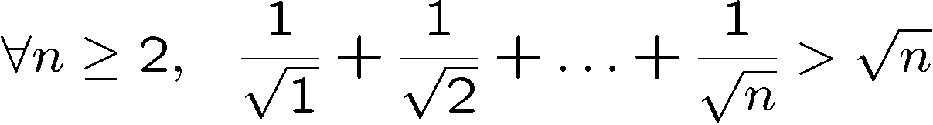
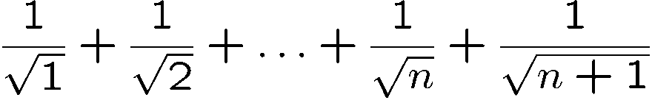
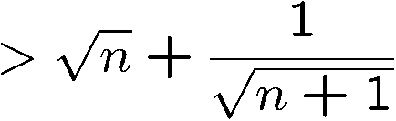
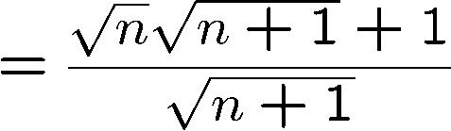
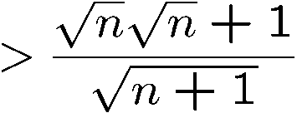
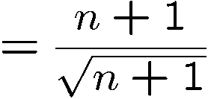

Proving an Inequality
Base Case (n = 2): is true
Induction Step: Assume P(i) for some i ≥ 2 and prove P(i + 1):
by induction

Slide 16
This Lecture
The idea of mathematical induction
Basic induction proofs (e.g. equality, inequality, property,etc)
An interesting example
A paradox

Slide 17

Puzzle
Goal: tile the squares, except one in the middle for Bill.

Slide 18

Puzzle
There are only L-shaped tiles covering three squares:
For example, for 8 x 8 puzzle might tile for Bill this way:

Slide 19

Puzzle
Theorem: For any 2^{n} x 2^{n} puzzle, there is a tiling with Bill in the middle.
Did you remember that we proved
is divisble by 3?
Proof: (by induction on n)
P(n) ::= can tile 2^{n} x 2^{n} with Bill in middle.
Base case: (n=0)
(no tiles needed)

Slide 20
Puzzle
Induction step: assume can tile 2^{n} x 2^{n},
prove can handle 2^{n+1} x 2^{n+1}.
Now what??
2
n
+
1

Slide 21
Puzzle
The new idea:
A stronger property
Prove that we can always find a tiling with Bill anywhere.
Theorem B: For any 2^{n} x 2^{n} puzzle, there is a tiling with Bill anywhere.
Clearly Theorem B implies Theorem.
Theorem: For any 2^{n} x 2^{n} puzzle, there is a tiling with Bill in the middle.

Slide 22
Puzzle
Theorem B: For any 2^{n} x 2^{n} puzzle, there is a tiling with Bill anywhere.
Proof: (by induction on n)
P(n) ::= can tile 2^{n} x 2^{n} with Bill anywhere.
Base case: (n=0)
(no tiles needed)

Slide 23
Puzzle
Induction step:
Assume we can get Bill anywhere in 2^{n} x 2^{n}.
Prove we can get Bill anywhere in 2^{n+1} x 2^{n+1}.

Slide 24
Puzzle
Induction step:
Assume we can get Bill anywhere in 2^{n} x 2^{n}.
Prove we can get Bill anywhere in 2^{n+1} x 2^{n+1}.

Slide 25
Puzzle
Method: Now group the squares together,
and fill the center with a tile.
Done!

Slide 26
Some Remarks
Note 1: It may help to choose a stronger hypothesis
than the desired result (e.g. “Bill in anywhere”).
Note 2: The induction proof of “Bill in corner” implicitly
defines a recursive procedure for finding corner tilings.
Note 3: Induction and recursion are very similar in spirit,
always tries to reduce the problem into a smaller problem.

