Slide 1
Gray Code
Can you find an ordering of all the n-bit strings in such a way that
two consecutive n-bit strings differed by only one bit?
This is called the Gray code and has many applications.
How to construct them?
Think inductively! (or recursively!)
2 bit
00
01
11
10
3 bit
000 001 011 010 110 111 101 100
Can you see the pattern?
How to construct 4-bit gray code?

Slide 2
Gray Code
4 bit
3 bit
000 001 011 010 110 111 101 100
3 bit (reversed)
100
101
111
110
010
011
001
000
0
0
0
0
0
0
0
0
1
1
1
1
1
1
1
1
000 001 011 010 110 111 101 100
differed by 1 bit
by induction
differed by 1 bit
by construction
100
101
111
110
010
011
001
000
Every 4-bit string appears exactly once.
differed by 1 bit
by induction

Slide 3
Gray Code
n+1 bit
n bit
000…0
…
…
…
…
…
…
100…0
n bit (reversed)
100…0
…
…
…
…
…
…
000…0
0
0
0
0
0
0
0
0
1
1
1
1
1
1
1
1
000…0
…
…
…
…
…
…
100…0
differed by 1 bit
by induction
differed by 1 bit
by construction
100…0
…
…
…
…
…
…
000…0
Every (n+1)-bit string appears exactly once.
differed by 1 bit
by induction
So, by induction,
Gray code exists for any n.

Slide 4
Paradox
Theorem: All horses are the same color.
Proof: (by induction on n)
Induction hypothesis:
P(n) ::= any set of n horses have the same color
Base case (n=0):
No horses so obviously true!
…

Slide 5
Paradox
(Inductive case)
Assume any n horses have the same color.
Prove that any n+1 horses have the same color.
…
n+1

Slide 6
Paradox
(Inductive case)
Assume any n horses have the same color.
Prove that any n+1 horses have the same color.
Second set of n horses have the same color
…
First set of n horses have the same color

Slide 7
Paradox
(Inductive case)
Assume any n horses have the same color.
Prove that any n+1 horses have the same color.
…
Therefore the set of n+1 have the same color!

Slide 8
Paradox
What is wrong?
n =1
Proof that P(n) → P(n+1)
is false if n = 1, because the two
horse groups do not overlap.
Second set of n=1 horses
First set of n=1 horses
(But proof works for all n ≠ 1)

Slide 9
Unstacking Game
Start: a stack of boxes
Move: split any stack into two stacks of sizes a,b>0
Scoring: ab points
Keep moving: until stuck
Overall score: sum of move scores
a+b
a
b

Slide 10
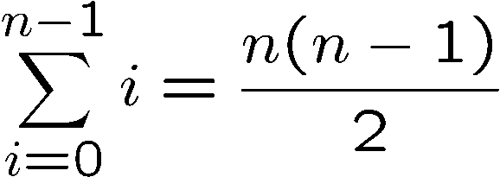
Unstacking Game
What is the best way to play this game?
Suppose there are n boxes.
What is the score if we just take the box one at a time?
n
n-1
1

Slide 11
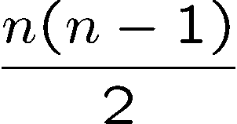
Unstacking Game
What is the best way to play this game?
2n
n
n
Suppose there are n boxes.
What is the score if we cut the stack into half each time?
Say n=8, then the score is 1x4x4 + 2x2x2 + 4x1 = 28
Not better than the first strategy!
first round
second
third
Say n=16, then the score is 8x8 + 2x28 = 120

Slide 12
Unstacking Game
Claim: Every way of unstacking gives the same score.
Claim: Starting with size n stack, final score will be
Proof: by Induction with Claim(n) as hypothesis
Base case n = 0:
score = 0
Claim(0) is okay.

Slide 13
Unstacking Game
Inductive step. assume for n-stack,
and then prove C(n+1):
(n+1)-stack score =
Case n+1 = 1. verify for 1-stack:
score = 0
C(1) is okay.

Slide 14
Unstacking Game
Case n+1 > 1. So split into an a-stack and b-stack,
where a + b = n +1.
(a + b)-stack score = ab + a-stack score + b-stack score
by induction:
a-stack score =
b-stack score =

Slide 15
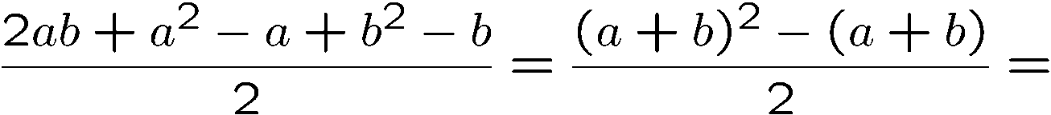
Unstacking Game
(a + b)-stack score = ab + a-stack score + b-stack score
so C(n+1) is okay.
We’re done!

Slide 16
Induction Hypothesis
Wait: we assumed C(a) and C(b) where 1  a, b  n.
But by induction can only assume C(n)
the fix: revise the induction hypothesis to
In words, it says that we
assume the claim is true
for all numbers up to n.
Proof goes through fine using Q(n) instead of C(n).
So it’s OK to assume C(m) for all m  n to prove C(n+1).

Slide 17
Strong Induction
Strong induction
Prove P(0).
Then prove P(n+1) assuming all of
P(0), P(1), …, P(n) (instead of just P(n)).
Conclude n.P(n)
equivalent
Ordinary induction
0 → 1, 1 → 2, 2 → 3, …, n-1 → n.
So by the time we got to n+1, already know all of
P(0), P(1), …, P(n)
The point is: assuming P(0), P(1), up to P(n), it is often easier to prove P(n+1).

Slide 18
Divisibility by a Prime
Theorem. Any integer n > 1 is divisible by a prime number.
Let n be an integer.
If n is a prime number, then we are done.
Otherwise, n = ab, both are smaller than n.
If a or b is a prime number, then we are done.
Otherwise, a = cd, both are smaller than a.
If c or d is a prime number, then we are done.
Otherwise, repeat this argument, since the numbers are
getting smaller and smaller, this will eventually stop and
we have found a prime factor of n.
Remember this slide?
Now we can prove it
by strong induction
very easily. In fact
we can prove a
stronger theorem
very easily.
Idea of induction.

Slide 19
Prime Products
Claim: Every integer > 1 is a product of primes.
Proof: (by strong induction)
Base case is easy.
Suppose the claim is true for all 2 <= i < n.
Consider an integer n.
If n is prime, then we are done.
So n = k·m for integers k, m where n > k,m >1.
Since k,m smaller than n,
By the induction hypothesis, both k and m are product of primes
k = p₁⋅ p₂⋅ ⋅ ⋅ p₉₄
m = q₁⋅ q₂⋅ ⋅ ⋅ q₂₁₄

Slide 20
Prime Products
Claim: Every integer > 1 is a product of primes.
…So
n = k⋅ m = p₁⋅ p₂⋅ ⋅ ⋅ p₉₄⋅ q₁⋅ q₂⋅ ⋅ ⋅ q₂₁₄
is a prime product.
∴ This completes the proof of the induction step.

Slide 21
Well Ordering Principle
Every nonempty set ofnonnegative integers
has a least element.
Axiom
This is an axiom equivalent to the principle of mathematical induction.
Note that some similar looking statements are not true:
Every nonempty set of nonnegative rationals
has a least element.
NO!
Every nonempty set of nonnegative integers
has a least element.
NO!

Slide 22
Well Ordering Principle
Thm: is irrational
Proof: suppose
…can always find such m, n without common factors…
why always?
By WOP,  minimum |m| s.t.
so
where |m₀| is minimum.

Slide 23
Well Ordering Principle
but if m₀, n₀ had common factor c > 1, then
and contradicting minimality of |m₀|
The well ordering principle is usually used in “proof by contradiction”.
Assume the statement is not true, so there is a counterexample.
Choose the “smallest” counterexample, and find a even smaller counterexample.
Conclude that a counterexample does not exist.

Slide 24
Well Ordering Principle in Proofs
To prove ``for all n in a set N. P(n)’’ using WOP:
Define the set of counterexamples
C ::= {n | ¬P(n)}
2. Assume C is not empty.
3. By WOP, have minimum element m₀ in C.
4. Reach a contradiction (somehow) –
usually by finding a member of C that is < m₀ .
5. Conclude no counterexamples exist. QED

Slide 25
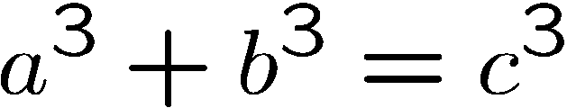
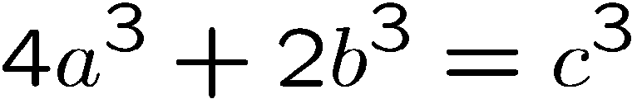
Non-Fermat Theorem
It is difficult to prove there is no positive integer solutions for
Fermat’s theorem
But it is easy to prove there is no positive integer solutions for
Non-Fermat’s theorem
Hint: Prove by contradiction using well ordering principle…

Slide 26
Non-Fermat Theorem
Suppose, by contradiction, there are integer solutions to this equation.
By the well ordering principle, there is a solution with |a| smallest.
In this solution, a,b,c do not have a common factor.
Otherwise, if a=a’k, b=b’k, c=c’k,
then a’,b’,c’ is another solution with |a’| < |a|,
contradicting the choice of a,b,c.
(*) There is a solution in which a,b,c do not have a common factor.

Slide 27
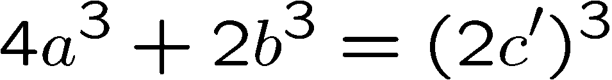
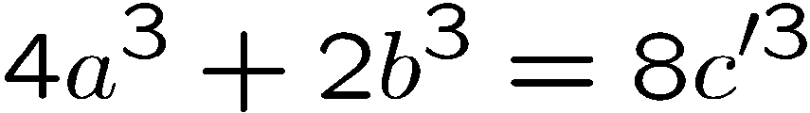
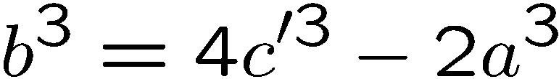
Non-Fermat Theorem
On the other hand, we prove that every solution must have a,b,c even.
This will contradict (*), and complete the proof.
First, since c³ is even, c must be even.
(because odd power is odd).
Let c = 2c’, then

Slide 28
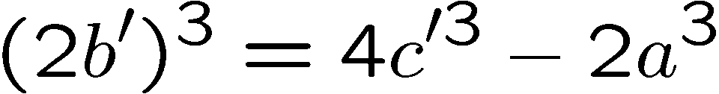
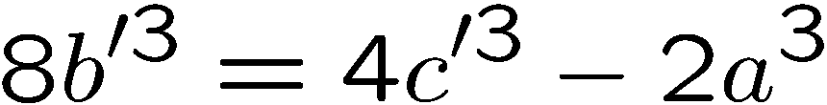
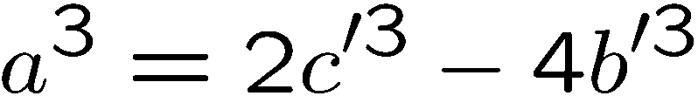
Non-Fermat Theorem
Since b³ is even, b must be even. (because odd power is odd).
Let b = 2b’, then
Since a³ is even, a must be even. (because odd power is odd).
There a,b,c are all even, contradicting (*)

Slide 29
Invariant Method
1 | 2 | 3 | 4
5 | 6 | 7 | 8
9 | 10 | 11 | 12
13 | 14 | 15
1 | 2 | 3 | 4
5 | 6 | 7 | 8
9 | 10 | 11 | 12
13 | 15 | 14

Slide 30


A Chessboard Problem
A Bishop can only move along a diagonal
Can a bishop move from its current position to the question mark?
 |  | ?

Slide 31
A Chessboard Problem
A bishop can only move along a diagonal
Can a bishop move from its current position to the question mark?
 |  | ?
Impossible!
Why?

Slide 32
A Chessboard Problem
Invariant!
 |  | ?
The bishop is in a red position.
A red position can only move to a red position by diagonal moves.
The question mark is in a white position.
So it is impossible for the bishop to go there.
This is a simple example of the invariant method.

Slide 33
Domino Puzzle
An 8x8 chessboard, 32 pieces of dominos
Can we fill the chessboard?

Slide 34
Domino Puzzle
An 8x8 chessboard, 32 pieces of dominos
Easy!

Slide 35
Domino Puzzle
An 8x8 chessboard with two holes, 31 pieces of dominos
Can we fill the chessboard?
Easy!

Slide 36
Domino Puzzle
An 8x8 chessboard with two holes, 31 pieces of dominos
Can we fill the chessboard?
Easy??

Slide 37
Domino Puzzle
An 4x4 chessboard with two holes, 7 pieces of dominos
Can we fill the chessboard?
Impossible!

Slide 38
Domino Puzzle
An 8x8 chessboard with two holes, 31 pieces of dominos
Can we fill the chessboard?
Then what??

Slide 39
Domino Puzzle
An 8x8 chessboard with two holes, 31 pieces of dominos
Can we fill the chessboard?

Slide 40
Domino Puzzle
Invariant!
Each domino will occupy one white square and one red square.
There are 32 blue squares but only 30 white squares.
So it is impossible to fill the chessboard using only 31 dominos.
This is another example of the invariant method.

Slide 41
Invariant Method
Find properties (the invariants) that are satisfied throughout the whole process.
Show that the target do not satisfy the properties.
Conclude that the target is not achievable.
In the rook example, the invariant is
the colour of the position of the rook.
In the domino example, the invariant is that
any placement of dominos will occupy the same
number of blue positions and white positions.

Slide 42
The Possible
We just proved that if we take out two squares of
the same colour, then it is impossible to finish.
What if we take out two squares of different colours?
Would it be always possible to finish then?
Yes??

Slide 43
Prove the Possible
Yes??

Slide 44
Prove the Possible
The secret.

Slide 45
Prove the Possible
The secret.

Slide 46
Fifteen Puzzle
1 | 2 | 3 | 4
5 | 6 | 7 | 8
9 | 10 | 11 | 12
13 | 14 | 15
Move: can move a square adjacent to the empty square
to the empty square.

Slide 47
Fifteen Puzzle
1 | 2 | 3 | 4
5 | 6 | 7 | 8
9 | 10 | 11 | 12
13 | 14 | 15
1 | 2 | 3 | 4
5 | 6 | 7 | 8
9 | 10 | 11 | 12
13 | 15 | 14
Initial configuration
Target configuration
Is there a sequence of moves that allows you to start
from the initial configuration to the target configuration?

Slide 48
Invariant Method
Find properties (the invariants) that are satisfied throughout the whole process.
Show that the target do not satisfy the properties.
Conclude that the target is not achievable.
What is an invariant in this game??
This is usually the hardest part of the proof.

Slide 49
Hint
1 | 2 | 3 | 4
5 | 6 | 7 | 8
9 | 10 | 11 | 12
13 | 14 | 15
1 | 2 | 3 | 4
5 | 6 | 7 | 8
9 | 10 | 11 | 12
13 | 15 | 14
Initial configuration
Target configuration
((1,2,3,…,14,15),(4,4))
((1,2,3,…,15,14),(4,4))
Hint: the two states have different parity.

Slide 50
Parity
Given a sequence, a pair is “out-of-order” if the first element is larger.
More formally, given a sequence (a₁,a₂,…,a_{n}),
a pair (i,j) is out-of-order if i<j but a_{i} > a_{j}.
For example, the sequence (1,2,4,5,3) has two out-of-order pairs, (4,3) and (5,3).
Given a state S = ((a1,a2,…,a15),(i,j))
Parity of S = (number of out-of-order pairs + row) mod 2
row number of the empty square

