Slide 1
Russell’s Paradox
In words, W is the set that contains all the sets that don’t contain themselves.
Is W in W?
If W is in W, then W contains itself.
But W contains only those sets that don’t contain themselves.
So W is not in W.
If W is not in W, then W does not contain itself.
But W contains those sets that don’t contain themselves.
So W is in W.
What’s wrong???

Slide 2
Barber’s Paradox
There is a male barber who shaves all those men,
and only those men, who do not shave themselves.
Does the barber shave himself?
Suppose the barber shaves himself.
But the barber only shaves those men who don’t shave themselves.
Since the barber shaves himself, he does not shave himself.
Suppose the barber does not shave himself.
But the barber shaves those men who don’t shave themselves.
Since the barber does not shave himself, he shaves himself.
What’s wrong???

Slide 3
Solution to Russell’s Paradox
A man either shaves himself or does not shave himself.
A barber neither shaves himself nor not shaves himself.
Perhaps such a barber does not exist?
Actually that’s the way out of this paradox.
Going back to the barber’s paradox,
we conclude that W cannot be a set,
because every set either contains itself or does not contain itself,
but either case cannot happen for W.
This paradox tells us that not everything we define is a set.
Later on mathematicians define sets more carefully,
e.g. using sets that we already know.
Notes:
3

Slide 4
Halting Problem
Now we study one of the most famous problems in computer science.
The halting problem: Can we write a program which detects an infinite loop?
We want a program H that given any program P and input I:
H(P,I) returns “halt” if P will terminate given input I;
H(P,I) returns “loop forever” if P will not terminate given input I.
The halting problem: Does such a program H exist?
Note that the program H can not just simulate the program P on input I;
if P halts on I, then H can return halt successfully;
but if P loops forever on I, then H will also loop forever.

Slide 5
Halting Problem
We want a program H that given any program P and input I:
H(P,I) returns “halt” if P will terminate given input I;
H(P,I) returns “loop forever” if P will not terminate given input I.
The halting problem: Does such a program H exist?
Proof by contradiction:
Suppose, by way of contradiction, that H exists.
Both P and I are binary strings.
H should be able to determine if P will terminate given itself as the input.
That is, H(P,P) will either return “halt” or “loop forever”.

Slide 6
Halting Problem
Inverter: Do the opposite to what H says.
Construct an “inverter” program K which does the following given input P:
if H(P,P) returns “halt”, then K(P) will “loop forever” ;
if H(P,P) returns “loop forever”, then K(P) will “halt”.
Loop forever
H(P,I)
output
If H(P,P)=halt
Input for K(P)
P:=P
H(P,P)
If H(P,P)=
loop forever
program P
I:=P
halt
Input for program H(P,I)
K(P)

Slide 7
Halting Problem
What happen if K is the input to K? What is K(K)?
Loop forever
H(P,I)
output
If H(P,P)=halt
Input for K(P)
P:=P
H(P,P)
If H(P,P)=
loop forever
program P
I:=P
halt
Input for program H(P,I)
K(P)

Slide 8
Halting Problem
What happen if K is the input to K? What is K(K)?
Case 1: Suppose H(K,K) says “halt”, that is H determines K(K) will “halt”.
But then K(K) will “loop forever”, which is exactly the opposite to the answer.
Loop forever
H(P,I)
output
If H(K,K)=halt
Input for K(K)
P:=K
H(K,K)
If H(K,K)=
loop forever
program K
I:=K
halt
Input for program H(P,I)
K(K)

Slide 9
Halting Problem
What happen if K is the input to K? What is K(K)?
Case 2: Suppose H(K,K) says “loop forever”, that is H determines K(K) will “loop”,
But then K(K) will “halt”, which is exactly the opposite to the answer.
Loop forever
H(P,I)
output
If H(K,K)=halt
Input for K(K)
P:=K
H(K,K)
If H(K,K)=
loop forever
program K
I:=K
halt
Input for program H(P,I)
K(K)

Slide 10
Halting Problem
In either case, H outputs a wrong answer to K(K),
this contradicts that such a program exists.
Intuitively, no program can determine whether K halts when given input K,
because the program K will do the opposite “after” you give an answer.
The proof is due to Alan Turing (1936); you will see more of such arguments in a later class.

Slide 11
Remarks and References
The argument used in the halting problem is called the “diagonalization” method.
This was originally used by Cantor to prove that real numbers are “more” than
Integers.
This method has many other applications in theoretical computer science.

Slide 12
Functions
Informally, a function f “maps” the element of an input set A
to the elements of an output set B.
More formally, we write
to represent that f is a function from set A to set B, which
associates an element with an element
The domain (input) of f is A.
The codomain (output) of f is B.
Definition: For every input there is exactly one output.

Slide 13
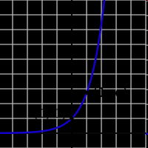

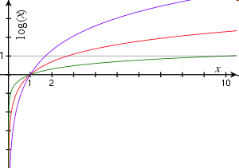

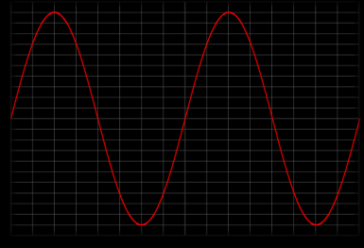


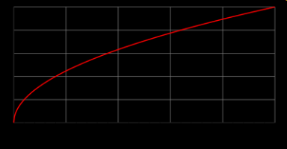
Functions
domain = R
codomain = R⁺-{0}
domain = R⁺-{0}
codomain = R
domain = R
codomain = [0,1]
domain = R⁺
codomain = R⁺

Slide 14
Functions
f(S) = |S|
domain = the set of all sets
codomain = non-negative integers
domain = the set of all strings
codomain = non-negative integers
f(string) = length(string)
not a function,
since one input could have
more than one output
f(student-name) = student-ID
f(x) = is-prime(x)
domain = positive integers
codomain = {T,F}

Slide 15
Injections (One-to-One)
is an injection iff no two inputs have the same output.
f( ) =
≤ 1 arrow in
A
B
|A| ≤ |B|

Slide 16
Surjections (Onto)
is a surjection iff every output is possible.
f( ) =
1 arrow in
A
B
|A| ≥ |B|

Slide 17
Bijections
is a bijection iff it is surjection and injection.
exactly one arrow in
f( ) =
A
B
|A| = |B|

Slide 18
In-Class Exercises
Function | Domain | Codomain | Injective? | Surjective? | Bijective?
f(x)=sin(x) | Real | Real
f(x)=2^{x} | Real | Positive real
f(x)=x² | Real | Non-negative real
Reverse string | Bit strings of length n | Bit strings of length n
No
No
No
Yes
Yes
Yes
No
Yes
No
Yes
Yes
Yes
Whether a function is injective, surjective, bijective
depends on its domain and the codomain.

Slide 19
Inverse Sets
A
B
Given an element y in B, the inverse set of y := f⁻¹(y) = {x in A | f(x) = y}.
In words, this is the set of inputs that are mapped to y.
More generally, for a subset Y of B,
the inverse set of Y := f⁻¹(Y) = {x in A | f(x) in Y}.

Slide 20
Inverse Function
Informally, an inverse function f⁻¹ is to “undo” the operation of function f.
exactly one arrow in
f( ) =
A
B
There is an inverse function f⁻¹ for f if and only if f is a bijection.

