Slide 1
SYSTEM OVERVIEW
ACME CompensationOS: Enterprise Compensation Platform
Multi-currency compensation management system engineered for 10,000+ employees across 5 global jurisdictions
BUSINESS CHALLENGE
• Decentralized Compensation
Disparate spreadsheets across regional HR teams cause salary drift, data inconsistencies, and compliance exposure.
• Currency Cross-Contamination
Mixing currencies in statistical analysis skews departmental medians and invalidates compensation reviews.
• Overlapping Date Conflicts
Absence of temporal database constraints leads to conflicting salary records for the same employee.
• Audit Vulnerability
Inability to produce immutable, point-in-time salary progression snapshots for internal and external labor audits.
CORE ARCHITECTURAL SOLUTION
• Unified Hexagonal Monolith
Modular Monolith built with Clean Architecture, SOLID principles, and zero circular dependencies.
• PostgreSQL Temporal Engine
btree_gist exclusion constraints enforce mathematically non-overlapping compensation date ranges.
• Sovereign Currency Isolation
Isolated analytics for INR, USD, EUR, GBP, and AED with PostgreSQL continuous percentile medians.
• Immutable Audit Trail
Transactional append-only salary audit log capturing actor email, timestamps, and exact delta percentages.
GLOBAL SCALE & TECH STACK
• 10,000 Synthetic Employees
Deterministic batch seeded dataset spanning 9 departments across 5 countries.
• Frontend: Angular 18
Standalone architecture, Signals state management, RxJS debounce, Tailwind CSS, ng2-charts.
• Backend: Spring Boot 3.3.4
Java 21/22, Spring Data JPA, Spring Security 6, Stateless JWT, HikariCP pool.
• Database: PostgreSQL 16/18
Hosted on Neon Serverless with SSL/TLS, Flyway schema migrations, and GiST indexes.
• Cloud Infrastructure
Firebase Hosting global edge CDN + Google Cloud Run scale-to-zero container service.
ACME CompensationOS • Enterprise Architecture & Engineering Assessment
Slide 1 of 8
Notes:
Welcome to the technical presentation for ACME CompensationOS. ACME CompensationOS addresses the critical enterprise challenge of managing compensation drift across multinational operations. Engineered for 10,000+ employees across India, USA, UK, Germany, and UAE, the system eliminates spreadsheet chaos through temporal database integrity, strict sovereign currency isolation, and an immutable audit trail. Built with Angular 18 Standalone and Java 21 Spring Boot 3.3.4, it represents an audit-grade, free-tier cloud deployment.

Slide 2
PRODUCT REQUIREMENTS
Core Functional Requirements & Non-Functional SLAs
Structured around the HR Manager persona with enterprise-grade financial precision and auditability
1. PERSONA & EMPLOYEE DIRECTORY
• Primary Persona: HR Compensation Manager managing international salary reviews, band equity, and audit reporting.
• Real-Time Directory: Paginated directory supporting 10,000 synthetic employees with 300ms RxJS search debounce.
• Multi-Factor Filtering: Instant faceted filtering by Country (5), Department (9), and Employment Status (Active, Resigned, Terminated).
2. EFFECTIVE-DATED SALARY REVISIONS
• Atomic Revisions: Form modal calculates live base and bonus percentage deltas before transactional commit.
• Temporal History: Closed-open intervals [effective_from, effective_to) preserve complete career progression timelines.
• PostgreSQL Guardrails: Database-level exclusion constraint guarantees no overlapping compensation intervals can ever be committed.
3. MULTI-CURRENCY ANALYTICS & AUDIT TRAIL
• Sovereign Tabs: 5 dedicated currency workspaces (INR, USD, EUR, GBP, AED) preventing statistically invalid currency cross-mixing.
• PostgreSQL Medians: Computes PERCENTILE_CONT(0.5) medians alongside average, minimum, and maximum base compensation.
• Immutable Audit Log: Append-only table capturing changed_by, timestamps, before/after values, and revision rationale.
4. NON-FUNCTIONAL REQUIREMENTS & SECURITY
• Performance SLA: Sub-100ms API response time across 10,000 records using composite B-Tree indexes and streaming CSV exports.
• Role-Based Access (RBAC): Stateless JWT with ROLE_ADMIN, ROLE_HR_MANAGER, and ROLE_EXECUTIVE authorization checks.
• Monetary Precision: Strict DECIMAL(19,4) representations for monetary values to completely eliminate floating-point rounding errors.
ACME CompensationOS • Enterprise Architecture & Engineering Assessment
Slide 2 of 8
Notes:
Slide 2 details our core functional requirements and non-functional guarantees. The primary persona is the HR Manager. We designed the directory around fast, debounced search and faceted filtering. The compensation module guarantees temporal validity, meaning salary increases have an effective start date, automatically closing prior packages without gaps or overlaps. In analytics, we enforce strict currency isolation: an INR salary is never averaged with a USD salary. Our non-functional requirements mandate sub-100ms response times, strict decimal precision, and role-based access control.

Slide 3
SYSTEM ARCHITECTURE
High-Level Architecture & Modular Monolith Design
Clean Architecture with strict hexagonal boundaries, SOLID principles, and zero circular dependencies
CLIENT TIER: ANGULAR 18 STANDALONE SPA (FIREBASE HOSTING CDN)
• Standalone Components (No NgModules) • Angular Signals State Management • RxJS 300ms Debounce • Chart.js Visualizations • Tailwind CSS
APPLICATION TIER: JAVA 21 + SPRING BOOT 3.3.4 (GOOGLE CLOUD RUN - DOCKER CONTAINER)
Employee Module
Directory, filtering, employee profiles, designation tracking
Compensation Module
Effective-dated salary records, atomic revision engine
Analytics Module
PERCENTILE_CONT medians, histograms, threshold calculator
Audit Module
Append-only salary audit log, streaming CSV exporter
Security Module
Stateless JWT provider, JwtAuthenticationFilter, RBAC
Clean Hexagonal Architecture: REST Controllers (API) ➔ Domain Services & Ports (Application) ➔ Entities & Value Objects (Domain) ➔ JPA Adapters (Infrastructure)
DATA TIER: NEON SERVERLESS POSTGRESQL (AWS US-EAST-2 / JDBC OVER TLS 1.3)
• 10,000 Seeded Employees • btree_gist Temporal Exclusion Constraint • Flyway Version-Controlled Schema • HikariCP Connection Pool (Max: 5, Min: 1)
ACME CompensationOS • Enterprise Architecture & Engineering Assessment
Slide 3 of 8
Notes:
Slide 3 presents our High-Level Architecture. We chose a Modular Monolith architecture over microservices to eliminate distributed transaction failures and network serialization overhead. The system is organized into five decoupled business modules: Employee, Compensation, Analytics, Audit, and Security. Inside each module, Clean Hexagonal Architecture ensures business logic is entirely independent of Spring framework details. The Angular 18 frontend communicates over HTTPS REST APIs through Firebase Hosting rewrites, while Spring Boot on Google Cloud Run connects to Neon PostgreSQL over encrypted TLS.

Slide 4
DATABASE ARCHITECTURE
Entity-Relationship Model & Temporal Exclusion Design
Relational PostgreSQL schema with btree_gist temporal non-overlapping constraints and audit trails
USERS & AUTH
id: BIGSERIAL [PK]
email: VARCHAR(120) [UNIQUE]
password_hash: VARCHAR(255)
role: VARCHAR(50) [ADMIN/HR/EXEC]
active: BOOLEAN
created_at: TIMESTAMPTZ
EMPLOYEE MASTER
id: BIGSERIAL [PK]
employee_code: VARCHAR(30) [UNIQUE]
first_name, last_name: VARCHAR(100)
email: VARCHAR(150) [UNIQUE]
country, department: VARCHAR(60), VARCHAR(80)
designation, status: VARCHAR(100), VARCHAR(30)
joining_date: DATE
EXCHANGE RATES
id: BIGSERIAL [PK]
source_currency: VARCHAR(3)
target_currency: VARCHAR(3)
exchange_rate: DECIMAL(19,6)
effective_date: DATE
CONSTRAINT: UNIQUE (source, target, date)
COMPENSATION (TEMPORAL)
id: BIGSERIAL [PK]
employee_id: BIGINT [FK -> employees.id]
base_salary: DECIMAL(19,4) CHECK (> 0)
bonus: DECIMAL(19,4) CHECK (>= 0)
currency: VARCHAR(3) [INR,USD,EUR,GBP,AED]
effective_from, effective_to: DATE, DATE (Nullable for active)
btree_gist EXCLUDE: gist (employee_id WITH =, daterange(...) WITH &&)
SALARY AUDIT LOGS (IMMUTABLE)
id: BIGSERIAL [PK]
employee_id: BIGINT [FK -> employees.id]
changed_by, changed_by_email: BIGINT [FK], VARCHAR(150)
previous_base_salary, new_base: DECIMAL(19,4)
previous_bonus, new_bonus: DECIMAL(19,4)
change_reason, effective_date: TEXT, DATE
changed_at: TIMESTAMPTZ DEFAULT CURRENT_TIMESTAMP
ACME CompensationOS • Enterprise Architecture & Engineering Assessment
Slide 4 of 8
Notes:
Slide 4 details our relational schema and database constraints in PostgreSQL. A critical engineering decision was using DECIMAL(19,4) for all monetary fields, avoiding floating-point inaccuracies. Our core architectural highlight is the compensation table's temporal exclusion constraint: using PostgreSQL's btree_gist extension, we enforce that no employee can ever have overlapping compensation date intervals. Any conflicting insert is rejected at the database engine level with SQLState 23P01. Finally, the salary_audit_logs table maintains an immutable, append-only historical trail of all compensation revisions.

Slide 5
API & WORKFLOW
RESTful Contracts & Atomic Salary Revision Workflow
Contract specifications, stateless token security, and atomic transactional execution sequence
CORE RESTFUL API CONTRACTS
POST /api/v1/auth/login
Public authentication endpoint; returns Bearer JWT and user profile
GET /api/v1/employees
Paginated search & filtering (search, country, department, status)
GET /api/v1/employees/{id}
Detailed employee record with active package and timeline progression
POST /api/v1/employees/{id}/compensation
Atomic salary revision (newBaseSalary, bonus, effectiveFrom, reason)
GET /api/v1/analytics/overview
Executive KPI counters: headcount, active retention, revision count
GET /api/v1/analytics/departments
Calculates PERCENTILE_CONT(0.5) medians and averages by currency
GET /api/v1/audit-logs
Paginated immutable audit logs with before/after delta snapshots
GET /api/v1/audit-logs/export
Streams audit log dataset directly as RFC 4180 CSV attachment
ATOMIC SALARY REVISION WORKFLOW
Step 1: HR Manager Input
HR Manager initiates revision modal; Angular form validates positive base salary and future effective date, previewing live percentage delta.
Step 2: Authenticated Dispatch
Angular HTTP interceptor attaches Bearer JWT; request routed over HTTPS to Spring Boot /employees/{id}/compensation.
Step 3: Security & Authorization
JwtAuthenticationFilter validates HMAC signature; @PreAuthorize enforces ROLE_HR_MANAGER or ROLE_ADMIN permissions.
Step 4: Transactional Service Layer
@Transactional boundary begins. Service fetches employee and verifies active status and currency compatibility.
Step 5: PostgreSQL Exclusion & Insertion
Active package updated with effective_to = new_date - 1. New package inserted. btree_gist verifies zero date overlap.
Step 6: Immutable Audit Record
SalaryAuditLogEntity created with previous/new compensation, changed_by user ID, and change reason in the same ACID commit.
Step 7: HTTP 201 Created Response
Transaction commits. 201 Created returned with revised compensation DTO. Angular UI updates signals and refreshes timeline.
ACME CompensationOS • Enterprise Architecture & Engineering Assessment
Slide 5 of 8
Notes:
Slide 5 outlines our REST API contracts and the transactional salary revision workflow. All protected endpoints require Bearer JWT authentication. When an HR Manager revises compensation, the entire update is encapsulated within a single Spring @Transactional boundary. The current package's effective_to date is updated, the new package is inserted, and the audit log entry is written atomically. If any step fails, or if a concurrent update violates the btree_gist date exclusion constraint, the entire transaction rolls back cleanly.

Slide 6
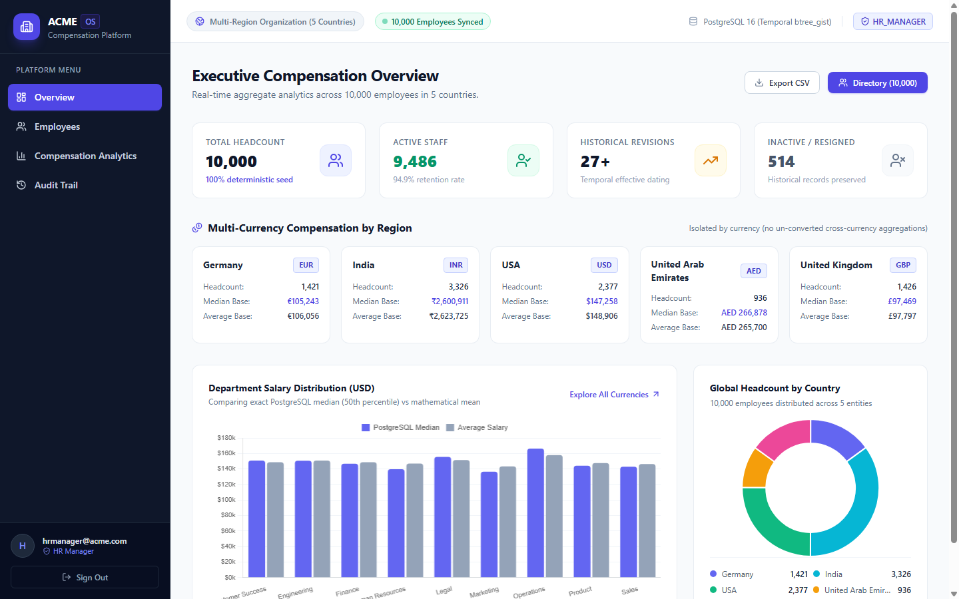
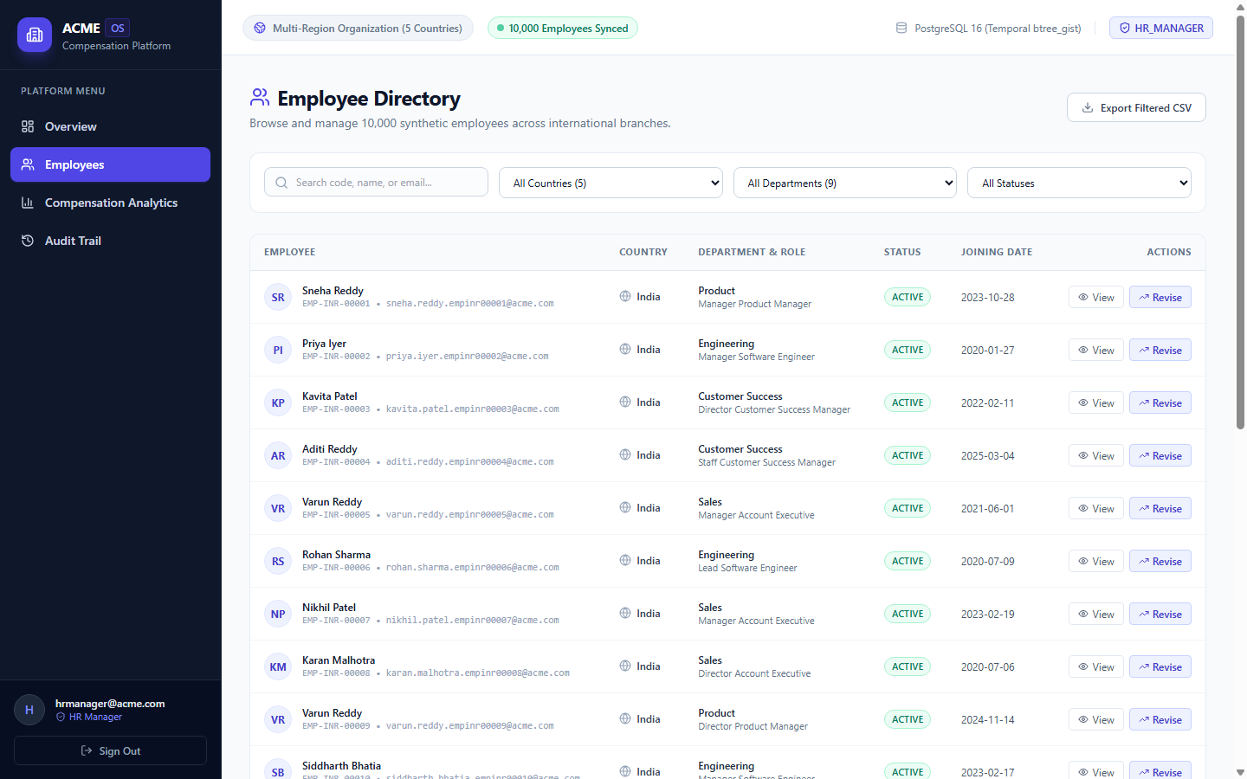
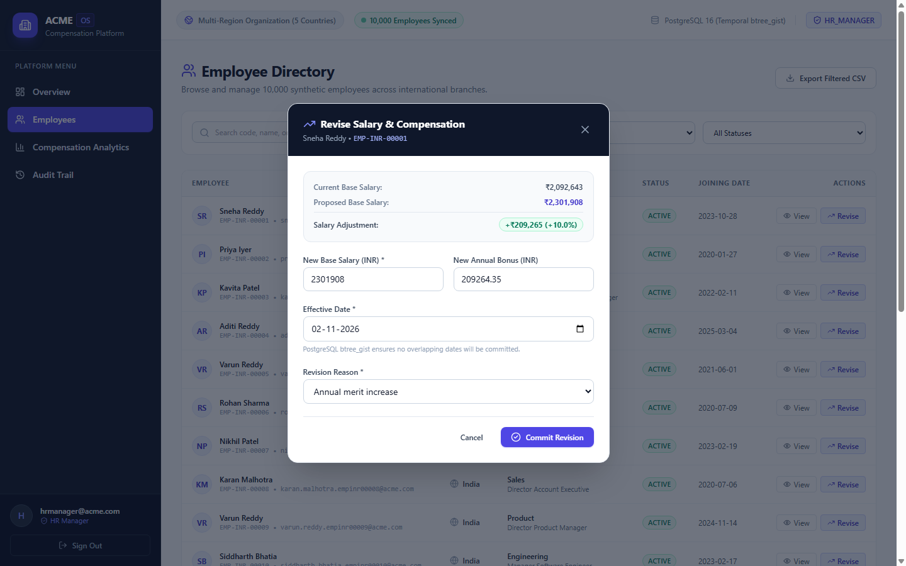
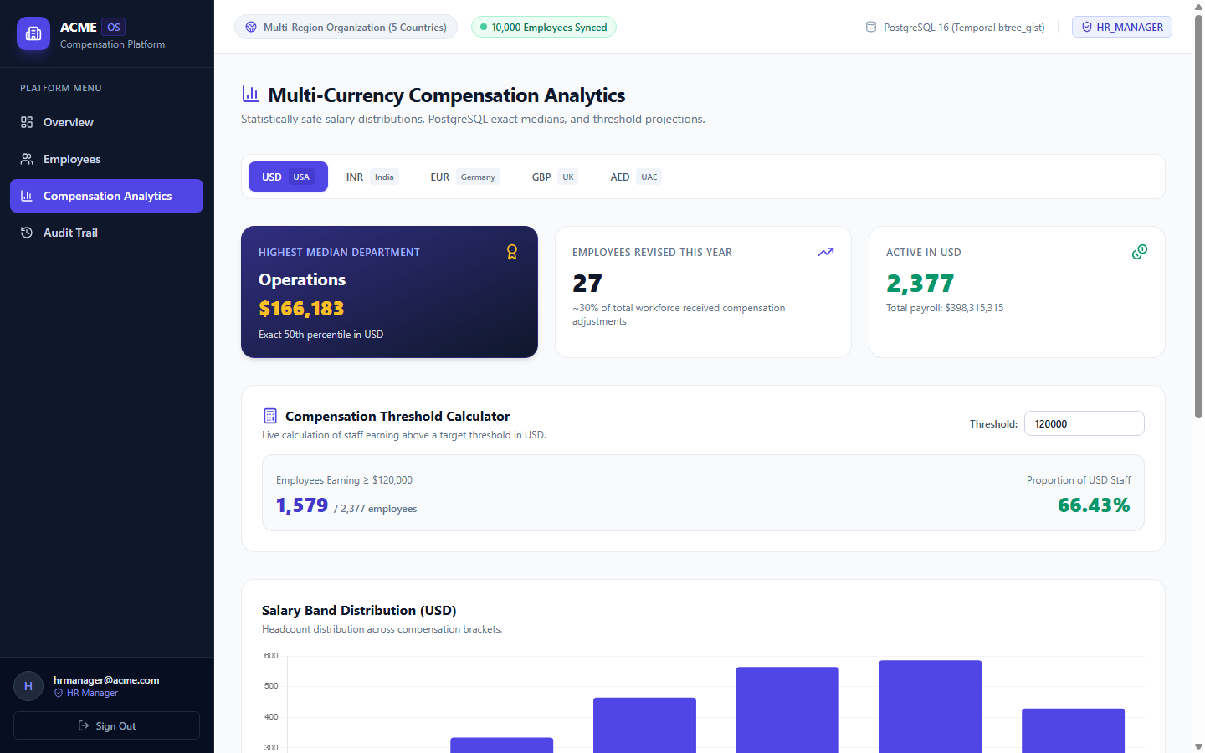
APPLICATION DEMO
Live User Interface & Operational Walkthrough
Actual production screenshots capturing the end-to-end HR Manager workflow on the live deployment
1. Executive Dashboard: 4 KPI cards, 5 regional cards, Chart.js median visualizer
2. Employee Directory: 10,000 synthetic staff, debounced search, faceted filters
3. Salary Revision Modal: Reactive delta preview, reason code, effective date
4. Multi-Currency Analytics: 5 sovereign workspaces, salary band histogram
ACME CompensationOS • Enterprise Architecture & Engineering Assessment
Slide 6 of 8
Notes:
Slide 6 presents actual production screenshots from our deployed application at priyanshi-dev.web.app. Top-left: The Executive Dashboard aggregates headcount, active staff retention, and Chart.js department median comparisons. Top-right: The Employee Directory displays our seeded 10,000 employees with instant 300ms search debounce and country badges. Bottom-left: The Salary Revision Modal dynamically calculates the adjustment delta and percentage before submission. Bottom-right: The Analytics page isolates calculations across five sovereign currency tabs with dynamic histograms and threshold projections.

Slide 7
QUALITY & GOVERNANCE
Testing Rigor, Architecture Governance & Security
Verified automated test results, ArchUnit architectural enforcement, and defense-in-depth security
VERIFIED TEST SUITES
✔ Backend JUnit & Spring Boot
23 of 23 Tests Passed (BUILD SUCCESS). Zero failures, zero errors. Full validation of domain rules, Money value objects, and seed verification.
✔ Frontend Angular Unit Tests
14 of 14 Unit Tests Passed (100% success). Tests AuthService signals, authGuard, EmployeeService, and CurrencyFormatterPipe.
✔ Live Production E2E Tests
7 of 7 Live Scenarios Passed against the production deployment, testing login, 10,000 employee queries, and multi-currency statistics.
ARCHUNIT ARCHITECTURE RULES
• Layer Dependency Rule
Domain layer classes have ZERO dependencies on Spring or infrastructure layers.
• Package Cyclomatic Isolation
Automated verification enforces zero circular package dependencies across any modules.
• Naming & Annotation Integrity
Controllers must reside in api packages and be annotated with @RestController.
• Immutability Governance
Domain value objects (Money, Currency) are strictly immutable records.
SECURITY & PERFORMANCE
• GCP Secret Manager
Streams audit log dataset directly as RFC 4180 CSV attachment
• CORS Whitelist
Streams audit log dataset directly as RFC 4180 CSV attachment
• Indexed Query Speed
Streams audit log dataset directly as RFC 4180 CSV attachment
• Streaming CSV Exporter
Streams audit log dataset directly as RFC 4180 CSV attachment
ACME CompensationOS • Enterprise Architecture & Engineering Assessment
Slide 7 of 8
Notes:
Slide 7 demonstrates our commitment to software craftsmanship, automated testing, and security. We achieved 100% test success across all tiers: 23 backend tests, 14 Angular unit tests, and 7 live end-to-end production scenarios. Using ArchUnit, we mathematically verify our Clean Architecture rules on every build, ensuring the domain layer never couples to frameworks. Security-wise, database passwords and JWT signing keys are stored exclusively in Google Cloud Secret Manager. For performance, composite B-Tree indexes deliver sub-50ms queries over 10,000 records, and CSV exports stream directly without memory exhaustion.

Slide 8
PRODUCTION & ROADMAP
Multi-Cloud Deployment Topology & Engineering Artifacts
Verified free-tier production infrastructure, comprehensive documentation, and strategic roadmap
MULTI-CLOUD PRODUCTION TOPOLOGY
• Frontend: Firebase Hosting (CDN)
URL: https://priyanshi-dev.web.app
• Global edge caching, automatic SSL, SPA pushState fallback.
• Proxies /api/** directly to Cloud Run to eliminate CORS overhead.
• Backend: Google Cloud Run
URL: https://compensation-backend-846701126658.us-central1.run.app
• Containerized Java 21 Spring Boot service in region us-central1.
• Scale-to-zero (--min-instances=0) ensuring $0 idle cost.
• Database: Neon Serverless PostgreSQL
Endpoint: ep-soft-grass-b51ljflq.c-7.us-east-2.aws.neon.tech
• Serverless Postgres with automatic compute suspension.
• 10,000 employees, 13,735 compensations, 3,735 audit logs migrated.
ENGINEERING ARTIFACTS & ROADMAP
• GitHub Repository
https://github.com/Priyanshi-Premkumar/salary-management.git
Complete commit history, clean branch structure, and verified security.
• Comprehensive Documentation Suite
• docs/deployment-guide.md (Multi-cloud free tier guide)
• docs/architecture-review.md (DDD & SOLID evaluation)
• docs/database-design.md (Temporal schema specifications)
• README.md (Setup instructions, API list, live links)
• Strategic Future Enhancements
1. AI Anomaly Detector: Flag compensation outliers across departments.
2. Multi-Tenant Tenancy: Partition data for subsidiary business units.
3. Annual Review Cycles: Scheduled batch salary increment approvals.
ACME CompensationOS • Enterprise Architecture & Engineering Assessment
Slide 8 of 8
Notes:
In conclusion, Slide 8 summarizes our multi-cloud deployment topology and engineering deliverables. The application is fully deployed and operational across Firebase Hosting, Google Cloud Run, and Neon PostgreSQL. Our scale-to-zero architecture ensures complete free-tier compliance with zero idle infrastructure costs. All source code, Docker configs, and thorough documentation are publicly available on GitHub. ACME CompensationOS demonstrates how enterprise-grade domain integrity, temporal constraints, and modern cloud deployment can be delivered with high quality, rigorous testing, and exceptional maintainability. Thank you.

