Slide 1

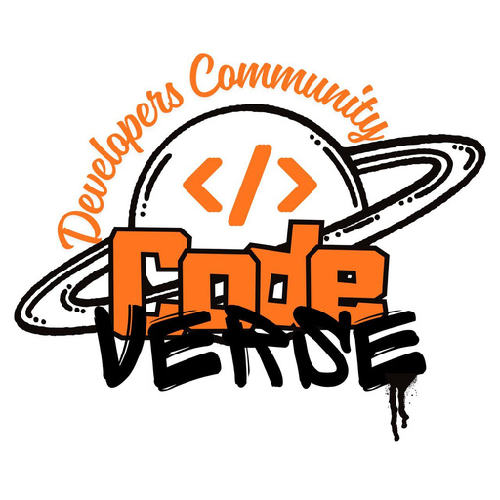
iNSIGHTS Search Less. Solve More.
BUILD WITH भारत — NATIONAL LEVEL HACKATHON
NexFactory AI
AI that predicts machine failure — before it happens.
TEAM NAME
Gamma
PROBLEM STATEMENT
AI/ML, IoT, Smart Sensor & Industrial Automation — Predictive Maintenance for MSME Manufacturing
TEAM MEMBERS
Priyanshi Choudhary • Raina Goel • Kunal Chauhan • Kartik Tyagi
COLLEGE
Jagannath University
Notes:
Cover slide. Update College name before submission. Team Gamma is competing with the same PredictIQ build for both n-InC's Deeptech Bharat Hackathon and Build With Bharat 2026 — framing differs by pitch, not by build.

Slide 2




THE PROBLEM
iNSIGHTS Search Less. Solve More.
India's factories run on guesswork, not data
Most Indian MSME manufacturers still practice reactive maintenance — machines run until they break, then get fixed. There's no early warning, no visibility into machine health, and no way to see energy being wasted by a degrading motor. Enterprise platforms exist, but they're built — and priced — for large factories, not MSMEs.
INDIA, RIGHT NOW
88%
of Indian industrial businesses suffer unplanned outages at least once a month
No early warning
Zero real-time visibility
₹7M
Failures are discovered only after the machine has already stopped.
No live view of vibration, temperature, current draw, or RPM on the floor.
lost for every single hour of unplanned downtime, on average
16.5M+
manufacturing MSMEs in India — almost none have predictive tooling
Silent energy waste
Enterprise tools, enterprise prices
50%+
Degrading motors draw excess power for weeks before anyone notices.
Siemens Senseye / GE Predix-class platforms are built for large plants, not MSMEs.
fewer sudden failures achievable with real-time condition monitoring
Source: ABB / Sapio Research “Value of Reliability”; P&S Intelligence India PdM Market Report
BUILD WITH भारत • Team Gamma • PredictIQ
02 / 10

Slide 3




THE SOLUTION
iNSIGHTS Search Less. Solve More.
One dashboard. Four jobs. Zero guesswork.
PredictIQ turns raw sensor signals into a plain-English risk score and a rupee figure — so a machine operator and a factory owner see the same story.
01
02
Real-Time Monitoring
AI Failure Prediction
Live vibration, temperature, current draw and RPM per machine — refreshed continuously, not on a weekly report.
An anomaly-detection model scores every machine's failure risk in real time and explains why it flagged it.
03
04
Energy Insights
ROI Dashboard
Flags machines drawing abnormal power and estimates exactly how much electricity is being wasted.
Converts every alert into “money saved” — so the value is obvious to a non-technical factory owner.
BUILD WITH भारत • Team Gamma • PredictIQ
03 / 10

Slide 4





SYSTEM ARCHITECTURE
iNSIGHTS Search Less. Solve More.
One pipeline — real sensors or simulated.
Sensors
Ingestion API
Telemetry Store
AI Engine
Dashboard
Vibration • Temp • Current • RPM
FastAPI + Uvicorn
Live sensor feed
Python microservice
React + Recharts
Simulated for demo — IoT-ready
WebSocket / REST
Every reading, every alert
Isolation Forest / z-score
Live charts, risk, ROI
Hardware-agnostic by design. For the hackathon, “Sensors” is a script generating realistic readings with injected anomaly spikes. Nothing downstream knows or cares whether the data is real or simulated — swap in an ESP32 + vibration/temp/current sensor later with zero code changes.
BUILD WITH भारत • Team Gamma • PredictIQ
04 / 10

Slide 5






TECHNOLOGY STACK
iNSIGHTS Search Less. Solve More.
Boring, proven technology — on purpose
Every layer is a widely-used, well-documented tool. That's a feature: it means we ship a working demo in 8 hours, not a research prototype.
Frontend
React + Vite, Recharts, Tailwind CSS
Fast to build, live charts, matches team's existing skillset
Backend
FastAPI (Python 3.11)
Handles ingestion API, ML inference, and async telemetry
Database
Telemetry Store
Stores time-series sensor logs and alert history
AI / ML
Python microservice — Isolation Forest (scikit-learn) / rolling z-score
Lightweight, fast to train, explainable to judges — not a black box
Simulation
Python-based sensor simulator with injected anomalies
Stands in for real IoT hardware for the demo
Deployment
Vercel / Render + GitHub
Free, fast, gives us a live demo link
BUILD WITH भारत • Team Gamma • PredictIQ
05 / 10

Slide 6
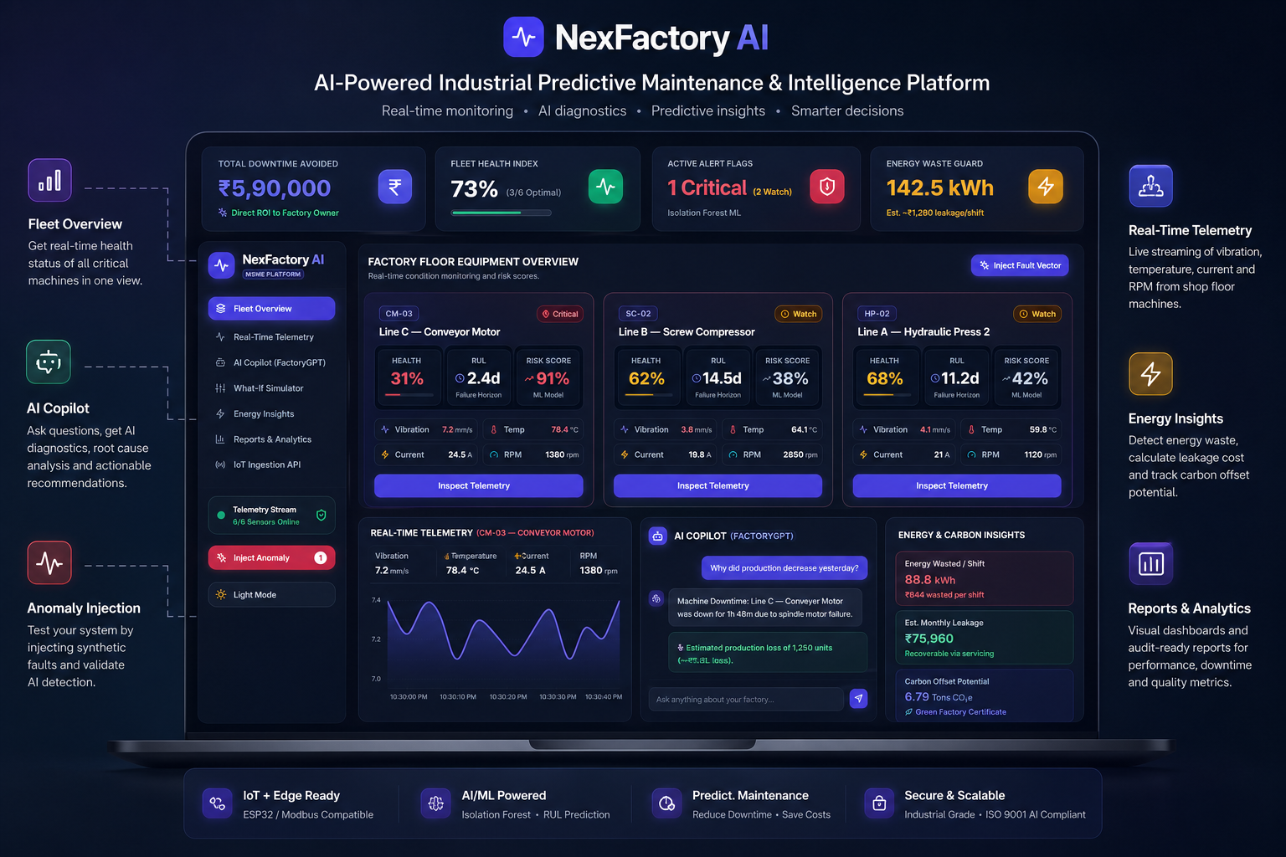
PRODUCT WALKTHROUGH
iNSIGHTS Search Less. Solve More.
BUILD WITH भारत • Team Gamma • PredictIQ
06 / 10
Notes:
Demo script: 1) Open dashboard, all machines green. 2) Trigger the simulator's injected anomaly live — watch Line C spike to red. 3) Show the AI alert explaining why (vibration 3x baseline). 4) Show the ROI page converting the alert into rupees saved. 5) Close with: 'Real sensors plug into the same ingestion API — this is a hardware-agnostic platform, ready to pilot with a real factory.'

Slide 7

KEY FEATURES & INNOVATION
iNSIGHTS Search Less. Solve More.
What makes PredictIQ different
Explainable, not a black box
Every alert states the reason — “vibration 3x above baseline” — not just a mystery score. Judges (and factory owners) can verify the logic.
Hardware-agnostic from day one
The exact same ingestion API accepts simulated data today and real ESP32 + vibration/temp/current sensors tomorrow — no rebuild required.
ROI-first UX
Every technical alert is auto-converted into a rupee figure, so a non-technical factory owner — not just an engineer — sees the value instantly.
True real-time pipeline
WebSocket streaming flags anomalies the moment they happen, not in a batch report the next morning.
BUILD WITH भारत • Team Gamma • PredictIQ
07 / 10

Slide 8
WHAT'S NEW — BEYOND THE ORIGINAL PLAN
iNSIGHTS Search Less. Solve More.
Four upgrades that turn a hackathon build into a fundable product
Remaining Useful Life, not just a %
A critical alert now projects forward — “~2 days to bearing failure” — instead of a bare 91% score. That turns an alert into an actual maintenance decision, not just a warning.
WhatsApp-first alerting
A floor supervisor doesn't watch a dashboard all day — he reads WhatsApp. Every critical alert is modeled as a push to the floor, not just a badge nobody opens.
Aligned to real MSME schemes
Energy-waste tracking maps directly onto ZED Certification's energy pillar, and the product targets Udyam-registered MSMEs — the exact segment India's own schemes are built for.
Two builds, zero demo-day risk
A self-contained offline dashboard for the live pitch (nothing to crash on stage), plus a real FastAPI + async telemetry backend for the code walkthrough — judges see a flawless demo backed by real code.
BUILD WITH भारत • Team Gamma • PredictIQ
08 / 11

Slide 9
FEASIBILITY & COMPETITORS
iNSIGHTS Search Less. Solve More.
Enterprise platforms exist. MSMEs can't afford them.
Target user
Hardware
AI model
Entry cost / yr
Siemens
Senseye
Large, Siemens-
standardized plants
Existing TIA /
MindSphere sensors
Black-box ML
$36,000+
Augury
Large enterprise,
rotating equipment
Proprietary sensors
required
Managed, opaque
$12,000–$40,000+
GE Digital
(Predix)
Power & oil-and-gas
enterprises
Historian /
SCADA integration
Complex, custom
Custom enterprise
PredictIQ
(us)
Indian MSME
manufacturers
Sensor-agnostic —
simulate → real, no rebuild
Explainable
(Isolation Forest)
$0 to start
(open-source stack)
Why we win on feasibility: every component (React, FastAPI, scikit-learn) is a mature, documented library — low technical risk, 8-hour build window. Cold-start risk (no historical data) is mitigated with a rolling z-score fallback alongside Isolation Forest, and the demo's synthetic anomaly injection proves the pipeline end-to-end.
BUILD WITH भारत • Team Gamma • PredictIQ
09 / 11

Slide 10

IMPACT & MARKET OPPORTUNITY
iNSIGHTS Search Less. Solve More.
A $4B market that today's players can't reach
40–60%
16.5M+
30.8%
cut in unplanned downtime with predictive maintenance
manufacturing MSMEs in India — our addressable market
CAGR of India's predictive maintenance market, 2026–32
India Predictive Maintenance Market (USD, Millions)
Manufacturing already leads
Manufacturing holds the largest single share (35%) of India's predictive maintenance market in 2025 — and MSMEs, priced out of Siemens- and GE-class tools, are almost entirely unserved.
Same codebase powers both n-InC's Deeptech Bharat Hackathon and Build With Bharat 2026 — built once, pitched twice, pilot-ready for a real factory.
Source: P&S Intelligence, India Predictive Maintenance Market Report (30.8% CAGR, 2026–32)
BUILD WITH भारत • Team Gamma • PredictIQ
10 / 11

Slide 11




REFERENCES & TEAM
iNSIGHTS Search Less. Solve More.
Where to find everything
GitHub Repository
TEAM GAMMA
https://github.com/Priyanshi0907/NexFactory
PC
RG
Priyanshi Choudhary
Raina Goel
Live Demo
https://nex-factory.vercel.app
KC
Kunal Chauhan
KT
Kartik Tyagi
REFERENCES
ABB / Sapio Research — “The Value of Reliability” global downtime survey
P&S Intelligence — India Predictive Maintenance Market Report, 2026–2032
IBEF — MSME Industry Report, Feb 2026 (Udyam registration data)
scikit-learn documentation — Isolation Forest anomaly detection
Thank you
Roadmap: swap the simulator for an ESP32 + vibration / temperature / current sensor rig — same ingestion API, zero code changes. Pilot-ready with a real factory.
Built for Build With भारत 2026 by Team Gamma. Software today, factory-floor-ready tomorrow.
BUILD WITH भारत • Team Gamma • PredictIQ
11 / 11

