Slide 1

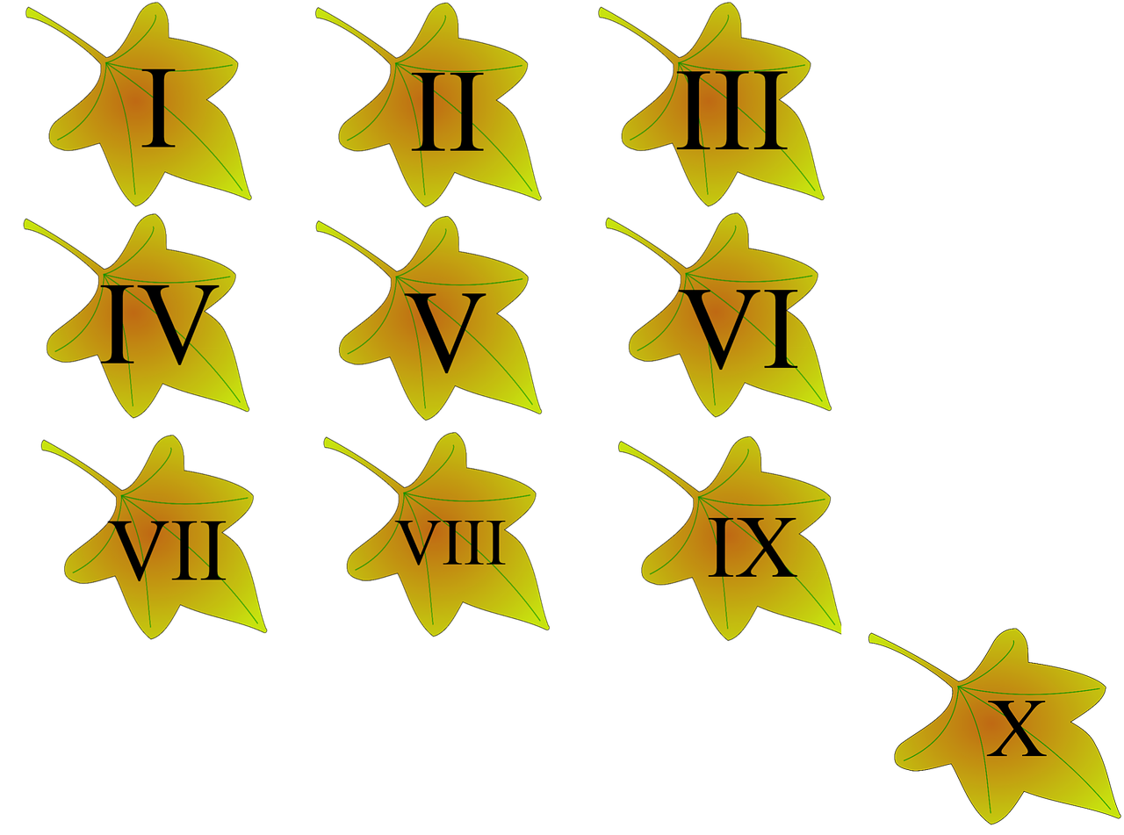

Project By: PRIYANSHI TALAVIYA 21CE141
Project Name
converter
Guided By:
Dhurvi trivedi

Slide 2


oman numeral converter

Slide 3
Table Of Contents
Problem statement
Technology used
References
Plan
Design

Slide 4
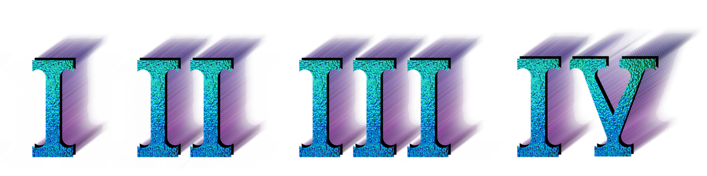
PROBLEM STATEMENT
We only know a few numbers in roman, thus if we need to convert a number to roman, we can do so by using a website like this.

Slide 5

Tools & Technology Used
HTML
CSS
JAVASCRIPT

Slide 6
References
https://www.youtube.com/watch?v=6mbwJ2xhgzM&list=PLu0W_9lII9agiCUZYRsvtGTXdxkzPyItg
https://www.youtube.com/watch?v=Edsxf_NBFrw
https://www.youtube.com/watch?v=G3e-cpL7ofc

Slide 7
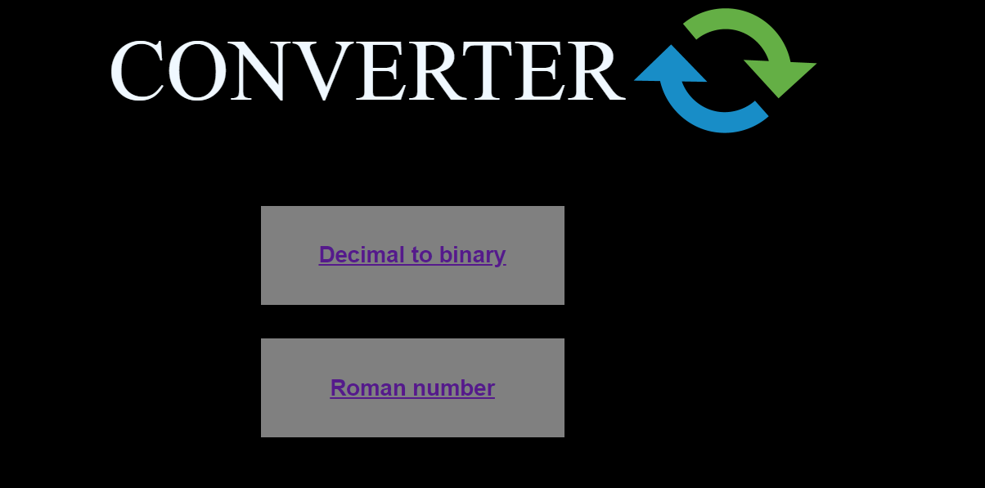
Homepage Design

Slide 8
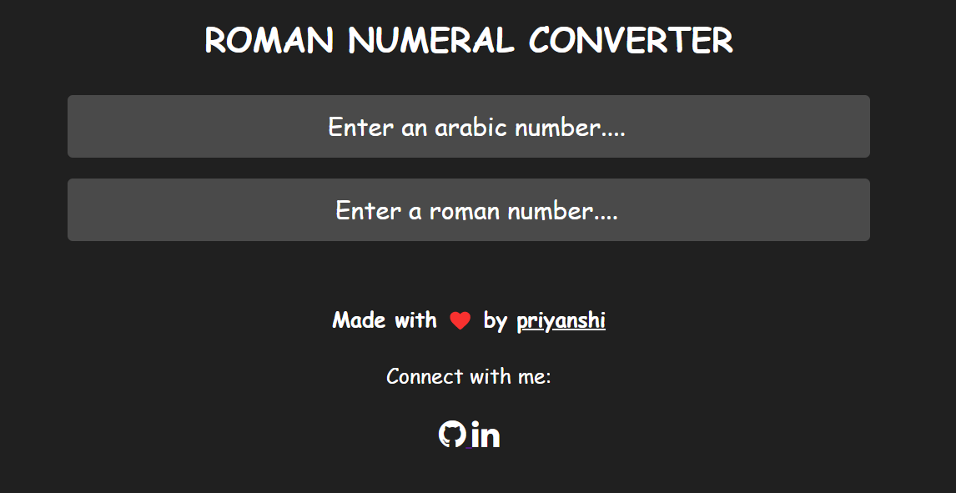
Design

Slide 9
Decimal to Binary converter

Slide 10
PROBLEM STATEMENT
We can use this website to convert decimal numbers to binary numbers.

Slide 11
References
https://www.youtube.com/watch?v=RKAQsyPRk_w
https://www.youtube.com/watch?v=Edsxf_NBFrw
https://www.youtube.com/watch?v=G3e-cpL7ofc

Slide 12
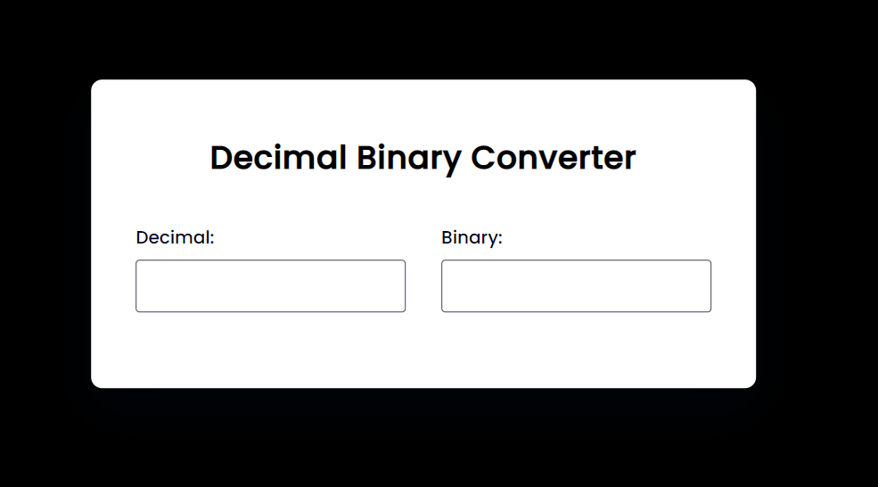
Design

Slide 13
Thank you

