Slide 1
Indore Institute of Science & Technology
Department of Information Technology
A Minor Project Presentation on
CYBERTRACE
Real-Time Network Security Monitoring & Anomaly Detection System
Project Guide
Presented By
Ms. Rupal Yadav
Department of Information Technology
Priyanshi Gupta 0818IT241053
Palak Yadav 0818IT241047
Vishwajeet Singh Tomar 0818IT241075
Academic Year: 2024 – 2025
Indore Institute of Science & Technology | Minor Project – 2024-25

Slide 2
Section 00 • Table of Contents
Outline
01. Proposed Area and Topic:
01. Proposed Area and Topic: Domain focus and project title.
Domain focus and project title.
02. Introduction:
02. Introduction: Overview of the CyberTrace platform.
•
•
Overview of the CyberTrace platform.
03. Objectives:
03. Objectives: Five primary goals of the project.
Five primary goals of the project.
04. Proposed Methodology:
04. Proposed Methodology: System architecture and data flow.
•
•
System architecture and data flow.
05. Technical Details:
05. Technical Details: Minimum hardware and software stack.
Minimum hardware and software stack.
06. Expected Outcome:
06. Expected Outcome: Project deliverables and impact.
•
•
Project deliverables and impact.
07. References:
07. References: Standard papers and documentation.
•
Standard papers and documentation.

Slide 3

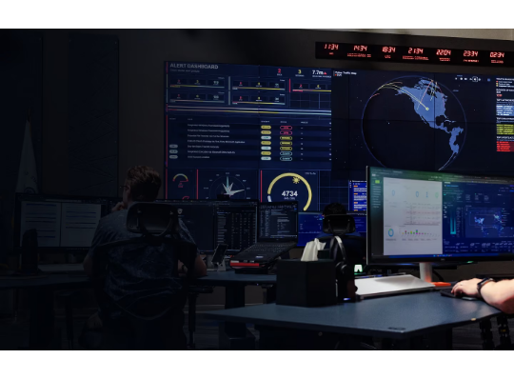
Section 01 • Font Style: Times New Roman
Proposed Area and Topic
Proposed Area & Motivation
Why This Project?
•
Cybersecurity Domain: Network traffic inspection and analysis.
→ Global cybercrime damage is projected to reach $10.5 trillion annually by 2025.
•
Intrusion Detection: Automated, rule-based threat identification.
→ Most existing IDS tools are expensive and require deep expertise to operate.
•
Packet Monitoring: Real-time and historical stream analysis.
•
Cost Efficiency: Open-source alternative to costly enterprise tools.
→ Institutions and small teams lack accessible, real-time threat visibility tools.
→ CyberTrace will provide a lightweight, open-source dashboard that any IT team can deploy.
Proposed Project Topic
→ It will bridge the gap between raw packet data and actionable security insights.
CyberTrace: Real-Time Network Security Monitoring & Anomaly Detection System using Python, FastAPI, and React.

Slide 4
Section 02 • Brief Introduction of Project
Introduction
"CyberTrace will bridge raw network data and actionable security intelligence — in real time."
The proposed system aims to monitor network activity continuously, identify threats automatically, and present findings through an intuitive web-based dashboard — without requiring expensive enterprise solutions.
What It Will Do
How It Will Work
Why It Matters
Capture and parse network packets (live or from PCAP files) and run them through multiple anomaly detection engines to flag threats in real time.
A Scapy-based capture layer will feed a FastAPI backend that processes packets, stores alerts, and serves data via REST and WebSocket to a React dashboard.
Early automated threat detection reduces incident response time. The system will be deployable by small teams without enterprise-level licensing or infrastructure costs.

Slide 5
Section 03 • Goals of the Project
Objectives
01
Packet Capture: Develop a module to capture live traffic from a network interface and parse recorded PCAP files using the Scapy library.
02
Anomaly Detection: Implement rule-based and ML-threshold detectors for DoS attacks, Port Scans, and DNS anomalies to generate real-time alerts.
03
Web Dashboard: Design a responsive, browser-based UI using React JS to display live packet metrics, protocol charts, and active threat alerts.
04
PCAP Forensics: Build an upload module allowing investigators to submit stored .pcap files for offline threat analysis and report generation.
05
Decoupled Design: Architect the system as a modular FastAPI backend paired with a React frontend, enabling independent scaling of each layer.

Slide 6
Section 04 • Proposed Algorithm / Method
Proposed Methodology: Architecture
LAYER 1
LAYER 2
LAYER 3
LAYER 4
Data Capture Layer
Detection Engine
Backend API
Frontend UI
The system will use Scapy to sniff live packets from a NIC or read uploaded PCAP files through a PCAPReader module.
Each parsed packet will pass through four detector modules: DoSDetector, PortScanDetector, DNSAnomalyDetector, and MLAnomalyDetector.
FastAPI will expose REST endpoints (/api/metrics, /api/alerts, /api/upload_pcap) and a WebSocket channel for live streaming.
A React + Vite application will render an interactive dashboard featuring live charts, an alert panel, and a PCAP upload interface.
→
→
→

Slide 7
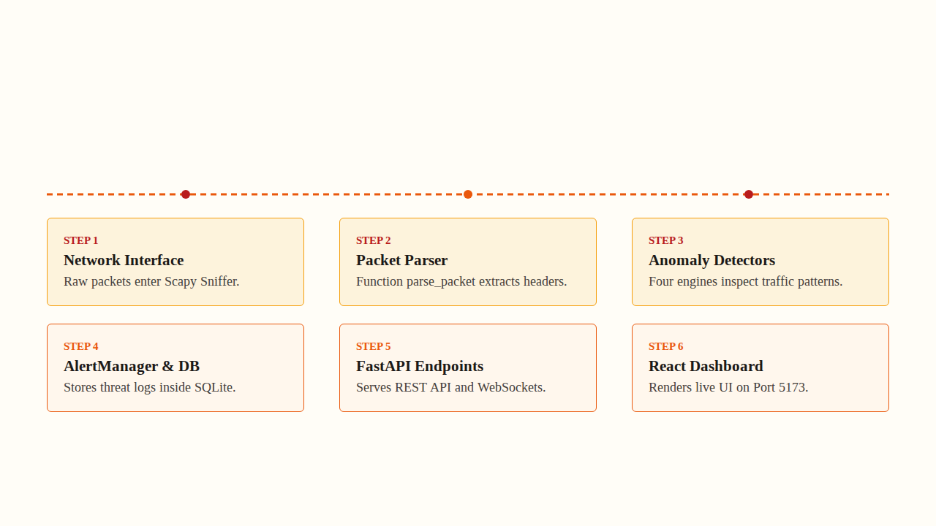
Section 04 • Process of the Whole Project
Proposed Methodology: Flow Chart
START
→
CAPTURE
→
PARSE
→
DETECT
→
ALERT / STORE
→
SERVE
→
DASHBOARD
System initialises and selects capture source (Live NIC or PCAP file).
Scapy captures or reads packets and sends them to the Packet Parser.
Parser extracts: Source/Dest IP, Port, Protocol, Payload size, Timestamp.
Four engines run in parallel: DoS, PortScan, DNSAnomaly, MLThreshold.
Flagged packets generate alerts stored in SQLite via SQLAlchemy ORM.
FastAPI serves metrics and alerts via REST + WebSocket to the React frontend.
React dashboard renders live charts, an alert feed, and forensics upload UI.

Slide 8
Section 05 • Hardware and Software Requirement (MIN)
Technical Details
Hardware Requirements (MIN)
Software Requirements & Tech Stack
•
System Type: Standard PC or Laptop.
•
Languages: Python 3.x and JavaScript (ES2022).
•
Memory (RAM): Minimum 4 GB (8 GB Recommended).
•
Packet Capture: Scapy – sniffing and PCAP parsing.
•
Processor: Intel Core i3+ or AMD Ryzen 3+.
•
Backend & DB: FastAPI, Uvicorn, SQLite, SQLAlchemy.
•
Network Card: Standard NIC for live packet capture.
•
Frontend UI: React JS, Vite, TailwindCSS, Recharts.
•
Disk Space: Minimum 500 MB free storage.
•
OS Support: Linux (Recommended) and Windows.

Slide 9
Section 06 • Summary of the Project
Expected Outcome
1. Functional Prototype
2. Interactive Web Dashboard
A working prototype capable of capturing live packets or reading PCAP files, detecting anomalies, and generating real-time security alerts through automated rule engines.
A browser-based React dashboard displaying live traffic metrics, protocol distribution charts, and a threat alert feed — accessible from any device on the network.
3. PCAP Forensics Module
4. Scalable & Decoupled Architecture
A dedicated forensics page allowing investigators to upload recorded .pcap files for offline analysis and downloadable incident reports for post-event investigation.
A cleanly separated FastAPI backend and React frontend ensuring each layer can be independently maintained, scaled, or upgraded without disrupting the other.

Slide 10
Section 07 • Citations & Documentation
References
[1] RFC 793: Transmission Control Protocol (TCP), IETF, 1981.
[2] Scapy Documentation: Packet Manipulation Library — https://scapy.net
[3] FastAPI Documentation: High Performance APIs with Python — https://fastapi.tiangolo.com
[4] React JS Documentation: JavaScript Library for Building UIs — https://react.dev
[5] V. Chandola et al.: "Anomaly Detection: A Survey", ACM Computing Surveys, 2009.
[6] UI Component Library: TailwindCSS & DaisyUI — https://daisyui.com
Thank You!
We look forward to your guidance and feedback.

Slide 11

Image Sources
https://cdn.prod.website-files.com/6a9832a0d0b02b3817cea503/6ab12de09e3951699bdf84db_SNC_Cybersecurity_hero_v002.webp
Source: www.sncorp.com

