Slide 1



From XML to RDF step by step: approaches for leveraging XML workflows with linked data
XML Prague | 12 February 2016
www.freme-project.eu
Felix Sasaki, DFKI / W3C Fellow
On behalf of the FREME Consortium and Contributors

Slide 2
The Co-Authors of This Effort and Paper
Marta Borriello, Vistatec
Christian Dirschl, Wolters Kluwer
Axel Polleres, Vienna University of Economics and Business (WU)
Phil Ritchie, Vistatec
Frank Salliau, iMinds
Felix Sasaki, DFKI / W3C Fellow
Giannis Stoitsis, Agro-Know

Slide 3
Motivation – This breaks XML Processing!
<myData> <head>...</head> <body>
<linkedDataStorage>...</linkedDataStorage> ... </body> </myData>
Validation
Transformation
Query
...
Adaptation of schemas in real life scenarios often not possible

Slide 4
Is this RDF Chimera again?
No: RDF Chimera is about relation between formats
XML, HTML RDF, JSON
Our Issue here is about integration of formats
RDF in XML workflows for multilingual and semantic enrichment of content

Slide 5








Background: The FREME Project
Two year H2020 Innovation action; start February 2020
Industry partners leading four business cases around digital content and (linked) data
FREME = A framework for multilingual and semantic enrichment of digital content
Is there a real need for this? Oh yes! See the following business cases
Notes:
This slide probably needs no visualization.

Slide 6
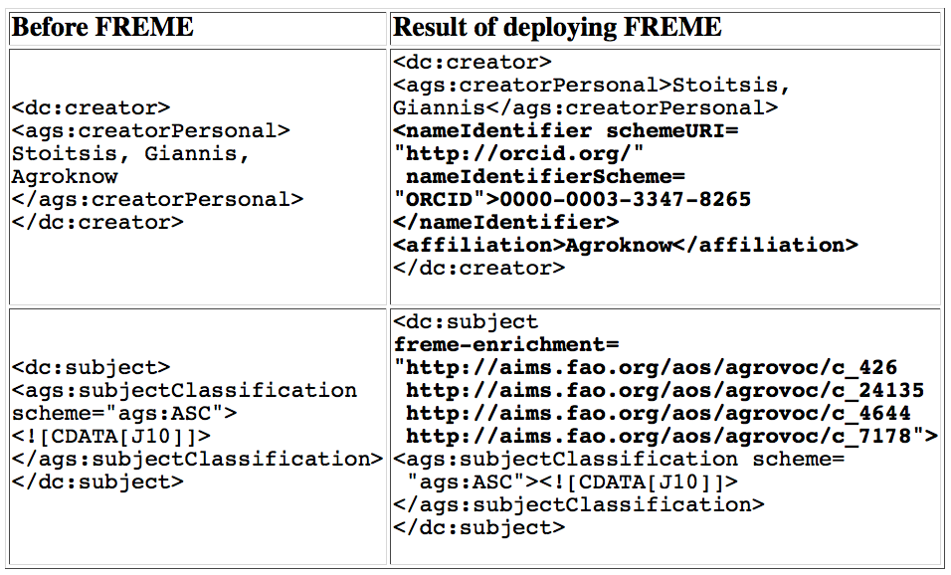
Business Case “Linked Data in Publishing Workflows”
Wolters Kluwer, Agroknow
Enrichment of academic publication metadata

Slide 7
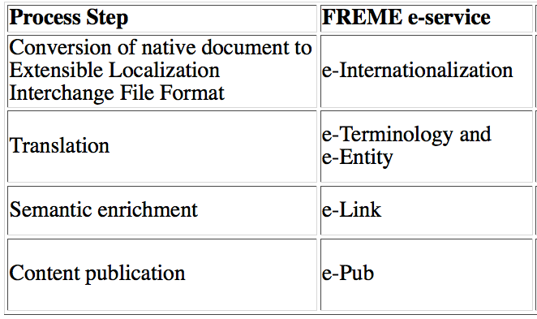
Business Case “Linked Data in XML Localization Workflows”
Vistatec – workflows integrating localization XML formats XLIFF, ITS 2.0 and linked data, in the Ocelot editor for translation editing and review – see GUI screenshot next slide

Slide 8
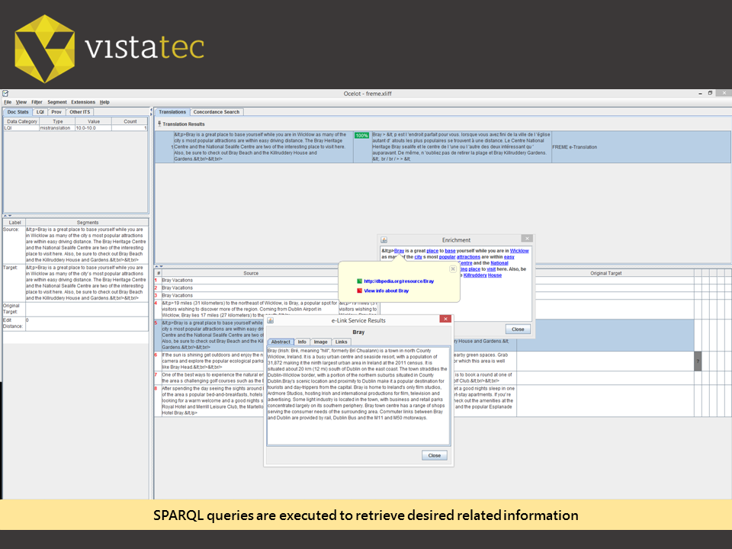

Slide 9
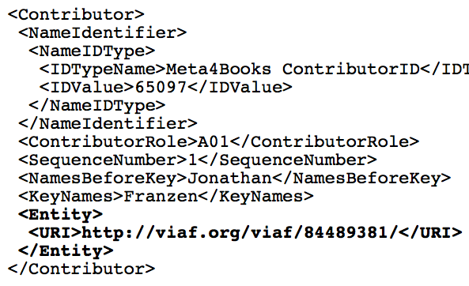
Business Case “Linked Data in book metadata”
iMinds – linked data in book metadata
A potential approach for embedding linked data in ONIX

Slide 10
Approaches for Linked Data Integration
Convert XML to linked data
Embed linked data into XML via structured markup
Anchor Linked data in XML attributes
Embed linked data in metadata sections of XML files
Anchor linked data via annotations in XML content
Try them out with DocBook or TEI content athttp://api-dev.freme-project.eu/doc/freme-showcase/xml-to-rdf.html
Implementation uses FREME, the Okapi framework and Saxon-CE, the Swiss army knife of XML in the browser processing

Slide 11
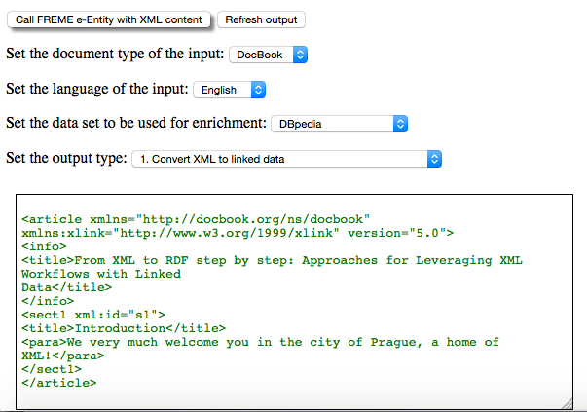
Screenshot from Demo

Slide 12
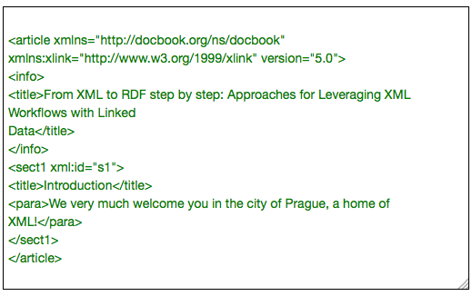
1. Convert XML to linked data

Slide 13
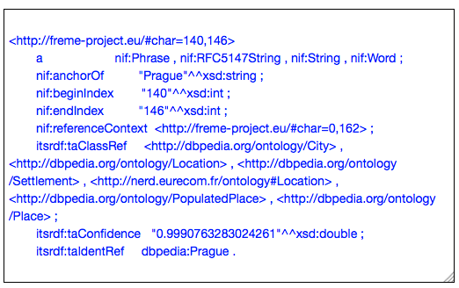
1. Convert XML to linked data

Slide 14
1. Convert XML to linked data
Benefits
No need to change XML workflow
Similar to RDF Chimera approach
Difference: here focus on adding new (linked) information
Drawback
New tool chain needed
No useful representation of mixed content

Slide 15
2. Embed linked data into XML via structured markup
<para>We very much welcome you in the city of <emphasis vocab="http://schema.org/" typeof="Place" property="name" resource="http://dbpedia.org/resource/Prague">Prague</emphasis>, a home of <emphasis vocab="http://schema.org/" typeof="Thing" property="name" resource="http://dbpedia.org/resource/XML">XML</emphasis>!</para>

Slide 16
2. Embed linked data into XML via structured markup
Benefits
Relying on hooks for data integration, e.g. RDFa 1.1 lite
Common for search engine optimization, cf. schema.org
May use other syntaxes like json-ld
Drawback
May break XML validation
May need at least adapted tool chains to understand RDFa / json-ld

Slide 17
3. Anchor Linked data in XML attributes
Example: Embedding anchors in XLIFF via ITS 2.0 text analytics markup
<source ...>
<mrk ...its:taIdentRef="http://dbpedia.org/resource/Berlin">
Berlin</mrk> is the capital of Germany!</source>

Slide 18
3. Anchor Linked data in XML attributes
Benefits
Using existing XML attributes = no new markup is needed
Toolchain can be kept as is
Drawback
Actual data integration is just postponed
Data integration does not leave a trace – missing provenance

Slide 19
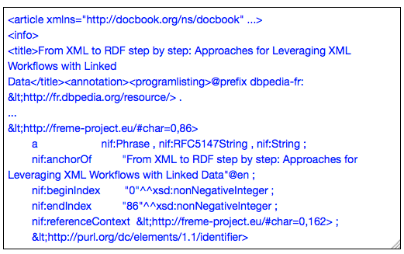
4. Embed linked data in metadata sections of XML files

Slide 20
4. Embed linked data in metadata sections of XML files
Benefits
Metadata section does not influence size of main content
Clear separation of concerns and processing
Drawback
No per se relation to actual content
Character offset pointers to content are fragile

Slide 21
5. Anchor linked data via annotations in XML content – Here Using W3C Annotation Model
{ "id": "http://example.com/myannotations/a1", "type": "Annotation“...
"selector": { ...
"/xlf:unit[1]/xlf:segment[1]/xlf:source/xlf:mrk[1]" "itsrdf:taIdentRef": "http://dbpedia.org/resource/Berlin", "itsrdf:taClassRef": "http://schema.org/Place", ... } }

Slide 22
5. Anchor linked data via annotations in XML content
Benefits
Same as approach 4
In addition, more robust anchoring via path expressions
Drawback
Resolution of path expressions can be computationally expensive

Slide 23
Approaches for Linked Data Integration …
Convert XML to linked data
Embed linked data into XML via structured markup
Anchor Linked data in XML attributes
Embed linked data in metadata sections of XML files
Anchor linked data via annotations in XML content
… Or: Routes to Bridge between RDF and XML

Slide 24
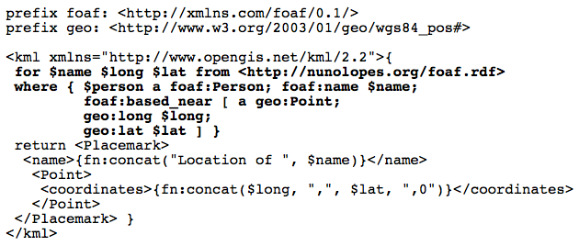
Routes to Bridge between RDF and XML
XSPARQL – W3C Member submission
Compilation of SPARQL queries into XQuery

Slide 25
Next steps – What Do you Think?
Conclusion with my co-authors:
“We believe that joint efforts in standardization bodies to bridge the gaps between RDF and XML in order to enable such transformations and integrated tooling in a standard way should be further pursued.”
What do you think – is it worth documenting this further
Have a W3C community group on the topic?
Document approaches and best practices?
Provide of-the-shelf tooling?

Slide 26






contacts
FELIX SASAKI
Senior Researcher DFKI / W3C Fellow
On behalf of the FREME consortium and collaborators
E-mail: felix.sasaki@dfki.de
Notes:
Back Page #1
Social network icons refer to speaker (he/she has to link his/her accounts)

