Slide 1
DS4270 MAJOR PROJECT · MANIPAL UNIVERSITY JAIPUR · 2026
🧠 MINDscan
95.67%
Test Accuracy
AI-Based Mental Health Risk Screening System for University Students
95.65%
Preliminary screening support · Anonymous · Explainable AI · Not a diagnostic tool
F1-Score
👩‍💻 Priyanshi Goel
🏛️ Manipal University Jaipur
🧑‍🏫 Dr. Aparna Tripathi
📅 June 2026
1,151
🔴 Publicly Deployed: mental-health-predictor-0oat.onrender.com
Students Surveyed
LR Model
Best Algorithm
MINDscan · AI-Based Mental Health Screening · Priyanshi Goel · DS4270 · MUJ · 2026
1 / 12
Notes:
OPENING — say this naturally, don't read the slide.
"Good morning/afternoon. I'm Priyanshi Goel, B.Tech final year, DS4270 Major Project. My project is MINDscan — an AI-based mental health screening system for university students."
"The system uses a Logistic Regression model trained on 1,151 real MUJ students, achieving 95.67% test accuracy. The app is live right now — any student can use it anonymously in under 2 minutes."
"Before I begin — important: this is a preliminary screening support tool. It is NOT a clinical diagnostic tool and does not replace professional care."
[Pause — let them read the metrics on the right. Then go to Slide 2.]

Slide 2
01 · PROBLEM STATEMENT
The Problem We Addressed
University Mental Health Has a Screening Gap
📉
🚫
🔍
Scale of the Crisis
Students Don't Seek Help
No Suitable Tool Exists
1 in 4 university students experiences depression or anxiety
Stigma, cost, and lack of awareness are the three main barriers
Validated tools need careful clinical interpretation. Generic wellness apps usually do not provide validated depression-risk screening.
University students often avoid formal counselling due to stigma, time constraints, and lack of early screening.
MINDscan provides anonymous, instant, explainable risk screening — bridging this gap.
MINDscan · AI-Based Mental Health Screening · Priyanshi Goel · DS4270 · MUJ · 2026
2 / 12
Notes:
WHAT TO SAY:
"The core problem is a screening gap. 1 in 4 university students has depression or anxiety. Yet most never seek help."
"Why? Three main reasons: stigma — they fear judgment. Cost — therapy is expensive. And simply not knowing they have a problem."
"Existing solutions don't solve this. PHQ-9 and GAD-7 are validated screening tools, but their results need careful interpretation. Generic wellness apps usually do not provide validated depression-risk screening. Also, limited tools combine PHQ-9, lifestyle context, explainability, and deployment for Indian university students."
"MINDscan is designed to fill exactly this gap — anonymous, instant, no appointment needed, and it explains its reasoning."
IF ASKED: "Why can't they just Google the PHQ-9 and score it themselves?"
→ "They can calculate their PHQ class, but they do not get probability confidence, lifestyle context, SHAP-based explanations, or a deployed screening interface. That is what the model adds."

Slide 3
02 · IMPACT & SIGNIFICANCE
Why This Project Matters
Five Reasons This Is Important
🕐
🔒
🔍
🇮🇳
🌐
Early Screening
Anonymous Access
Explainable AI
India-Focused Dataset
Publicly Deployed System
Detects risk before it escalates to crisis
No login, no personal profile stored. Removes the stigma barrier
SHAP shows WHY the risk is assigned — not a black box
1,151 real MUJ students Not a foreign dataset
Not just a research paper Anyone can use it right now
"The goal is not to replace mental health professionals — but to give every student a private, instant first step toward understanding their own wellbeing."
MINDscan · AI-Based Mental Health Screening · Priyanshi Goel · DS4270 · MUJ · 2026
3 / 12
Notes:
WHAT TO SAY — this slide is your "impact pitch". Say it with confidence.
"I want to take a moment to explain why this project matters beyond just the technical implementation."
Go through each pillar:
1. "Early screening catches risk before it becomes a crisis — like a smoke detector before the fire."
2. "It's completely anonymous — It requires no login and stores no personal profile, which reduces the stigma barrier."
3. "The AI explains its reasoning using SHAP — it doesn't just say 'you are High Risk', it shows which specific symptoms are driving that risk."
4. "The dataset is from real Indian university students — not a foreign dataset that may not reflect our cultural and academic context."
5. "And most importantly — this is a deployed, working system. Any student in India can use it right now for free."
IMPORTANT: End this slide by saying — "All of this while being very clear: MINDscan is a preliminary screening support tool. It is not a clinical diagnosis."

Slide 4
03 · DATA & METHODOLOGY
Data Collection + Project Pipeline
1,151 Students · 22 Features · 8-Phase Build
Total Responses
1,151
Phase 1
Literature Review — 16 research papers
Features per Student
22
Phase 2
Primary Data Collection — Google Forms
Low Risk (PHQ 0–9)
58%
Phase 3
EDA — 10 visualizations generated
Phase 4
Model Training — 4 algorithms compared
Moderate (PHQ 10–19)
29%
Upgrade 1
SHAP Explainability — feature attribution
High Risk (PHQ 20+)
13% ← imbalanced
Upgrade 2
SMOTE — address class imbalance
⚠️ PHQ-9 Total Score dropped before training — prevents data leakage
Upgrade 3
Anxiety Estimation (GAD-7 inspired)
Phase 5–6
Flask App Build → Live Deployment
MINDscan · AI-Based Mental Health Screening · Priyanshi Goel · DS4270 · MUJ · 2026
4 / 12
Notes:
WHAT TO SAY:
"We collected our own primary dataset — 1,151 students at MUJ through a Google Forms survey. Not a downloaded dataset."
"Each student answered 22 questions: all 9 PHQ-9 clinical items rated 0 to 3, plus lifestyle data — sleep hours, exercise frequency, screen time, stress levels, and academic overload."
"The target variable — Low, Moderate, or High Risk — was derived from the PHQ-9 total score using the standard clinical thresholds."
"Critical decision: we then DROPPED the PHQ-9 total score before training. If we kept it, the model would just memorise the formula. Dropping it prevents direct leakage from the final PHQ total while retaining individual PHQ symptoms as valid screening inputs."
"The project was built in 8 phases — from literature review to a publicly deployed application."
IF ASKED about class imbalance now: "13% High Risk is a small minority — we addressed this with SMOTE in the model training phase."

Slide 5
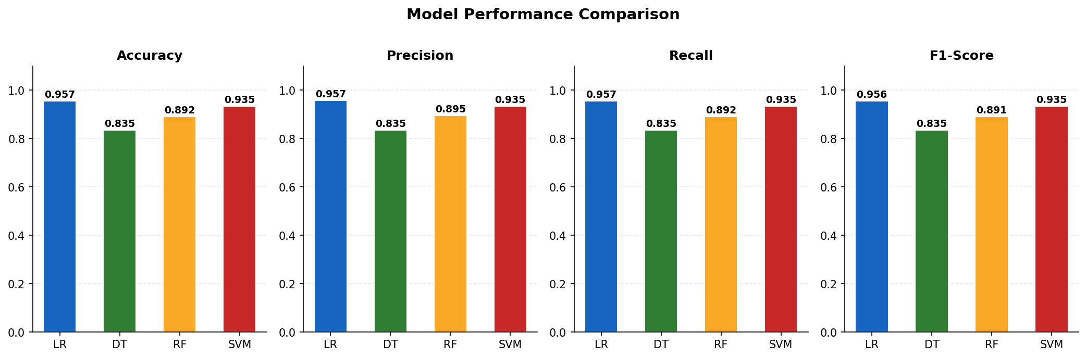
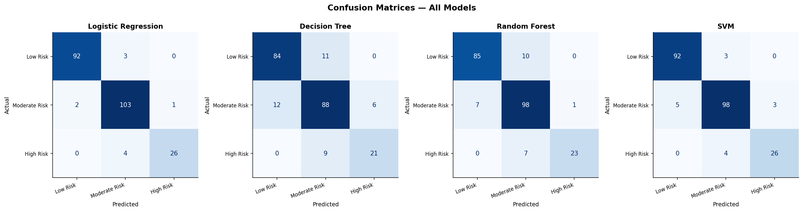
04 · MODEL TRAINING & RESULTS
4 Algorithms Compared
Logistic Regression Won — Here's Why
Algorithm
CV Accuracy
Test Accuracy
F1-Score
⭐ Logistic Regression
95.98%
95.67%
95.65%
SVM (RBF kernel)
94.24%
93.51%
93.48%
Random Forest
92.39%
89.18%
89.15%
Decision Tree
80.54%
83.55%
83.48%
Per-Class F1 — Logistic Regression
🟢 Low Risk
🟡 Moderate
🔴 High Risk
97%
95%
91%
Why LR? Labels use LINEAR PHQ thresholds (0–9 / 10–19 / 20+). LR is the ideal algorithm for linear decision boundaries.
MINDscan · AI-Based Mental Health Screening · Priyanshi Goel · DS4270 · MUJ · 2026
5 / 12
Notes:
WHAT TO SAY:
"We trained four algorithms and compared them using 5-fold stratified cross-validation."
"Logistic Regression came out clearly on top — 95.67% test accuracy."
"The reason is conceptual: our target labels are based on fixed LINEAR PHQ-9 thresholds. The decision boundary between Low, Moderate, and High Risk is fundamentally linear. Logistic Regression is purpose-built for linear classification — adding complexity with Random Forest or deep learning would only hurt performance on this type of data."
"For the most critical class — High Risk — we achieved 91% F1. This shows a strong balance between precision and recall for identifying at-risk students."
"CV accuracy 95.98% versus test accuracy 95.67% — a gap of only 0.3%. No significant overfitting was observed."
CRITICAL QUESTION YOU WILL BE ASKED:
"Is your model just learning the PHQ-9 thresholds?"
BEST ANSWER:
"Yes — the labels ARE PHQ-derived, so the model is not replacing PHQ-9. Its added value is: probability confidence scores for each class, lifestyle context from 13 additional features, SHAP explanations showing which specific factors drive each prediction, and a deployed screening interface accessible to any student. The formula gives a class label. The model gives a complete decision support system."

Slide 6
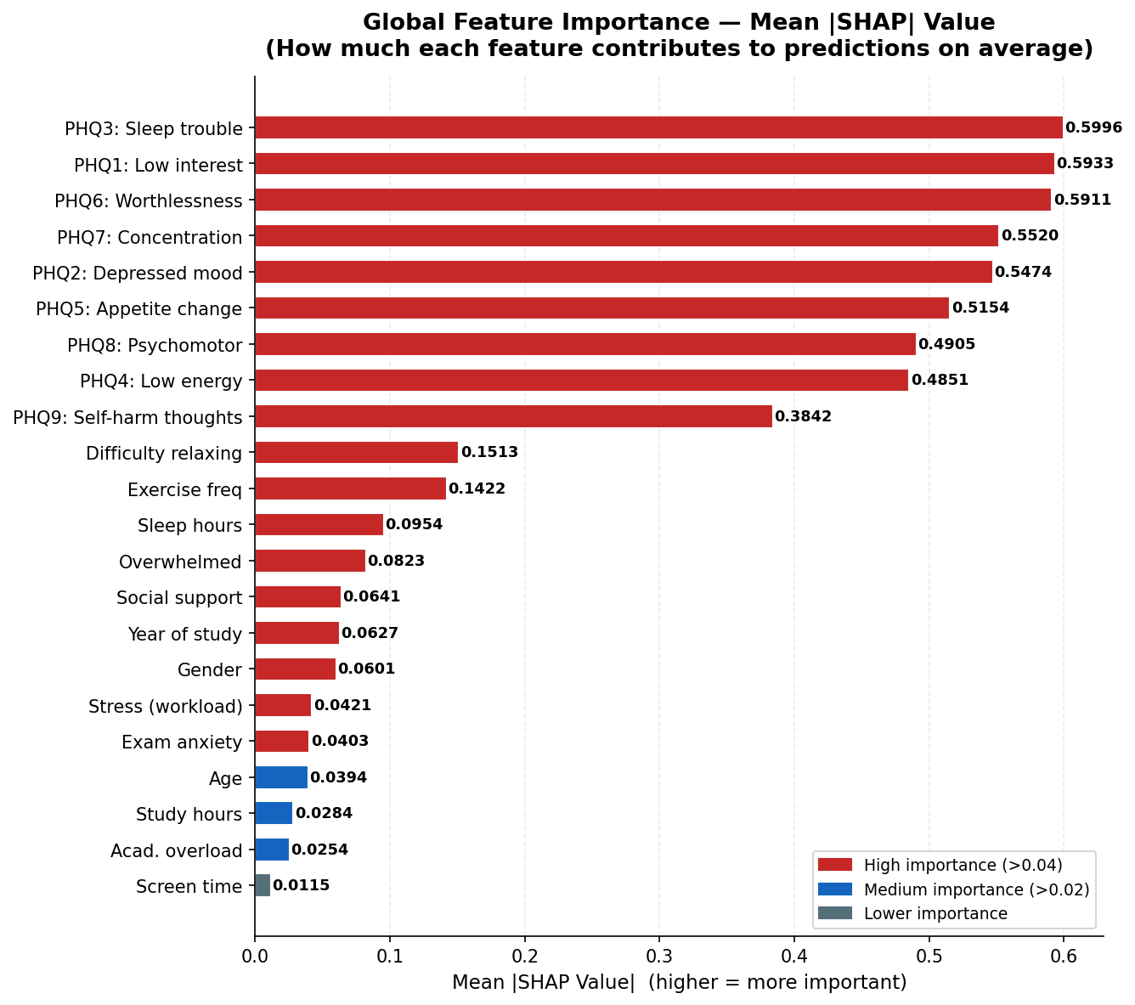
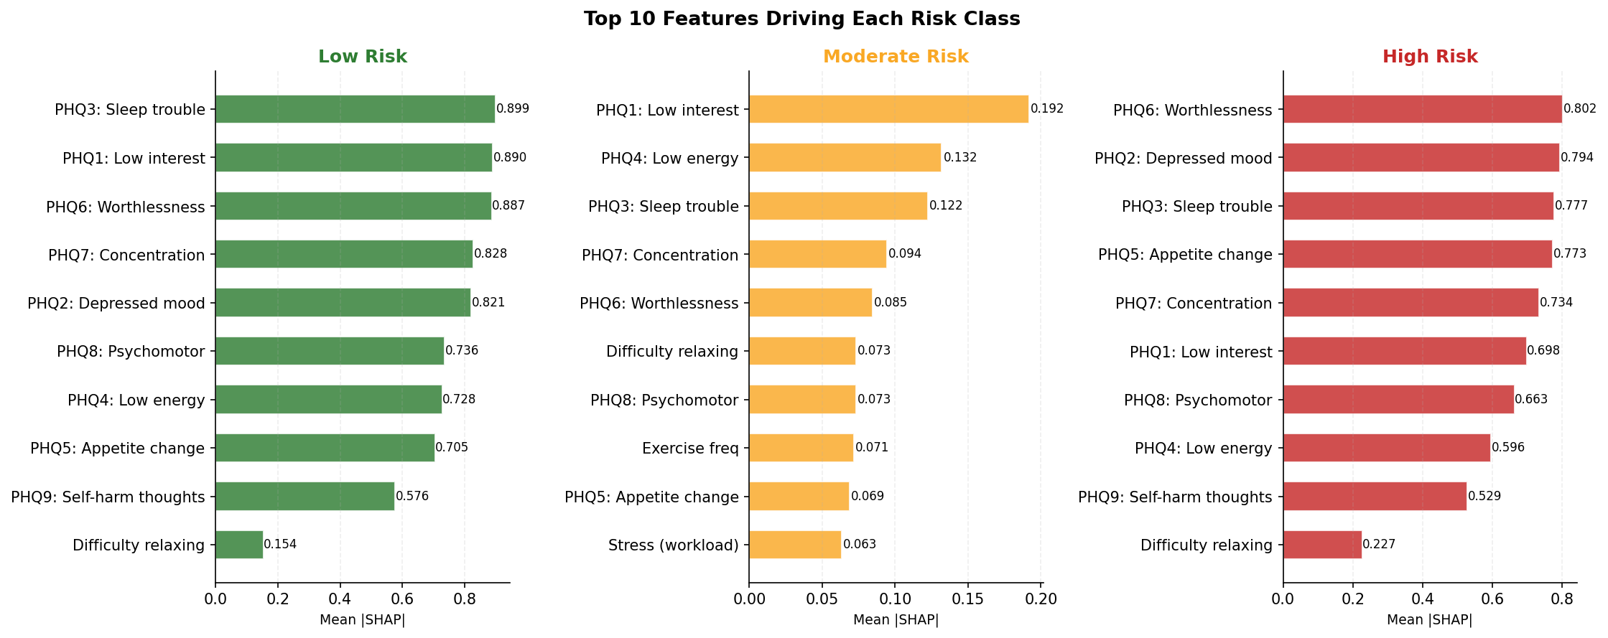
05 · EXPLAINABILITY
SHAP — Why the Model Decided What It Did
Explainable Decision Support
What is SHAP?
Assigns a score to each feature showing how much it pushed the prediction toward or away from each risk class.
Top Finding
PHQ-3 (Sleep trouble) = most influential feature globally. SHAP score: 0.5996
Why It Matters
Students see WHICH specific symptoms are their biggest risk drivers — not just a label. Builds trust in the AI decision.
MINDscan · AI-Based Mental Health Screening · Priyanshi Goel · DS4270 · MUJ · 2026
6 / 12
Notes:
WHAT TO SAY — keep it short, the charts speak for themselves.
"SHAP stands for SHapley Additive exPlanations. It comes from game theory. SHAP tells us how each feature contributes to the model's risk prediction behaviour."
"The chart on the left is our actual output. PHQ-3 — the sleep trouble question — is the single most influential feature with a SHAP score of 0.5996."
"The bottom chart breaks this down by risk class — showing which features matter most specifically for predicting High Risk versus Low Risk."
"Why is this important in a mental health context? Because we can't tell a student 'you are High Risk' without explaining why. SHAP provides that explanation. A student who scores High Risk might see that their sleep trouble and exam anxiety are the main drivers — which is immediately actionable."
IMPORTANT SAFETY NOTE TO MENTION:
"We use SHAP's LinearExplainer specifically for Logistic Regression — it gives mathematically exact values, not approximations."
IF ASKED: "What's the difference between SHAP and just looking at feature coefficients?"
→ "Coefficients give global average weights. SHAP gives per-prediction, per-student explanations that account for actual feature values — much more useful for individual interpretation."

Slide 7
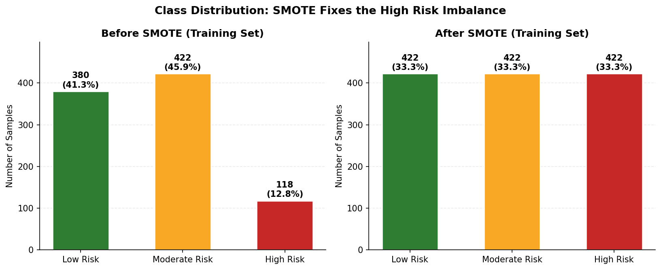
06 · CLASS BALANCING + ANXIETY ESTIMATION
SMOTE + Anxiety Estimation
Two Key Enhancements to the Base System
⚖️ SMOTE — Fixing Class Imbalance
🧠 GAD-7 Inspired Anxiety Estimation
▸ High Risk = only 12.8% of dataset — a class imbalance problem
⚠️ This is a GAD-7 INSPIRED proxy estimate — not a validated clinical GAD-7 score.
▸ A biased model defaulting to 'Low Risk' always = 58% accuracy
GAD-7 is the clinical standard for anxiety (scored 0–21). We approximate it using 3 related survey questions:
▸ SMOTE creates synthetic High Risk samples by interpolating between real ones in feature space
▸ Applied ONLY to training data — test set stays real-world
Estimate = (workload + difficulty_relaxing + exam_anxiety) × 1.2
▸ Result: High Risk F1 improved to 91%
▸ Students see depression risk + anxiety estimate together
▸ Labelled clearly as estimate — not a clinical score
▸ Future scope: replace with full 7-item GAD-7 questionnaire
MINDscan · AI-Based Mental Health Screening · Priyanshi Goel · DS4270 · MUJ · 2026
7 / 12
Notes:
SLIDE HAS TWO TOPICS — address SMOTE first, then GAD-7.
SMOTE:
"High Risk students were only 12.8% of our dataset. This is called class imbalance. A naive model could just predict Low Risk for everyone and still get 58% accuracy — while completely missing every genuinely at-risk student."
"SMOTE addresses this by creating new synthetic High Risk data points — not duplicates — by interpolating between existing High Risk students in the 22-dimensional feature space."
"Critically: SMOTE was applied ONLY to the training data. The test set was never modified. This preserves real-world class distribution in evaluation."
"High Risk F1 of 91% shows a strong balance between precision and recall — the model is neither over-flagging nor under-flagging at-risk students."
GAD-7 — BE VERY CAREFUL HERE:
"The second enhancement is a GAD-7 INSPIRED anxiety estimate. To be precise: this is NOT a validated clinical GAD-7 score. GAD-7 is a 7-item clinical questionnaire. We approximated it using 3 related survey questions — workload stress, difficulty relaxing, and exam anxiety."
"The estimate is clearly labelled as such in the application. It gives students a sense of their anxiety level alongside depression risk."
IF CHALLENGED on GAD-7 validity:
→ "You're right to flag this. Our system explicitly labels it as a proxy estimate, not a clinical score. This is a documented limitation. Replacing it with the full 7-item GAD-7 is listed as future scope."

Slide 8
07 · SYSTEM ARCHITECTURE
How MINDscan Works
Student Form → ML Model → Risk Result
Student Form
Flask API
Pre- process
ML Model
SHAP Insights
Risk Result
Wellness Tips
→
→
→
→
→
→
22 inputs
/predict
Scale [0,1]
LR predict
Model behaviour
Low/Mod/High
+ Helplines
🐍 Backend
🌐 Frontend
☁️ Deployed on Render
▸ Python 3.11 + Flask
▸ HTML5 + CSS + JavaScript
▸ GitHub → auto-deploy
▸ scikit-learn, pandas, numpy
▸ Async fetch() API
▸ Procfile + runtime.txt
▸ SHAP + imbalanced-learn
▸ Fully mobile-responsive
▸ Publicly deployed and accessible online
# Two most critical lines in app.py:
input_df = pd.DataFrame([input_dict])[FEATURES] # ← enforce correct column order (critical!) input_scaled = scaler.transform(input_df) # ← same scaler used during training
MINDscan · AI-Based Mental Health Screening · Priyanshi Goel · DS4270 · MUJ · 2026
8 / 12
Notes:
WHAT TO SAY — walk them through the flow left to right.
"Let me walk you through what happens from the moment a student clicks Submit."
1. "The student fills 22 input fields in the web form."
2. "JavaScript sends these as a POST request to our Flask /predict endpoint."
3. "Flask receives the JSON, maps it to a DataFrame — in the EXACT column order the model was trained on."
4. "The same MinMaxScaler from training normalises the features to 0–1."
5. "The Logistic Regression model runs predict() and predict_proba() — giving us the risk class and confidence percentages."
6. "SHAP explanations were generated from the trained model to interpret predictions — the charts are pre-computed and served as static images."
7. "All of this is returned to the frontend — rendered as colour-coded risk, probabilities, SHAP charts, and personalised wellness suggestions."
8. "For High Risk students, Indian crisis helplines are displayed automatically — iCall, Vandrevala Foundation, NIMHANS."
CRITICAL CODE POINT (if asked about the code):
"The two most important lines are shown at the bottom. First — we enforce the exact column order the model was trained on. Second — we use the same MinMaxScaler that was fitted during training. If either of these is wrong, the predictions become meaningless."
IF ASKED about deployment:
"The app is on Render's free tier. It sleeps after 15 minutes of inactivity — the first request after sleep takes about 30 seconds. This is a known limitation of the free hosting tier."

Slide 9
08 · LIVE APPLICATION
Beyond Prediction — A Complete Wellness Platform
📊 Risk Assessment
📈 Progress Dashboard
📔 Private Journal
PHQ-9 + lifestyle ML prediction Low / Moderate / High + SHAP
Assessment history, wellness score & mood trend over time
Guided prompts, password-protected Stored only on your device
🌬️ Breathing Timer
🧘 Body Scan
😊 Quick Mood Check-in
Guided breathing exercise Anxiety relief — no data stored
Step-by-step mindfulness meditation Head-to-toe guided awareness
Daily emoji mood log Tracks emotional state over time
🔒 Privacy:
All data (profile, journal, history) stored in browser localStorage only — no data sent to or stored on any server. Complete privacy by design.
MINDscan · AI-Based Mental Health Screening · Priyanshi Goel · DS4270 · MUJ · 2026
9 / 12
Notes:
WHAT TO SAY - open the live app on projector for this slide. Let me show you the full application - it is running live right now. Walk through each feature: The core feature is the Risk Assessment - PHQ-9 based ML prediction. We extended the app into a complete wellness platform. 1. Progress Dashboard - track risk and wellness score across multiple assessments over time. 2. Private Journal - guided prompts, password-protected, entries saved only on this device - never sent to server. 3. Breathing Timer - guided box-breathing for anxiety relief. UI-only, no ML. 4. Body Scan - text-guided mindfulness meditation. Wellness tool, no backend. 5. Quick Mood Check-in - daily emoji mood log without a full PHQ assessment. KEY POINT: All data (journal, history, profile) stored in browser localStorage only. Nothing sent to server. Flask backend only receives data when student submits an assessment. IF ASKED why localStorage not a database: Deliberate privacy-first design. localStorage means zero data collection - removing the stigma barrier. IF ASKED about Body Scan/Breathing Timer being AI: No - UI-only wellness tools. No ML model. Included to make MINDscan a holistic wellness companion.

Slide 10
08 · LIMITATIONS
Honest Limitations
What This System Cannot Do
🚫
Not a Clinical Diagnosis
📋
Self-Reported Data
🏛️
Single-Institution Dataset
MINDscan is preliminary screening support only. A trained mental health professional must make any clinical determination.
PHQ-9 relies on student honesty. Stigma may cause under-reporting of severe symptoms.
Trained only on MUJ students. Generalisation to other universities requires retraining.
📐
Anxiety Estimate is a Proxy
🔗
Needs Counselor Integration
⏱️
Cross-Sectional Snapshot
GAD-7 inspired estimate, not a validated clinical GAD-7 score. Clearly labelled as estimate in the application.
Currently a standalone tool. Real-world impact requires linking High Risk students to campus counselors.
One-time assessment only. Cannot track how a student's risk changes over a semester.
MINDscan · AI-Based Mental Health Screening · Priyanshi Goel · DS4270 · MUJ · 2026
10 / 12
Notes:
THIS IS YOUR MOST IMPORTANT SLIDE for maturity and credibility.
"Every honest research project must acknowledge its limitations. Let me walk through ours."
1. "Most importantly — MINDscan is NOT a clinical diagnosis. It is preliminary screening support. This disclaimer is displayed prominently in the application."
2. "The data is self-reported. Students may under-report symptoms due to stigma — especially for severe symptoms. This is a fundamental limitation of any questionnaire-based tool."
3. "The model was trained on MUJ students only. Different universities may have different academic cultures, demographics, and stress patterns. Before using this at another institution, the model should be retrained on that population."
4. "The anxiety estimation is a proxy. It is GAD-7 inspired, not a validated GAD-7 administration. We were transparent about this in the application and in the report."
5. "The most significant real-world limitation: it's a standalone tool. For maximum impact, High Risk users need to be connected to campus counselors. This integration is listed as future scope."
6. "Finally — it's a one-time assessment. We can't track change over time. Longitudinal monitoring would be much more clinically useful."
WHY THIS SLIDE MATTERS:
Boards and panels respect researchers who proactively identify limitations — it shows scientific maturity. If they ask about a weakness you haven't mentioned, point to this slide and say "yes, this is one we identified and documented."

Slide 11
09 · RESULTS & FUTURE SCOPE
What Was Achieved + What's Next
Results Summary + Future Directions
95.67%
95.65%
91%
1,151
Test Accuracy
F1-Score
High Risk F1
Students
✅ All Deliverables Completed
🔭 Future Scope
▸ 1,151-student primary dataset (original research)
▸ Counselor referral integration (highest priority)
▸ 4 ML models trained & compared with 5-fold CV
▸ NLP-based journaling + sentiment analysis
▸ SHAP explainability — 4 charts generated
▸ Daily micro-assessments (30-sec emoji check-ins)
▸ SMOTE applied (training data only)
▸ Full validated GAD-7 questionnaire
▸ GAD-7 inspired anxiety estimation
▸ Multi-university dataset for India-wide model
▸ Full-stack Flask web app — publicly deployed
▸ Progressive Web App (mobile installable)
▸ 16-reference peer-reviewed bibliography
Research Contribution: A system combining PHQ-9, lifestyle data, SHAP explainability, and live deployment — designed for Indian university students.
MINDscan · AI-Based Mental Health Screening · Priyanshi Goel · DS4270 · MUJ · 2026
11 / 12
Notes:
WHAT TO SAY:
"Let me summarise what was built and where it can go."
"In terms of results: 95.67% test accuracy, 91% F1 for the High Risk class showing strong precision-recall balance — trained and validated on 1,151 real students with no significant overfitting observed."
"Every major deliverable was completed — original data collection, 4 models compared, SHAP explainability, SMOTE, GAD-7 inspired estimation, and a publicly deployed application."
"The research contribution: a system combining PHQ-9, lifestyle data, SHAP explainability, and live deployment — designed specifically for Indian university students."
"For future scope, the most impactful next step is counselor integration — an opt-in pathway where High Risk students can share results with campus mental health services."
IF ASKED why extensions weren't done:
"This is a B.Tech Major Project with a defined scope and timeline. Counselor integration requires institutional agreements and ethical approval — beyond the scope of a single-semester project. These are clearly documented as future work."

Slide 12
🧠
Thank You
Questions & Discussion
🔴 Publicly Deployed: mental-health-predictor-0oat.onrender.com
👩‍💻 Priyanshi Goel
🎓 DS4270 · MUJ · 2026
🧑‍🏫 Dr. Aparna Tripathi
95.67%
95.65%
1,151
Publicly
Accuracy
F1-Score
Students
Deployed
⚠️ MINDscan is a preliminary screening support tool. It is NOT a clinical diagnostic instrument.
MINDscan · AI-Based Mental Health Screening · Priyanshi Goel · DS4270 · MUJ · 2026
12 / 12
Notes:
CLOSING SLIDE — Q&A PREP.
Say: "Thank you. MINDscan is a clinically grounded, explainable, and publicly deployed AI screening tool for university mental health — combining PHQ-9 with lifestyle data for Indian university students."
"I'm happy to take any questions."
--- QUICK ANSWER CARDS FOR PANEL QUESTIONS ---
Q: "Is the model just learning PHQ thresholds?"
A: "Yes — the labels are PHQ-derived, so the model is not replacing PHQ-9. Its added value is probability confidence scores, lifestyle context from 13 additional features, SHAP explanations for each prediction, and a deployed screening interface. The formula gives a class. The model gives a complete decision support system."
Q: "Why Logistic Regression and not deep learning?"
A: "1,151 samples and 22 structured features. Deep learning would massively overfit. LR is optimal for linear decision boundaries, which match our linear PHQ thresholds."
Q: "How did you handle class imbalance?"
A: "SMOTE — applied only to training data. Test set preserved real-world distribution. High Risk F1 = 91% — strong balance between precision and recall."
Q: "Is this a medical device or clinical tool?"
A: "No. It is explicitly a preliminary screening support tool — not a diagnostic instrument. The disclaimer is displayed prominently in the application."
Q: "What is SHAP?"
A: "Game theory-based method assigning a contribution score to each feature per prediction. PHQ-3 sleep trouble was our most influential feature globally — SHAP score 0.5996."
Q: "What about the GAD-7 score?"
A: "It is a GAD-7 INSPIRED proxy estimate using 3 related survey questions — not a validated clinical GAD-7 administration. Clearly labelled as an estimate in the app."
Q: "Does the model overfit?"
A: "CV accuracy is 95.98%, test accuracy is 95.67% — a gap of only 0.3%. No significant overfitting was observed."
Q: "What would you do differently?"
A: "Collect full validated GAD-7 data. Expand dataset to multiple universities. Add counselor referral integration as the highest-priority next step."

