Slide 1

UNIVERSITY INSTITUTE OF ENGINEERING
DEPARTMENT OF COMPUTER SCIENCE
AND ENGINEERING
Numerical Methods and Optimization Using Python
Course Code- 22CSH-259/22ITH-259
By: MSC Shivali (12930)
DISCOVER . LEARN . EMPOWER

Slide 2
Introduction of Optimization
Optimization is a fundamental concept that plays a crucial role in various fields, ranging from mathematics and engineering to economics and computer science.
At its core, optimization involves finding the best possible solution to a problem from a set of feasible options.
Key Components of Optimization:
Objective Function:
This is the function that needs to be either maximized or minimized. It represents the quantity of interest in a given problem. For example, in manufacturing, the objective might be to minimize production costs, while in project scheduling, the objective could be to maximize resource utilization.
Decision Variables:
These are the variables that can be adjusted or controlled to influence the outcome of the objective function. The goal is to find the values of these variables that optimize the objective function.
Constraints:
Constraints are conditions or limitations that must be satisfied during the optimization process. They represent real-world restrictions on the values the decision variables can take. Constraints play a crucial role in defining the feasible solution space.

Slide 3
Applications of Optimization:
Operations Research:
Optimization is widely used in operations research to optimize resource allocation, logistics, and scheduling problems.
Engineering:
Engineers use optimization to design efficient systems, such as optimizing the shape of an aircraft wing or maximizing the efficiency of a chemical process.
Finance:
In finance, optimization is used for portfolio management, risk assessment, and asset allocation.
Machine Learning:
Optimization plays a key role in training machine learning models. Algorithms like gradient descent are used to minimize the error or loss function.
Economics:
Economic models often involve optimizing utility functions or production costs.

Slide 4
Types of Optimization:
Linear Optimization (Linear Programming):
In linear optimization, both the objective function and the constraints are linear. The Simplex algorithm is a common method used to solve linear programming problems.
Nonlinear Optimization:
In nonlinear optimization, either the objective function or the constraints (or both) involve nonlinear relationships. Various algorithms, such as the Newton-Raphson method or genetic algorithms, can be employed for nonlinear optimization.
Integer Programming:
In integer programming, some or all of the decision variables are restricted to integer values. This is often encountered in problems where variables represent discrete entities, like the number of items to be produced.
Multi-objective Optimization:
Some problems involve multiple conflicting objectives. Multi-objective optimization aims to find a set of solutions that represent a trade-off between these objectives, known as the Pareto front.

Slide 5
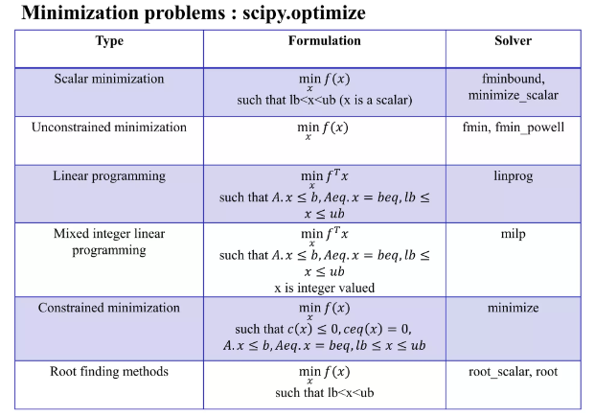
Optimization in Python

Slide 6

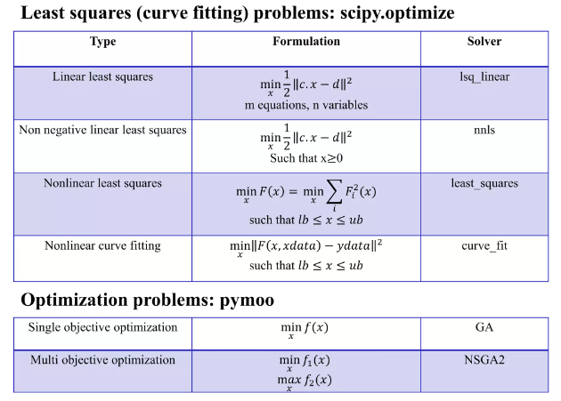

Slide 7
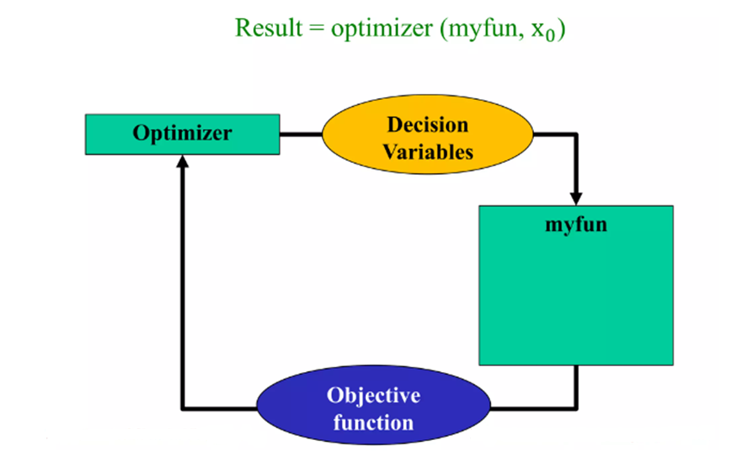

Slide 8
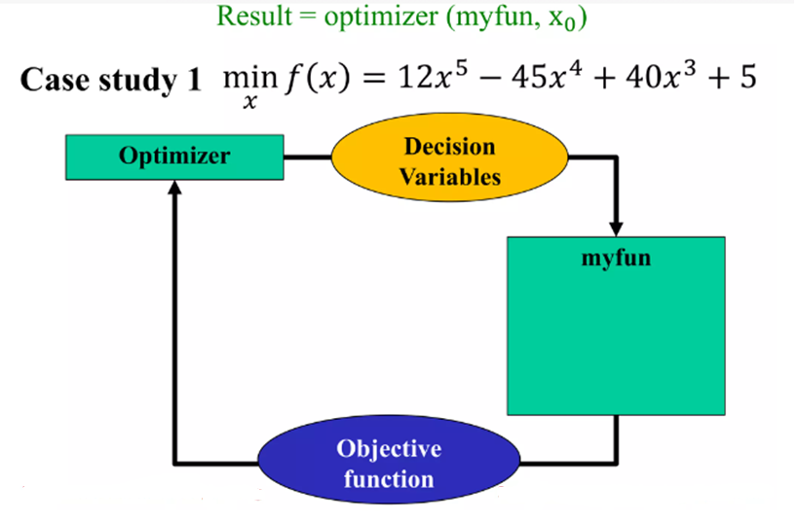

Slide 9
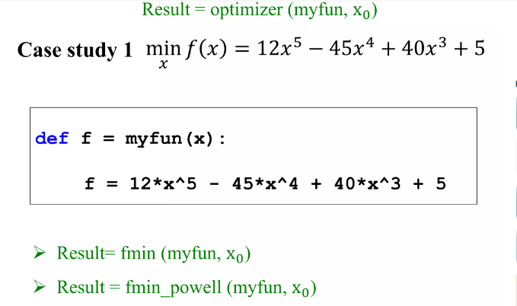

Slide 10
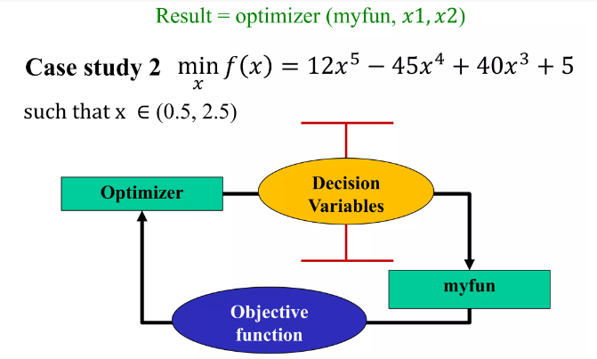

Slide 11
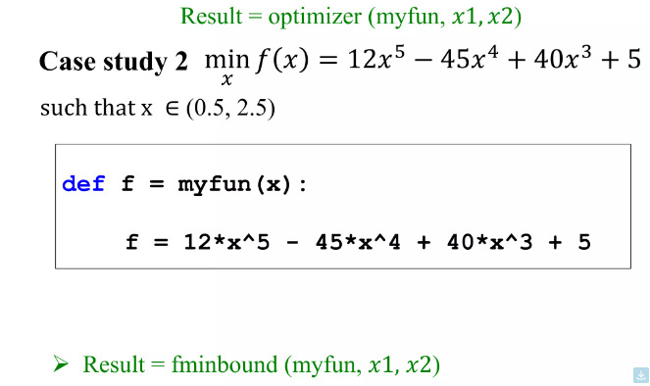

Slide 12
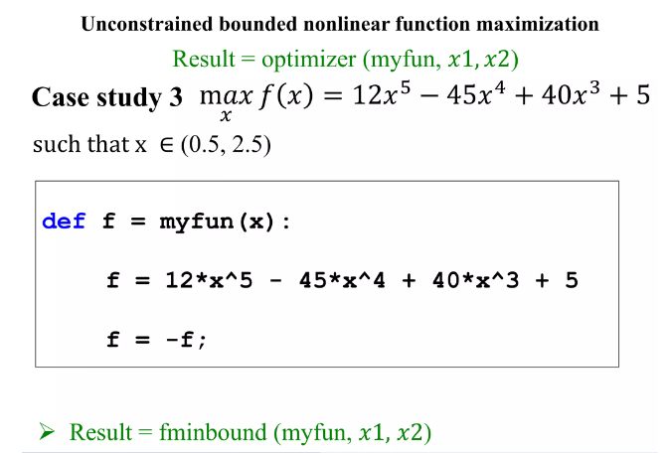

Slide 13
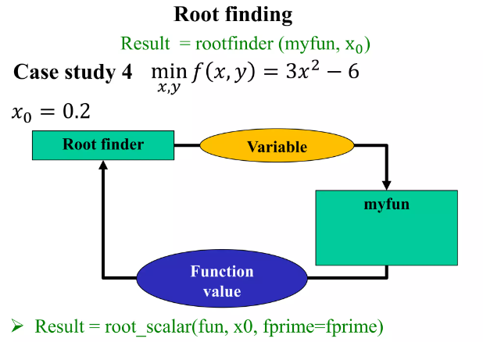

Slide 14
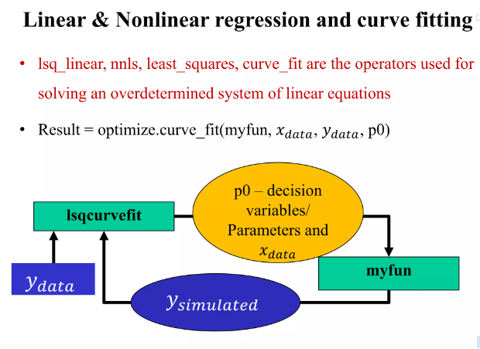

Slide 15
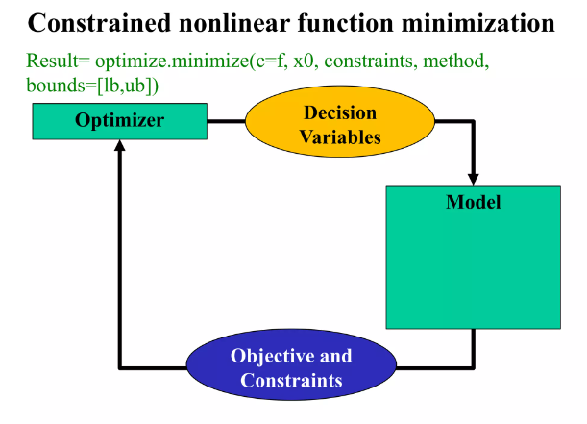

Slide 16
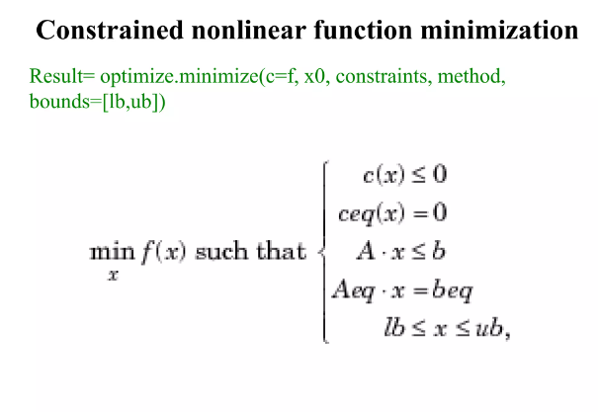

Slide 17
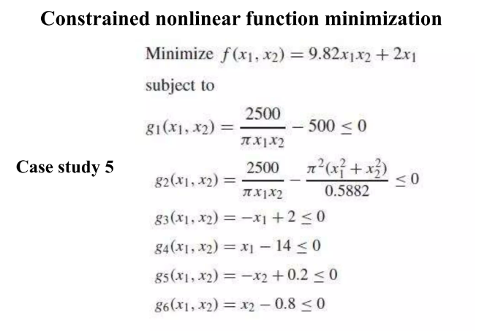

Slide 18
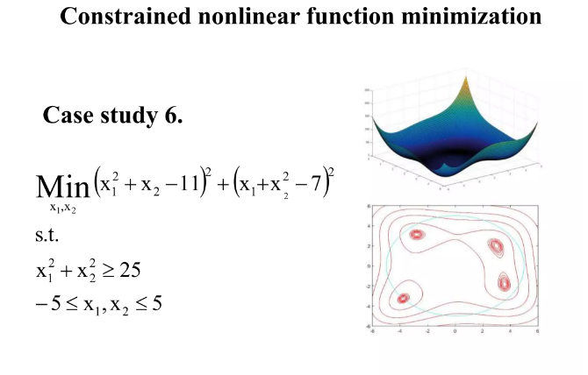

Slide 19
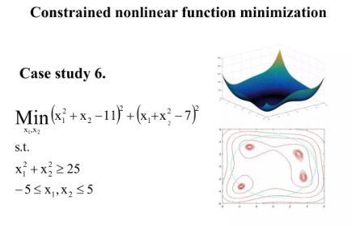

Slide 20
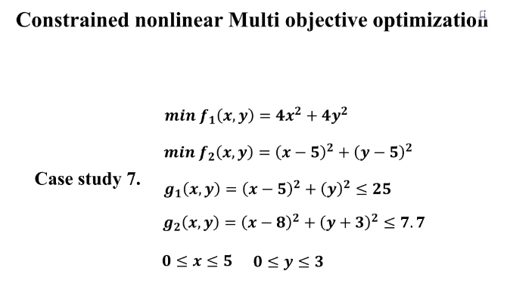

Slide 21
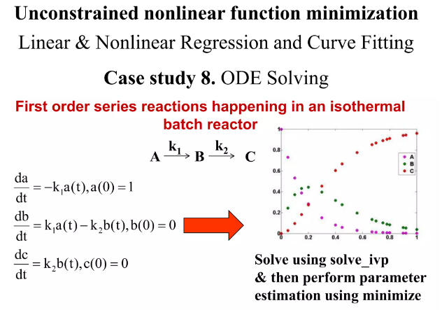

Slide 22
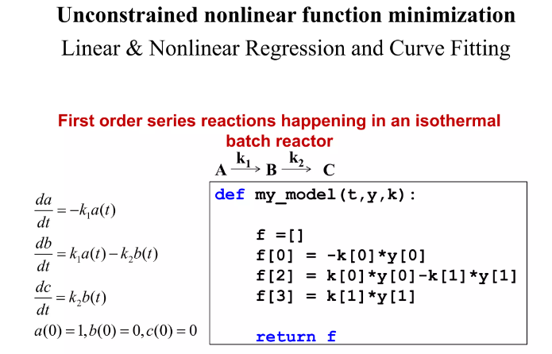

Slide 23
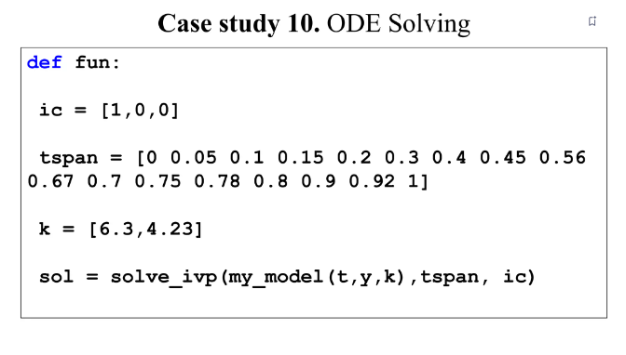

Slide 24
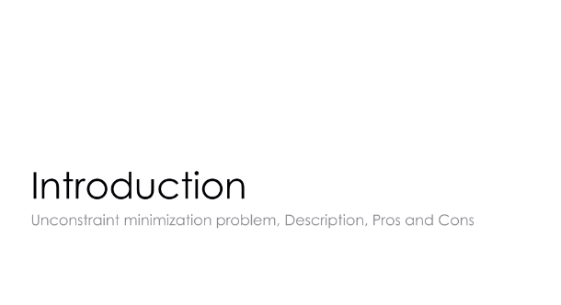
Unconstrained Optimization: Gradient-based methods
(e.g., gradient descent).

Slide 25
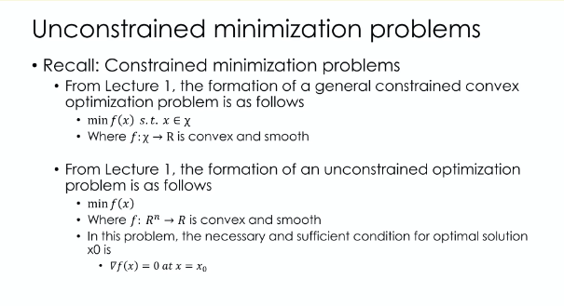

Slide 26
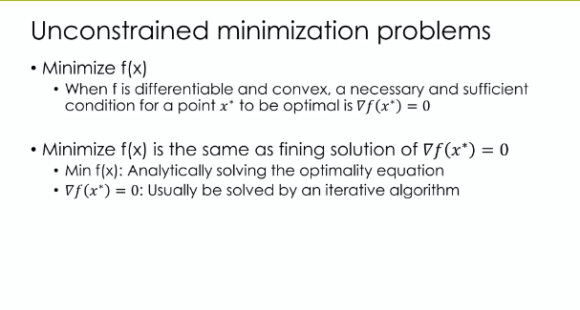

Slide 27
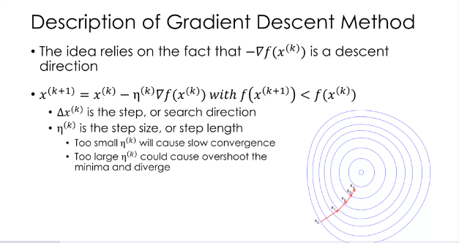

Slide 28
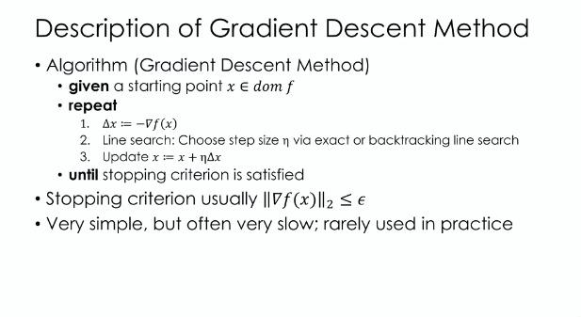

Slide 29
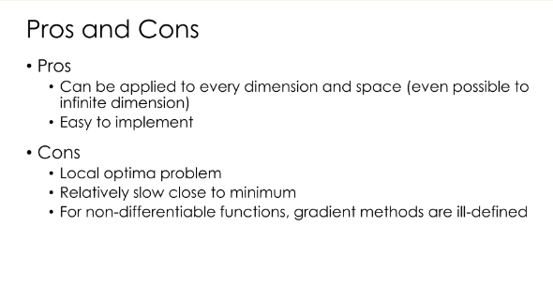

Slide 30
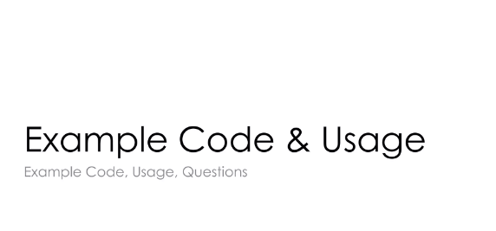

Slide 31
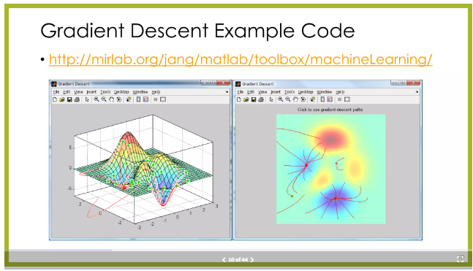

Slide 32
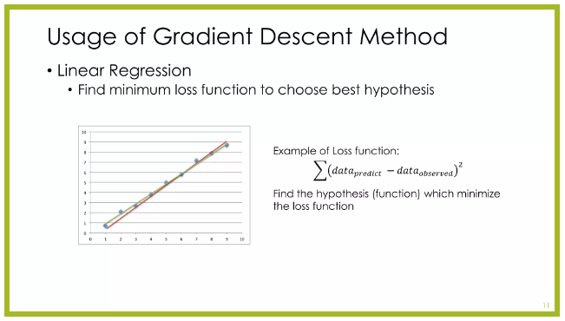

Slide 33
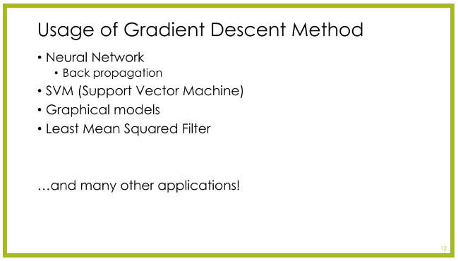

Slide 34
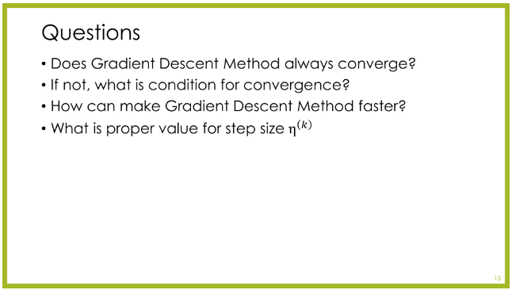

Slide 35
Thank you

