Slide 1


INSTITUTE FOR ADVANCED COMPUTING
AND
SOFTWARE DEVELOPMENT
AKURDI, PUNE
A PRESENTATION ON
“RedOPsAI - AI POWERED OFFENSIVE ATTACK FRAMEWORK”
Group no - 07
PRIYANSHU AGARWAL (252426)
PRIYANSHU KUMAR (252427)
Project Guide Centre Co-ordinator
Mrs. Shushma Hattarki Mr. Prashant Deshpande

Slide 2
1. INTRODUCTION
Cybersecurity threats are evolving at an unprecedented pace. Attackers today are not only faster but also more adaptive, using automation, AI, and collaborative attack infrastructures. Organizations must therefore prepare for adversaries that can execute complex, multi-phase attacks within minutes rather than days.
RedOpsAI was conceived to overcome these limitations by merging AI-driven decision-making with automated offensive tooling. The framework is designed to autonomously conduct reconnaissance, assess vulnerabilities, prioritize them, and execute targeted exploits with minimal human intervention.
By adopting RedOpsAI, red teams can conduct faster, more comprehensive, and more adaptive engagements — reducing manual workloads while increasing the realism and efficiency of simulated attacks.

Slide 3
2. PROBLEM STATEMENT
Traditional red team and penetration testing workflows require a significant amount of manual analysis and execution. While skilled analysts can chain together reconnaissance and exploitation phases, the process is labor-intensive and prone to bottlenecks.
Some key challenges include:
Volume of Data – Large attack surfaces yield thousands of scan results, requiring time-consuming manual triage.
Tool Fragmentation – Each tool (e.g., Nmap, OpenVAS, Metasploit) produces outputs in different formats, making correlation tedious.
Slow Decision-Making – Manually selecting and prioritizing exploits is time-consuming, delaying attack execution.

Slide 4
3. OBJECTIVES
To develop a framework that automates the correlation of scan results with global vulnerability intelligence (CVE, NVD).
To implement an AI Decision Engine that prioritizes targets based on real-time risk scoring and exploitability.
To integrate leading offensive security tools (Nmap, OpenVAS, Metasploit) into a single, unified workflow.
To build an adaptive system that can adjust its strategy based on real-time findings.
To automatically generate structured technical and executive-level reports for post-engagement analysis.

Slide 5
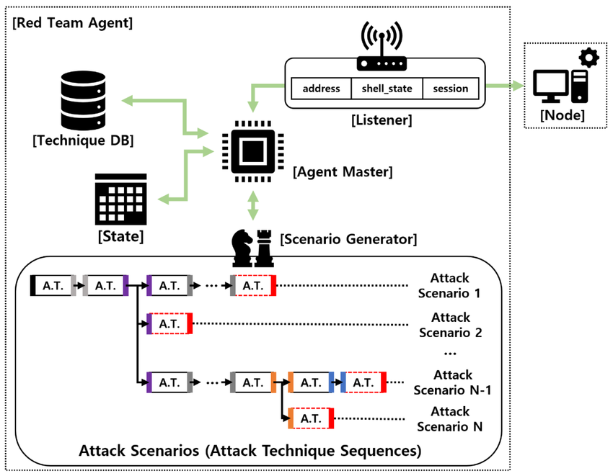
4. ARCHITECTURE DIAGRAM
RedOpsAI implements a modular, AI-powered red team workflow that seamlessly integrates all phases of offensive security.
The architecture is adaptive, allowing the AI engine to recalibrate attack strategy mid-execution if environmental changes occur.

Slide 6
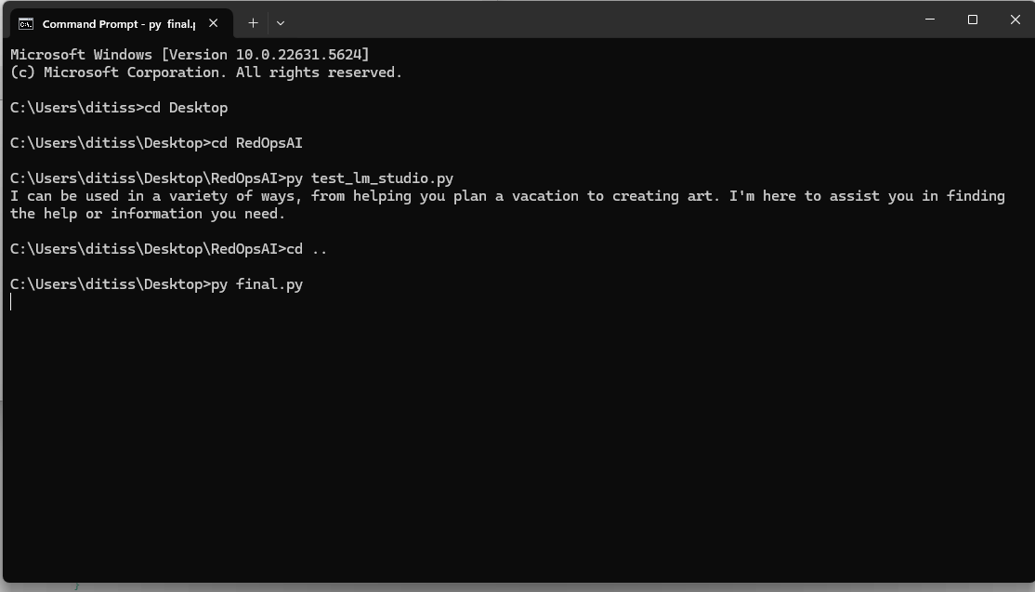
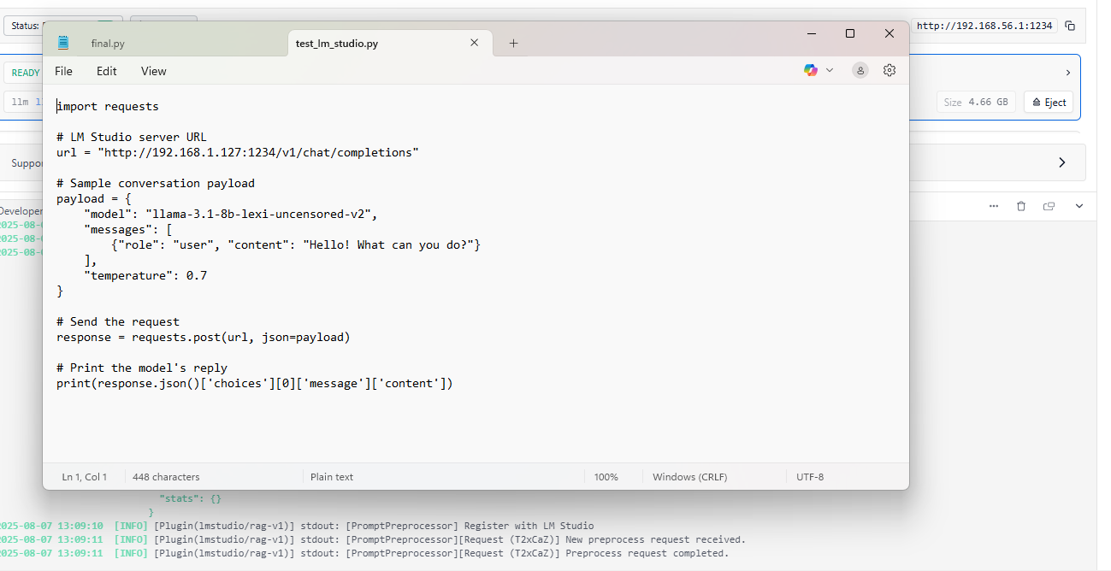
Implementation

Slide 7
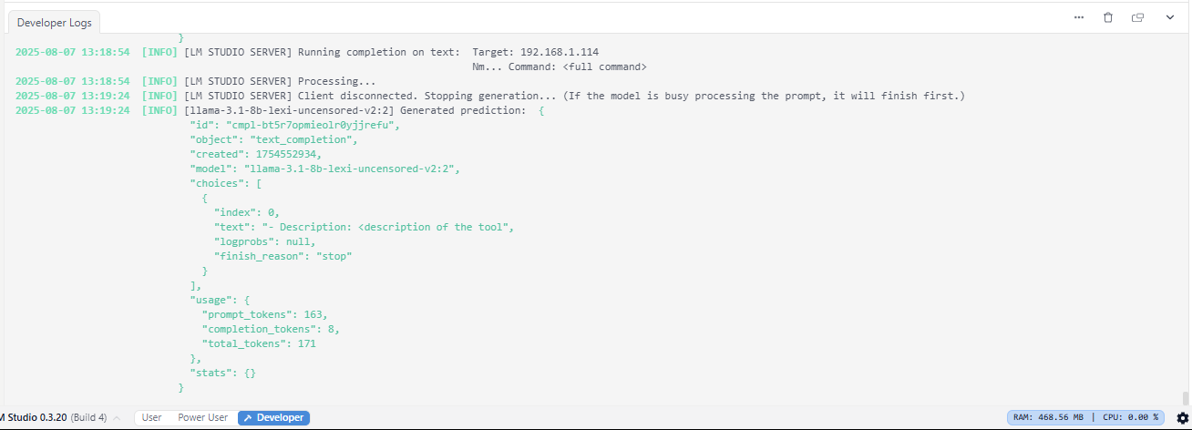

Slide 8
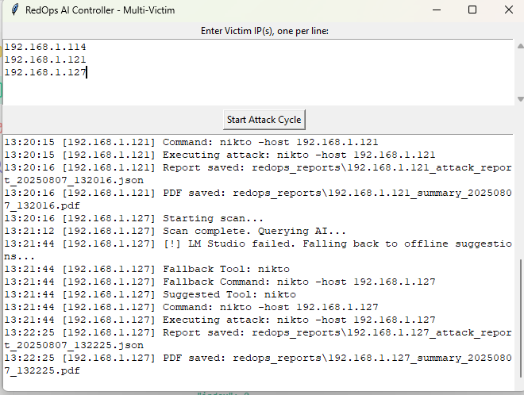

Slide 9
5. WORKING
Phase 1: Reconnaissance: Initiates by mapping the target network with Nmap and Rustscan to enumerate hosts, ports, and services.
Phase 2: Vulnerability Analysis: Collected data is fed into OpenVAS, and custom scripts correlate findings with CVE/NVD databases.
Phase 3: AI Decision Engine: The core of the system uses NLP and ML to evaluate vulnerability descriptions, CVSS scores, and exploitability, then ranks targets.
Phase 4: Exploitation Module: Automatically initiates tailored attacks on prioritized targets using tools like Metasploit.
Phase 5: Reporting Engine: All intelligence and results are compiled to auto-generate technical and executive-level reports.

Slide 10
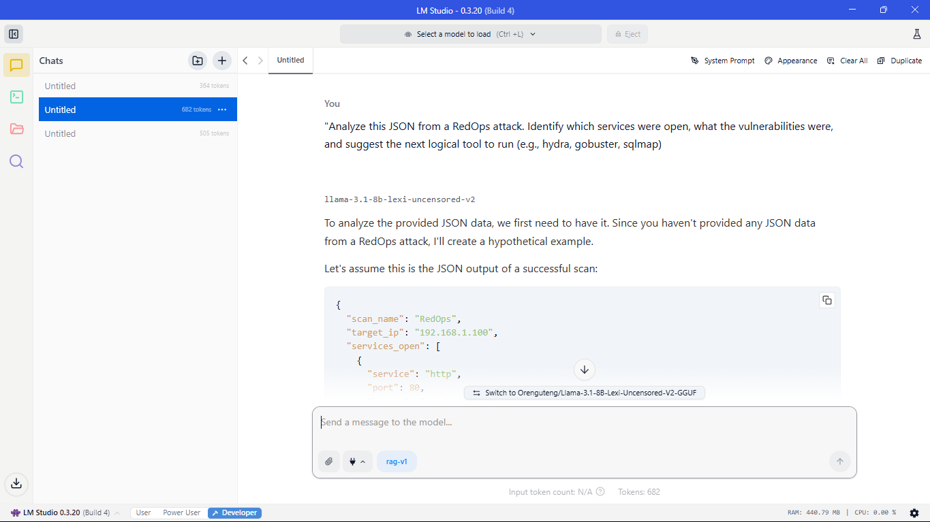
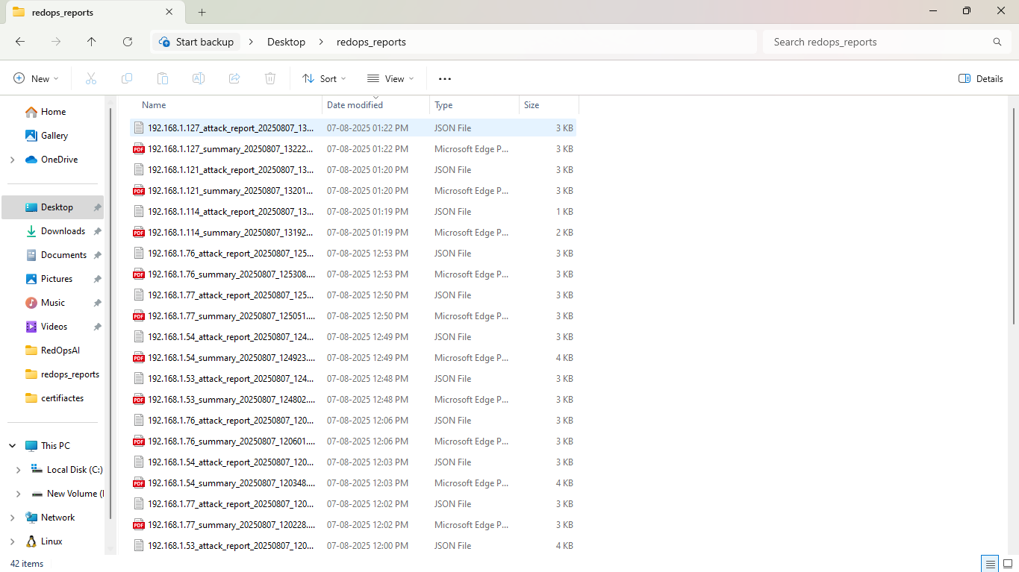

Slide 11
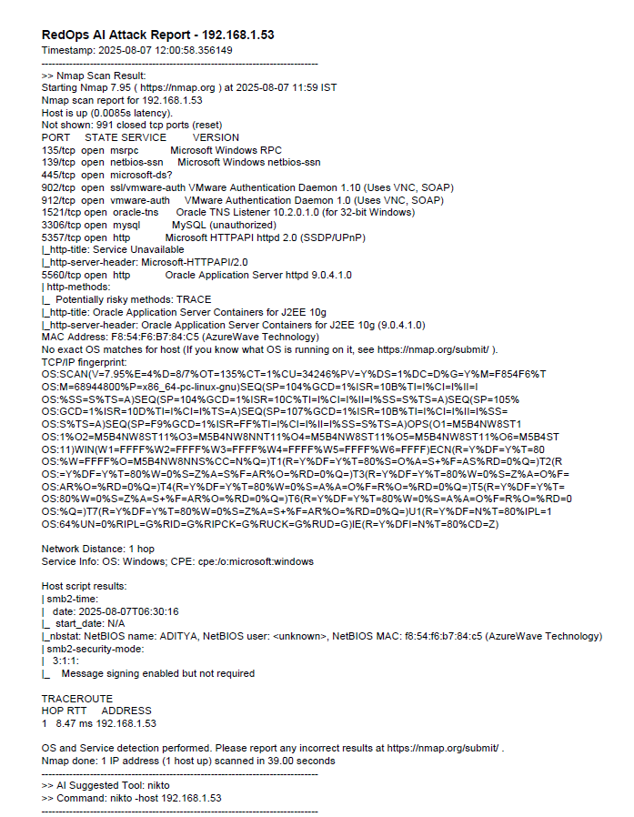
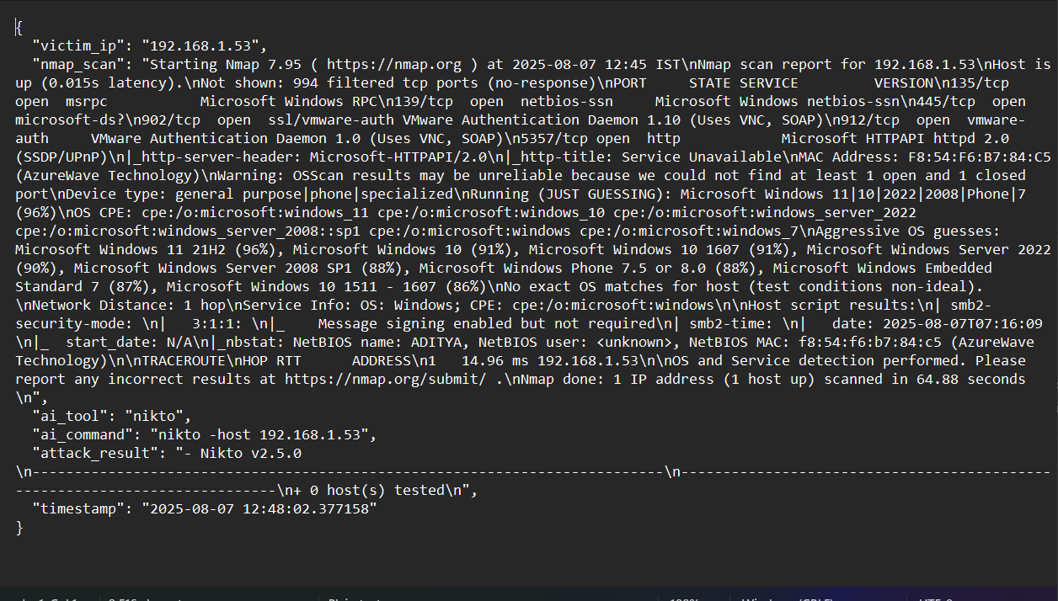

Slide 12
6. EXPECTED RESULTS
The system generates two primary forms of output for comprehensive analysis.
PDF Report:
A human-readable summary designed for stakeholders.
JSON Report:
A structured, machine-readable output containing all data points.
Ideal for integration with other security platforms or for detailed technical review.

Slide 13
7. CONCLUSION
The development of RedOpsAI demonstrates how artificial intelligence can be effectively integrated into red team operations to automate, accelerate, and enhance offensive security assessments. By combining traditional reconnaissance and vulnerability scanning tools with an AI-driven decision engine, RedOpsAI is able to intelligently prioritize attack surfaces, adapt its strategy in real time, and generate actionable reports for both technical and non-technical stakeholders.
In conclusion, RedOpsAI serves as a proof of concept for an intelligent, automated red teaming assistant. It paves the way for further research and development into AI-enhanced cybersecurity tools, where human expertise is amplified rather than replaced, leading to more efficient, informed, and effective security assessments.

Slide 14
THANK YOU

