Slide 1



Optimized ANN Model for Predicting Photocatalytic Degradation of 2,4-Dinitrophenol in Wastewater

Slide 2
General Introduction
Rapid industrialization has led to significant environmental pollution, especially in water bodies.
Importance of Wastewater Treatment:
Protect aquatic ecosystems.
Prevent health hazards in humans.
Ensure sustainable use of water resources.
Emerging Solutions: Use of photocatalysis combined with machine learning for efficient treatment.

Slide 3
Motivation
Salient Features of Photocatalysis:
Environmentally friendly and sustainable.
Decomposes pollutants into harmless by-products like CO2 and water.
Effective against a wide range of organic pollutants.
Integration with AI:
Traditional methods are time-consuming and resource-intensive.
Machine learning (ML) can:
Model complex nonlinear relationships between variables.
Predict catalytic efficiency under varying conditions.
Reduce experimentation time and costs.

Slide 4
Problem Statement & Objective
Problem Statement:
Development of ANN-based AI model for accurately predicting the catalytic degradation efficiency of 2,4-Dinitrophenol through NH2-MIL-125(Ti)/red phosphorus (RP) photocatalyst.
Objective:
To understand the working of the photocatalyst and also to design and develop the ANN (Artificial Neural Network), a machine learning model to model out the effects of the enlisted operating parameters on the photocatalytic efficiency.

Slide 5
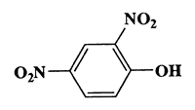
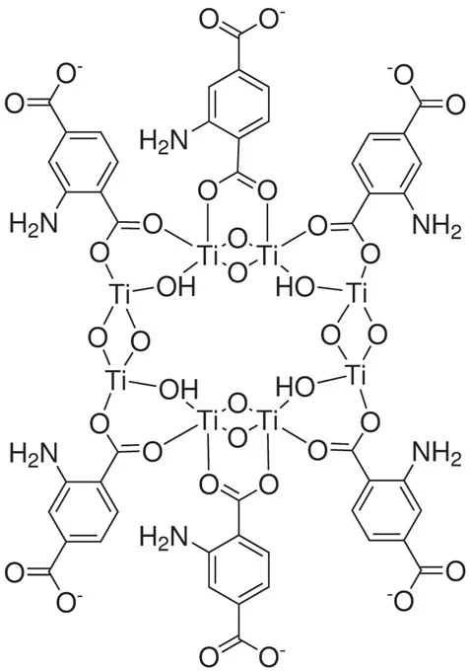
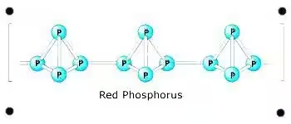
Molecular Structure of the contaminant (2,4- Dinitrophenol) and Photocatalyst (heterostructure composed of NH2-MIL-125(Ti)/red phosphorus(RP) and Red Phosphorus)
2,4- Dinitrophenol NH2-MIL-125(Ti)/red phosphorus (RP) Red Phosphorus

Slide 6
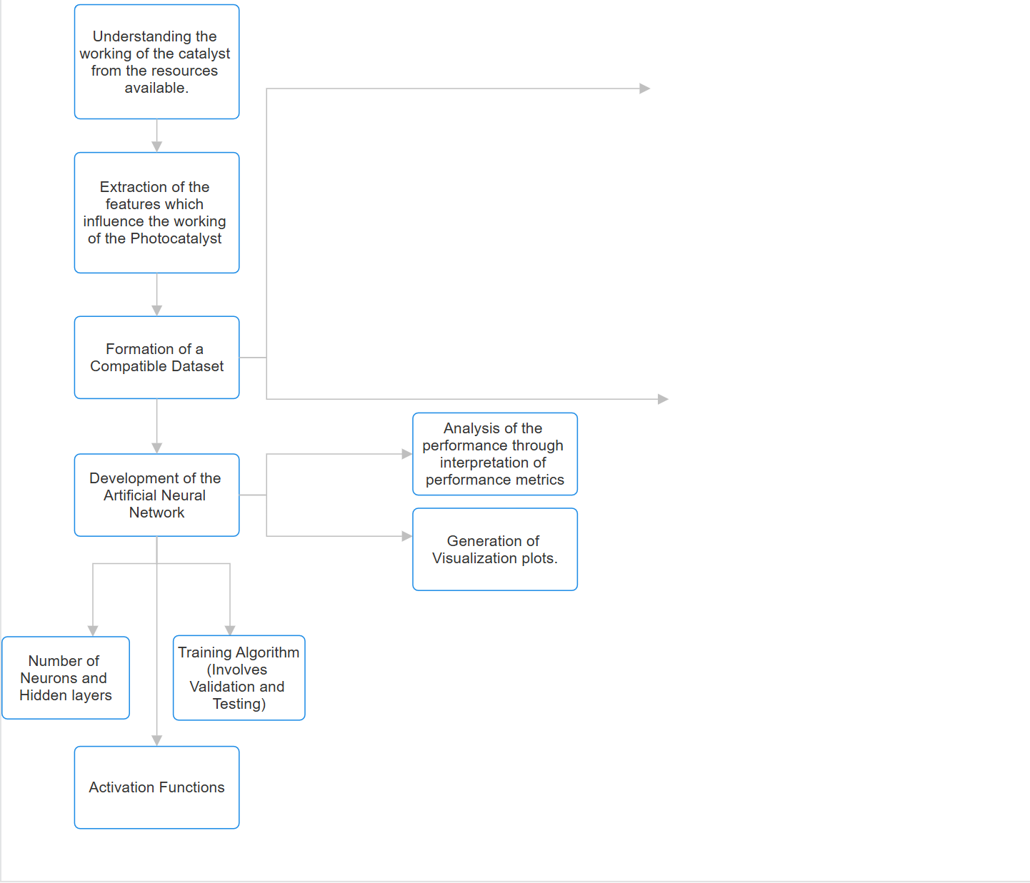
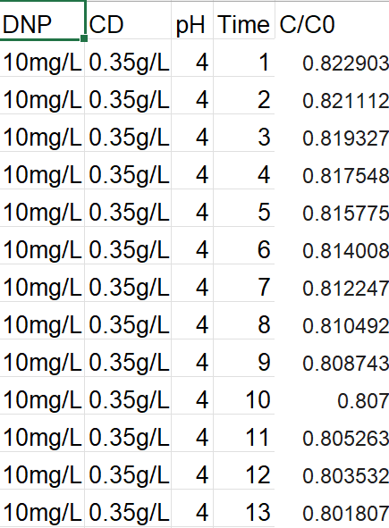
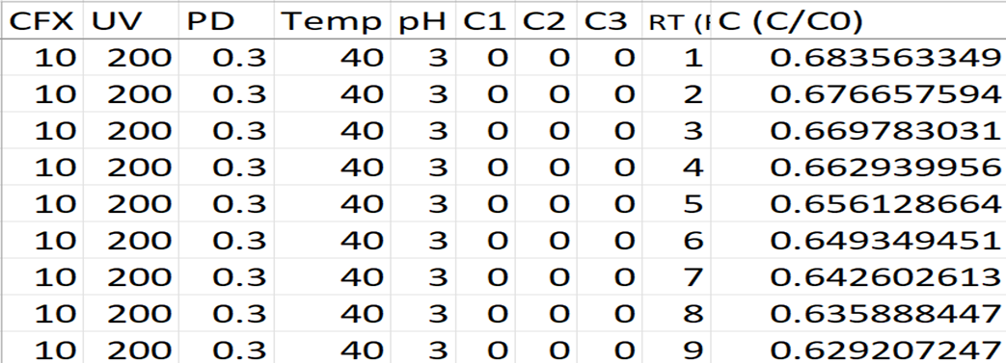
Workflow
1
2
1 → Dataset for Model Testing
2 → Dataset for Model Validation

Slide 7
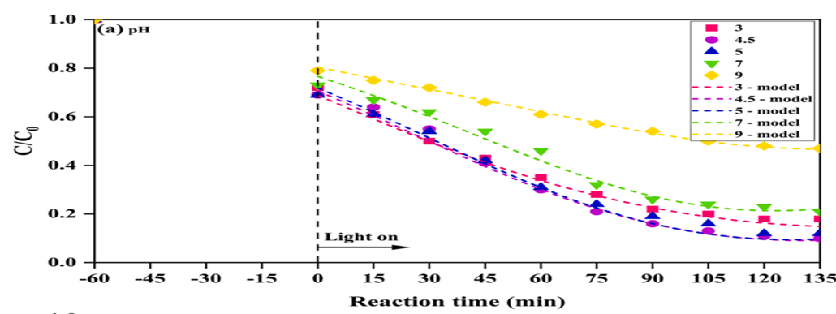
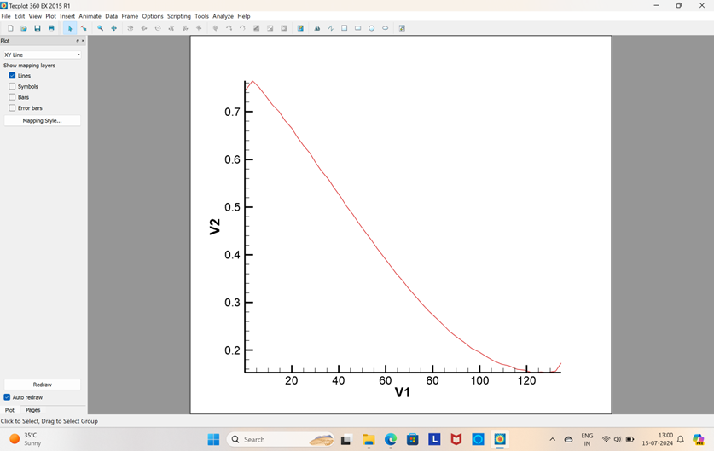
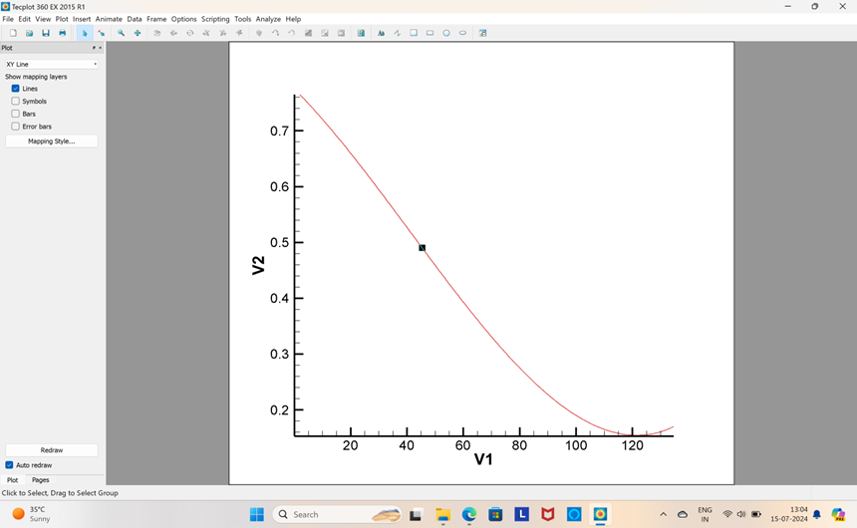
Compatible Dataset Preparation
Data Extraction:
The curve generated from the extracted data points (From the experimental plots)
Data Points from plots like these were extracted using dedicated softwares.
The curve after being subjected to polynomial fitting to get the mathematical relationship between output and input variables.

Slide 8
ML Model Development Pipeline
1. Library Imports and Setup:
Purpose: Libraries are like tools that help us work efficiently. Instead of creating everything from scratch, we use pre-made functions to save time and effort.
Key Libraries Used: pandas (for data handling), numpy (for numerical operations), matplotlib & seaborn (for visualization), sklearn (for machine learning), keras (for deep learning).
2. Loading and Exploring the Dataset: Before starting, we must understand the data we're working with. Think of this step as opening a new recipe book and skimming the ingredients list.

Slide 9
ML Model Development Pipeline
3. Cleaning and Preparing the Data:
Purpose: Real-world data often contains errors, missing values, or inconsistencies, requiring cleaning for smooth analysis. This is like organizing a messy workspace before starting a project.
Remove units: Convert mixed values like "10 cm" into plain numbers.
Handle missing values: Fill empty spots with the column's most common value to prevent errors.
4. Understanding the Data (Exploratory Data Analysis): To uncover patterns, relationships, and potential issues. This step is like studying a map before planning a journey.

Slide 10
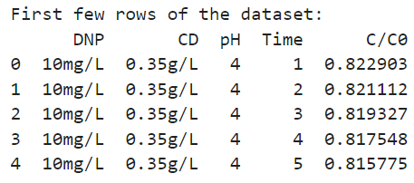
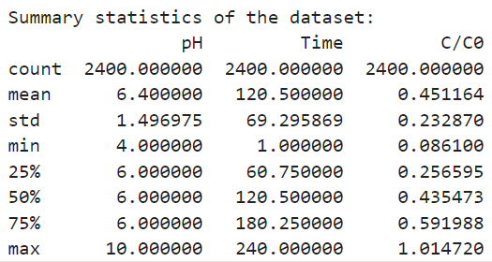
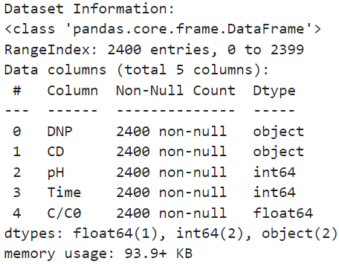
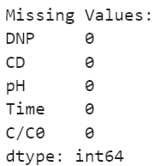
ML Model Development Pipeline
4. Exploratory Data Analysis(continued…):
Charts and Graphs: Use histograms to visualize data distribution and boxplots to spot outliers.
Pairplots: Examine relationships between feature pairs (e.g., "Time" vs. "C/C₀").
Correlation Heatmap: Highlight features most influencing the target variable.

Slide 11
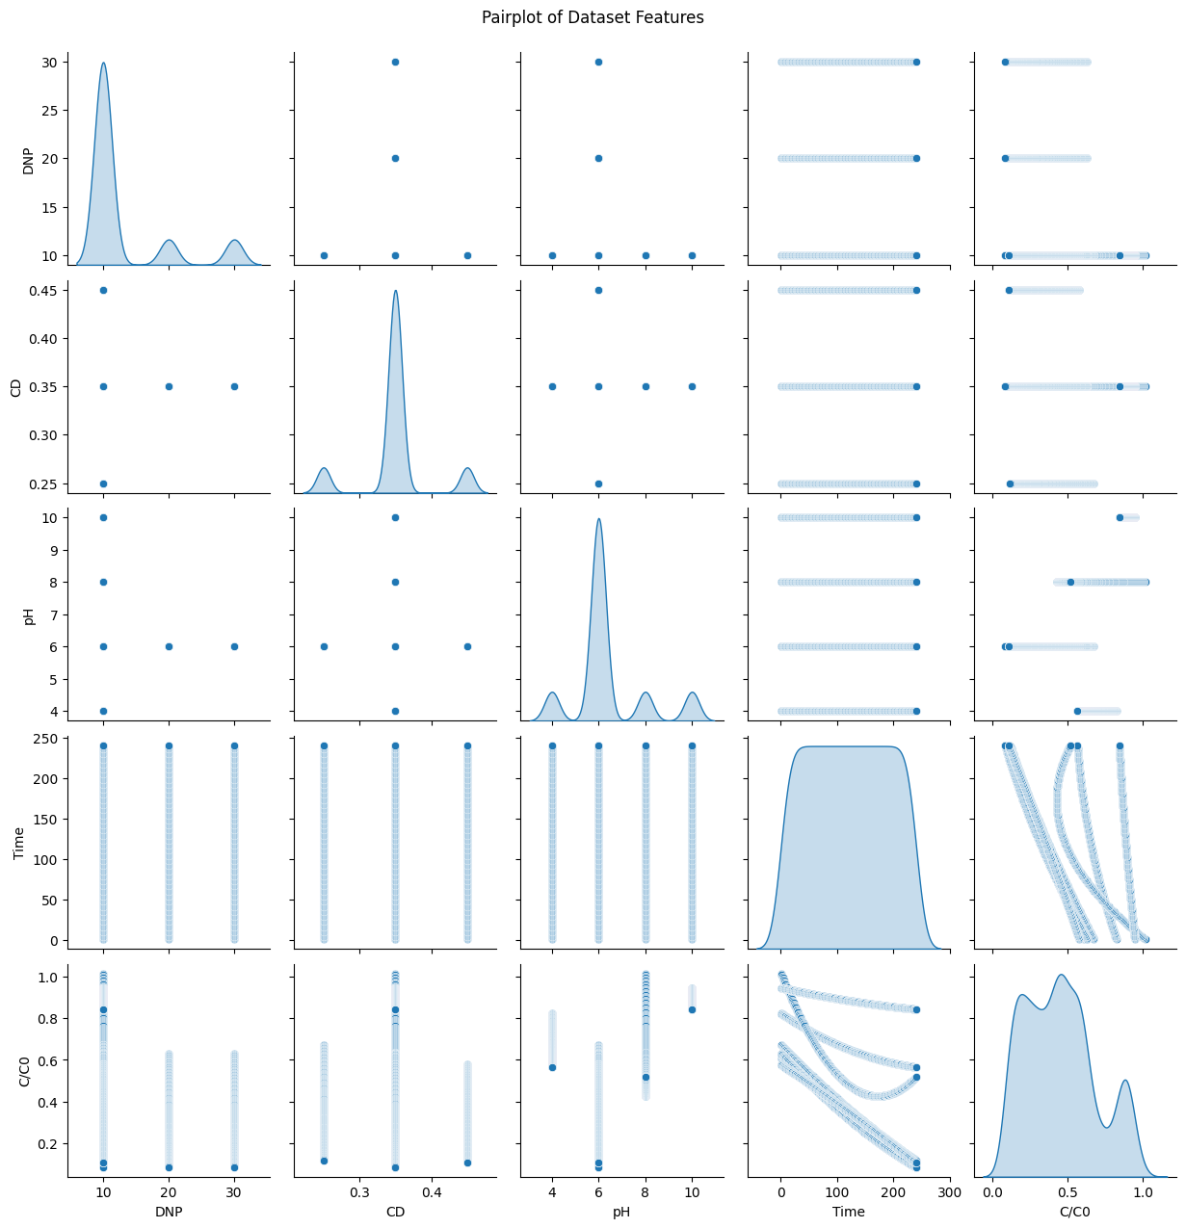
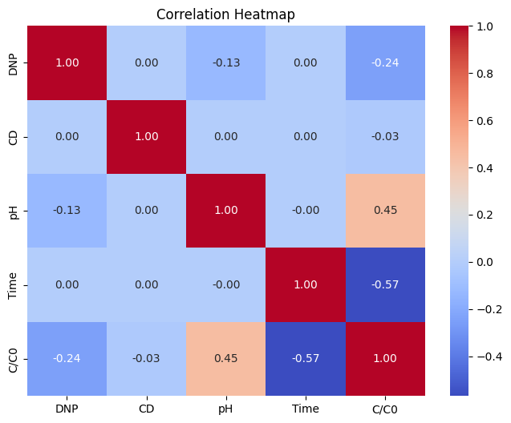
ML Model Development Pipeline

Slide 12
ML Model Development Pipeline
5. Data Splitting and Simplification: The dataset is split into training, validation, and test sets respectively. We simplified the data by combining similar features into fewer components, focusing on key aspects.
6. Standardizing Data: Features like "pH" and "Time" are standardized to a similar scale, ensuring equal contribution to the model.
7. Building and Optimizing the Model: A Layer with input, hidden, and output layers is built. Hyperparameter optimization is conducted to refine performance.

Slide 13
ML Model Development Pipeline
8. Evaluating the Model: Model performance is assessed using metrics like MSE, MAE, MAPE, R^2, MAPE, F1, Precision and Recall scores to measure prediction accuracy and checks for bias or overfitting, like taste-testing a dish to ensure it meets expectations.
9. Visualizing Results: Visual tools like loss curves, actual vs. predicted plots, and feature importance charts explain the model's performance and highlight key contributing factors, serving as a "report card" for the model.
10. Showing the Model's Structure: The neural network's structure is visualized, detailing the input layer (data entry), hidden layers (data processing), and output layer (predictions). This blueprint illustrates how the model works step by step.

Slide 14
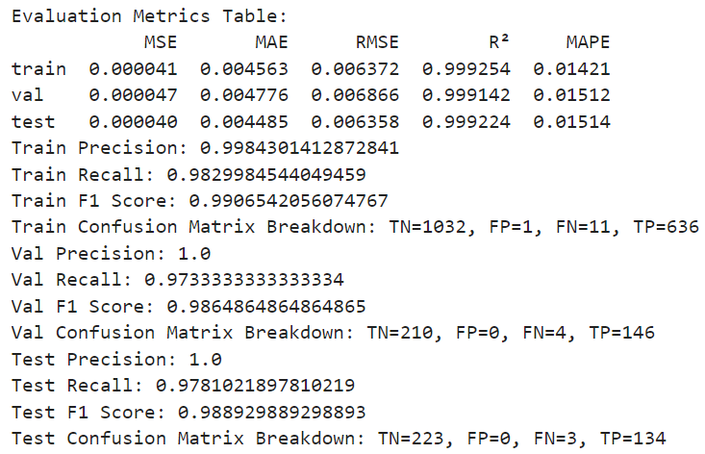
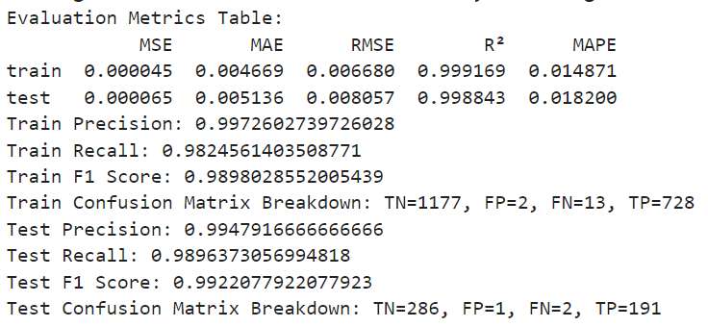
ML Model Development Pipeline
Case 1: Train-Test-Validation Case 2: Train-Test-Validation

Slide 15
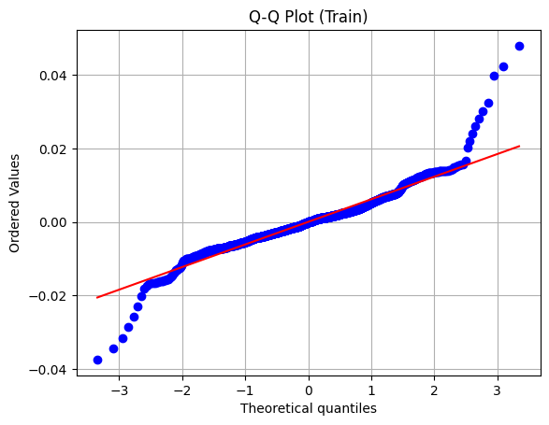
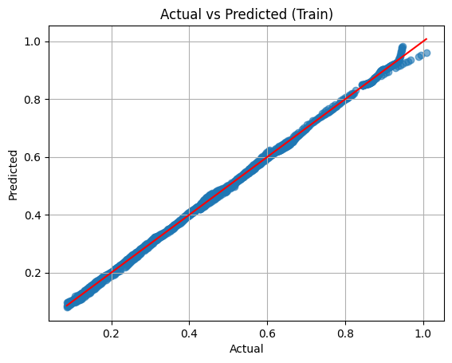
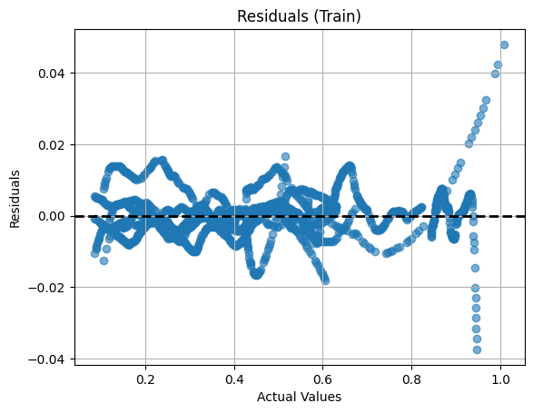
ML Model Development Pipeline
Curated Visualization Curves: Case 1: Train-Test-Validation

Slide 16
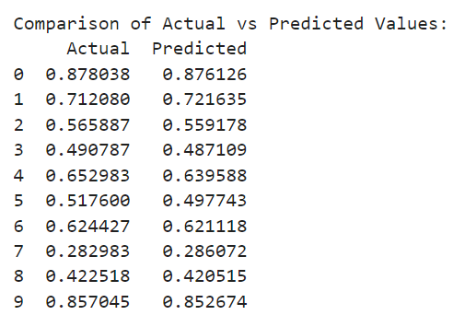
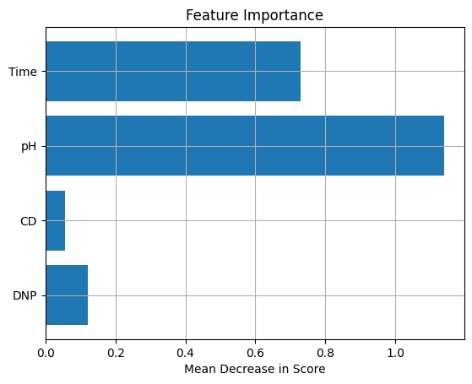
ML Model Development Pipeline
Curated Visualization Curves: Case 1: Train-Test-Validation

Slide 17
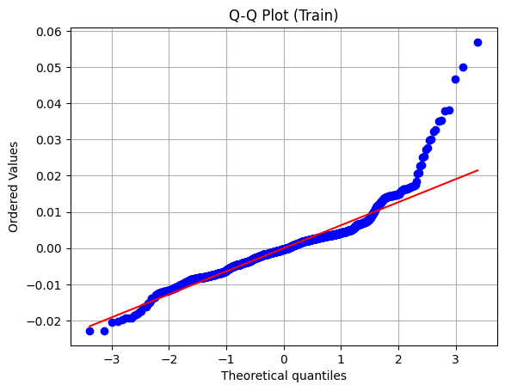
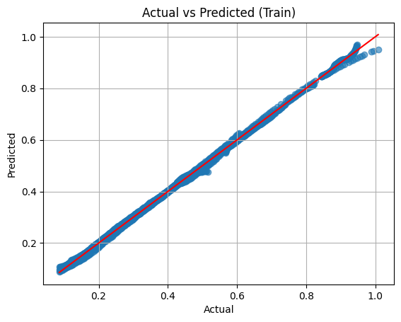
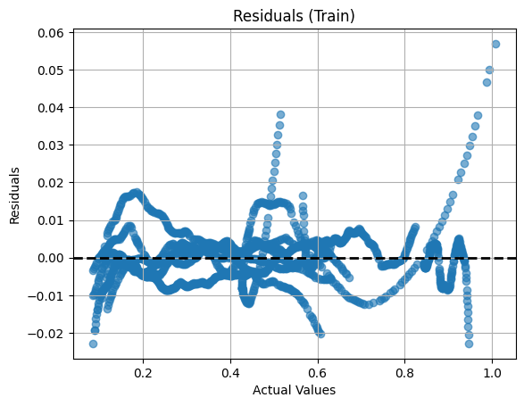
ML Model Development Pipeline
Curated Visualization Curves: Case 2: Train-Test

Slide 18
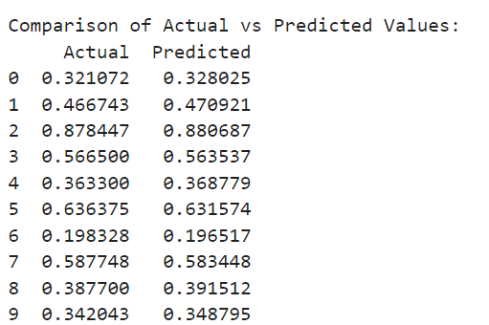
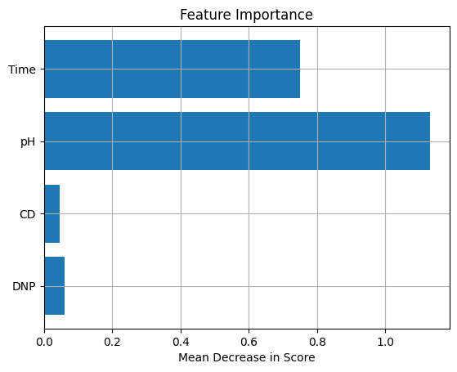
ML Model Development Pipeline
Curated Visualization Curves: Case 2: Train-Test

Slide 19
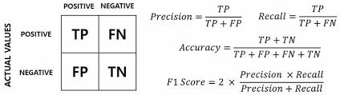
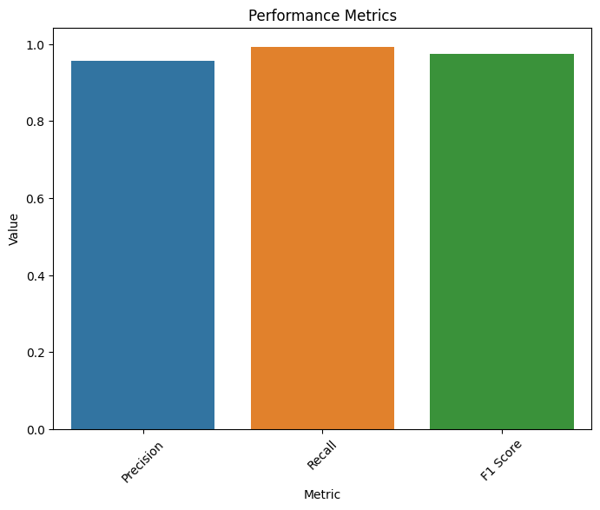
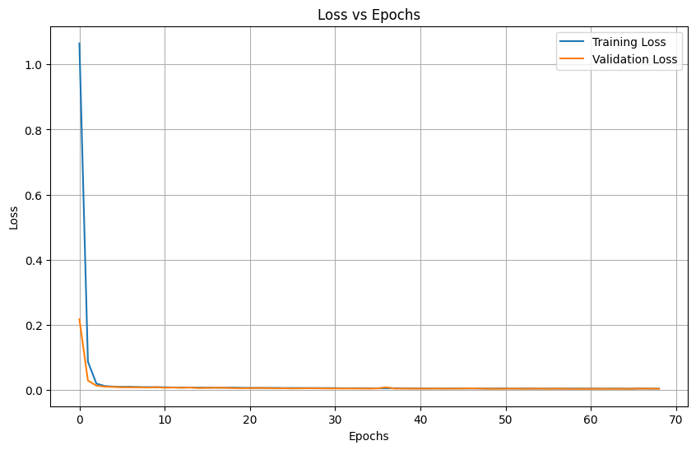
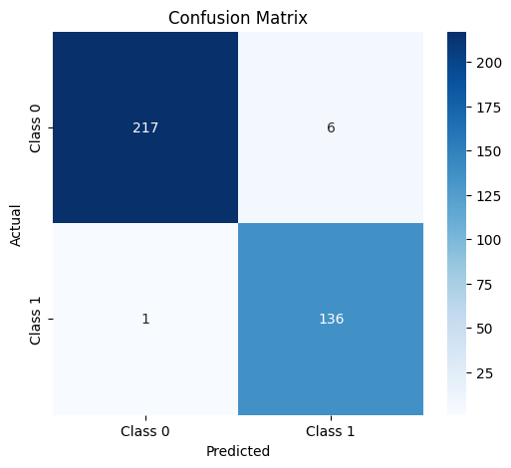
Other ML Model Development Pipeline

Slide 20
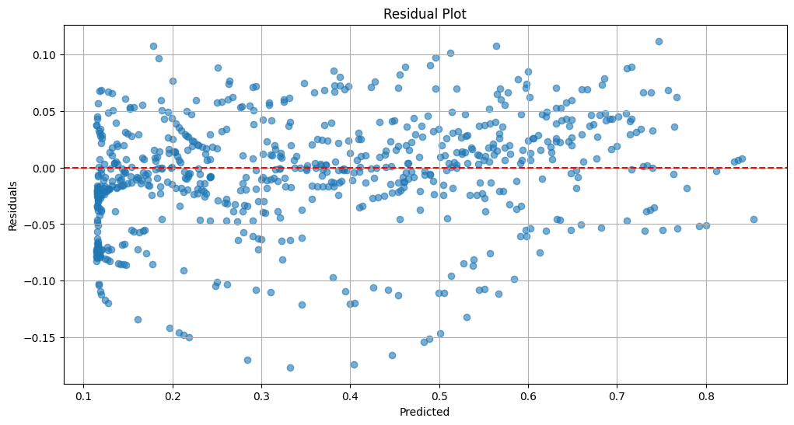
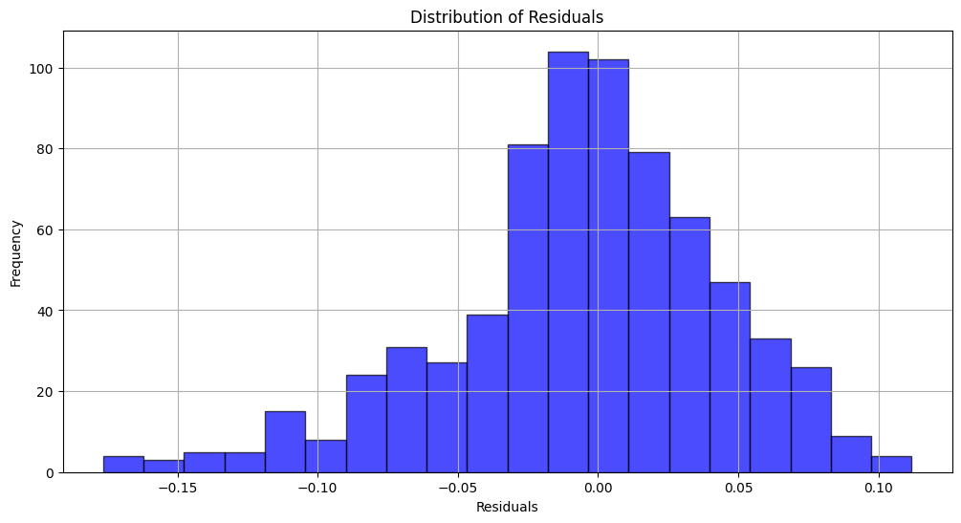
ML Model Development Pipeline

Slide 21

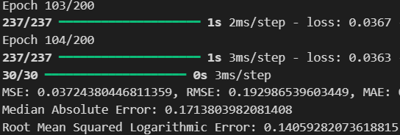
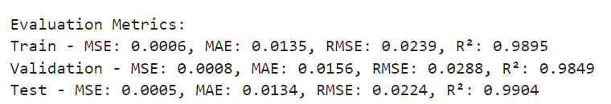

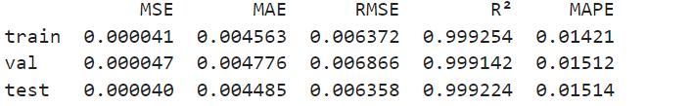
Progress and Challenges
Our iterative approach addresses initial prediction gaps, focusing on optimization to achieve reliable results.

Slide 22
Acknowledgment
We would like to extend our sincerest gratitude towards our institute for providing us with immense support and funds. With their help, we were able to develop our project and are very thankful to our entire institute team.
We would also like to present our gratitude towards our Professors who were equally helpful and provided substantial support towards our project.

Slide 23
THANK YOU

