Slide 1
Apple Stock Dataset Prediction using Artificial Neural Network (ANN)
Priyanshu (102208010)
Faculty Advisors:
Dr. Rajnish Mallick
Department of Mechanical Engineering
Thapar Institute of Engineering and Technology, Patiala-147004
© Industrial Engineering 2024 – crop yield prediction - Research Term Project
© Dr. Rajnish Mallick

Slide 2
Introduction
Forecasting in Industry 4.0 applications:
Proactive Maintenance: Utilizing predictive analytics based on sensor data and historical performance can significantly enhance maintenance strategies. By identifying potential issues before they become critical, businesses can perform maintenance tasks in a timely manner, reducing unplanned downtime. This proactive approach not only increases the operational hours of machinery but also extends its overall lifespan, ensuring more efficient use of assets. Moreover, fully automated processes minimize errors, further boosting productivity and reliability.
Quality Control: Implementing advanced forecasting methods based on process data and historical trends facilitates early detection of potential quality issues. This enables prompt corrective actions, reducing the need for rework and ensuring a higher standard of product quality. Consistent monitoring and predictive quality control help maintain stringent quality standards, resulting in increased customer satisfaction and reduced waste.

Slide 3
Introduction
Forecasting in Industry 4.0 applications:
Artificial Intelligence and Machine Learning: The application of AI and ML in analyzing vast amounts of data allows for highly accurate predictions and the automation of complex decision-making processes. These technologies can uncover hidden patterns and insights, driving more informed business decisions. The resulting improvements in efficiency, accuracy, and innovation can lead to exponential growth for organizations, as they leverage data-driven strategies to stay ahead in a competitive market.
By integrating these advanced forecasting techniques into Industry 4.0 applications, businesses can achieve significant improvements in maintenance, quality control, and overall operational efficiency. This strategic approach not only enhances current performance but also positions companies for long-term success and sustainability.

Slide 4
Introduction
Overview: Welcome to the presentation on predicting Apple stock prices using Artificial Neural Networks (ANN). This project aims to develop a robust and accurate model for forecasting Apple stock prices by leveraging advanced neural network techniques.
Importance: Stock price prediction holds significant importance in the finance industry. Accurate predictions can assist investors, financial analysts, and companies in making informed decisions, managing risks, and developing strategies. This project is particularly crucial for demonstrating how modern technological frameworks, including ANN and Industry 4.0, can be harnessed to enhance prediction accuracy and reliability.

Slide 5
Literature survey (International) - 01
PREDICTING STOCK MARKET MOVEMENTS USING NEURAL NETWORKS: A REVIEW AND APPLICATION STUDY
Adedoyin Tolulope Oyewole, Omotayo Bukola Adeoye, Wilhelmina Afua Addy, Chinwe Chinazo Okoye, Onyeka Chrisanctus Ofodile, & Chinonye Esther Ugochukwu. (2024). PREDICTING STOCK MARKET MOVEMENTS USING NEURAL NETWORKS: A REVIEW AND APPLICATION STUDY. Computer Science & IT Research Journal, 5(3), 651-670.
https://doi.org/10.51594/csitrj.v5i3.912.
Literature survey (National) - 02
Systematic analysis and review of stock market prediction techniques
Dattatray P. Gandhmal, K.Kumar
https://doi.org/10.1016/j.cosrev.2019.08.001

Slide 6
Novelty of the Approach
Advanced Data Preprocessing: Using sophisticated techniques for data cleaning, normalization, and feature engineering to ensure high-quality input data for the model.
Continuous Learning and Adaptation: The model is designed to continuously learn from new data and adapt to changing market conditions, which enhances its predictive power over time
Research Objectives
Develop a predictive model to forecast Apple stock prices using ANN.
Integrate concepts and techniques to enhance forecasting capabilities.
Provide accurate and reliable stock price predictions for investors and stakeholders.

Slide 7
Data Preparation
Dataset:
The dataset used for this project is the Apple stock dataset obtained from Kaggle.
It contains historical stock data, including opening price, high price, low price, closing price, and trading volume.
Preprocessing Steps:
Data preprocessing involves handling missing values, scaling numerical features, and splitting the dataset into training and testing sets.
Normalization of Data:
Normalization scales the features to a range between 0 and 1, ensuring uniformity and stability in model training.

Slide 8
ANN Model Architecture
The architecture of the ANN:
The ANN model architecture consists of multiple layers, including input, hidden, and output layers.
Input Layer: Three neurons representing high price, open price, and trading volume.
Hidden Layers: Two hidden layers with 64 and 32 neurons, respectively.
Output Layer: One neuron representing the predicted closing price.
Activation Functions:
ReLU (Rectified Linear Activation) is used in the hidden layers for introducing non-linearity.
Linear activation function is used in the output layer for regression tasks.

Slide 9
Model Training,Evaluation and Performance
Training Details:
The model is trained using the Adam optimizer with a learning rate of 0.001.
Training is performed for 50 epochs with a batch size of 64.
A validation split of 10% is used for monitoring model performance during training.
Evaluation Metrics:
Mean Squared Error (MSE) and Root Mean Squared Error (RMSE) are used to evaluate the model's performance on both training and testing datasets.
Model Performance:
The model achieves a train score of 0.000028 MSE (0.005280 RMSE) and a test score of 0.000106 MSE (0.010278 RMSE).
These scores indicate high accuracy and minimal error in predicting stock prices.

Slide 10
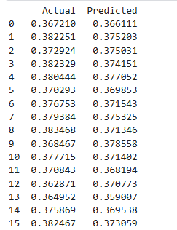

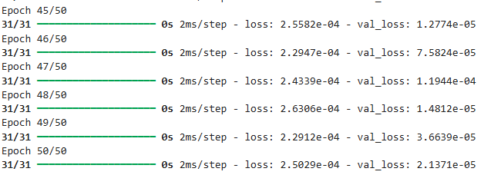
Predicted vs Actual Values along with Epoch Simulation
Tabular Comparison:
The table displays a few rows of actual vs. predicted values, allowing for a detailed comparison of model predictions with ground truth.

Slide 11
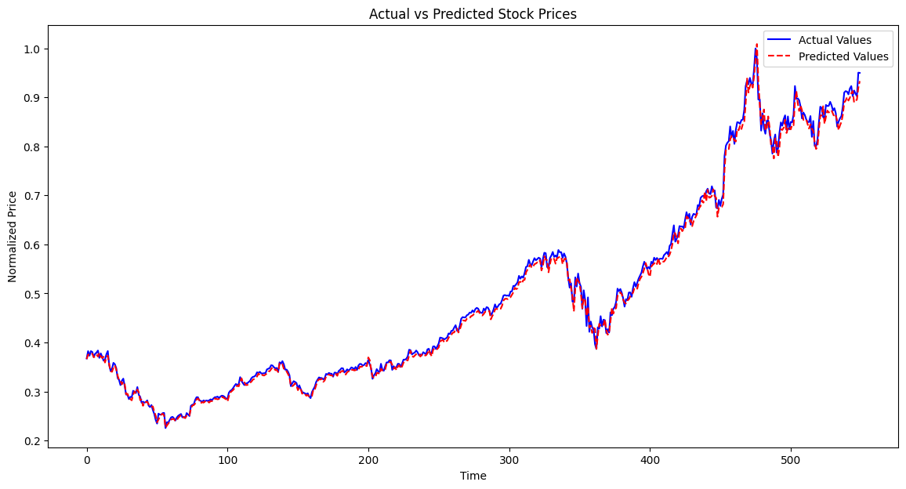
Visualization and Inferences
The overlapping graphs of actual vs. predicted values demonstrate the model's ability to capture the underlying patterns in the data. It depicts the close overlap between actual and predicted stock prices, indicating the model's effectiveness in forecasting.

Slide 12
Conclusion
Summary:
The project successfully demonstrates the use of ANN for predicting Apple stock prices.
Integration of Industry 4.0 techniques enhances forecasting accuracy and reliability.
Future Work:
Future work may involve exploring advanced models like LSTM (Long Short-Term Memory) for time series forecasting.
Expanding the analysis to include other stock datasets and exploring additional features for improved predictions.

Slide 13
Engineering Approach
Why the Chosen Engineering Approach is the Best:
Flexibility and Adaptability: The chosen engineering approach of utilizing Artificial Neural Networks (ANN) offers flexibility in modeling complex relationships within the stock market data. ANNs can adapt to changing patterns and dynamics, making them suitable for time series forecasting tasks.
Scalability: ANN models can be scaled up or down based on the size and complexity of the dataset. This scalability ensures that the model can handle large volumes of historical data while maintaining computational efficiency.
Proven Effectiveness: The effectiveness of ANN in time series forecasting has been demonstrated in various domains, including finance, economics, and business analytics. Research studies and practical applications have shown that ANN models can outperform traditional statistical methods in terms of accuracy and predictive power.

Slide 14
Importance for Industry and Stakeholders
Why This Problem is Important for Industry and Stakeholders::
Risk Management: Accurate stock price prediction is vital for mitigating financial risks and optimizing investment strategies.
Strategic Planning: By incorporating accurate predictions into strategic decision-making processes, organizations can gain a competitive edge and drive sustainable growth.
Investment Decisions: Timely and accurate forecasts enable investors to capitalize on market opportunities, maximize returns, and achieve their financial goals.
Economic Stability: Reliable stock price forecasts contribute to economic stability by providing insights into market sentiment, and investor behavior. This, in turn, influences policy-making decisions aimed at fostering growth and stability.

Slide 15
Thank You
© Dr. Rajnish Mallick

