Slide 1

Coffee Shop Sales Dashboard
Built in Excel | by Priyanshu Choudhary

Slide 2
Project Overview
Goal: Analyze sales and customer behavior using Excel dashboard
Tools: Excel (Office 365), Power Query, Pivot Tables, Charts
AI + Prompt Engineering used for framing questions and structuring insights
Dataset includes sales, product categories, time, size, and store locations

Slide 3
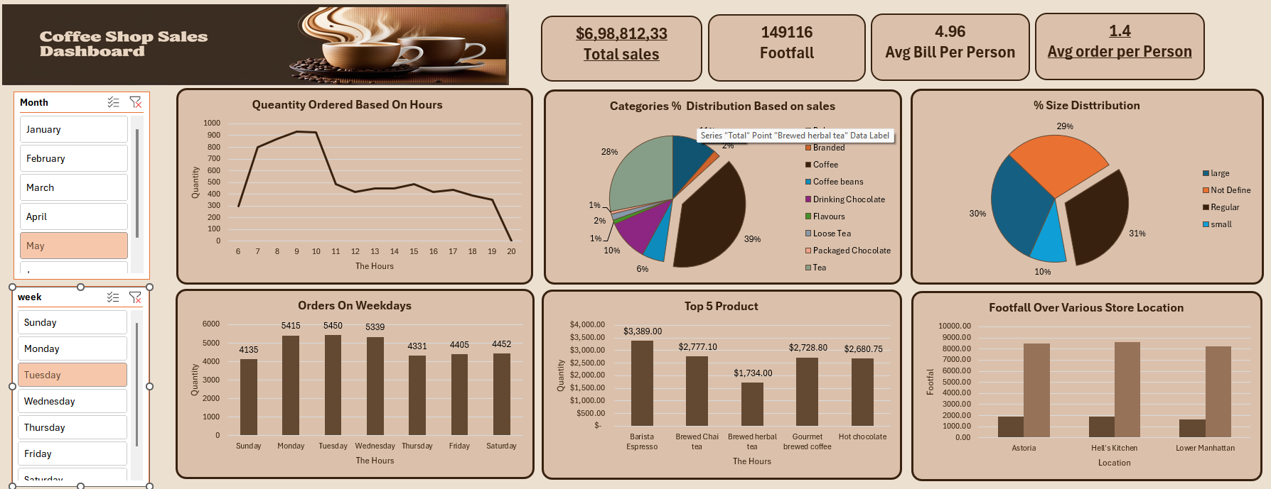
Dashboard Preview

Slide 4
Q1: What is the total sales and footfall?
Total Sales: ₹6,98,812.33
Total Footfall: 1,49,116
Shown through KPI cards at the top of dashboard.

Slide 5
Q2: Which product categories generate the most revenue?
Top Category: Coffee (39%)
Followed by Drinking Chocolate (28%)
Visualized using pie chart.

Slide 6

Q3: What time of day do most customers place orders?
Peak time: 8 AM to 10 AM
Orders drop sharply afterward
Insights from hourly line chart.

Slide 7
Q4: Which weekday has the highest order volume?
Highest: Monday & Tuesday (~5,400 orders)
Lowest: Sunday (~4,135)
Bar chart used for analysis.

Slide 8

Q5: What are the top 5 best-selling products by revenue?
1. Barista Espresso
2. Brewed Chai Tea
3. Gourmet Brewed Coffee
4. Hot Chocolate
5. Brewed Herbal Tea

Slide 9

Q6: How are orders distributed by size?
Regular: 31%
Small: 30%
Large: 29%
10% undefined
Pie chart used to show distribution.

Slide 10
Q7: Which store locations have the highest footfall?
Top: Hell’s Kitchen, Lower Manhattan, Astoria (~9,000 each)
Bar chart used for comparison.

Slide 11

Learnings & What's Next
Improved skills in Excel, Power Query, Pivot Tables, and Data Visualization
Practiced framing business questions and extracting insights
Used AI + prompt engineering for structuring analysis
Next: Add time trend analysis, more interactivity, and integrate SQL backend

