Slide 1
Microsoft Clarity
Presented by
Priyanshu Koley

Slide 2
Contents
Introduction
Key features
Setup and Configuration
Data Analysis
Analyzing User Interactions
Screenshots
Identifying Most Frequently Used Features
Post analysis report
Conclusion

Slide 3
Introduction
In this presentation, I will discuss the utilization of Microsoft Clarity, an analytics tool, to analyze user interactions within an application.
The primary objective is to determine which features/buttons are most frequently used by users. By leveraging Microsoft Clarity's capabilities, I aim to gain valuable insights into user behavior and optimize the application for improved user experience.
Microsoft Clarity is a comprehensive analytics tool that offers various features and functionalities to track user interactions on web pages and mobile apps. It provides session recordings, heatmaps, scroll depth and click tracking capabilities, allowing us to understand how users engage with our application in real-time.

Slide 4
Key features of Microsoft clarity
Microsoft Clarity offers a range of features designed to provide insights into user behavior and optimize website performance. Some of the key features of Microsoft Clarity include:
Session Recordings: Clarity captures user sessions, allowing us to replay interactions, including mouse movements, clicks, scrolls, and keystrokes. This feature provides a detailed view of how users navigate and interact with our website.
Heatmaps: Heatmaps visually represent user activity by highlighting areas of the website that receive the most interaction. This allows us to identify popular sections, elements, or features of our website and optimize them for better engagement.
Click Tracking: Clarity tracks user clicks on specific elements such as buttons, links, or images. This feature helps us understand which elements users are interacting with the most and how they navigate through our website or mobile application.
Scroll Tracking: By tracking user scrolling behavior, Clarity provides insights into how far users scroll down each page. This information helps us optimize content placement and layout to ensure important information is easily accessible.

Slide 5
Rage Clicks and Error Tracking: Clarity identifies instances of "rage clicks," where users repeatedly click on an element out of frustration, as well as errors encountered by users during their session. This helps us pinpoint areas of the website that may be causing frustration or technical issues.
Dead Click Tracking: Microsoft Clarity identifies dead clicks, which occur when users click on elements that are not interactive or do not lead to any action. By tracking dead clicks, Clarity helps us to identify elements that may be confusing or misleading to users. This information can be used to improve the design and functionality of the website, ensuring that all clickable elements provide a clear and meaningful interaction for users.
Quick backs: Quick backs occurs when users quickly navigate back to their previous page or step in their browsing session. By tracking quick backs, Clarity provides insights into user behavior patterns, such as users' tendencies to backtrack during their interactions with the website. Understanding quick backs can help us identify points of confusion or inefficiency in the user journey and optimize navigation flow for better user experience.

Slide 6
Session Replay Filters: Clarity allows us to apply filters to session replays based on criteria such as device type, browser, or user interactions. This enables us to focus on specific segments of users or sessions for more targeted analysis.
Insights Dashboard: The Clarity dashboard provides a centralized location to view and analyze all collected data, including session recordings, heatmaps, and click data. The dashboard offers various visualization tools and metrics to help us gain actionable insights into user behavior.
Privacy Features: Microsoft Clarity prioritizes user privacy and includes features such as masking sensitive information (like passwords) in session recordings and providing options for users to opt-out of tracking.
Copilot: It is an AI that helps us in analysis. It gives a summary on the user actions.
It's free—forever: Enjoy all the features of Clarity at absolutely zero cost. We will never run into traffic limits or be forced to upgrade to a paid version.
GDPR & CCPA ready
No sampling
Built on open source

Slide 7
Setup and Configuration
To track user interactions within an application using Microsoft Clarity, the following steps were undertaken:
Sign up for a Microsoft Clarity account to access the necessary tools and features.
Generate a unique tracking code.(Options given by clarity)
Obtain the tracking code snippet provided by Microsoft Clarity.
Install on a third-party platform, works with Shopify, SquareSpace, Wix, WordPress, and more.
Email to our teammate with the tracking code and setup steps.
Integrate the tracking code snippet into the HTML of the application's pages, Copy and paste the Clarity code into the <head> element of our site or app.
Clarity is now configured to track specific events, such as clicks on the identified features/buttons.

Slide 8
Data Analysis
After setting up tracking, data on user interactions will get collected, analyzed and will be show on the dashboard within 2 hours of setup.
Now we can,
Access the Microsoft Clarity dashboard to view recorded sessions, heatmaps, click data and etc.
Filter the data to focus on interactions with the identified features/buttons.
Utilize Clarity's analytics tools to visualize click patterns and identify the most frequently used features/buttons.

Slide 9
Data analysis in Clarity:
Analyzing user engagement metrics such as session duration, page views, and bounce rates to understand how users interact with the website and which pages or features are most engaging.
Examining click data to identify which elements on the website are clicked most frequently, including buttons, links, images, and other interactive elements. This analysis helps prioritize feature improvements and optimize user flows.
Analyzing scroll data to determine how far users scroll down each page and where they may be dropping off. This information is valuable for optimizing content placement and layout to ensure important information is visible to users.
Interpreting heatmap data to visualize user interaction patterns and identify hotspots of activity on the website. Heatmaps provide insights into which areas of the website receive the most attention and engagement from users.
Reviewing session recordings to observe user behavior in real-time, including mouse movements, clicks, scrolls, and keystrokes. Session recordings help identify user pain points, usability issues, and areas for improvement.

Slide 10
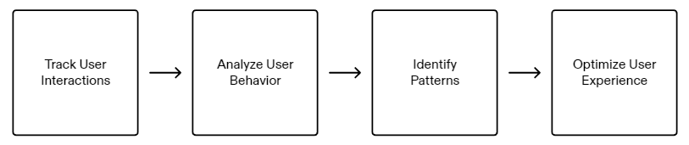
Analyzing User Interactions
Microsoft Clarity is a powerful analytics tool that allows you to gain insights into user behavior and preferences within an application. By analyzing user interactions, we can make data-driven decisions to improve the user experience and drive business growth.

Slide 11
Analyzing User Interactions
Track User Interactions
Microsoft Clarity allows us to track various user interactions, such as clicks, scrolls, and form submissions. By collecting this data, we can understand how users engage with our application and identify areas for improvement.
Analyze User Behavior
Once we have collected user interaction data, we can analyze it using Microsoft Clarity's powerful analytics features. This includes heatmaps, session recordings, and funnels. These tools provide valuable insights into how users navigate our application and where they may encounter difficulties.

Slide 12
Analyzing User Interactions
Identify Patterns
By analyzing user behavior data, we can identify patterns and trends that emerge. This can include common paths that users take, popular features or pages, and areas where users may drop off or abandon the application. These patterns can inform our decision-making and help us prioritize improvements.
Optimize User Experience
With the insights gained from Microsoft Clarity, we can optimize the user experience of our application. This may involve making design changes, improving navigation, or streamlining the user flow. By addressing pain points and enhancing usability, we can create a more engaging and satisfying experience for our users.

Slide 13
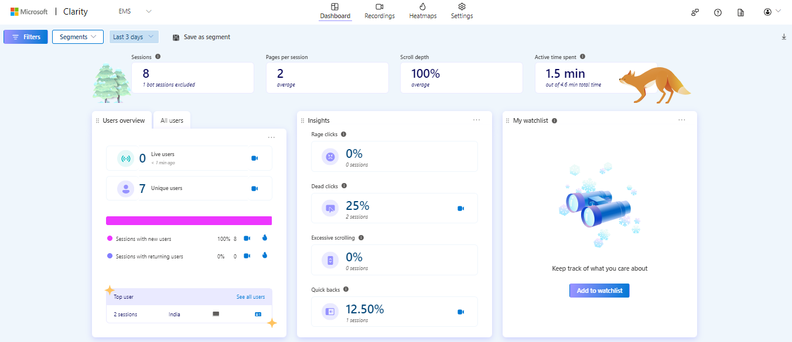
Dashboard
Rage clicks, dead clicks, quick backs and extensive scrolling given in the Insights section

Slide 14
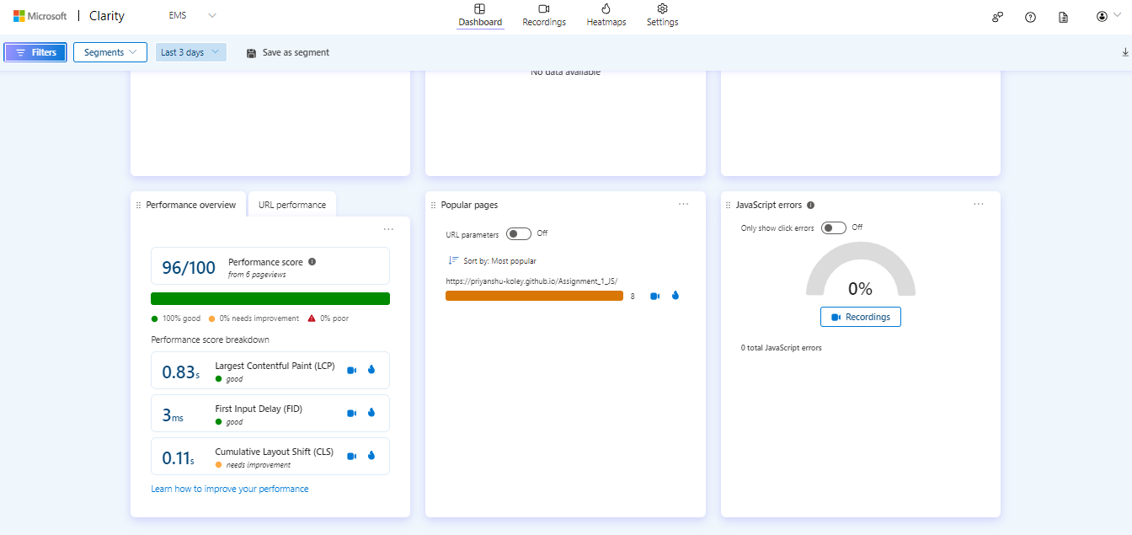
Dashboard

Slide 15
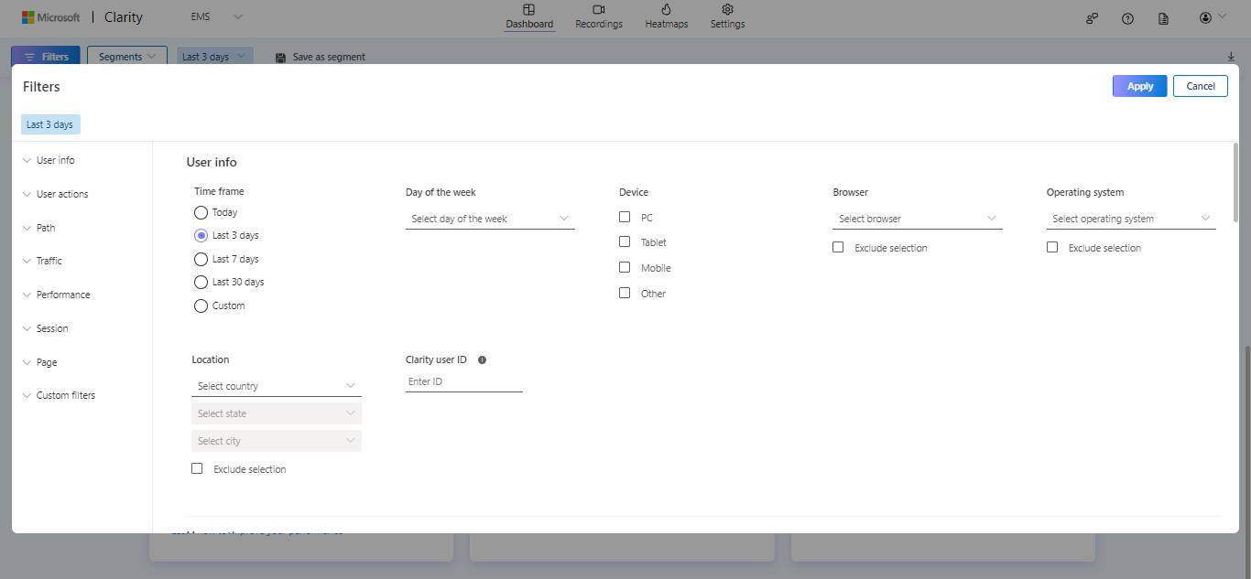
Filters

Slide 16
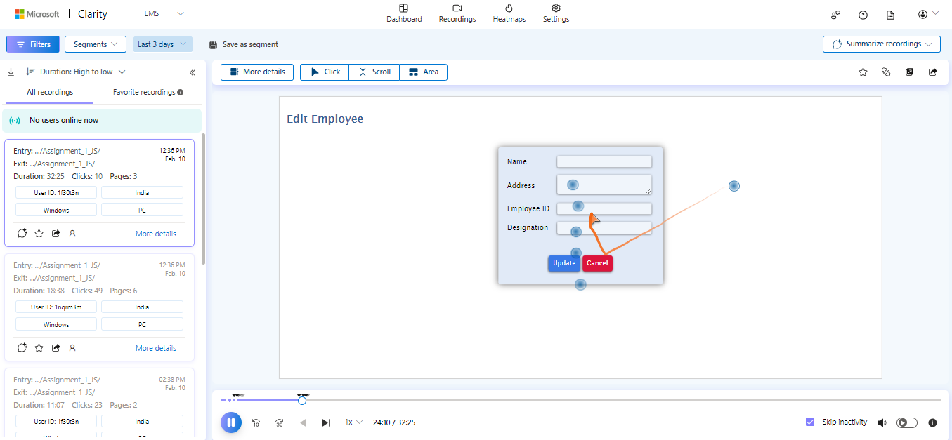
Recordings

Slide 17
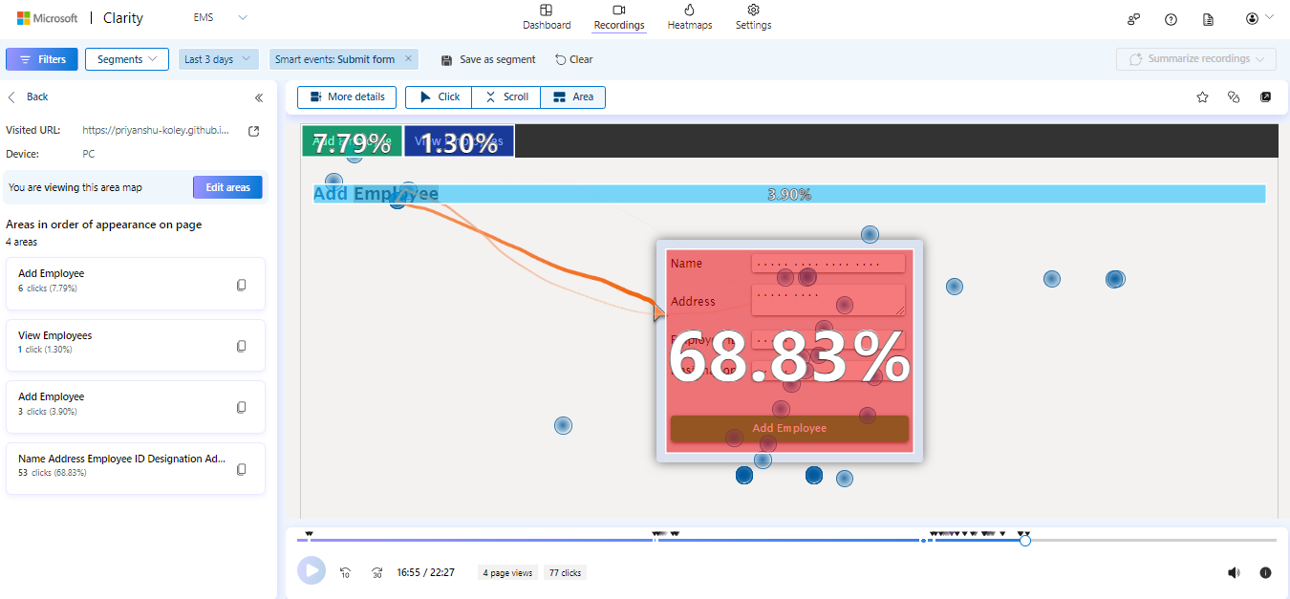
Area view for click analysis in recordings
Percentage of clicks in the area

Slide 18
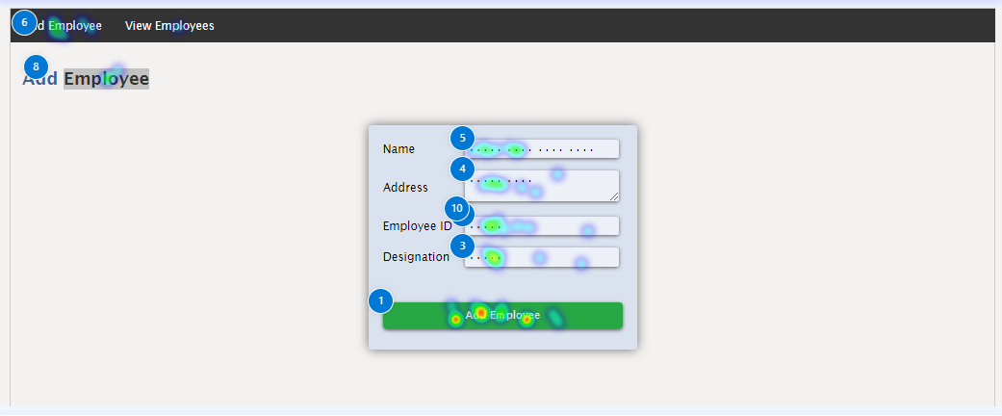
Heatmaps
Red is most popular, Blue is least popular

Slide 19
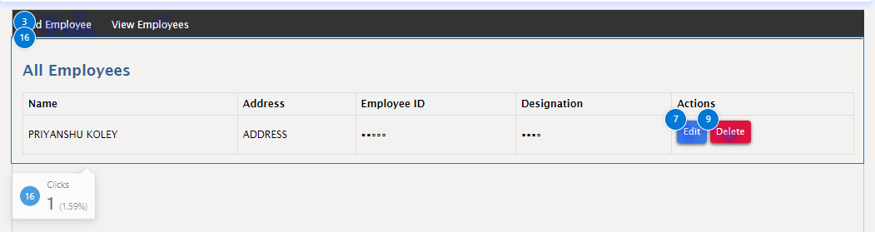
Heatmaps
Privacy feature: Masked Employee ID and Designation

Slide 20
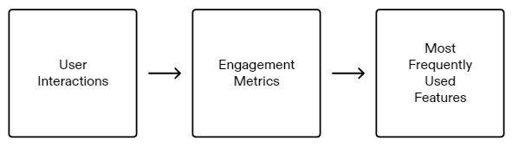
Identifying Most Frequently Used Features
User interactions can include actions such as clicks, scrolls, form submissions, and other events that indicate user engagement. By analyzing these interactions, we can understand which features are being used the most and prioritize them for further improvements or enhancements.
Engagement metrics provide additional insights into user behavior and can include metrics such as session duration, bounce rate, and conversion rate. By analyzing these metrics in conjunction with user interactions, we can gain a comprehensive understanding of how users engage with different features and identify opportunities for optimization.
By identifying the most frequently used features, we can focus our efforts on improving and optimizing those features to enhance user experience and drive user engagement. This can lead to increased user satisfaction, higher retention rates, and ultimately, the success of our application.

Slide 21
Post analysis report
Based on the analysis conducted using Microsoft Clarity on my hosted website “Employee Management System”, the following insights were obtained:
The “Add Employee" feature received the highest engagement from users, with a significant number of clicks recorded.
“Update" and “Edit" buttons were also frequently clicked, indicating their importance in the user workflow.
“View Employees" and “Cancel" buttons had relatively lower engagement compared to other features, suggesting potential areas for improvement.
We can do:
Conduct user testing and feedback sessions to gather insights into user preferences and pain points, allowing for iterative improvements.
Continuously monitor user interactions using Microsoft Clarity and iterate on feature design based on observed patterns and trends.

Slide 22
Conclusion
In conclusion, leveraging Microsoft Clarity for user interaction analysis has provided valuable insights into how users engage with an application. By identifying the most frequently used features/buttons and optimizing their usability, we can enhance the overall user experience and drive increased user engagement. Moving forward, continuous monitoring and analysis using Microsoft Clarity will be instrumental in maintaining and improving the application's performance and user satisfaction.
There are also some drawbacks to consider:
Data Sampling: Microsoft Clarity may employ data sampling techniques, especially for websites with high traffic volumes. Data sampling can lead to inaccuracies in insights and analysis, as it only considers a subset of the total data.
Privacy Concerns : While Microsoft Clarity prioritizes user privacy and includes features such as masking sensitive information in session recordings, some users may still have concerns about data privacy and security
Overall, while Microsoft Clarity offers valuable insights into user behavior and website performance, users should carefully consider these drawbacks and evaluate whether Clarity meets their specific analytical needs and requirements.

Slide 23
THANK YOU

