Slide 1


Charotar University of Science and Technology[CHARUSAT] Faculty of Technology and Engineering Devang Patel Institute of Technology and Research Computer Science & Engineering Academic Year: 2021 – 2022
A Software Group Project
“CHAT APP”
Created By
Ajmera Bhavya(19DCS003)
Maurya Priyanshu(19DCS060)
Desai Ashray(19DCS026)
Guided By
Prof. Chandrasekhar Pawar
Prof. Priyal Vaghela

Slide 2
Index
Objective
Scope of Project
Requirements
Features and Services
Database Structures
Snapshots of project
Future Enhancement
References

Slide 3
OBJECTIVE
Develop an Social Media Web Application for Chatting.
First we will make an chat application with login and logout features.
It will also Show us status of an user if user is online or not.

Slide 4
Scope of Project
SOFTWARE SCOPE
.
Understandability
It is based on a very simple UI design providing all the necessary features and easy to understand for users.
Effectiveness
As our Web App has pretty clean and user friendly UI so the user experince will be far more sophisticated and thus pulling more and more users.

Slide 5
Requirements
Hardware requirements
Pc with 256mb ram
Software requirements
Web browser support
phpmyadmin

Slide 6
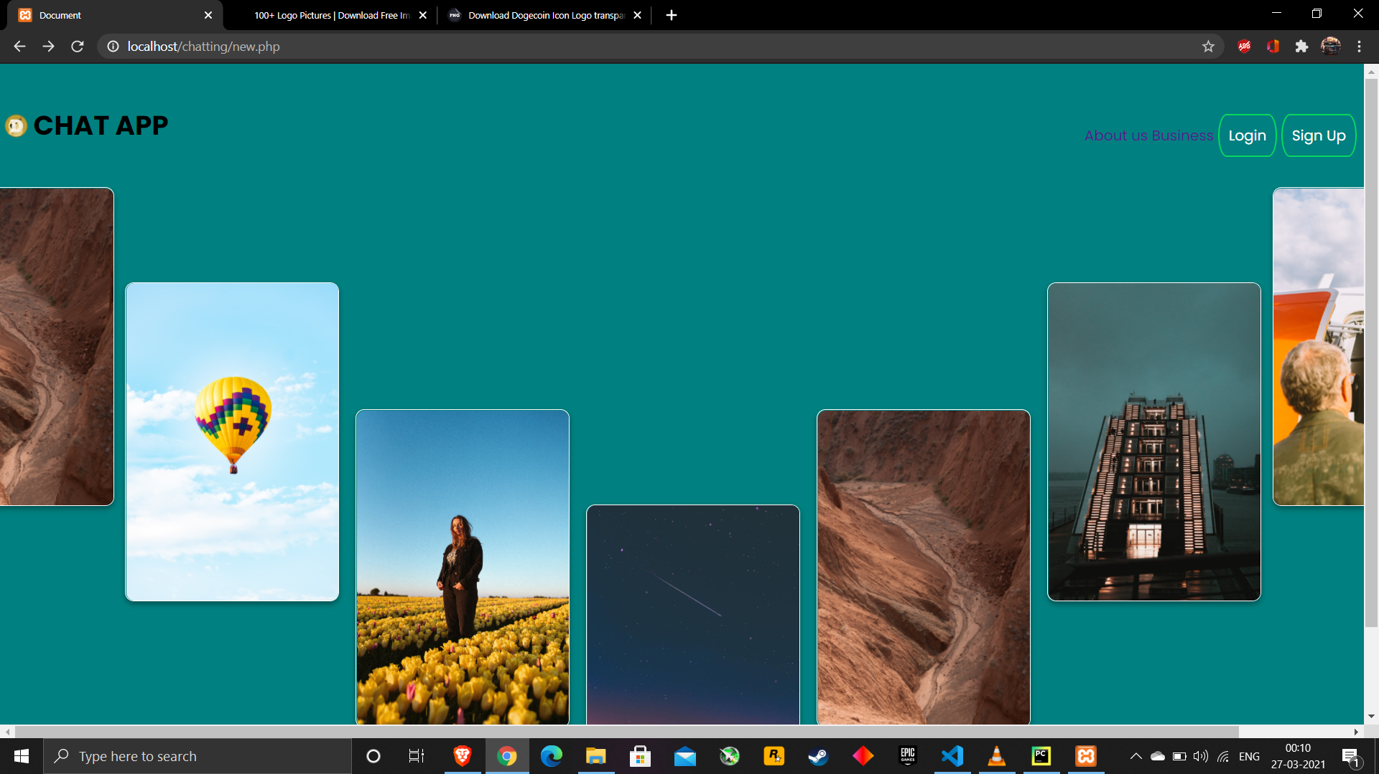
ScreenShot

Slide 7
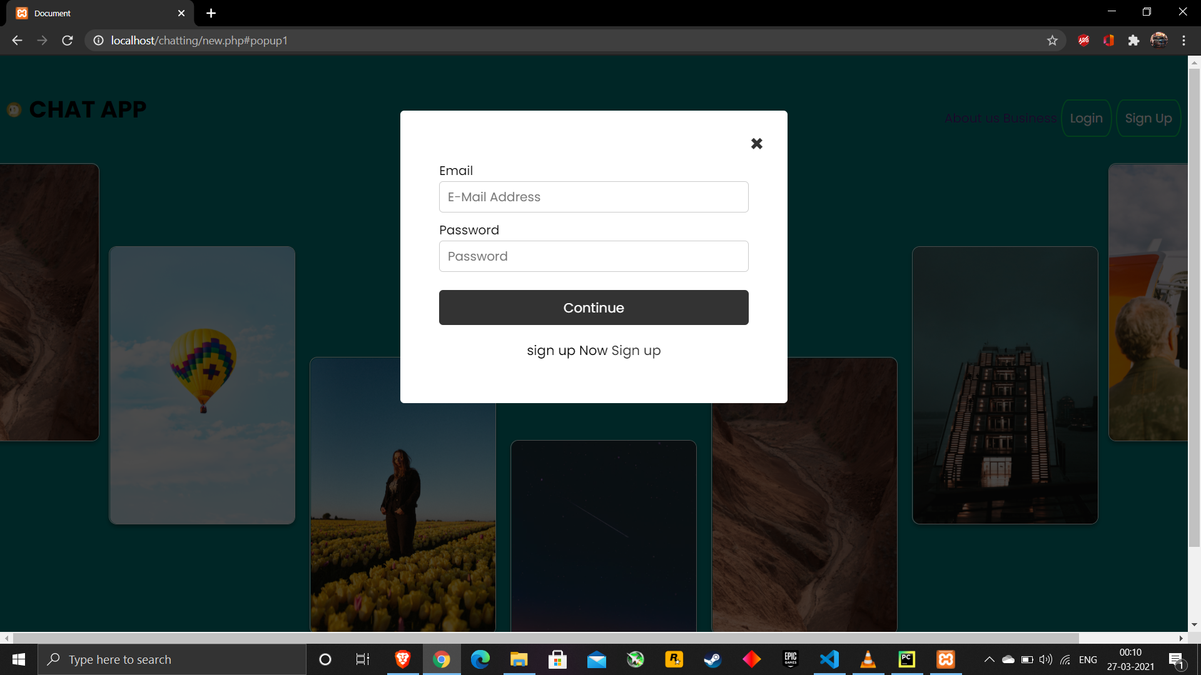
Screenshot

Slide 8
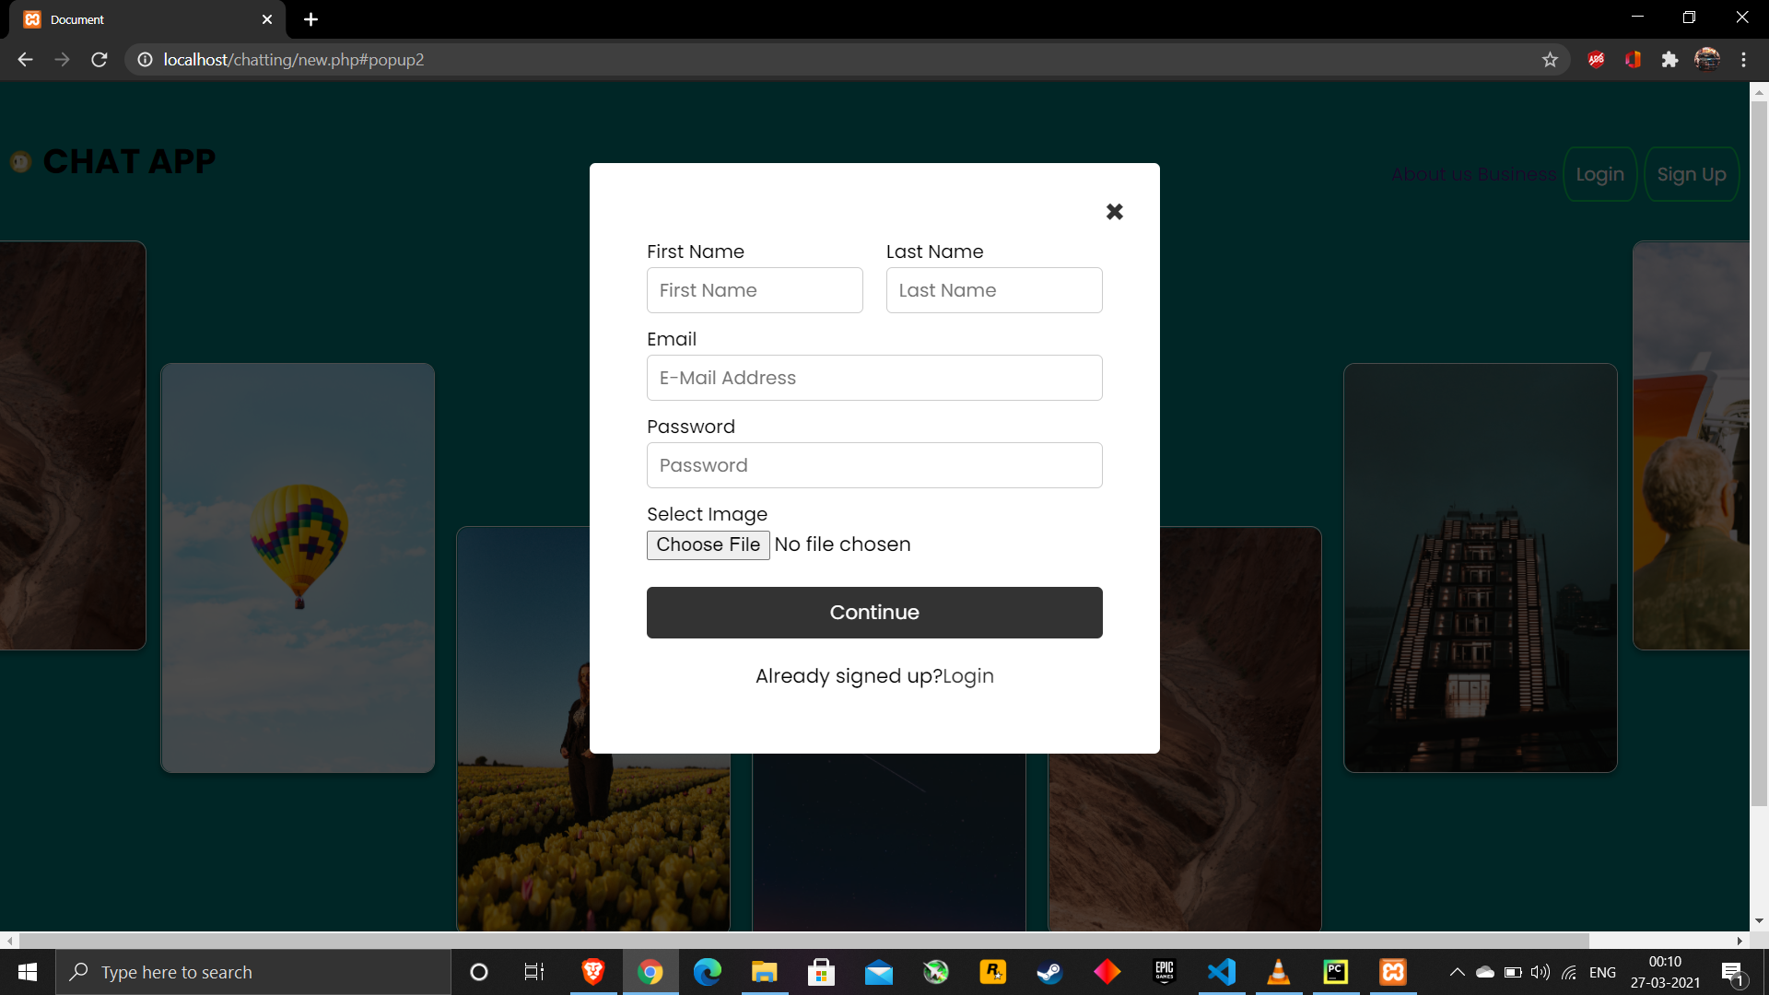
Snapshots()

Slide 9
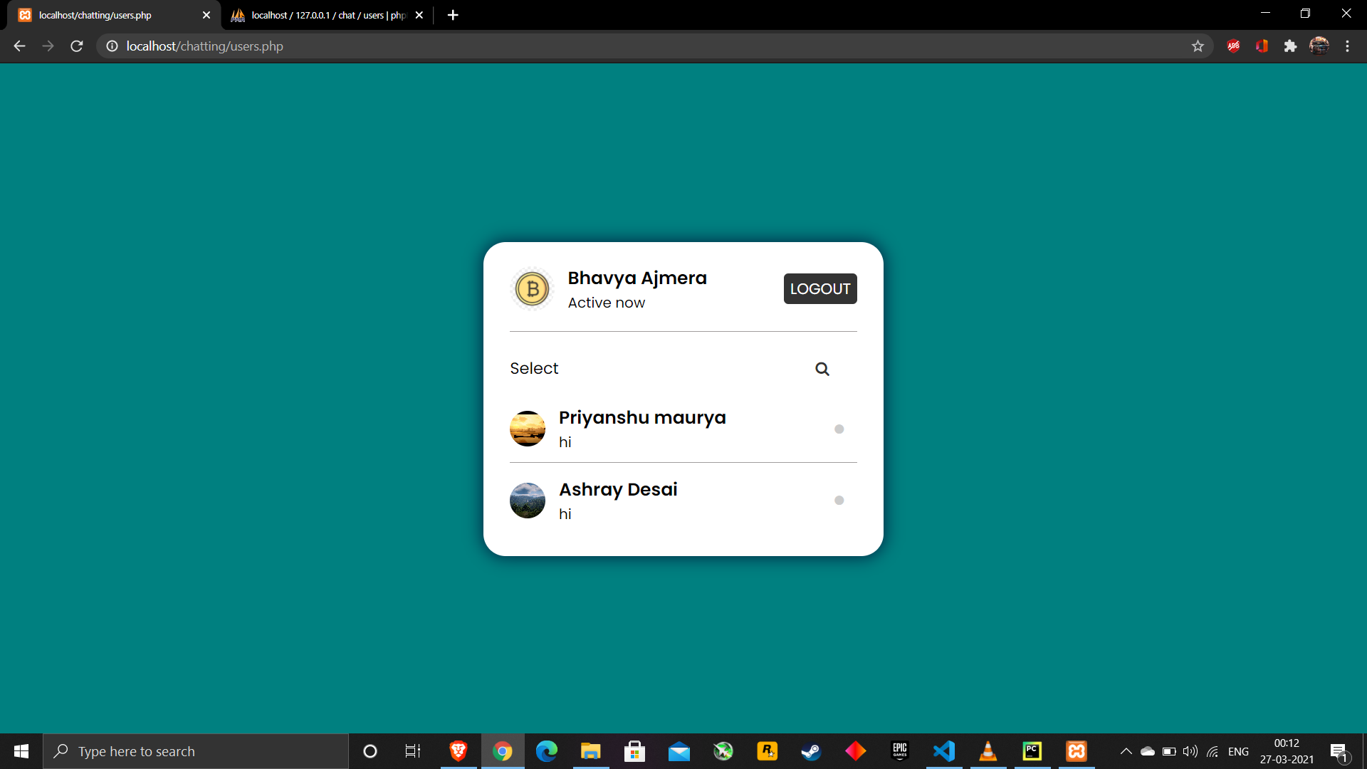
Snapshots()

Slide 10
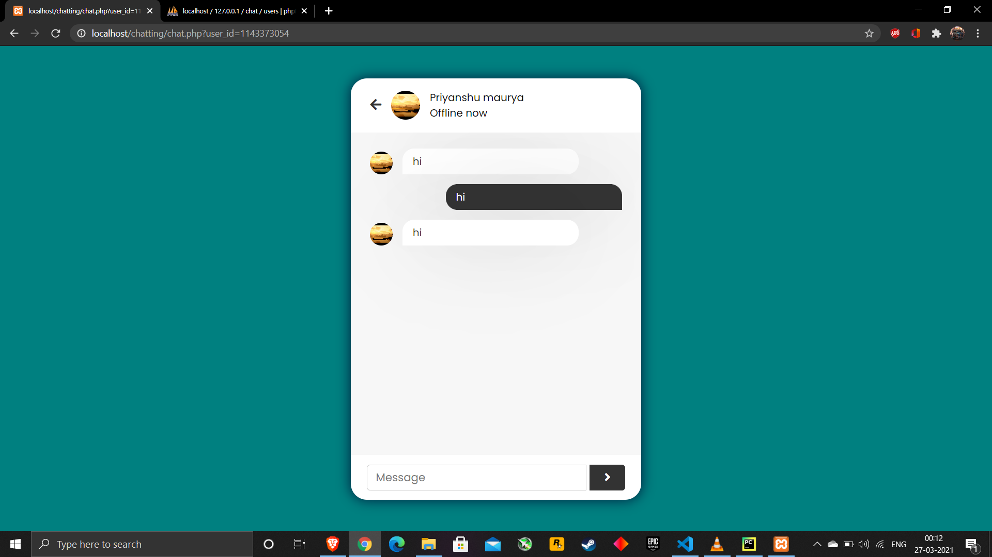
Snapshots()

Slide 11
FUTURE ENHHANCEMENTS
Our Application Can Be hosted on Server so more user can access the application.
Use of Google API to directly login/signup througth Gmail Account.
Focus more on Security of the application.
Making Website Responsive For different size of Devices.

Slide 12
CONCLUSION
In this Project A Web Chat Application has been made using different web technologies.According to us the developers of this project .The project is completed with primary functionalities as specified in the project definition.
We have worked on this project for last few weeks and we learned different things from aligning an item to centre to inserting a value in the database.we encountered many problems along the way and solved most of them and we plan to add more functionalities in this project in near future

Slide 13
REFERENCES
https://www.w3schools.com/php/DEFAULT.asp
https://www.youtube.com/watch?v=OK_JCtrrv-c
https://www.youtube.com/watch?v=W6NZfCO5SIk
https://developer.mozilla.org/enUS/docs/Web/Guide/HTML/HTMl5
https://www.w3schools.com/css/
http://tomcat.apache.org/
https://www.youtube.com/watch?v=fV8ointgMeQ
https://www.mysql.com/
https://www.w3schools.com/js/DEFAULT.asp

Slide 14


