Slide 1
CA-2 · DEEP LEARNING PROJECT
B.TECH CSIT · GENERATIVE MODELS
Conditional Image
Generation Using cGAN
PROJECT AIM
Generate a target class on demand
Class-Controlled Handwritten Digit Generation Using Deep Learning
This project implements a Conditional GAN that generates synthetic handwritten digit images based on a user-specified class label.
Student name(s): Priyansh Jaiswal(202401100500133)
Mohit Jaiswal(202401100500108)
Section: B
Institution: KIET deemed to be university
Stack: Python, PyTorch, Torchvision, Google Colab · Dataset: MNIST
Illustrative 0–9 conditioning field · replace with trained outputs when available

Slide 2
01 · THE PROBLEM
cGAN adds control to image generation
The label becomes part of the generation task, not a guess made after the image is produced.
STANDARD GAN
CONDITIONAL GAN
Randomness first
Label-guided synthesis
Random noise z is mapped to an image. The model does not directly specify which digit class should appear.
→
Noise z and class label y jointly guide the generator toward a target-class image.
Noise → generated image
Noise + class label → target-class image
Objectives. Implement a PyTorch cGAN, train on MNIST, generate labels 0–9, and evaluate image quality together with class consistency.

Slide 3
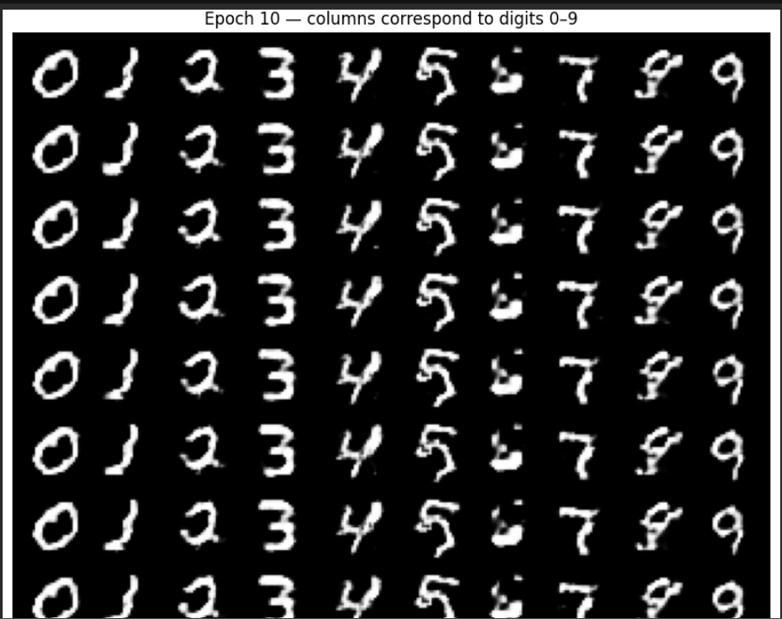
02 · DATASET
REAL MNIST SAMPLE STRIP
MNIST turns conditioning into a measurable task
One of ten handwritten digit classes is the target for each generated image.
VERIFIED DATASET FACTS
60,000 training images
10,000 test images
28 × 28 grayscale pixels
Ten classes: 0 through 9
PREPROCESSING FLOW
Torchvision: Load MNIST → Tensor: Convert samples → Normalize: Scale to [-1, 1] → Condition: Labels 0–9 → Batch: Shuffle mini-batches.

Slide 4
03 · MODEL DESIGN
Both networks learn from the class label
GENERATOR G
DISCRIMINATOR D
Target-class synthesis
Image–label pair authenticity
Noise z + target label y (class 0–9) → label embedding → combined representation → neural layers → synthetic image 1 × 28 × 28.
Image x + label y → image features + conditioning → real/fake prediction for the image–label pair.
G(z, y) is the generated image.
D(x, y) is the discriminator output.
MINIMAX OBJECTIVE
Practical training may use non-saturating generator loss or BCE-with-logits.

Slide 5
04 · TRAINING LOOP
Training alternates between generation and judgment
01
02
03
Load and preprocess MNIST.
Define Generator and Discriminator; initialize weights and optimizers.
Sample real images and labels; generate fake images from noise and selected labels.
04
05
06
Update the Discriminator on real and fake image–label pairs.
Update the Generator to improve realism and class alignment.
Record losses, save image grids, repeat for configured epochs, then evaluate.
EXPERIMENTAL CONFIGURATION
Setting | Value
Latent dimension | 100
Batch size | 128
Epochs | 12
Optimizer / learning rate | Adam/0.0002
Hardware | NVIDIA T4 GPU
Losses are recorded and image grids are saved across configured epochs.
END-TO-END FLOW
Dataset → Preprocessing → Label Conditioning → G/D Training → Evaluation → Generated Images

Slide 6
05 · EVIDENCE GATE
Experimental evidence must come from the trained model
Keep these panels as placeholders until run artifacts exist; make no success claims before training evidence exists.
EVIDENCE 01
EVIDENCE 02
EVIDENCE 03
Generated digit grid
Training loss curves
Epoch-wise comparison
Cover labels 0–9 with several samples per class.
Show Generator and Discriminator losses over time.
Compare selected epochs, if available.
EVIDENCE 04
Observations
Visual recognizability, Class-specific generation, Diversity, Stability

Slide 7
Evaluation separates class control from image realism
CLASS CONTROL
REALISM & NEXT SCOPE
Inspect generated grids and loss curves qualitatively.
Measure class consistency with a separately trained and validated MNIST classifier.
Class consistency: requested-label matches ÷ generated samples.
Use FID only if implemented appropriately; class consistency alone does not prove realism.
Limitations: 28 × 28 grayscale scope; unstable GAN training; possible mode collapse; artifacts; incomplete quality coverage.
Conclusion: cGAN conditions both networks on labels. Evaluate actual outputs, then consider Fashion-MNIST, WGAN-GP, and more complex datasets.

Slide 8
Repository, references, and questions
REFERENCES
Source | Reference
GAN | Goodfellow et al., “Generative Adversarial Nets,” NeurIPS, 2014
cGAN | Mirza and Osindero, “Conditional Generative Adversarial Nets,” 2014
MNIST | LeCun, Cortes and Burges, “The MNIST Database of Handwritten Digits”
Tools | Official PyTorch and Torchvision MNIST documentation
GitHub
https://github.com/Priyanshu-PJ/CA2-Conditional-Image-Generation-cGAN
Repository contents
CA2_cGAN_MNIST.ipynb · README.md · CA-2 presentation · actual experimental outputs.
Thank You

