Slide 1
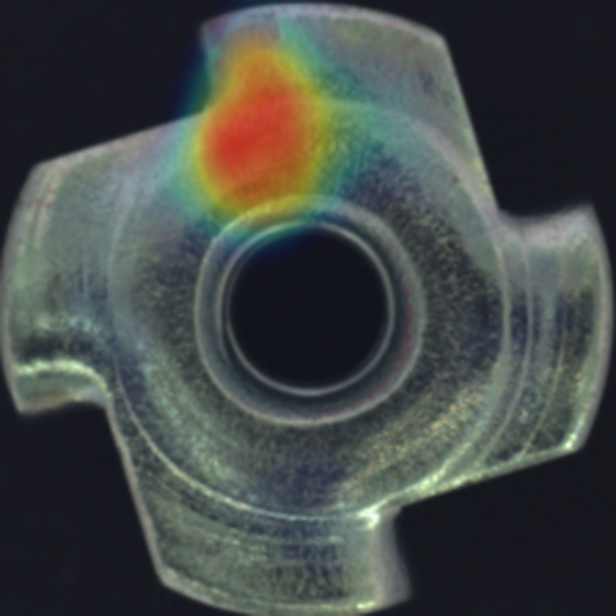
AI VISUAL INSPECTION
DefectScope
Spots scratches and dents.
No defect photos needed.
No defect labels
Pixel heatmap
Runs on CPU
● Defect found here
Notes:
0-10s: upload a defective part; the heatmap lights up exactly on the defect. Say: it was never shown a single defect, only good parts.

Slide 2
Rare defects make AI inspection hard.
THE PROBLEM
1
2
3
Normal AI needs defect photos
New defects slip through
Manual checks don't scale
A standard AI model must see hundreds of examples of every defect type. A good production line simply doesn't have them.
A scratch, crack or contamination nobody planned for goes straight past a model that was never shown it.
People get tired, disagree with each other, and can't check every part at line speed.
What you do have: photos of good parts. That's all DefectScope needs.
Notes:
Defects are rare by design, so you can't collect hundreds of labelled examples. Flip the problem: learn what good looks like.

Slide 3
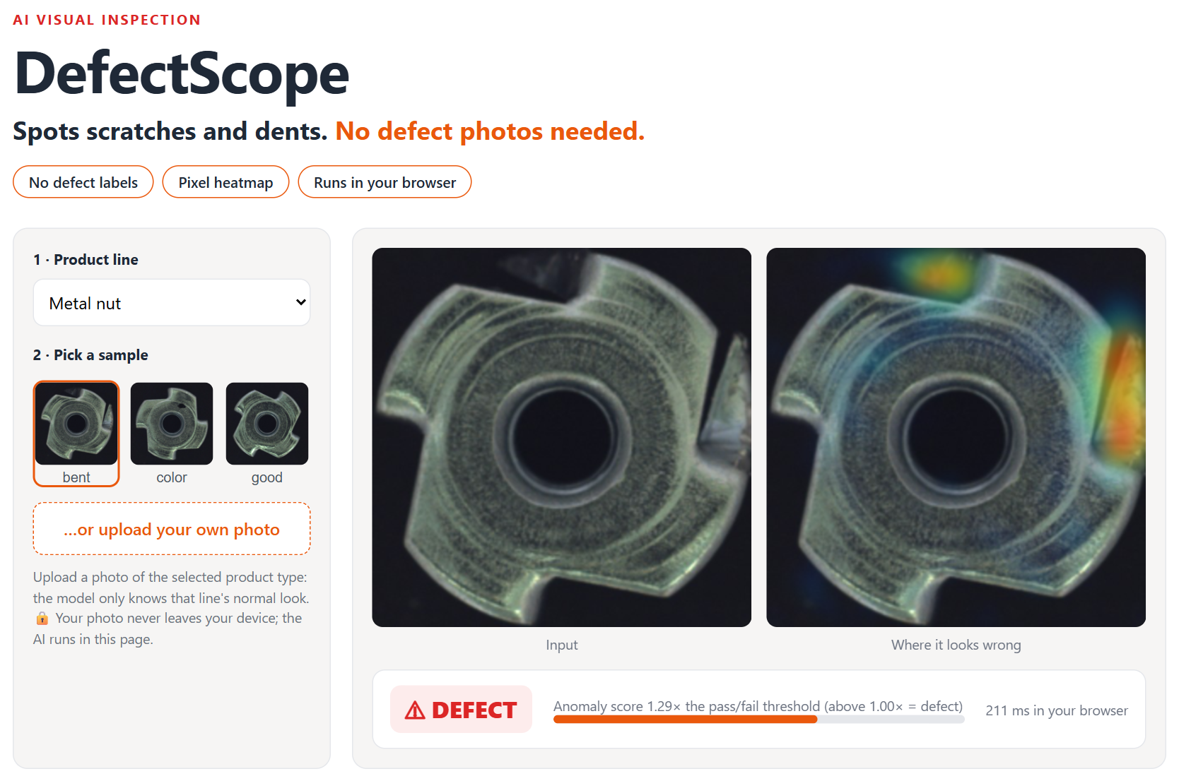
Upload a photo. See pass/fail and where.
TRY IT YOURSELF
1
Set up from good parts only
Each product line was set up from 209–320 photos of good parts. No defect photos, no labelling.
2
Shows the operator where
A heatmap marks the exact spot, so people can check it in seconds.
3
A pass/fail line you can trust
The reject threshold is set on good parts the model never saw, not tuned on the test set.
Notes:
Live demo: pick a product line, choose a sample or upload a photo; verdict and heatmap appear in about a second.

Slide 4
What it caught, what it wrongly rejected, how fast.
RESULTS IN PLAIN NUMBERS
94%
7%
50 ms
of defective parts caught
average over 5 product types
of good parts wrongly rejected
the false alarms that cost you money
per part on a normal CPU (≈1,200 parts/min)
2 CPU threads, no GPU
Product | Defective parts caught | Good parts wrongly rejected
Bottle | 98% (62 of 63) | 0% (0 of 20)
Screw | 76% (90 of 119) | 0% (0 of 41)
Carpet | 99% (88 of 89) | 25% (7 of 28)
Metal nut | 98% (91 of 93) | 5% (1 of 22)
Transistor | 100% (40 of 40) | 3% (2 of 60)
How this was measured
Public MVTec AD test images the model never saw, with one fixed pass/fail threshold per product. On your parts, the feasibility step measures these same numbers before you commit.
Notes:
One number that proves it works: read the defects-caught and false-alarm numbers.

Slide 5
Three steps. No labelling project.
HOW IT WORKS
1
2
3
Photos of good parts
It learns “normal”
It flags anything else
A few hundred photos of normal parts, taken at the line.
A pretrained vision network memorises what every small patch of a good part looks like.
Any patch that doesn't match normal is marked on a heatmap. Too far from normal means reject.
For engineers: a from-scratch re-implementation of PatchCore (Roth et al., CVPR 2022) in PyTorch: mid-level features from a frozen backbone, a greedy-coreset memory bank, and nearest-neighbour patch scoring. Benchmarks are in the appendix.
Notes:
Technical peek, kept simple. Key point for clients: nothing to label; a new product needs only good photos.

Slide 6
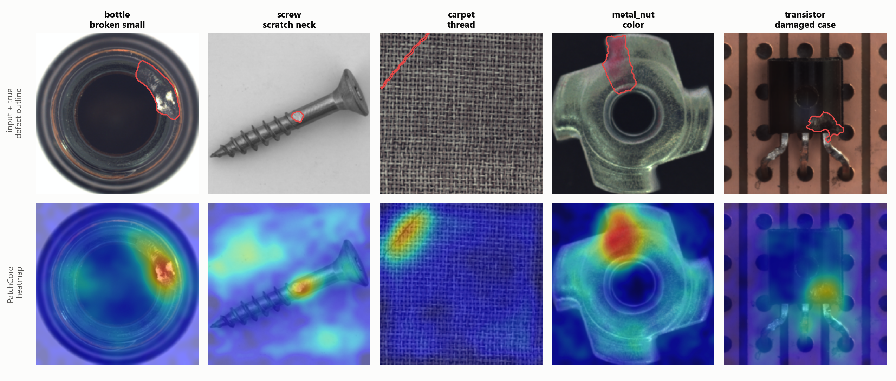
Defects found on parts it never saw.
REAL DETECTIONS
Per product: the defective test photo with the median score. Red outline = where the real defect is.
Notes:
Run three products live: screw, bottle, carpet. Then show a good part passing.

Slide 7
Start small. See it work on your parts first.
HOW WE'D WORK TOGETHER
STEP 1
STEP 2
STEP 3
Send photos
Feasibility report
Deploy at the line
A few hundred photos of good parts from your line (this demo used 209–320), plus any defective ones you have.
I set it up on your parts and report the real numbers: defects caught, false rejects, speed.
Runs on a PC or edge box next to your camera, with a pass/fail signal your line can act on.
What you get: the trained inspector for your product · an operator app or API · source code you own · setup docs so your team can add new products themselves.
Notes:
Lower the client's risk: a small first step on their own parts before any big commitment.

Slide 8

NEXT STEP
Send me photos of your parts.
I'll show you if it works.
Try the live demo
priyanshu-singh-git.github.io/defectscope/
Code and full benchmark
github.com/Priyanshu-Singh-git/defectscope
Priyanshu Singh · Freelance AI / ML Engineer · Demo set up on the public MVTec AD dataset (non-commercial licence); client systems are set up on your own parts.
Notes:
The live demo is linked. If you want this on your production line, message me.

Slide 9
The numbers behind it.
APPENDIX · FOR ENGINEERS
Versus published reference implementations
Method | Image | Pixel | Screw
DefectScope WideResNet-50 (mine) | 0.990 | 0.984 | 0.969
DefectScope ResNet-18 (mine) | 0.989 | 0.982 | 0.963
Intel anomalib PatchCore WideResNet-50 | 0.988 | 0.986 | 0.960
Intel anomalib PatchCore ResNet-18 | 0.980 | 0.984 | 0.943
Intel anomalib PaDiM WideResNet-50 | 0.961 | 0.984 | 0.845
Same 5 categories, image/pixel AUROC. Source: github.com/open-edge-platform/anomalib (v1.2.0 model benchmarks).
Keeping 1% of the memory bank (4 MB instead of 40 MB) costs 0.004 image AUROC.
Notes:
For technical buyers: four backbones measured, compared with Intel anomalib on the same categories.

